Slide 1

CUDA Project Report
CS 1645
Jason Henriquez and Ziyu Zhang (Ronian)

Slide 2

Background
Graphics processing unit (GPU)
Designed with a highly parallel structure
Mostly utilized for efficiently manipulating computer graphics and image processing
Extremely efficient for algorithms that process large blocks of data in parallel
That might be useful someday!

Slide 3

What’s CUDA?
CUDA stands for Compute Unified Device Architecture
Released June 23, 2007
Platform for parallel computing
Programming model
Utilizes graphics processing units

Slide 4
What’s CUDA? Part II
Allows GPUs to be used for general purpose processing
Enables fast and efficient general-purpose mathematical calculations
Acts a software layer
Provides direct access to the GPU’s virtual instruction set and parallel computational elements

Slide 5
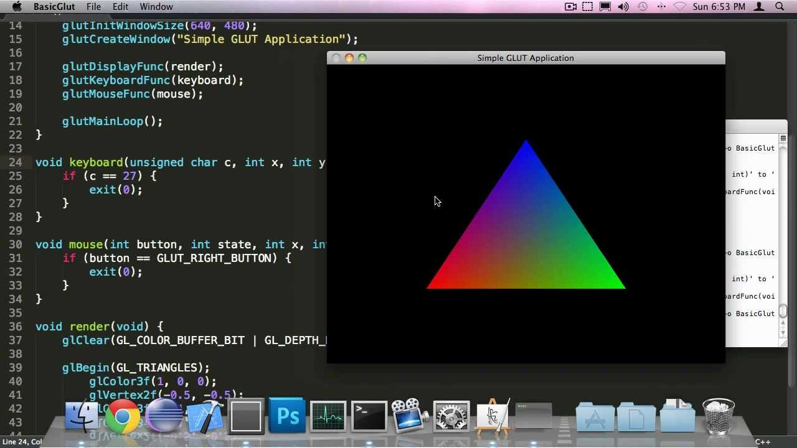
Motivations for CUDA
GPUs could be utilized for calculations before CUDA
APIs like Direct3D and OpenGL
However…
To use these abilities effectively, advanced graphics programming skills required
Many programmers lacked this expertise, but still could theoretically greatly benefit from the speed and efficiency of GPUs

Slide 6

What Does CUDA Offer?
CUDA platform provides:
Compiler directives
CUDA-accelerated libraries
Extensions to languages like C/C++ (Cuda C/C++)
Parallel programming specialists can employ the resources of the GPU even without graphics programming knowledge
CUDA C is the primary focus of this project

Slide 7

Real-Life Applications
Computing maximum flows in a flow network
Fast sorting of large lists
Two-dimensional fast wavelet transform
Molecular dynamics simulations
Machine learning

Slide 8
CUDA C Kernels
CUDA C kernels
Called from CPU code
Run on the GPU
Executed N times in parallel by N different CUDA threads
Declared using __global__ declaration specifier
Executive configuration syntax signifies number of threads for call
Ex: VecAdd<<1, N>>

Slide 9
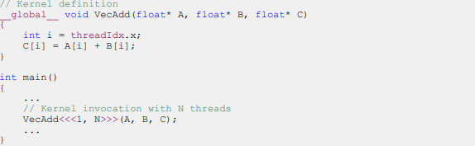
CUDA C Kernel Example
CUDA C kernels
Called from CPU code
Run on the GPU
Executed N times in parallel by N different CUDA threads
Declared using __global__ declaration specifier
Executive configuration syntax signifies number of threads for call
Ex: VecAdd<<1, N>>

Slide 10
CUDA C Memory
Allocated memory with cudaMallocManaged()
Deallocate memory with cudaFree()
Unified memory
can be accessed by every CPU and GPU in a system
cudaDeviceSynchronize() to maintain synchronization and intended program flow

Slide 11
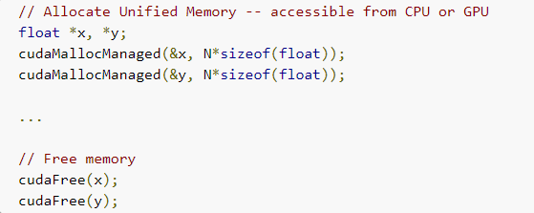
CUDA C Memory Example
Allocated memory with cudaMallocManaged()
Deallocate memory with cudaFree()
Unified memory
can be accessed by every CPU and GPU in a system
cudaDeviceSynchronize() to maintain synchronization and intended program flow

Slide 12
CUDA C Syntax (Cont.)
The keyword gridDim.x provides the number of blocks in the grid
blockIdx.x contains the index of the current thread block in the grid
Block size in blockDim.x

Slide 13
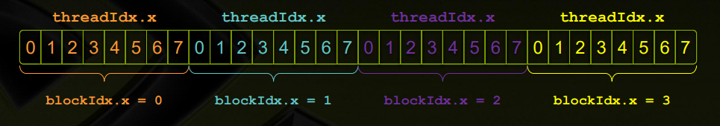
threadidx.x and blockidx.x (Cont.)

Slide 14
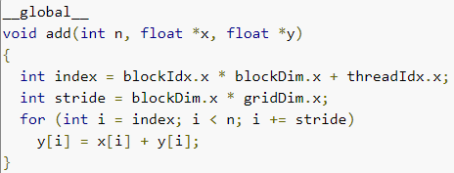
Idiomatic CUDA Example
Idiomatic CUDA snippet
each thread is getting its index by:
calculating the offset to the start of its block and…
adding the index of the thread within the block

Slide 15
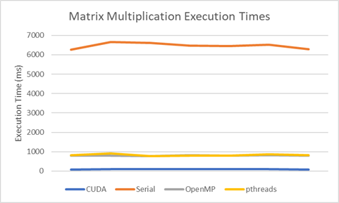
Execution Time Comparison

Slide 16
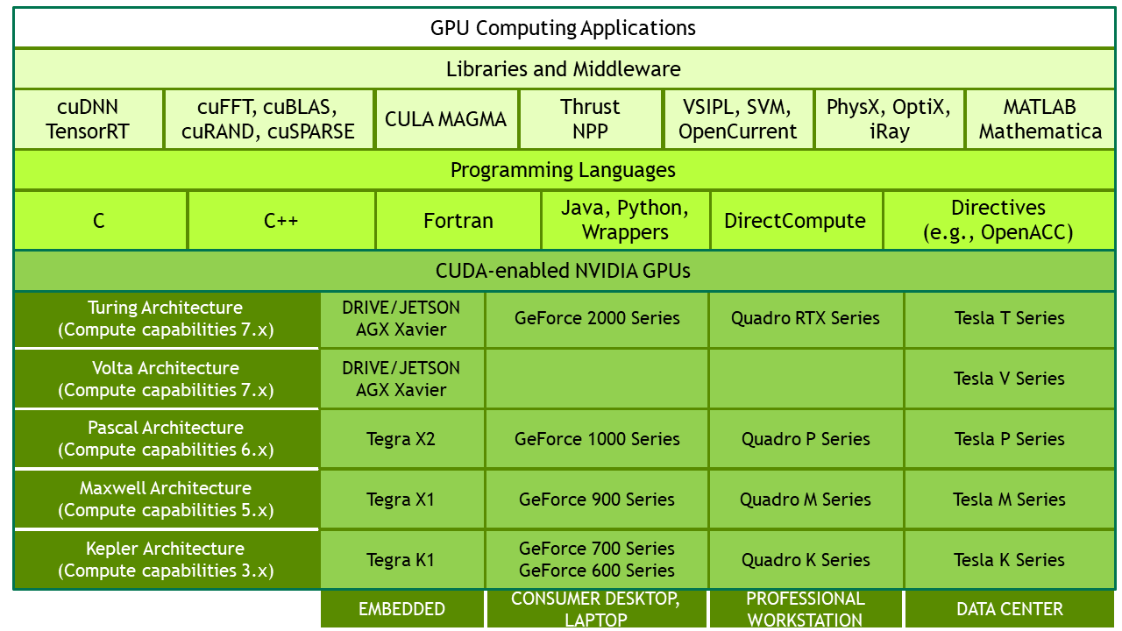
Comparisons
OpenMP
application programming interface for shared-memory multiprocessing programming that offers pragmas, directives, clauses, and work-sharing constructs
POSIX Threads
Offer a set of types, functions, and constants
CUDA C
An entire programming language

Slide 17
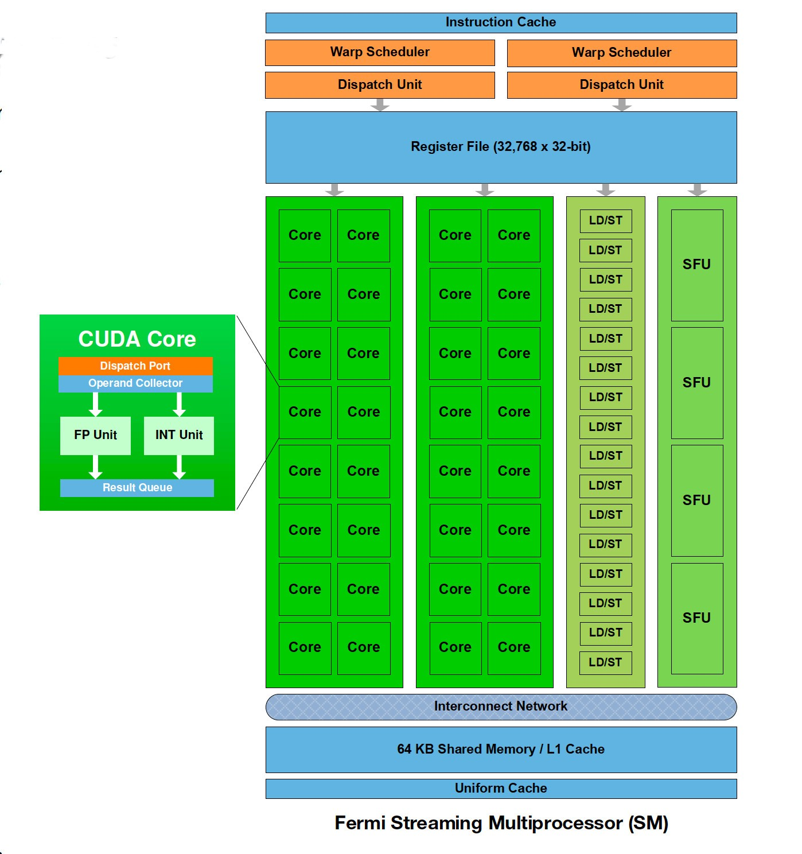
CUDA C Difficulty
The most difficult part of the project was fully conceptualizing the CUDA execution model
the mapping of thread blocks to Streaming Multiprocessors (SMs)
CUDA has a higher learning curve than POSIX Threads or OpenMP

Slide 18
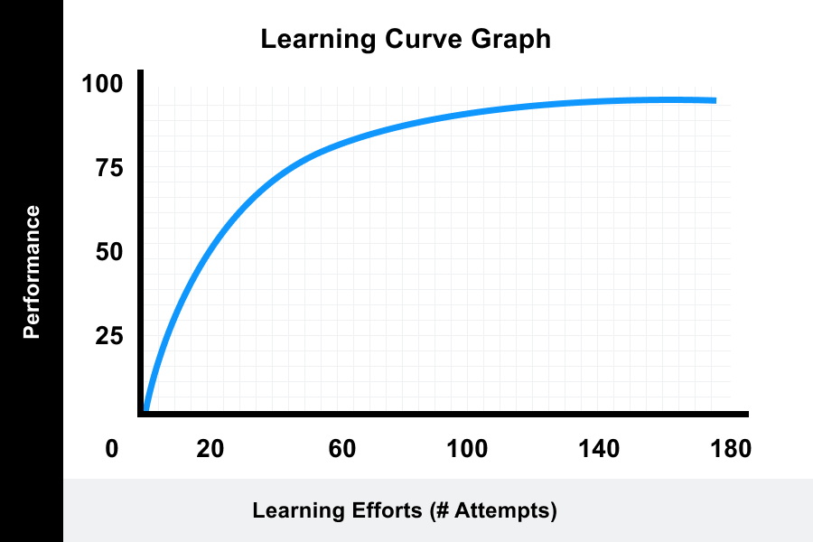
Should CUDA Be Added to CS1645 Curriculum?
No
Exceptionally high learning curve
Would unnecessarily burden students
Would demand enough time teaching it that other concepts would receive less attention

Slide 19
CUDA Strengths
Very powerful and rewarding
Purposely and intricately crafted for efficiency
Fine-tuned control and excellent performance
Learning it helps to understand high performance computing concepts

Slide 20

When to Use CUDA
Familiarizing yourself with parallel computing and the underlying concepts
Applications in which many business logic and abstractions are unnecessary
Efficient mathematical calculations and data processing needed

Slide 21

Conclusion
CUDA proved to be difficult to learn
CUDA C is a powerful programming language
CUDA itself is a formidable parallel computing platform
A staple of high-performance computing, for better or worse
Unlikely that we (the authors) will want to use it again

