Slide 1

RONNIE CLELAND
CREATIVE AI PLATFORM ARCHITECT
Artistic vision.
Human control.
I build creative AI tools that keep artists
in control of the next decision.
20+ YEARS OF CRAFT / ANIMATION / VFX / REAL-TIME
RONNIECLELAND.COM
PORTFOLIO / 01

Slide 2
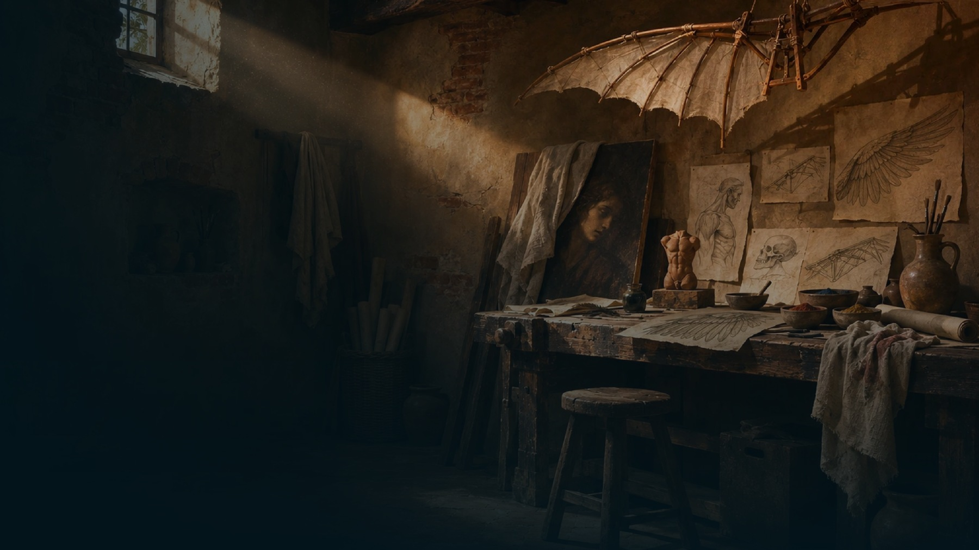
RONNIE CLELAND
THE FOUNDATION
The craft comes first.
20+ years of production experience shape how I design
creative systems.
DREAMWORKS / 2010 - 2021
REAL-TIME + INNOVATION
VISUAL JUDGMENT
Department Chair, Look Development
Spire Animation (2021 - 2023). FableLight
Lighting, materials, composition, and
Supervisor, and Environment Surfacing
Studios (2023 - 2024).
review at feature-film scale.
Lead.
PORTFOLIO / 02

Slide 3

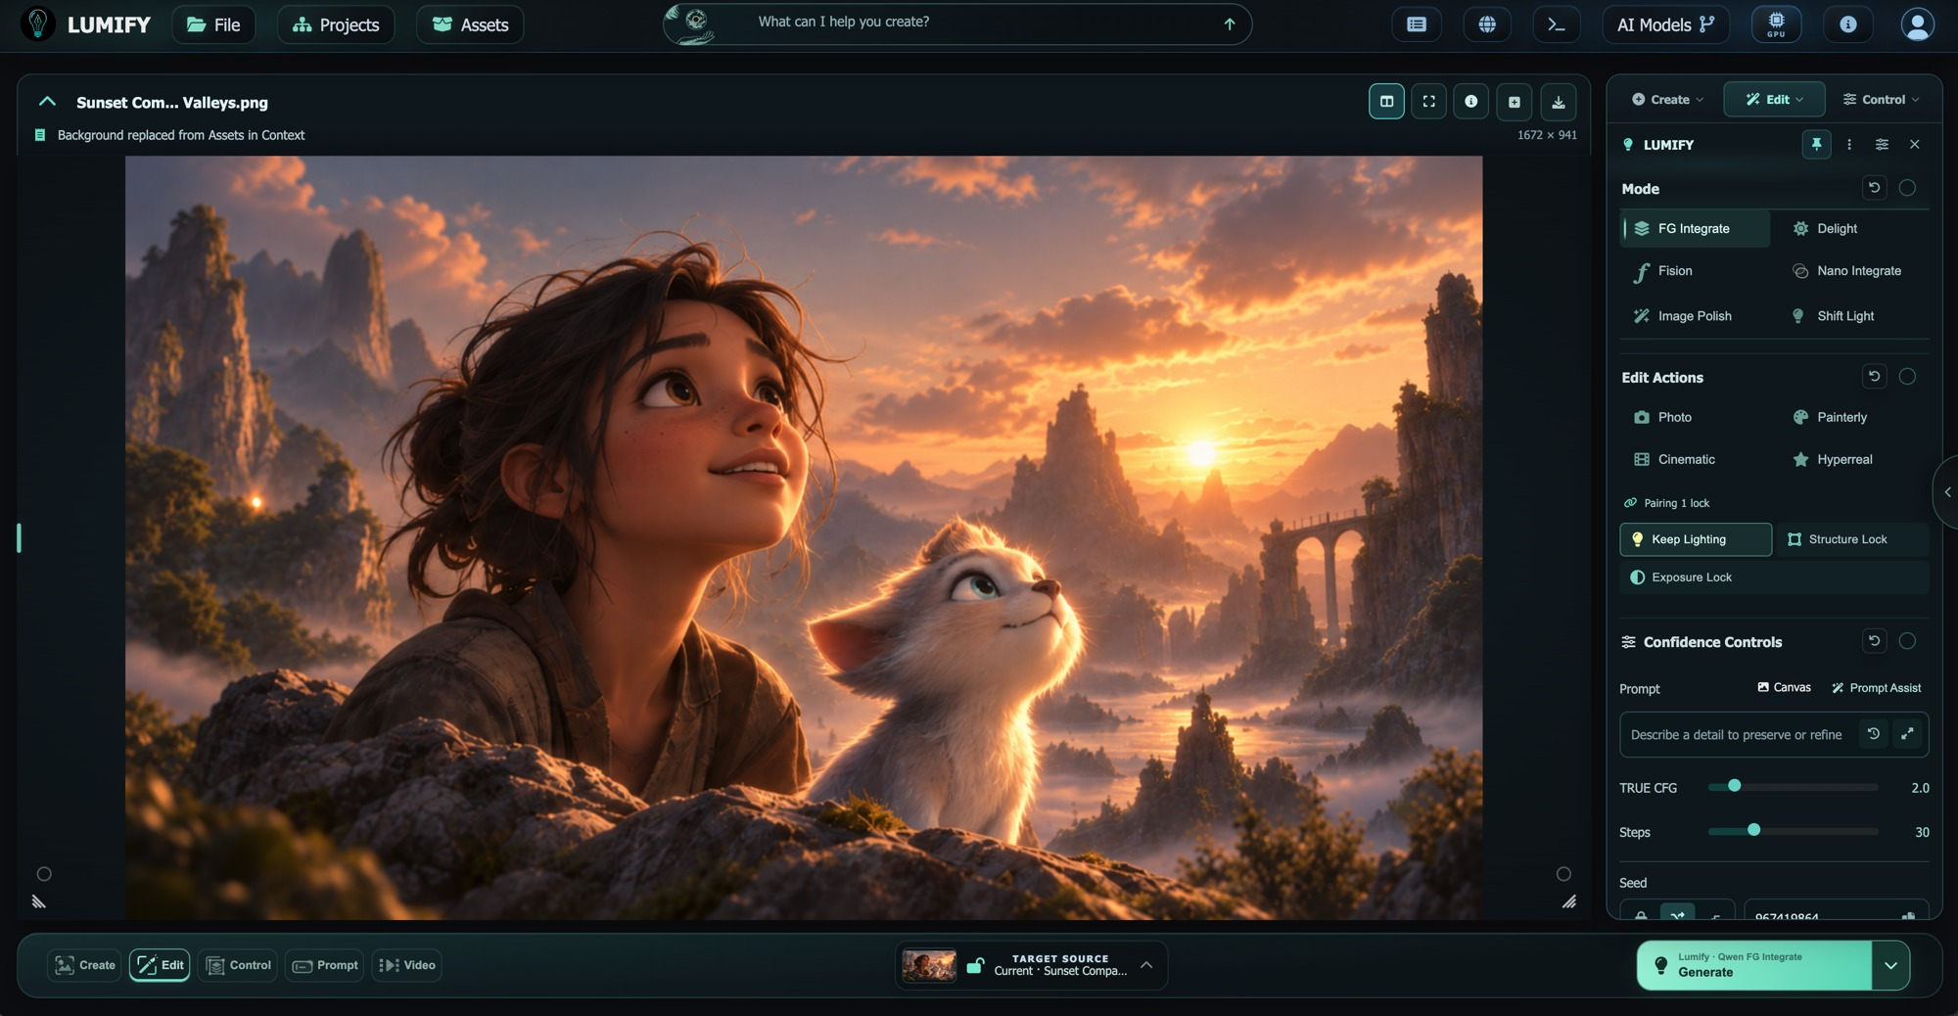
RONNIE CLELAND
LUMIFY / PRODUCT OWNERSHIP
Creative intent.
Connected work.
Co-Founder & Chief Creative Technology
Officer / 2024 - Present.
PRODUCT + DESIGN
Lead the creative direction and artist-facing
interaction design.
FULL-STACK OWNERSHIP
Connect responsive interfaces to Python/Flask
services and model routing.
ONE CREATIVE CONTEXT
Bring the canvas, references, shots, and the Cut
into a connected workflow.
LUMIFY V2 / WORKING INTERFACE
PORTFOLIO / 03

Slide 4

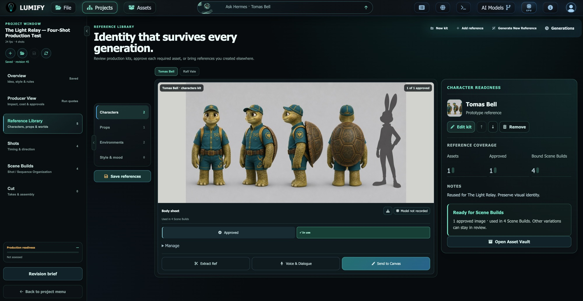
RONNIE CLELAND
REFERENCES / CONTEXT
The idea has
a visual history.
Begin with the material the artist has already
chosen.
REFERENCE LIBRARY
Organize source material and assign reference
roles.
APPROVAL + LOCK
Review imported references and preserve
approved Library context.
SAVED DIRECTION
Carry shot and camera choices into generation
and review.
LUMIFY V2 / WORKING INTERFACE
PORTFOLIO / 04

Slide 5

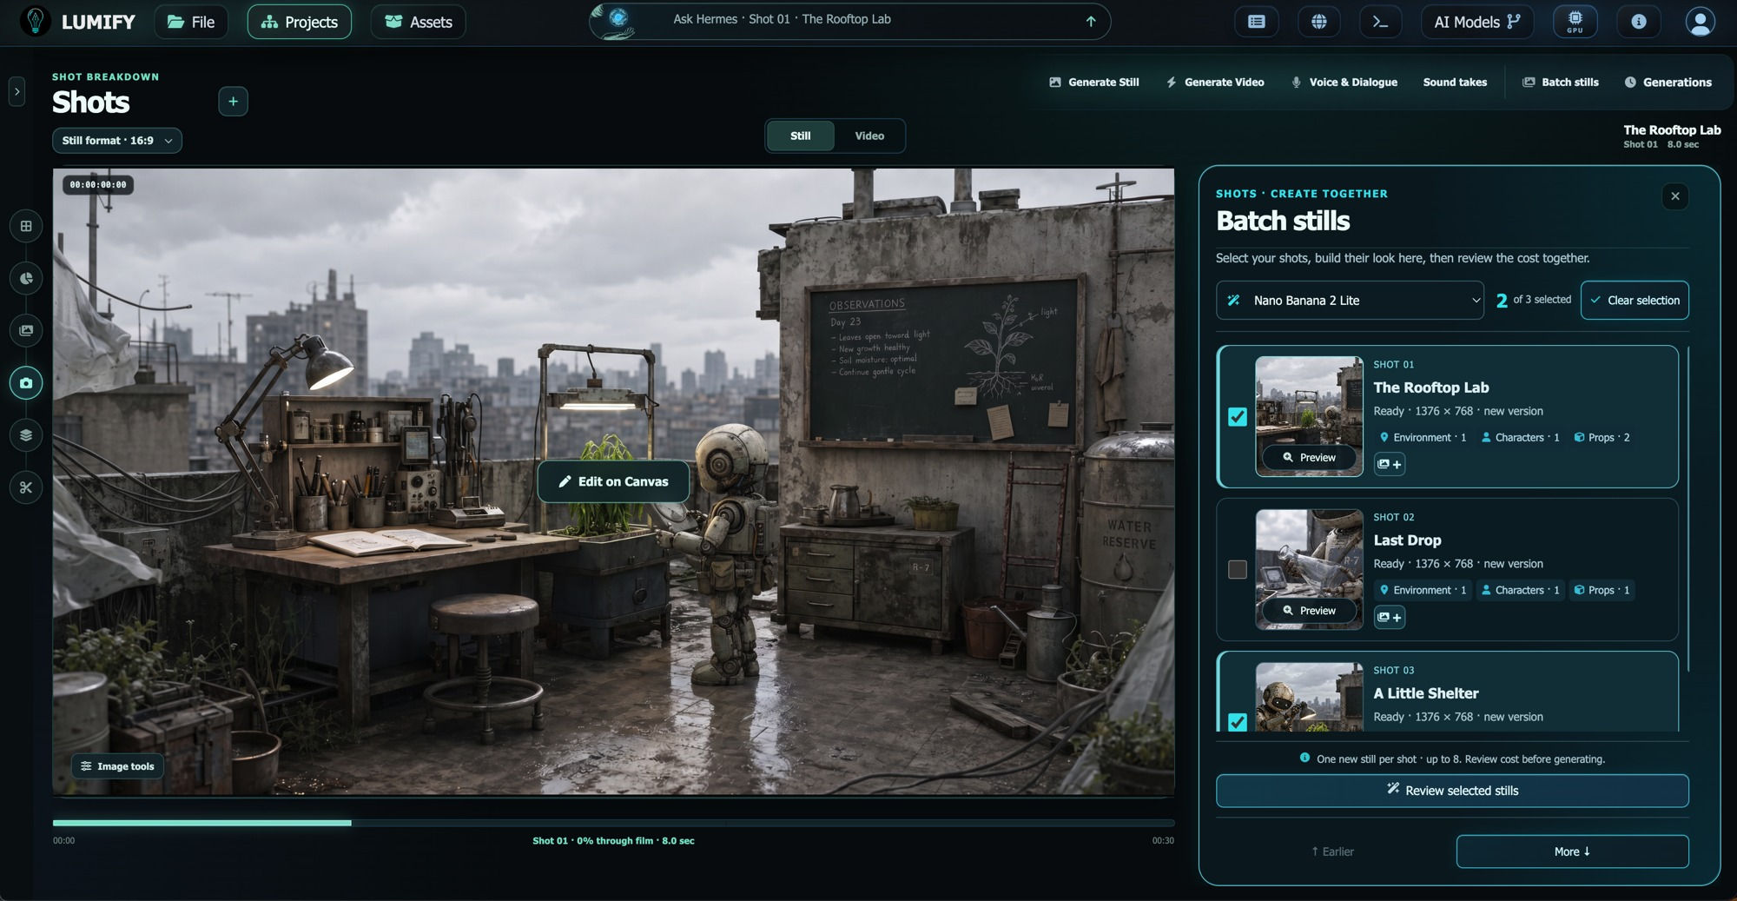
RONNIE CLELAND
GENERATION / APPROVAL
A clear action.
An informed choice.
Make creative direction and generation costs
visible before the run.
BATCH STILLS
Select shots and shape their look together.
QUOTE + APPROVAL
Review estimates and explicitly approve
chargeable generation.
VALID CONTROLS
Match available settings to the model, task, and
deployment policy.
LUMIFY V2 / WORKING INTERFACE
PORTFOLIO / 05

Slide 6

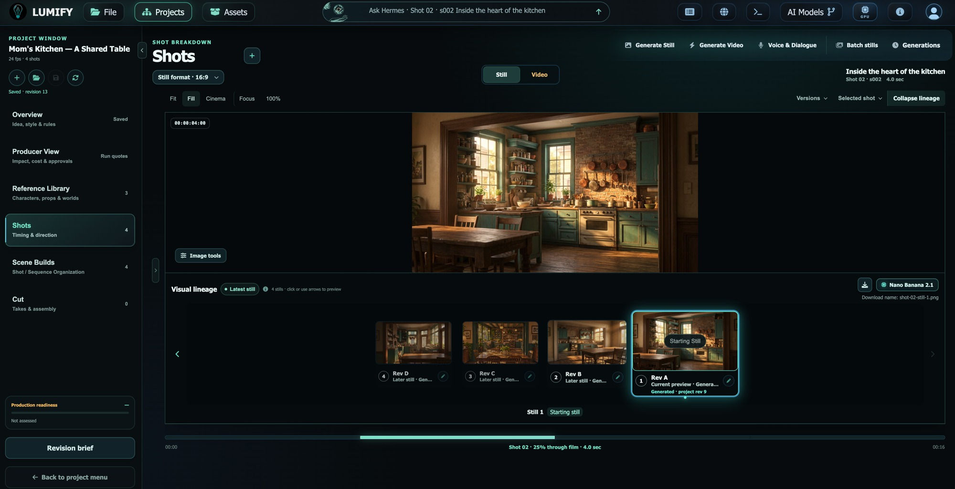
RONNIE CLELAND
SHOTS / ITERATION
Every take is
a creative choice.
Keep alternatives available as the work
evolves.
RETAINED TAKES
Return to earlier results and compare options.
SHOT VIDEO
Generate from approved inputs and supported
model contracts.
ARTIST SELECTION
Preview a take before explicitly choosing Use in
Cut.
LUMIFY V2 / WORKING INTERFACE
PORTFOLIO / 06

Slide 7

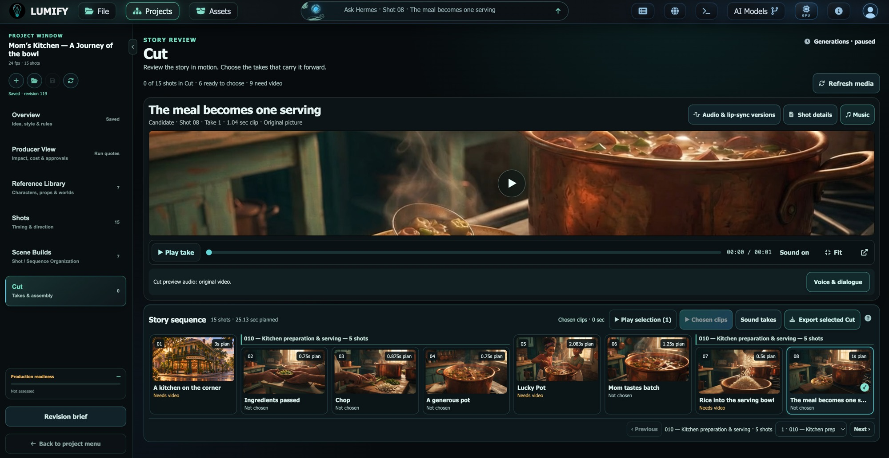
RONNIE CLELAND
THE CUT / EDITORIAL CONTINUITY
The choices
become a sequence.
Carry approved takes into a saved edit and a
visible path to review.
EXPLICIT SELECTION
Assemble the takes the artist chooses.
TIMING + REVIEW
Arrange shot timing and export a review MP4
from saved video selections.
SOUND + STORY
Support speech, music, and sound within the
project.
LUMIFY V2 / WORKING INTERFACE
PORTFOLIO / 07

Slide 8
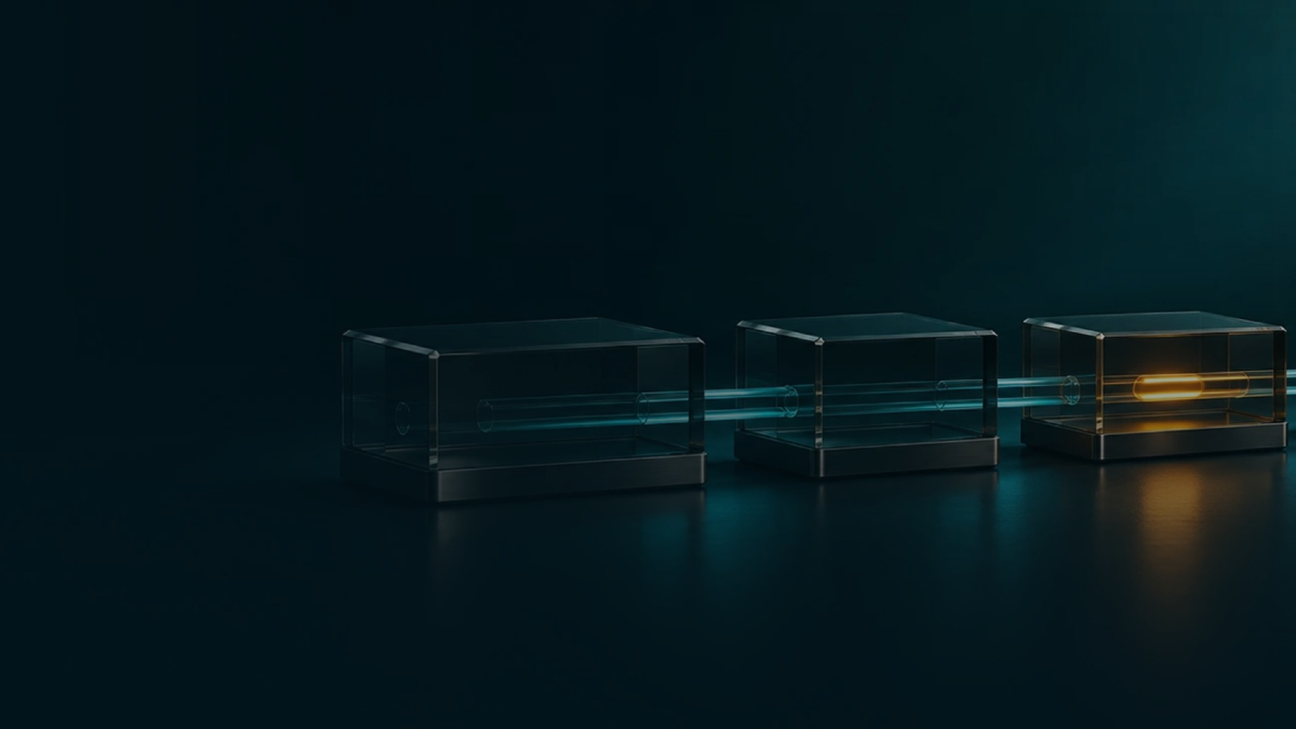
RONNIE CLELAND
ARCHITECTURE / END-TO-END OWNERSHIP
The system carries
the creative intent.
I connect what the artist sees to the services that make the
work possible.
INTERACTION
ORCHESTRATION
CONTINUITY
JavaScript and HTML/CSS. Direct controls,
Python/Flask, REST APIs,
Saved revisions, source lineage, provider
validation, and visible feedback.
server-controlled routing, job status, and
provenance, and review export.
recovery.
PORTFOLIO / 08

Slide 9

RONNIE CLELAND
INTEGRATION / EVOLVING CAPABILITIES
New capabilities.
A coherent workflow.
Models evolve. The artist still needs a clear next step.
PROVIDER CONNECTIONS
IMPLEMENTATION
AVAILABLE ACTIONS
Runway, fal.ai, World Labs, and local
Model adapters and AI Toolkit. Working
Model contracts and deployment policies
model services.
knowledge of PyTorch/CUDA, Diffusers,
define the supported controls.
and Transformers.
PORTFOLIO / 09

Slide 10

RONNIE CLELAND
SPATIAL THINKING / REAL-TIME CRAFT
A world beyond
the frame.
Materials, light, and camera direction connect image-making
with spatial exploration.
IMAGE DIRECTION
REAL-TIME FOUNDATION
SPATIAL WORKFLOWS
Relighting, material, time-of-day, and
Unreal Engine and Substance experience
3D and generated-world integrations
camera workflows make intent actionable.
in world building and look development.
extend the creative vocabulary.
PORTFOLIO / 10

Slide 11

RONNIE CLELAND
DESIGN OUTCOMES / ARTIST CONTROL
Confidence comes
from visible decisions.
Give artists a process they can inspect, revisit, and direct.
BEFORE GENERATION
DURING ITERATION
AFTER REVIEW
Review references, supported settings, and
See job status, retain earlier takes, and
Select takes for the Cut, protect saved
estimated costs.
trace source context.
revisions, and assemble work for review.
PORTFOLIO / 11

Slide 12

RONNIE CLELAND
LET’S CONNECT
An artist’s eye.
A builder’s mind.
Creative AI products, visual workflows,
and tools that serve the person creating.
ronnie@lumifyai.com
linkedin.com/in/ronniecleland
ronniecleland.com
PORTFOLIO / 12

