Slide 1
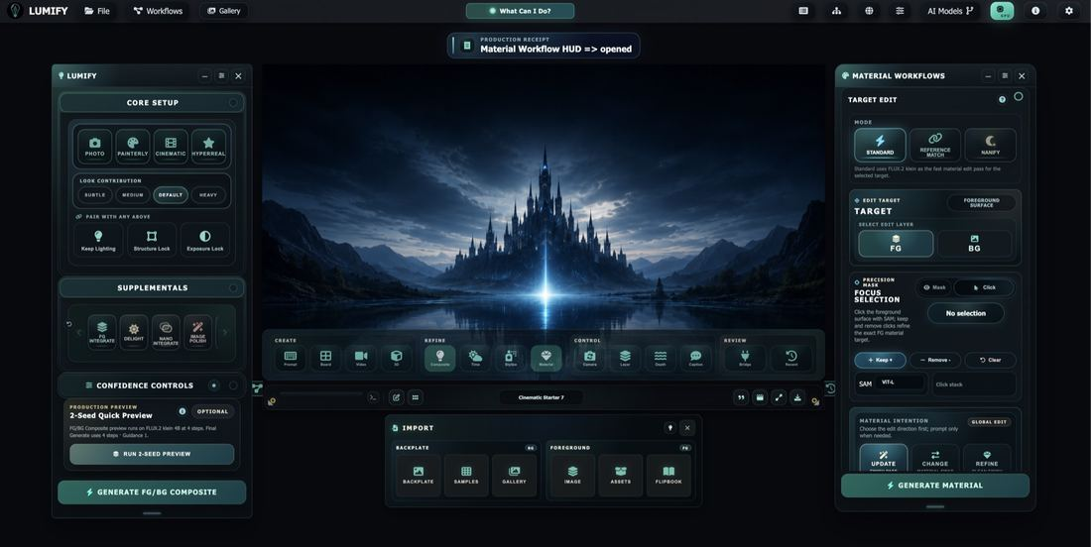
RONNIE CLELAND
LUMIFY · LIVE PRODUCT
CREATIVE AI PLATFORM ARCHITECT
I turn artist
judgment into
multimodal
creative systems.
01
02
03
04
ARTIST INTENT
MULTIMODAL UI
PLATFORM SERVICES
PRODUCTION HANDOFF
20 YEARS IN ANIMATION + VFX → REAL-TIME → GENERATIVE AI PRODUCT
DESIGN · ORCHESTRATE · SHIP
ARTIST-FIRST · FULL-STACK
PRODUCTION-READY
PORTFOLIO · 2026

Slide 2
02
CAREER ARC
My career moved from making shots
to designing how artists make them.
The throughline is visual judgment—expanded from individual work into tools, systems, and product strategy.
01
02
03
20 YEARS
NEXT
NOW
Animation + VFX
Real-Time Technology
Generative AI Product
Composition, lighting, storytelling, review, iteration, and studio pipeline reality.
Faster feedback, interactive scenes, and a new relationship between artist and tool.
Lumify: artist-controlled multimodal workflows, shipped as a cohesive platform.
The reel changed. The qualification did not disappear—it became product judgment.
RONNIE CLELAND · CREATIVE AI PLATFORM ARCHITECT
02 / 12

Slide 3
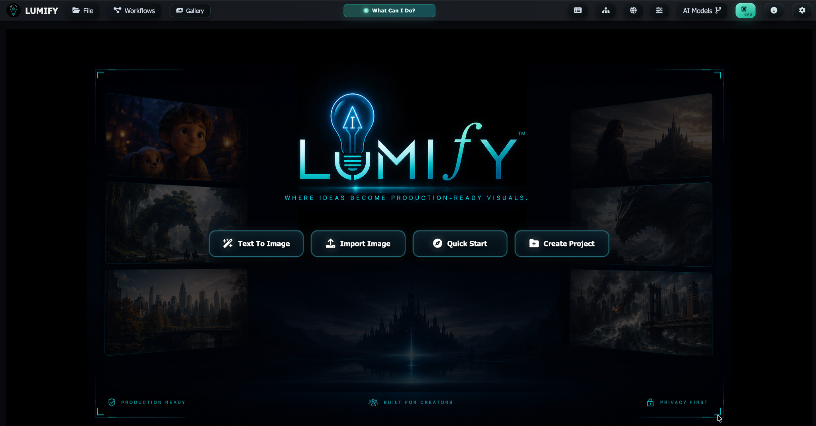
03
PRODUCT PROOF
Lumify proves I can build
an artist-first platform.
I stepped away from studio work to build the creative environment I believed artists would need next.
01
A coherent product
Not a disconnected collection of AI demos.
02
A visual point of view
Brand, interaction, hierarchy, and creative tone.
03
A live B2C direction
With an architecture that can mature toward studio use.
04
A builder’s commitment
Product decisions carried through interface and services.
CO-FOUNDER & CCTO · LUMIFY
ONLINE · MULTIMODAL · CREATOR-FIRST
RONNIE CLELAND · CREATIVE AI PLATFORM ARCHITECT
03 / 12

Slide 4
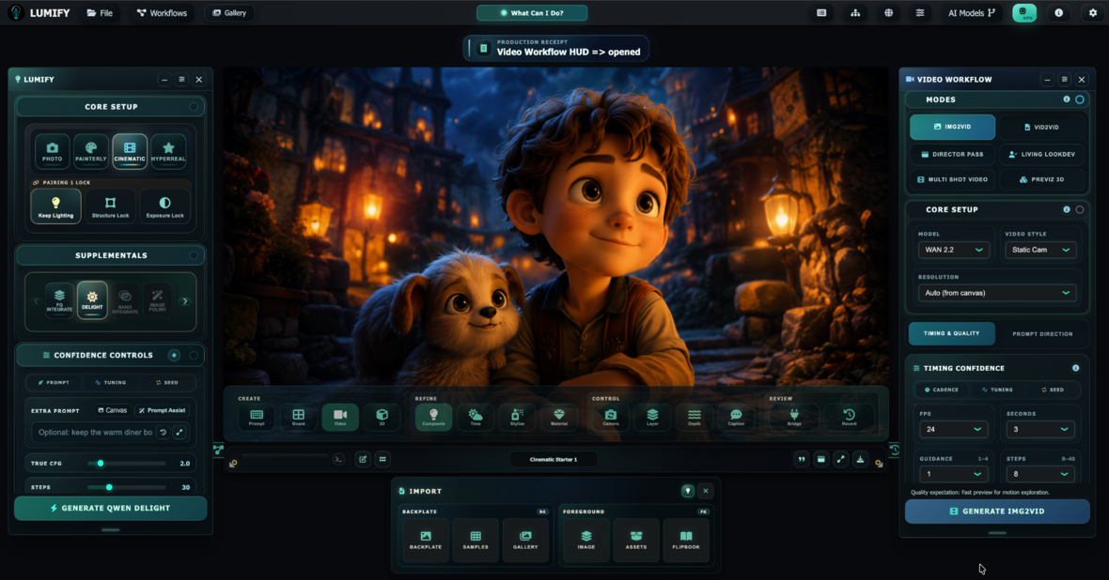
04
INTERACTION DESIGN
The interface translates production thinking
into an approachable control surface.
The UI is designed around artist decisions—mode, structure, timing, confidence, comparison, and handoff.
01
Core setup
Style and structural intent before generation.
02
Workflow HUDs
Purpose-built controls for video, camera, light, depth, material, and more.
03
Confidence controls
Timing, tuning, seed, steps, and model-specific parameters stay visible.
04
Production handoff
Import, gallery, projects, assets, packages, and review remain connected.
RONNIE CLELAND · CREATIVE AI PLATFORM ARCHITECT
04 / 12

Slide 5
05
WORKFLOW ARCHITECTURE
The product is a workflow system—
not a model menu.
Models can change. The artist’s creative progression should remain legible and stable.
01
02
03
04
CREATE
REFINE
CONTROL
REVIEW
Start the idea
Shape the result
Direct the shot
Keep it production-ready
Prompt
Storyboard
Image + reference
Project setup
Composite
Time of Day
Stylize
Material + lookdev
Camera
Layer + depth
Lighting
Video + motion
Compare + recent
Asset Vault
Bridge + packages
Studio Sync
A durable interaction language lets the platform swap, add, or retire models without making the artist relearn the product.
RONNIE CLELAND · CREATIVE AI PLATFORM ARCHITECT
05 / 12

Slide 6
06
FRONT END TO BACK END
I work from interaction concept
through backend execution.
My role is connective: translate visual intent into interface state, service contracts, model behavior, and a recoverable result.
01
02
03
04
05
ARTIST INTENT
FRONT END
PRODUCT LOGIC
BACK END
PRODUCTION
Visual goal
HUD + state
Policy + route
Jobs + services
Result + asset
Language, references, direct manipulation, workflow context.
HTML, CSS, JavaScript, validation, confidence controls.
Capabilities, cost, provider, model, task, deployment.
Python/Flask, REST, adapters, progress, cancel, errors.
Metadata, history, comparison, Asset Vault, package, sync.
MY ROLE
Connect all five layers.
The differentiator is continuity: the artist’s intention survives every layer.
RONNIE CLELAND · CREATIVE AI PLATFORM ARCHITECT
06 / 12

Slide 7
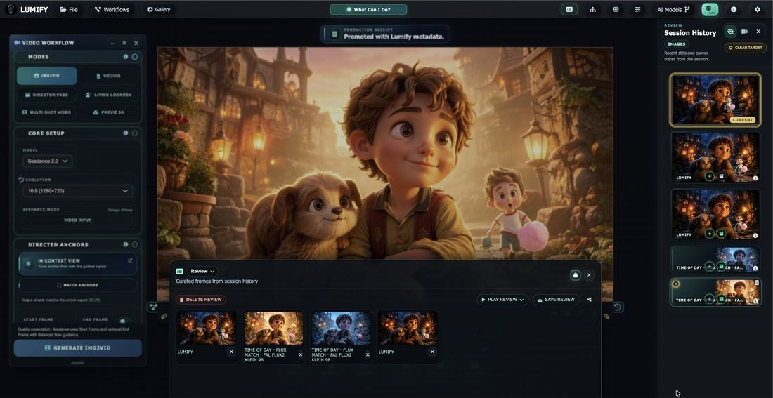
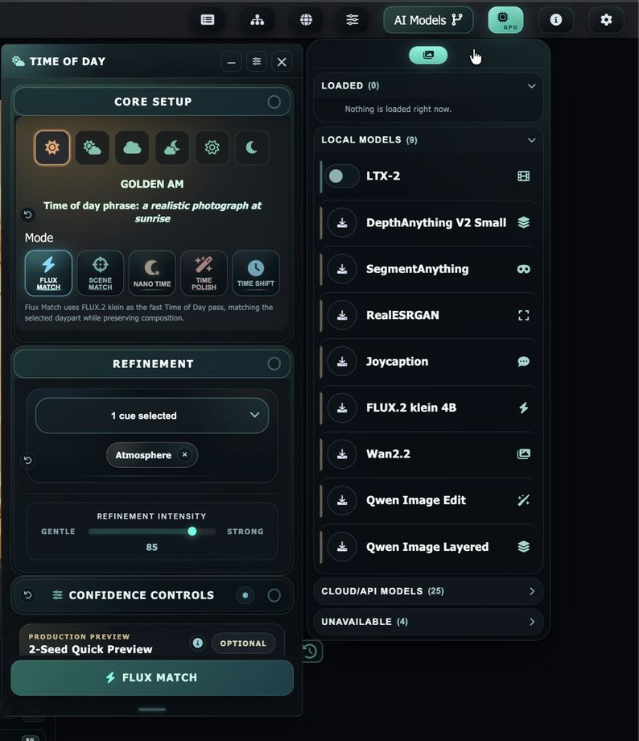
07
PLATFORM BREADTH
Multimodal breadth is organized
around creative outcomes.
Lumify combines generation, refinement, control, analysis, and production handoff without losing the visual context of the work.
CREATE + REFINE
Image · reference · segmentation · depth · material · composite · camera · light
MOTION + HANDOFF
Video · storyboard · 3D · world view · review · assets · packages · bridge
HOSTED APIS + LOCAL MODELS
RONNIE CLELAND · CREATIVE AI PLATFORM ARCHITECT
07 / 12

Slide 8
08
PRODUCTION DESIGN
Production trust is designed
into the experience.
A creative AI tool earns repeat use when artists can understand, reproduce, interrupt, compare, and carry the work forward.
01
Repeatability
Seed, parameters, references, model route, and metadata remain connected to the result.
02
Visibility
Provider, model, task, timing, credits, progress, and confidence controls are surfaced.
03
Recoverability
Jobs expose progress, cancel, errors, recent history, A/B comparison, and promotion paths.
04
Portability
Asset Vault, export profiles, packages, shared directories, and Studio Sync support handoff.
This is the difference between an impressive demo and a tool artists can build a practice around.
RONNIE CLELAND · CREATIVE AI PLATFORM ARCHITECT
08 / 12

Slide 9
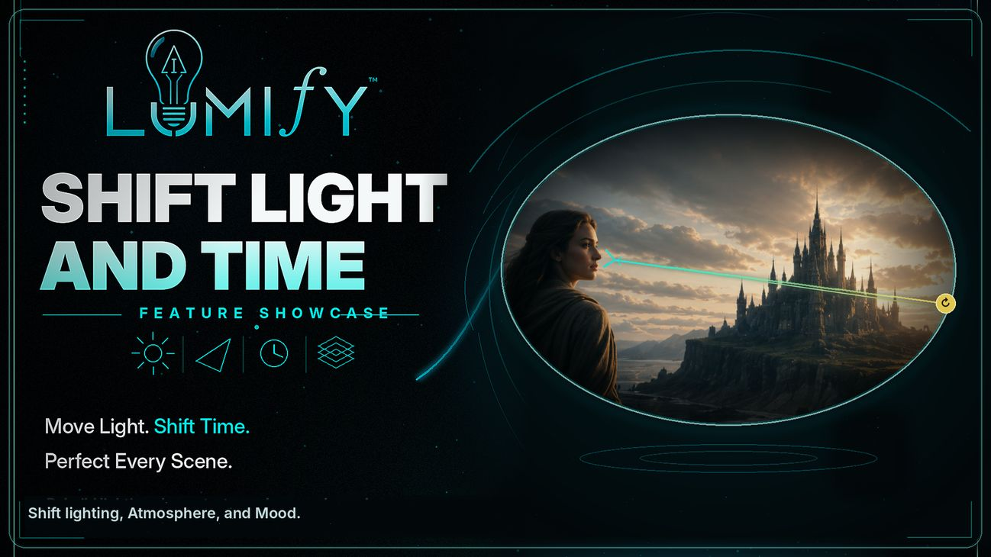
09
FLAGSHIP CASE STUDY
Shift Light turns visual judgment
into a product contract.
The feature begins with an artist’s request—move the light—then protects everything the request did not authorize changing.
ARTIST GOAL
Place or redirect the light source directly on the image; shape shadows and atmosphere without rebuilding the shot.
INTERACTION
A direct visual action becomes structured HUD state, model instructions, optional polish, and a visible generation path.
SYSTEM GUARDRAILS
Preserve camera, crop, subject identity, geometry, horizon, foreground placement, and the approved light origin.
My product instinct: make the creative action simple, then make the system responsibilities explicit.
RONNIE CLELAND · CREATIVE AI PLATFORM ARCHITECT
09 / 12

Slide 10
10
BUSINESS + PLATFORM STRATEGY
The same product thinking extends
from creator value to enterprise readiness.
B2C provides the proving ground. Studio adoption requires policy, deployment, billing, audit, rights, and partner boundaries.
01
02
03
04
B2C PRODUCT
TEAM + STUDIO
PARTNER LAYER
CREATOR ECONOMY
Prove artist value
Add production trust
Connect the ecosystem
Monetize methods
Fast onboarding, clear controls, visible results, reliable workflows.
Identity, projects, policy, credits, receipts, packages, deployment profiles.
Approved providers, MCP boundaries, agent planning, studio integrations.
Private Packs first; curated reusable workflows once rights and trust are proven.
I can help a team connect the creative experience, the technical boundary, and the business sequence.
RONNIE CLELAND · CREATIVE AI PLATFORM ARCHITECT
10 / 12

Slide 11
11
DIFFERENTIATION
My value sits at the overlap
most teams split apart.
I can speak with artists, product leaders, designers, engineers, model providers, and partners without losing the creative objective.
CREATIVE JUDGMENT
PRODUCT + UX
TECHNICAL EXECUTION
20 years of animation + VFX
Composition, lighting, story, review
Artist vocabulary and trust
Workflow architecture
Interaction systems and visual hierarchy
Feature definition and acceptance criteria
HTML/CSS/JavaScript
Python/Flask services and REST
Provider routing, jobs, assets, policy
SHIPPED CREATIVE AI WORKFLOWS
Not a handoff between disciplines—a continuous line from intent to implementation.
RONNIE CLELAND · CREATIVE AI PLATFORM ARCHITECT
11 / 12

Slide 12
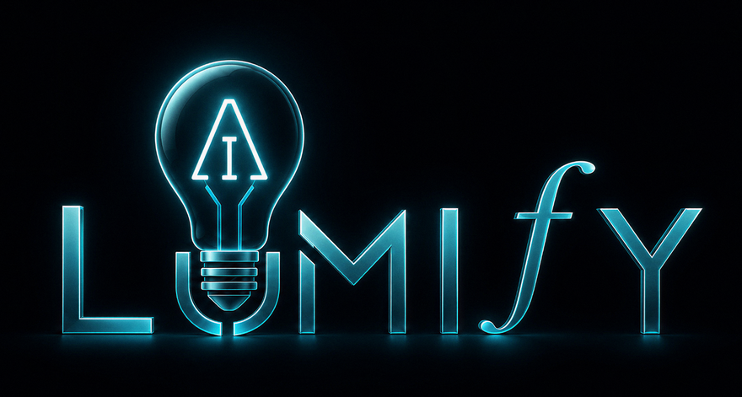
12
WHERE I FIT
Bring me the creative problem that is still too visual, ambiguous, or production-specific for a conventional software team.
WHAT I BRING
Artist credibility
Product judgment
ROLES
Visual systems
Full-stack initiative
Creative AI Platform Architect
Multimodal AI fluency
Clear product storytelling
AI Product Designer / Design Engineer
Creative R&D Lead
Generative AI Prototyping Lead
Technical Art Director — Emerging Technology
EMAIL
LINKEDIN
WEB
ronnie@lumifyai.com
linkedin.com/in/ronniecleland
ronniecleland.com
RONNIE CLELAND · 2026

