Slide 1
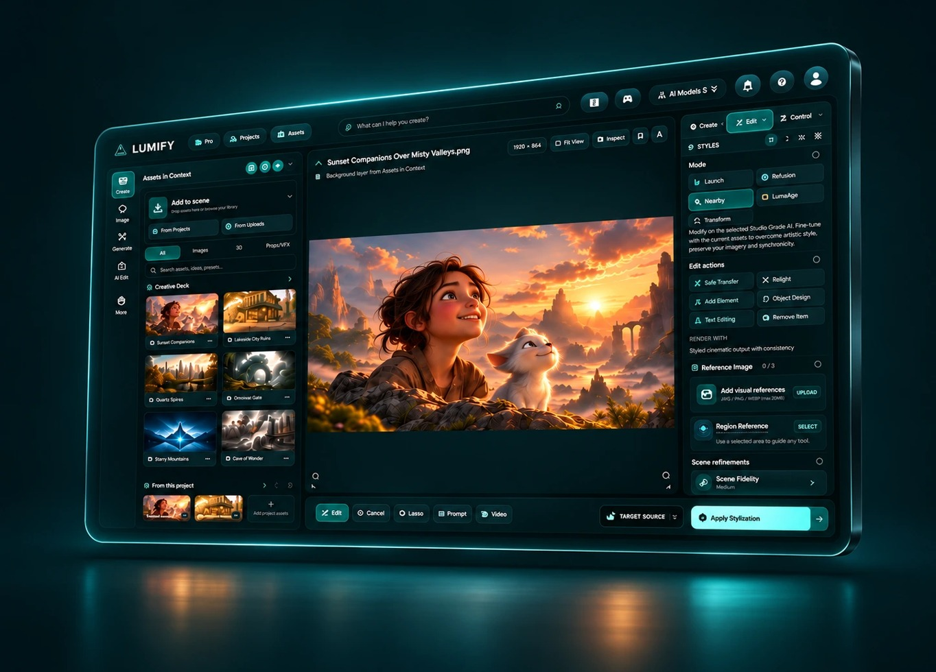
RONNIE CLELAND
CREATIVE AI PLATFORM ARCHITECT
PORTFOLIO / 2026
Artistic vision.
Practical systems.
I build creative AI tools that keep artists in
control of the next decision.
20+ YEARS OF PRODUCTION CRAFT
Animation + VFX / Real-time / Creative AI
01 / 12
RONNIECLELAND.COM

Slide 2

RONNIE CLELAND
CREATIVE AI PLATFORM ARCHITECT
THE FOUNDATION
The craft comes first.
20+ years across animation, VFX, real-time look
development, and artist tools shape how I design creative
systems.
DREAMWORKS ANIMATION / 2010 - 2021
Department Chair, Look Development Supervisor, and
Environment Surfacing Lead.
REAL-TIME + CREATIVE INNOVATION
Spire Animation (2021 - 2023) and FableLight Studios
(2023 - 2024).
PRODUCTION JUDGMENT
Composition, materials, lighting, review, and collaboration
at feature-film scale.
02 / 12
RONNIECLELAND.COM

Slide 3
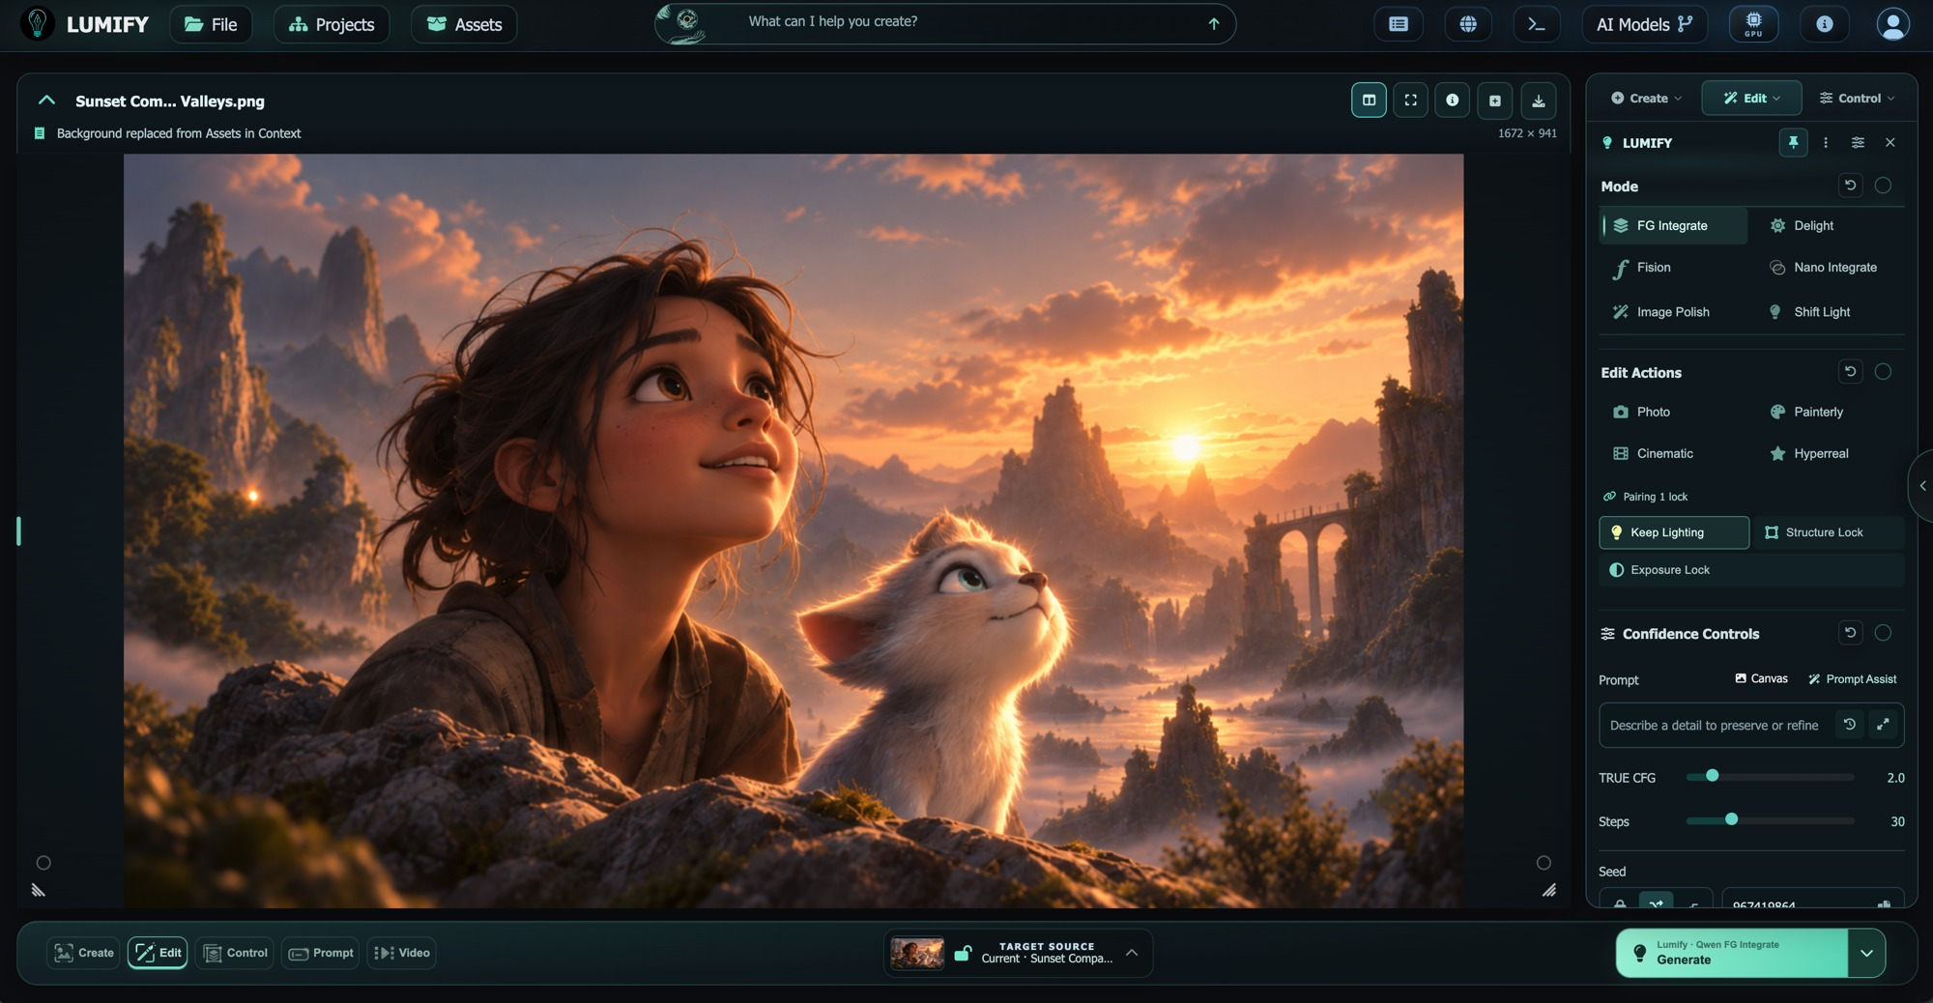
RONNIE CLELAND
CREATIVE AI PLATFORM ARCHITECT
LUMIFY / PRODUCT OWNERSHIP
A workspace built around
creative intent.
Co-Founder & Chief Creative Technology Officer, Lumify AI /
2024 - Present.
PRODUCT + INTERACTION
Lead creative direction, product strategy, and artist-facing
interaction design.
HANDS-ON IMPLEMENTATION
Connect responsive interfaces to Python/Flask services,
provider routing, asynchronous jobs, and saved work.
ONE CREATIVE CONTEXT
Bring the canvas, reference library, shots, and the Cut into
a connected workflow.
LUMIFY V2 / PRODUCT INTERFACE
03 / 12
RONNIECLELAND.COM

Slide 4
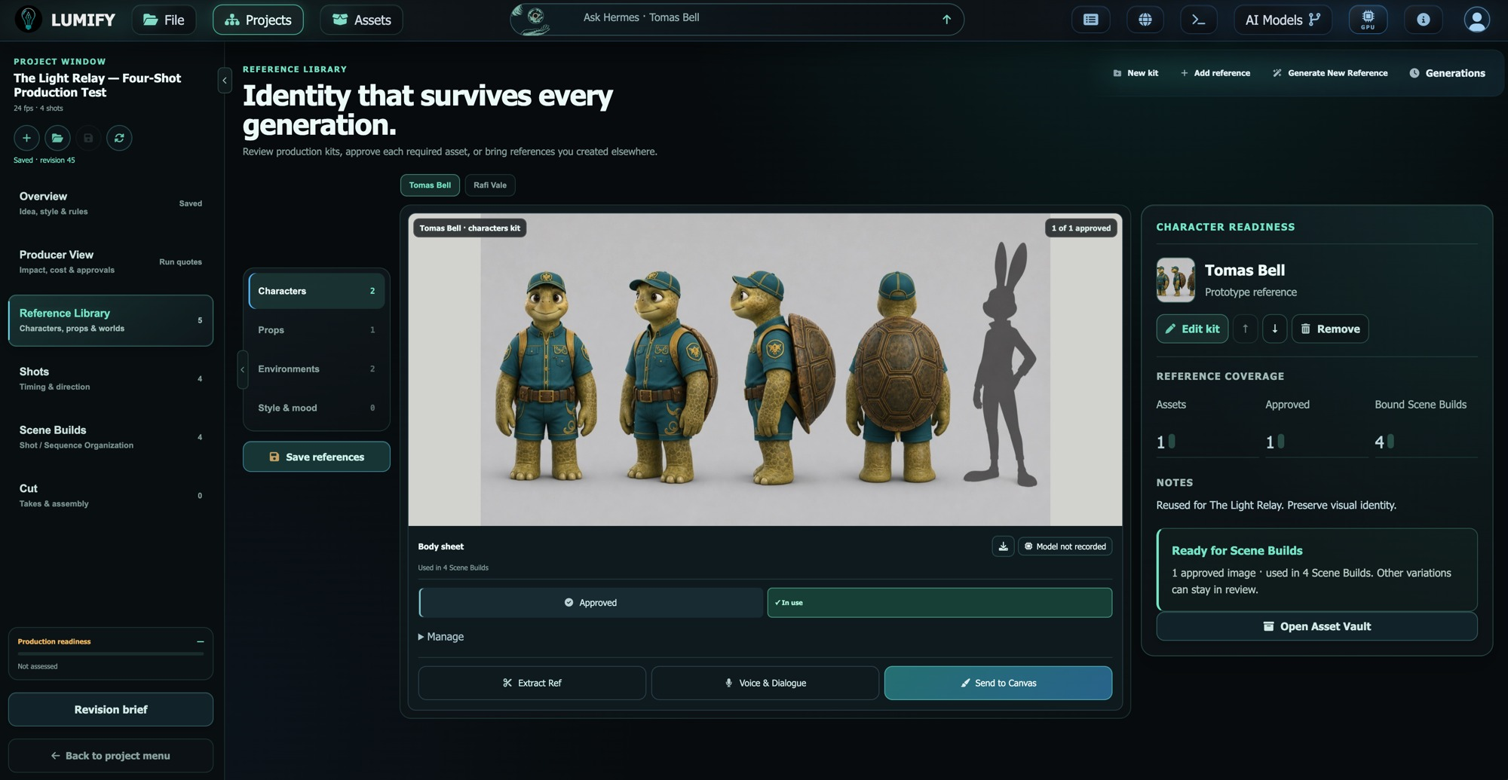
RONNIE CLELAND
CREATIVE AI PLATFORM ARCHITECT
REFERENCES / CREATIVE CONTEXT
Start with the work.
Give the system the visual context that the artist has already
chosen.
REFERENCE LIBRARY
Organize source material and assign reference roles within
the project.
APPROVAL + LOCK
Review imported references and preserve approved Library
context.
SAVED DIRECTION
Carry shot and camera choices into generation and review.
LUMIFY V2 / PRODUCT INTERFACE
04 / 12
RONNIECLELAND.COM

Slide 5
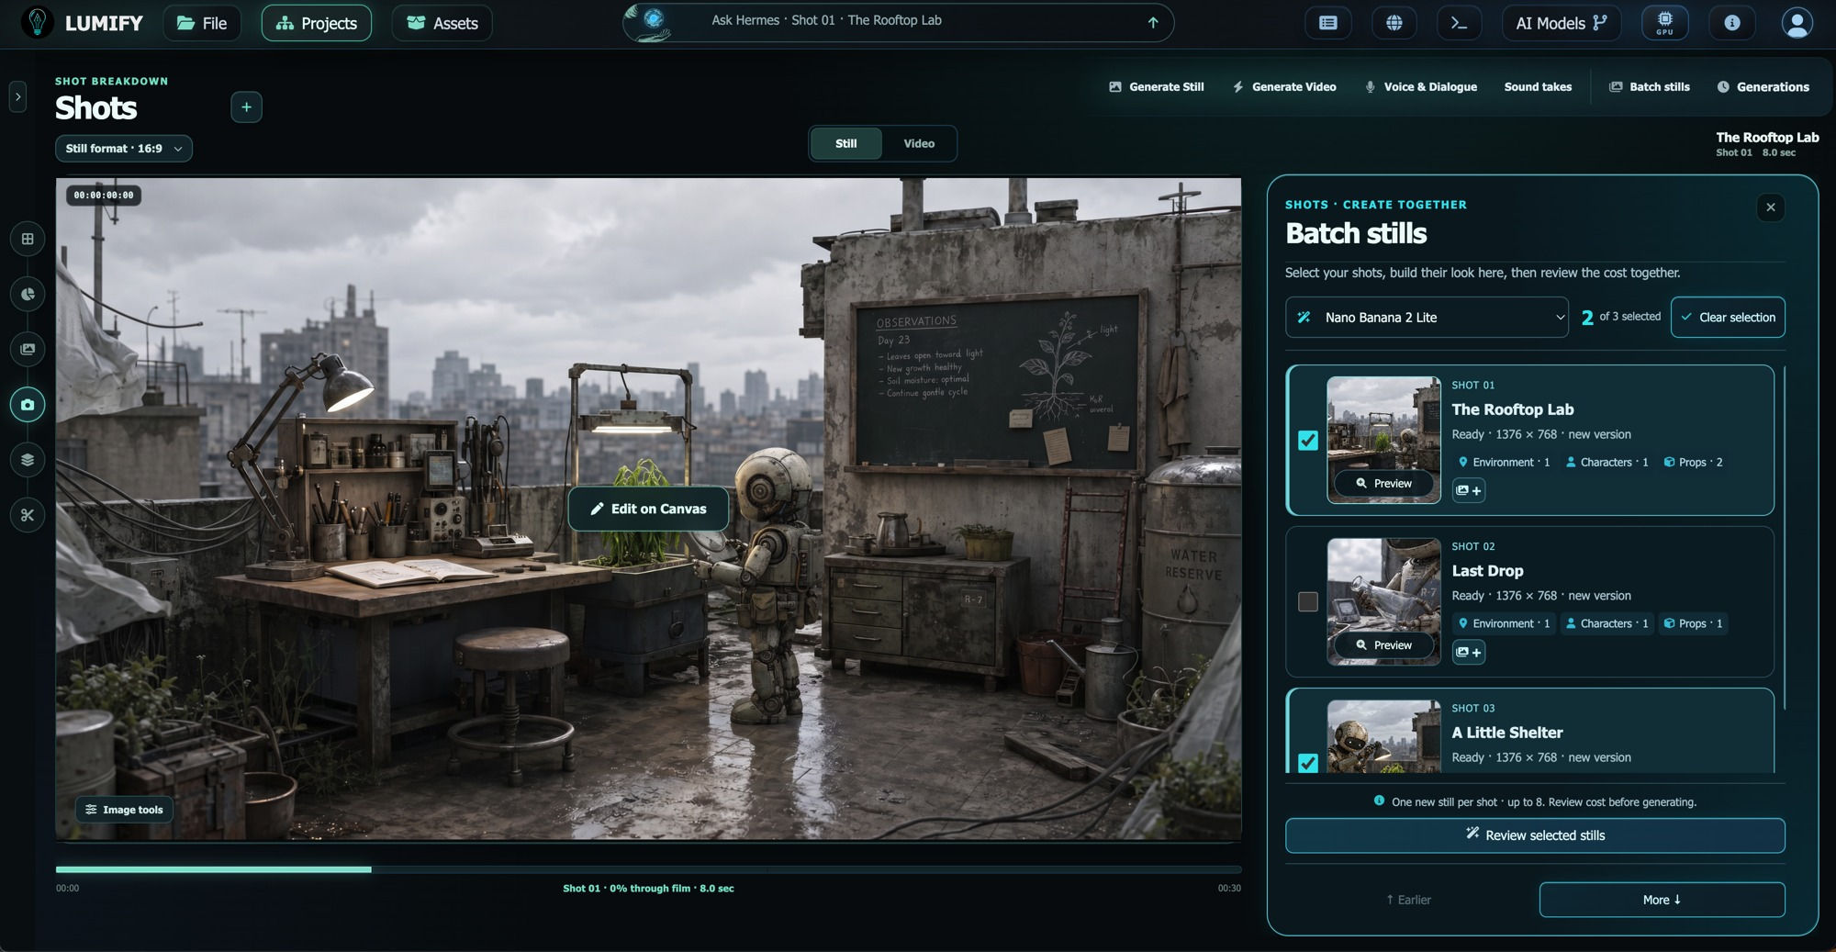
RONNIE CLELAND
CREATIVE AI PLATFORM ARCHITECT
GENERATION / REVIEW BEFORE ACTION
Make the next step explicit.
A clear creative action needs a clear decision about what will
run.
BATCH STILLS
Select shots, shape their look, and review the proposed
generation.
QUOTE + APPROVAL
Show estimates and require explicit approval before
chargeable generation.
CAPABILITY-AWARE CHOICES
Match available controls to model, provider, task, and
deployment policy.
LUMIFY V2 / PRODUCT INTERFACE
05 / 12
RONNIECLELAND.COM

Slide 6
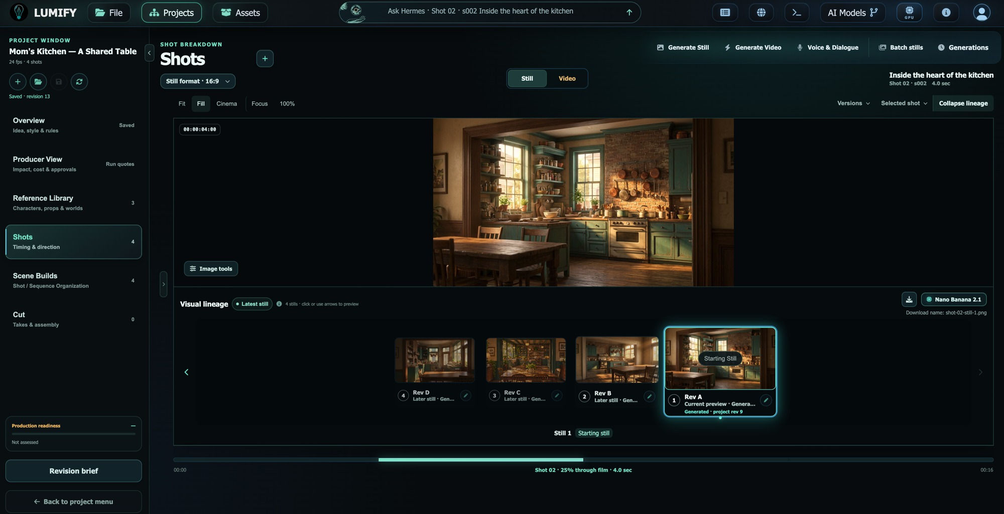
RONNIE CLELAND
CREATIVE AI PLATFORM ARCHITECT
SHOTS / ITERATION
Keep the alternatives.
Generation is part of the process. Choosing the right take is
an artistic decision.
RETAINED TAKES
Preserve earlier results so artists can return to and compare
their options.
SHOT VIDEO
Generate from approved inputs and supported model
contracts.
PREVIEW IS NOT SELECTION
Let artists inspect a take before explicitly choosing Use in
Cut.
LUMIFY V2 / PRODUCT INTERFACE
06 / 12
RONNIECLELAND.COM

Slide 7
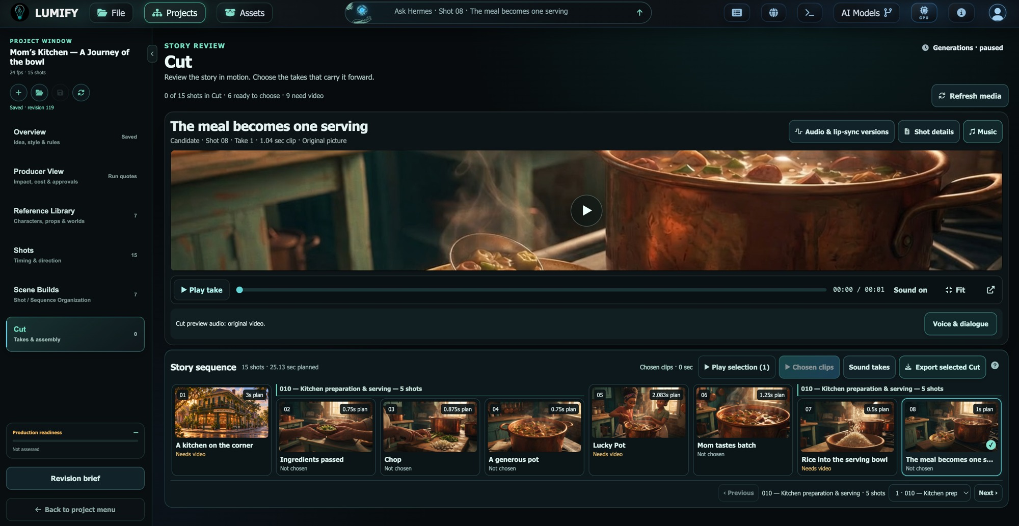
RONNIE CLELAND
CREATIVE AI PLATFORM ARCHITECT
THE CUT / EDITORIAL CONTINUITY
Carry decisions into the edit.
The selected take becomes part of a saved sequence, with a
visible path to review.
EXPLICIT SELECTION
Assemble the takes the artist has chosen for the Cut.
TIMING + REVIEW
Arrange shot timing and assemble a review MP4 from
saved video selections.
AUDIO WORKFLOWS
Support speech, music, and sound as part of the project
workflow.
LUMIFY V2 / PRODUCT INTERFACE
07 / 12
RONNIECLELAND.COM

Slide 8

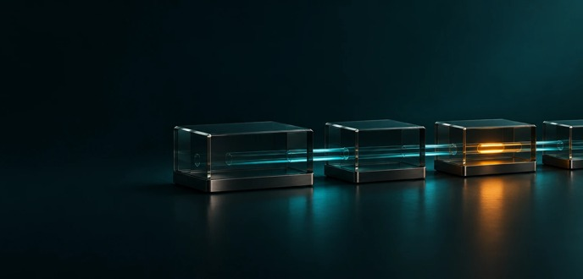

RONNIE CLELAND
CREATIVE AI PLATFORM ARCHITECT
ARCHITECTURE / END-TO-END OWNERSHIP
Connect the experience to the system.
I work across the layers that turn a visual goal into a reviewable result.
01 / INTERACTION
02 / ORCHESTRATION
03 / CONTINUITY
Artist-facing state
Policy, route, execute
Save, trace, review
JavaScript, HTML/CSS, visual controls,
Python/Flask, REST APIs, server-controlled
SQLite, source lineage, revisions, provider
validation, and feedback.
routing, job status, and recovery.
provenance, and FFmpeg review export.
08 / 12
RONNIECLELAND.COM

Slide 9

RONNIE CLELAND
CREATIVE AI PLATFORM ARCHITECT
INTEGRATION / EVOLVING CAPABILITIES
Models evolve.
Intent stays visible.
Integrate new capabilities through a consistent creative
workflow.
PROVIDER CONNECTIONS
Runway, fal.ai, World Labs, and local model services.
IMPLEMENTATION PRACTICE
Model/provider adapters, AI Toolkit, hosted and local
inference; working knowledge of PyTorch/CUDA, Diffusers,
and Transformers.
VALID CONTROLS
Deployment policies and model contracts shape which
actions and settings are available.
09 / 12
RONNIECLELAND.COM

Slide 10

RONNIE CLELAND
CREATIVE AI PLATFORM ARCHITECT
VISUAL + SPATIAL PRACTICE
Think beyond a single frame.
Production craft and spatial thinking inform the tools I build
for image, motion, and generated worlds.
ARTIST-DIRECTED IMAGE WORK
Relighting, material, time-of-day, and camera controls make
creative intent actionable.
REAL-TIME FOUNDATION
Unreal Engine and Substance experience connects
materials, world building, and interactive feedback.
SPATIAL WORKFLOWS
3D and world-generation integrations extend the creative
vocabulary alongside image and video.
10 / 12
RONNIECLELAND.COM

Slide 11

RONNIE CLELAND
CREATIVE AI PLATFORM ARCHITECT
DESIGN OUTCOMES
Make the process legible.
The product value is in the decisions artists can understand
and control.
BEFORE GENERATION
Review references, supported settings, and estimated
costs.
DURING ITERATION
See job status, retain takes, and trace source context.
AFTER REVIEW
Choose what enters the Cut, protect saved revisions, and
assemble work for review.
11 / 12
RONNIECLELAND.COM

Slide 12

RONNIE CLELAND
CREATIVE AI PLATFORM ARCHITECT
LET’S CONNECT
Creative judgment.
Product thinking.
Hands-on delivery.
Building artist-facing AI products, creative R &D;, and
visual workflow systems.
ronnie@lumifyai.com
linkedin.com/in/ronniecleland
ronniecleland.com
12 / 12
RONNIECLELAND.COM

