Slide 1
DATA ANALYTICS CAPSTONE | CAPSTONE 1
Colorado In-Store Sales Analysis
DATA SOURCE
MySQL sample_sales database
TOOLS
MySQL Workbench
SQL
Microsoft Excel
PivotTables and PivotCharts
GitBash
GitHub
Sales Performance Through SQL and Excel
Presenter: Ronise Drakes – Data Analyst
Territory: Colorado | Region: West | Channel: In-store only
Reporting period: January 1, 2022 – December 31, 2025

Slide 2
PURPOSE OF THE ANALYSIS
Agenda and Business Scenario
1
Data scope and methodology
Business scenario
Colorado has 18 physical stores and is the territory assigned to the West Region. The goal is to understand how in-store sales performed and where to focus next.
2
Colorado sales summary
3
Colorado vs. West Region
Analytical objectives
Measure total in-store revenue
Compare Colorado with the West Region
Explain revenue trends and product categories
Rank Colorado stores by revenue
Recommend where to focus next quarter
4
Revenue trends and product categories
5
Store ranking and Q4 2025 results
6
Findings and recommendation
Colorado In-Store Sales Analysis | Capstone 1 | Ronise Drakes
2

Slide 3
Data Scope and Methodology
Data source | MySQL sample_sales database
Reporting period | January 1, 2022 – December 31, 2025
Territory / Region | Colorado / West
Sales channel | In-store only (online excluded)
Physical stores | 18 Colorado locations
Tools | MySQL Workbench, SQL, Excel, GitHub
Analytical methods
SQL queries total, group, and rank sales
PivotTables summarize the query results
PivotCharts show trends and store rankings
Conclusions are limited to what revenue evidence supports
Analysis workflow
1
2
3
4
5
Database
SQL Analysis
Excel PivotTable
PivotChart
Business Recommendations
MySQL sample_sales
Filter, total, group, rank
Summarize results
Visualize patterns
Evidence-based next step
Colorado In-Store Sales Analysis | Capstone 1 | Ronise Drakes
3

Slide 4
JAN 1, 2022 – DEC 31, 2025
Colorado Sales Summary
18
physical Colorado stores included in the analysis
TOTAL IN-STORE REVENUE
$6,412,632.22
4 yrs
January 1, 2022 – December 31, 2025
Colorado, in-store only, four reporting years
What this means
All figures are in-store sales only; online sales are excluded.
Calculated average: $356,257.35 per store ($6,412,632.22 ÷ 18). Store totals differ, as the ranking slide shows.
Revenue measures sales volume, not profitability.
Colorado In-Store Sales Analysis | Capstone 1 | Ronise Drakes
4

Slide 5
GEOGRAPHIC COMPARISON | JAN 1, 2022 – DEC 31, 2025
Colorado vs. West Region: In-Store Sales
In-store revenue, Jan 1, 2022 – Dec 31, 2025 (USD)
COLORADO
WEST REGION
$6,412,632.22
$6,412,632.22
Why the totals are identical
Colorado is the only physical-store state assigned to the West Region in the provided management data.
So Colorado is 100% of the region’s in-store revenue.
Online sales are excluded.
This is not a comparison of two independent markets. Only in-store.
Colorado In-Store Sales Analysis | Capstone 1 | Ronise Drakes
5

Slide 6
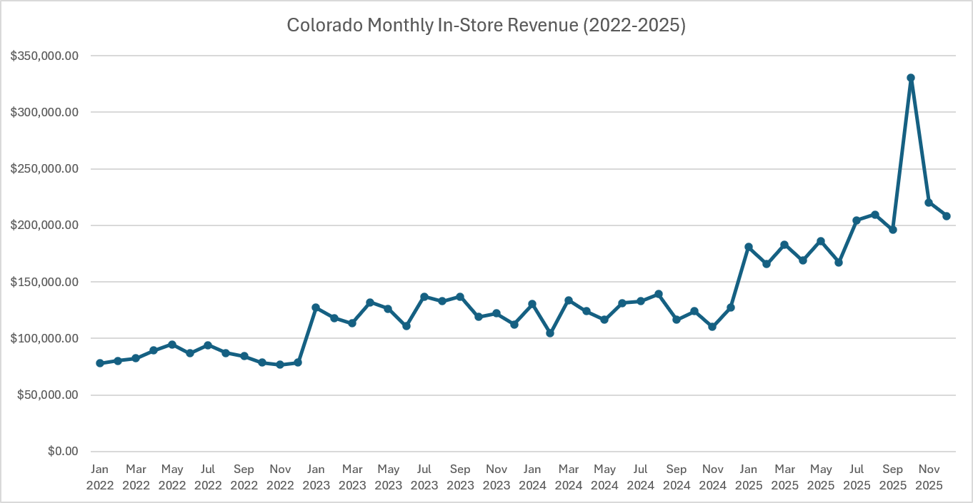
SQL QUESTION 2 | JAN 1, 2022 – DEC 31, 2025
Revenue Trends Over Time
Key Revenue Trends
Peak revenue: October 2025, at $330,762.82
Lowest revenue: November 2022, at $76,920.06
Largest monthly increase: Revenue grew 68.66% from September to October 2025.
Colorado In-Store Sales Analysis | Capstone 1 | Ronise Drakes
6

Slide 7
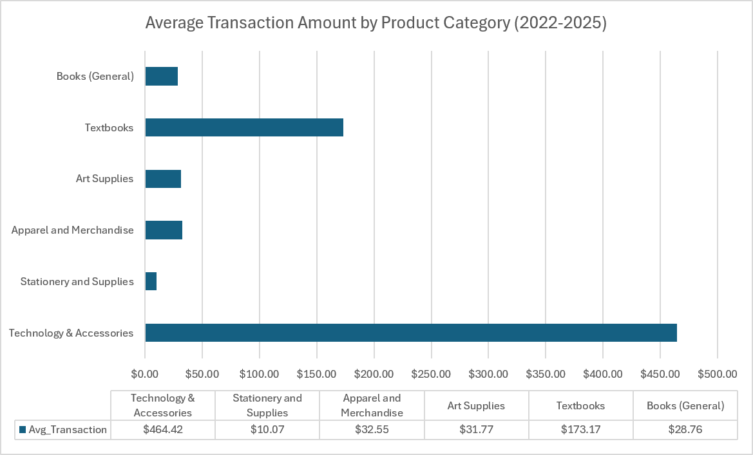
SQL QUESTION 4 | JAN 1, 2022 – DEC 31, 2025
Product Category Performance
Takeaway: Technology & Accessories had the highest average transaction amount ($464.42) and the most sales records (9,806), narrowly ahead of Stationery and Supplies (9,776 records).
Colorado In-Store Sales Analysis | Capstone 1 | Ronise Drakes
7

Slide 8
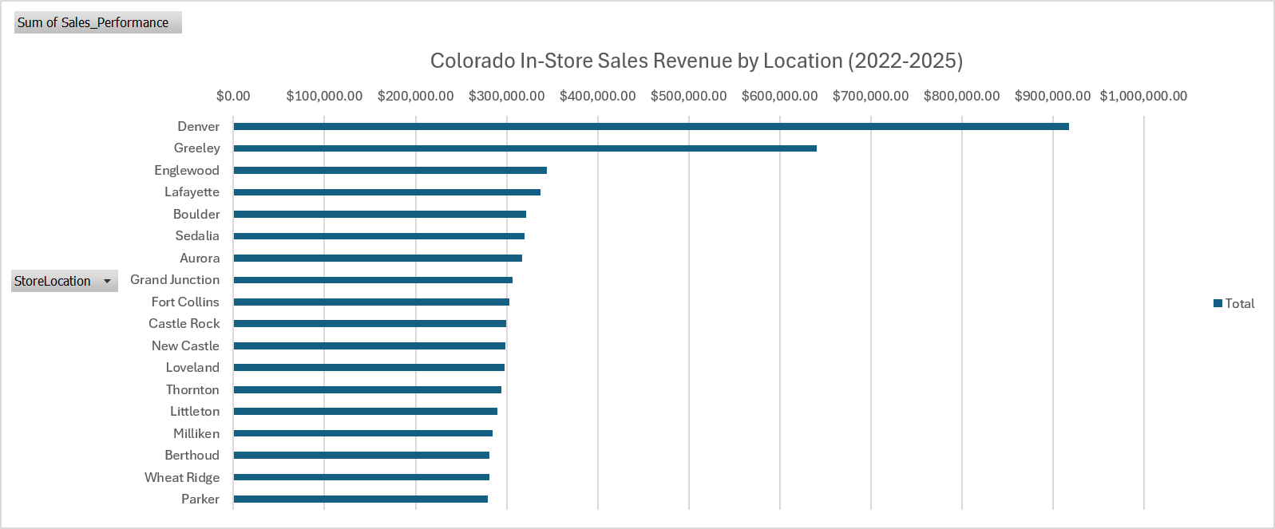
ALL 18 COLORADO STORES | JAN 1, 2022 – DEC 31, 2025
Store Performance Ranking
1
Denver
$917,471.53
14.31% of Colorado total
2
Greeley
$640,368.11
9.99% of Colorado total
3
Englewood
$344,647.48
5.37% of Colorado total
Shares are calculated from the verified Colorado total of $6,412,632.22. The top three stores together account for $1,902,487.12 (29.67%). All figures are four-year totals.
Colorado In-Store Sales Analysis | Capstone 1 | Ronise Drakes
8

Slide 9
QUARTERLY RESULTS | Q4 2025 (OCT 1 – DEC 31, 2025)
Most Recent Quarter: Q4 2025
Q4 2025 in-store revenue (USD), Oct 1 – Dec 31, 2025
Store | Four-year total Jan 1, 2022 – Dec 31, 2025 | Q4 2025 only Oct 1 – Dec 31, 2025
Denver | $917,471.53 | $111,875.48
Greeley | $640,368.11 | $68,447.67
Why recent sales add context
Four-year totals show long-run leaders; Q4 2025 shows the latest quarter.
Denver and Greeley lead in Q4 2025 as well, supporting their focus for next quarter.
Do not compare quarterly amounts with four-year totals: the time periods differ.
Colorado In-Store Sales Analysis | Capstone 1 | Ronise Drakes
9

Slide 10
EVIDENCE-BASED NEXT STEP
Findings and Recommendation
Key findings
NEXT-QUARTER RECOMMENDATION
$6,412,632.22 in-store revenue across 18 stores, Jan 1, 2022 – Dec 31, 2025.
Colorado is 100% of the West Region’s in-store revenue, so this is not two independent markets.
Four-year leaders: Denver $917,471.53, Greeley $640,368.11, Englewood $344,647.48.
Q4 2025: Denver $111,875.48 and Greeley $68,447.67.
Focus sales attention on Denver first, Greeley second.
Before committing resources, evaluate promotional opportunities and customer demand at both stores.
Colorado In-Store Sales Analysis | Capstone 1 | Ronise Drakes
10

