Slide 1


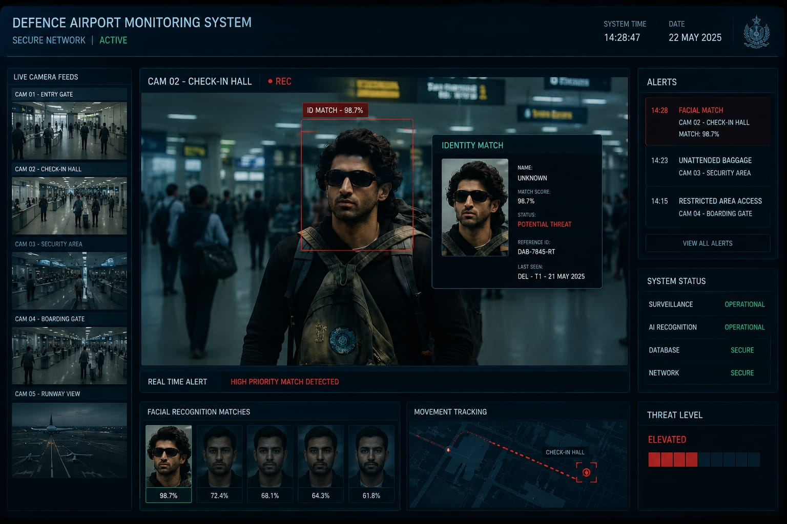
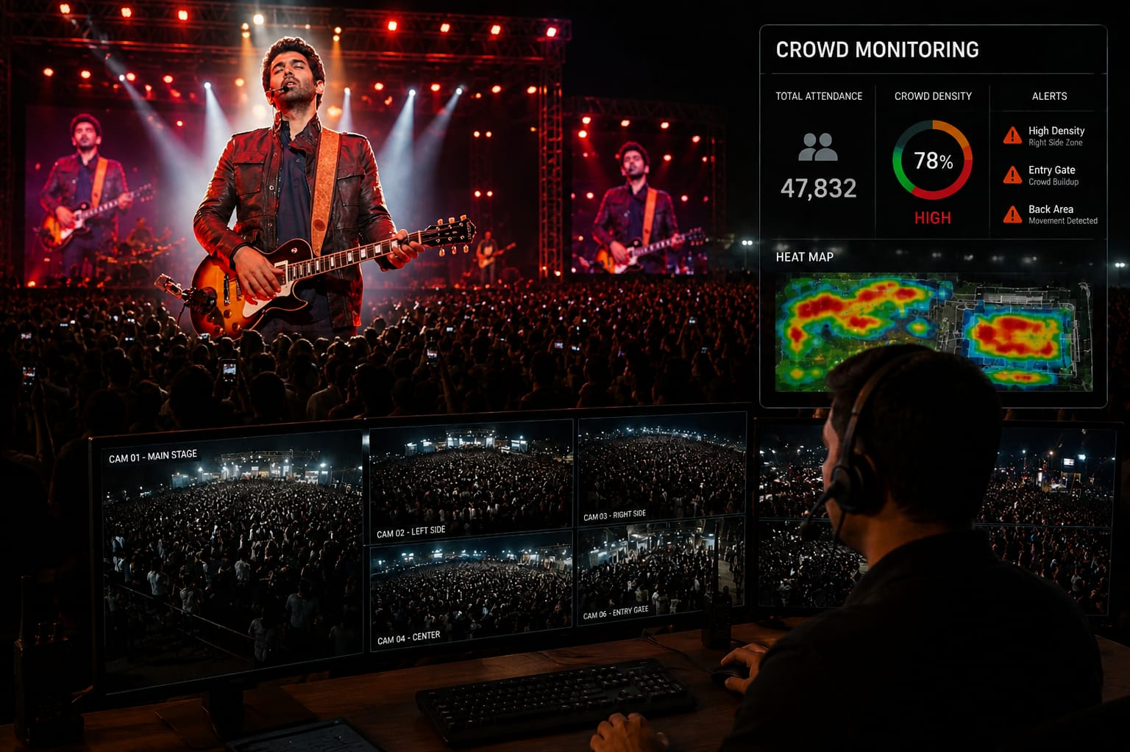
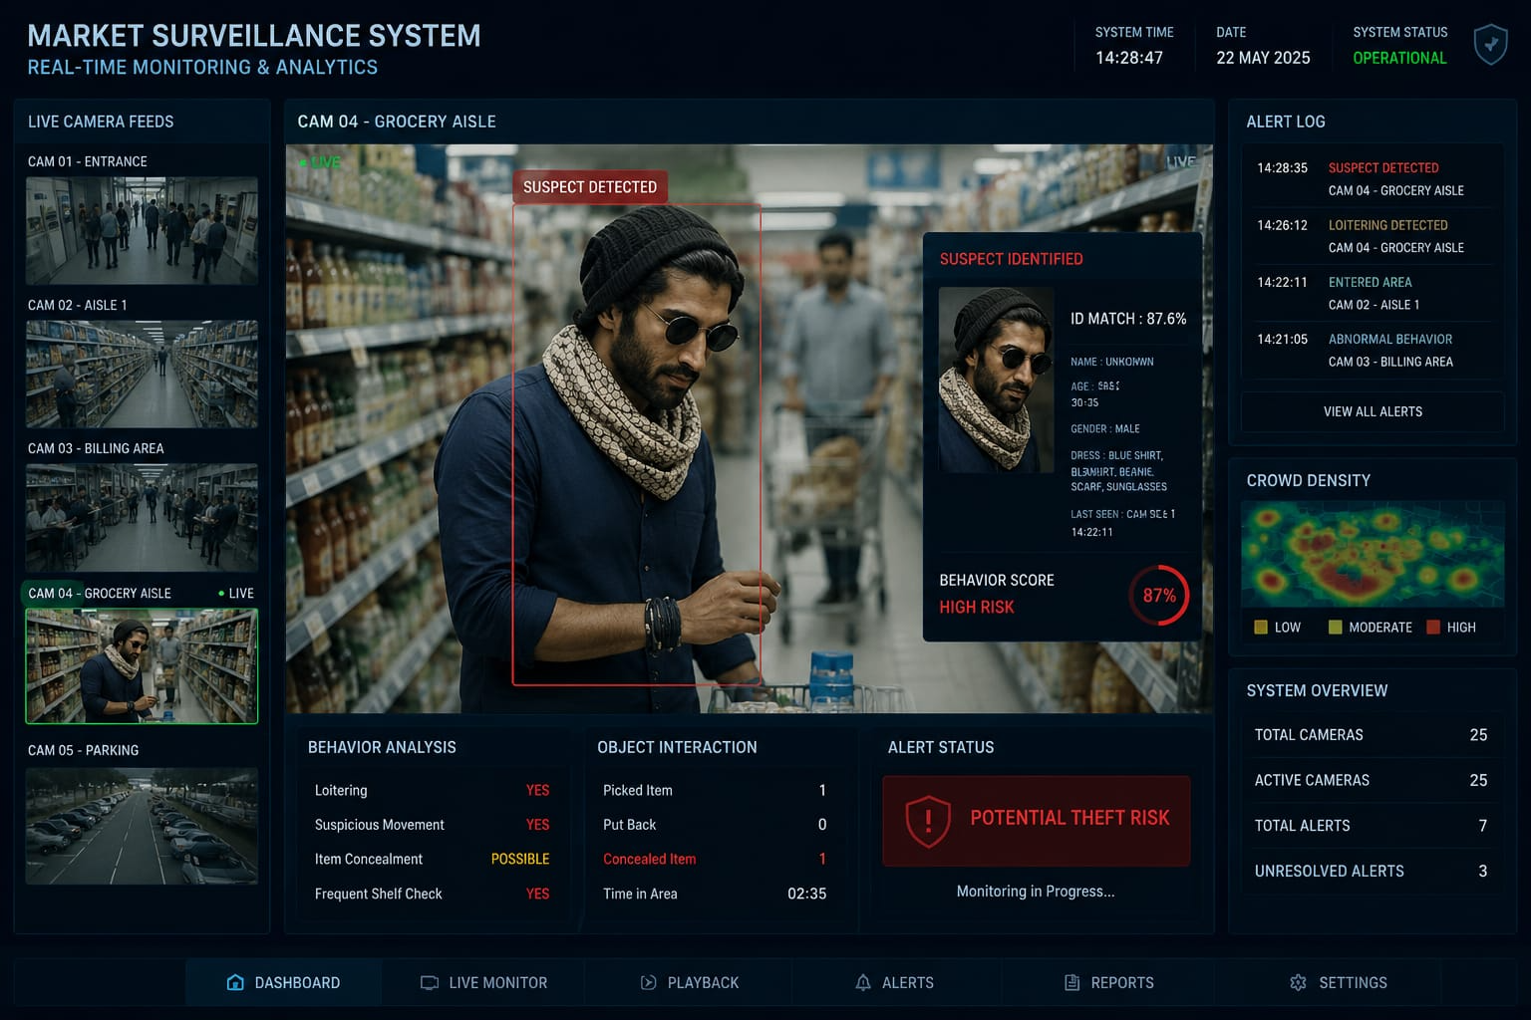
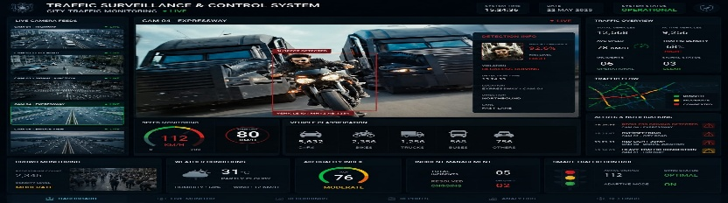
Multi-Mode AI-Based Intelligent Surveillance System
1. HARDIK 2. RONIT 3) YASHANT 4) SANKET
Department of Robotics and Artificial Intelligence, Bangalore Institute of Technology, Bengaluru.
E-mail: thehardik21@gmail.com
ABSTRACT
INTRODUCTION
Multi-Mode AI-Based Intelligent Surveillance System is an advanced smart monitoring solution designed for real-time security and surveillance applications. The system integrates Artificial Intelligence, Computer Vision, Face Recognition, Pose Estimation, Gait Analysis, and Behavioural Analytics to monitor and analyze human activities efficiently.
The proposed system operates in four different modes including Airport/Defence Mode, Crowd Monitoring Mode, Market Surveillance Mode, and Traffic Monitoring Mode. In Airport Mode, the system performs face recognition, multi-biometric verification, and suspicious object detection such as unattended baggage detection. Crowd Mode analyzes crowd density, abnormal gathering, and unusual movement patterns. Market Mode monitors customer activities and identifies possible shoplifting behaviour using object tracking and motion analysis. Traffic Mode detects vehicles, estimates speed, identifies accidents, and recognizes unsafe driving patterns.
The system also improves identification accuracy by combining facial recognition with height estimation, body posture analysis, and gait recognition. Optional depth cameras can further enhance detection accuracy using 3D spatial information. This project provides a real-time, intelligent, and multi-domain surveillance framework suitable for smart cities, airports, retail stores, highways, and public safety systems.
Artificial Intelligence (AI) and Computer Vision are transforming modern surveillance systems by enabling automatic monitoring, real-time threat detection, and intelligent behavioral analysis. Traditional CCTV systems mainly depend on human operators, which can result in delayed responses and monitoring errors. AI-based surveillance systems overcome these limitations by providing automated and accurate security monitoring.
The Multi-Mode AI-Based Intelligent Surveillance System is an advanced smart surveillance framework that combines technologies such as Face Recognition, Human Detection, Pose Estimation, Gait Analysis, Motion Tracking, and Behavioral Analytics. The system is designed to operate in four major modes: Airport/Defence Mode, Crowd Monitoring Mode, Market Surveillance Mode, and Traffic Monitoring Mode.
In Airport Mode, the system performs face recognition, biometric identification, and suspicious object detection. Crowd Mode analyzes crowd density and abnormal movement patterns. Market Mode detects shoplifting and monitors customer activities, while Traffic Mode performs vehicle detection, speed estimation, accident detection, and unsafe driving analysis.
The system improves identification accuracy using multiple biometric features including facial recognition, body posture, height estimation, and gait analysis. Due to its real-time analysis capability and multi-domain applications, the proposed system can be effectively used in airports, shopping malls, railway stations, highways, smart cities, security.
Despite the advantages of AI-based surveillance systems, challenges such as real-time data processing, crowded environment monitoring, privacy concerns, and false detections still exist. However, technologies like Computer Vision, Face Recognition, Pose Estimation, and Gait Analysis are improving surveillance accuracy and efficiency. This project explores how the Multi-Mode AI-Based Intelligent Surveillance System enhances security through real-time monitoring, biometric identification, behavioral analysis, and intelligent threat detection for smart surveillance applications.
SYSTEM MODES & WORKING
1. Airport / Defence Mode
This mode performs face recognition, biometric identification, and suspicious activity detection. It can identify unattended baggage, track individuals, and improve airport and defence security using AI-based monitoring.
2. Crowd Monitoring Mode
This mode analyzes crowd density and detects abnormal movement or sudden gatherings in public places. It helps in identifying panic situations and improving public safety during events or emergencies.
3. Market Surveillance Mode
This mode monitors customer activities in shops and malls. Using object tracking and motion analysis, the system detects suspicious behavior and possible shoplifting activities.
4. Traffic Monitoring Mode
This mode detects vehicles, estimates speed, and identifies accidents or unsafe driving patterns. It helps in intelligent traffic management and road safety monitoring.
The Multi-Mode AI-Based Intelligent Surveillance System is an advanced AI-powered security solution designed to improve modern surveillance and monitoring systems. The project integrates technologies such as Artificial Intelligence, Computer Vision, Face Recognition, Pose Estimation, Gait Analysis, Motion Tracking, and Behavioral Analytics to provide accurate and real-time monitoring. The system operates in four different modes including Airport/Defence Mode, Crowd Monitoring Mode, Market Surveillance Mode, and Traffic Monitoring Mode. Each mode performs specialized functions such as suspicious activity detection, crowd analysis, shoplifting detection, vehicle monitoring, speed estimation, and accident detection. The use of multi-biometric identification techniques including facial features, height estimation, body posture, and walking style improves identification accuracy and reliability. Compared to traditional CCTV systems, the proposed system reduces human monitoring effort and provides faster and smarter decision-making capabilities. The system can be effectively used in airports, railway stations, shopping malls, highways, military zones, smart cities, and other public security applications. Overall, this project demonstrates how Artificial Intelligence and Deep Learning technologies can transform conventional surveillance systems into intelligent, automated, and highly efficient smart security systems for future real-world applications.
REFERENCES
1.OpenCV Documentation – Computer Vision Library. 2.Redmon, J., et al. “YOLO: Real-Time Object Detection.” 3.Goodfellow, I., Bengio, Y., and Courville, A. Deep Learning. MIT Press. 4.Viola, P. and Jones, M. “Rapid Object Detection using Haar Cascade Classifiers.” 5.Face Recognition using Convolutional Neural Networks (CNN). 6.Research Papers on Human Pose Estimation and Gait Analysis. 7.Smart Traffic Monitoring and Vehicle Detection Systems using AI. 8.AI-Based Crowd Monitoring and Behavioral Analysis Systems. 9.Deep Learning Applications in Intelligent Surveillance Systems.
CONCLUSIONS

