Slide 1

CAR PRICE PREDICTION ANALYSIS: PYTHON

Slide 2


INTRODUCTION
Objective: Provide a clear and concise statement about the goal of your project. For example: "The objective of this project is to predict car prices based on various features using machine learning techniques."

Slide 3

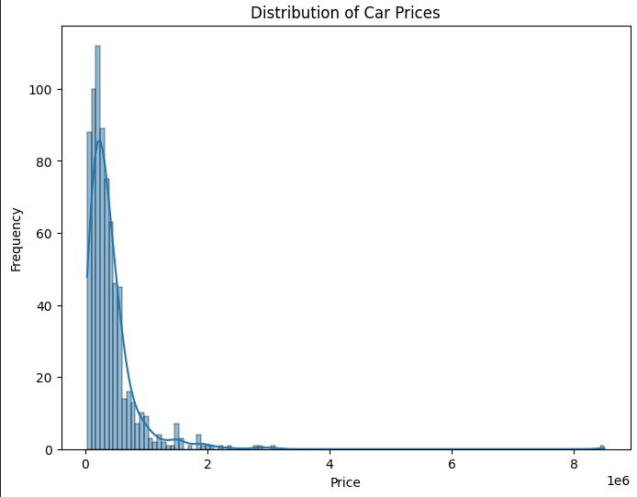
Statistical Analysis
Correlation Matrix: Explain the purpose of analyzing the correlation matrix, which helps identify the strength and direction of relationships between variables. Insert a heatmap or table showing the correlation between variables to provide visual insight.
P-Values: Briefly explain the concept of p-values and their significance in assessing the statistical relationship between variables. Highlight any significant findings from the correlation analysis.

Slide 4

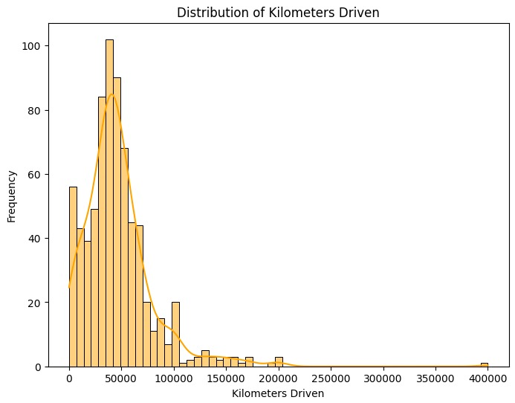
Data Standardization
Purpose: Explain why data standardization is crucial in machine learning, particularly when features have different scales

Slide 5
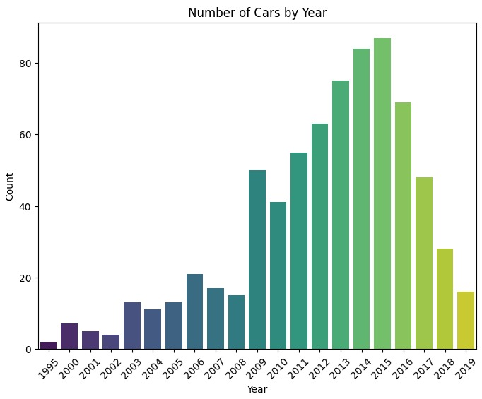
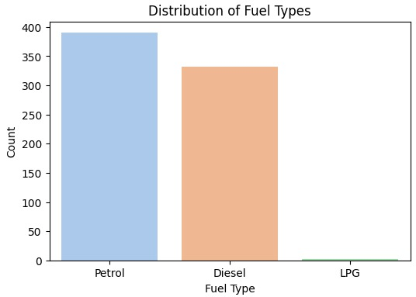
Model Building
Model Selection: Highlight the choice of Linear Regression for predicting car prices. Briefly justify why this model was selected
Training Process: Describe the training process, including how the model was trained using the training dataset. Mention any specific parameters or techniques used to optimize the model.

Slide 6
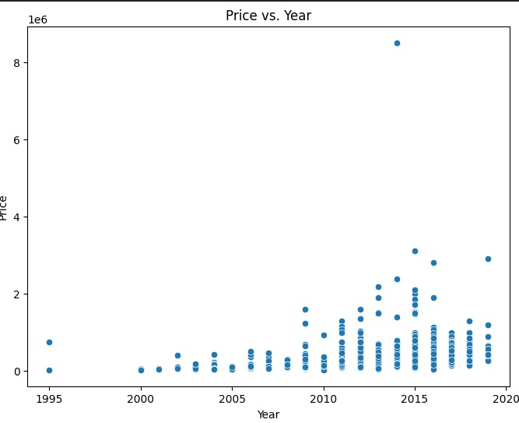
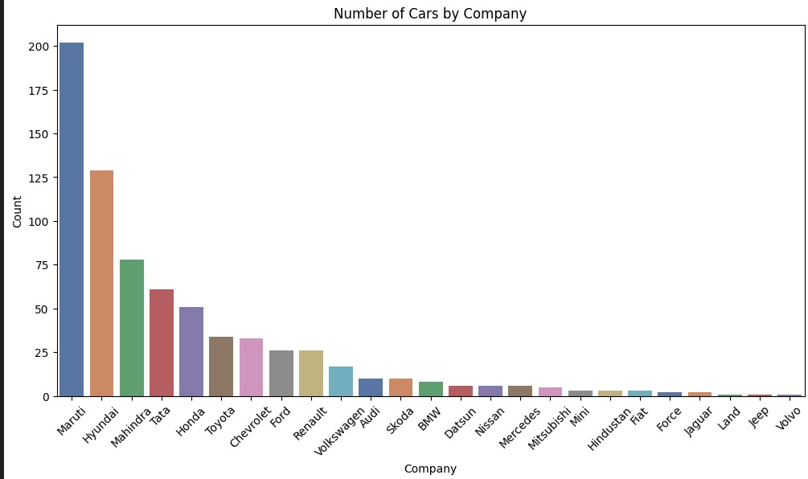
MODEL EVALUATION TECHNIQUES
Metrics: Introduce the evaluation metrics used to assess the model’s performance, such as Mean Squared Error (MSE) and R-squared (R²). Explain briefly what these metrics indicate about model accuracy and predictive power.
Results: Present the results obtained from the model evaluation (e.g., MSE and R² values). Discuss what these results mean in the context of predicting car prices.

Slide 7
CONCLUSION
Summary: Recap the main steps taken throughout the project, from data preparation and encoding to model building and evaluation.
Outcome: Discuss the effectiveness of the model and how well it predicts car prices. Mention any potential improvements or future work.

Slide 8

Thanks!
Ronit Patra

