Slide 1
Happy Insurance Project
This project completed by:
Ronit Schwartz

Slide 2
Assumptions taken in the project
The analysis of the sales, customers, products, and date data for the years 2011-2013 at "Happy Insurance" company involved several assumptions. Understanding these assumptions is crucial for interpreting the insights correctly and recognizing the limitations of the analysis. Here are the key assumptions taken:
Data Completeness and Accuracy
Assumption: The data provided in the files is complete and accurate. This means that all transactions, customer interactions, and product details relevant to the period of 2011-2013 are included and correctly recorded
Pricing Strategy
Assumption: Changes in unit prices over time are assumed to reflect intentional pricing strategies or market conditions rather than data recording errors. This includes the assumption that any significant fluctuations in unit prices for top products are due to strategic decisions or market demand changes.
Revenue and Sales Volume
Assumption: The analysis assumes that revenue and sales volume are indicative of product popularity and market demand. It does not account for external factors that might influence sales, such as marketing campaigns, economic conditions, or changes in competition, unless explicitly mentioned in the dataset descriptions.

Slide 3
Assumptions taken in the project
Geographic Market Representation
Assumption: Sales data is assumed to represent all significant geographic markets for the company. The analysis of revenue by geographic region assumes that the distribution of sales is indicative of market strength and potential areas for growth.
These assumptions are necessary for conducting a structured analysis but also highlight areas where additional data or context might be needed for a more comprehensive understanding. Recognizing these assumptions helps in acknowledging the limitations of the analysis and the need for careful interpretation of the results.

Slide 4
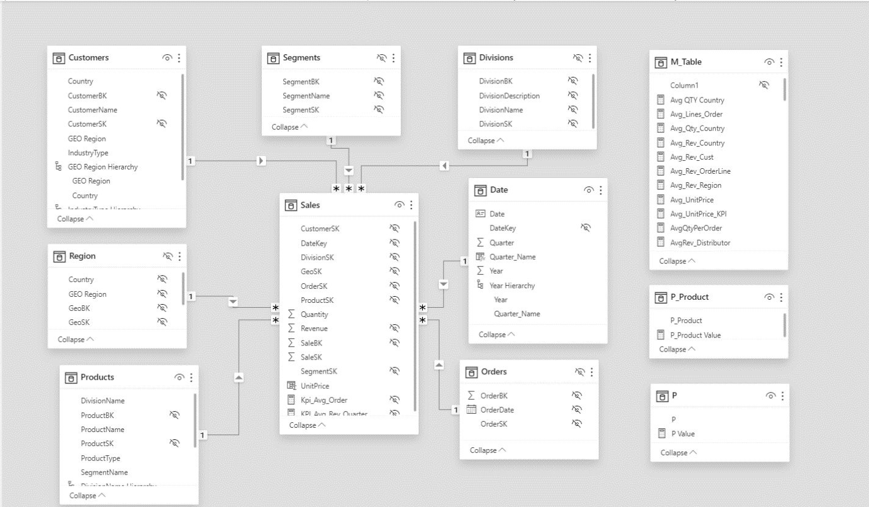
Data mart schema – Star schema

Slide 5
Stages in Project Development, Challenges, and Coping Strategies
In the process of drafting our analysis project, we encountered a variety of challenges, some caused by the technical essence of the project and others by the approach we adopted during the work process.
Data Collection
Gathering quality and relevant data is very important to the outcomes of our analysis. Flawed, incomplete, or inaccurate data could lead to incorrect conclusions. Therefore, it was necessary to construct our model in structured phases:
We imported the data infrastructure from the “Happy Insurance” database in SQL.
We chose not to merge the products division and segments tables following the initial guideline (which was later followed by a delayed instruction to merge).
We chose not to merge the customers and region tables, when the last one was provided in a separate CSV file, again following the initial guideline.
We merged the orders and order lines tables into a sales table.
In the Dim product table, under the Product Type column, we changed values that could be null to 'Unknown'.
We modified the order and names of columns across all tables. Since the original database referenced the time dimension but not in a continuous manner, we had to add a Dim date table.
We added an SK index column to each final table.
We connected all final dim tables to the sales table.

Slide 6
Stages in Project Development, Challenges, and Coping Strategies
Data Analysis
We reviewed the data types and realized we only had access to data related to product sales and customer segmentation of the company, from which we developed ideas for analysis questions.
Understanding the Data
The stage of understanding the data's meaning and interpreting it took time because we did not want to arrive at incorrect conclusions. We tried to comprehend the context and significance of the received data to derive accurate conclusions.
Project Planning and Execution
In the task division, we decided that each of us would build the model independently in Power Query, and then we would compare versions, select one version to continue working on, and develop metrics, charts, and queries in PBI and DAX.
Afterwards, we conducted peer reviews on the shared files, so each time the files were passed on to one of us for review, correction, and refinement of the final product.
In the last stage, we rewrote the presentation, and most conclusions were written.

Slide 7
Problems identified during the work on the project and ways to solve them
The challenges we’ve encountered with duplicate entries in both the Customers and Products tables are common issues in data analysis that can significantly impact the accuracy and reliability of insights derived from the data. The presence of identical names or labels for distinct entities complicates the analysis process, leading to potential misinterpretations or errors in decision-making. Here's a closer look at the steps we've taken to address these challenges :
Implementing Hierarchies
The approach of creating hierarchies to manage duplicate entries is an effective strategy for enhancing data clarity and analysis accuracy. By establishing hierarchical relationships, we can differentiate between entities that appear identical at first glance but differ in significant attributes, such as roles, identifiers, or specifications.
For Customers: Creating hierarchies based on roles (e.g., Distributor vs. End-User) and associated identifiers allows for the clear distinction between customers with the same name. This approach ensures that customer-related analysis accounts for the specific context and characteristics of each customer, enhancing the relevance and accuracy of insights.
For Products: Applying hierarchies to differentiate products with the same name but different specifications helps in accurately tracking product performance, customer preferences, and inventory needs. It ensures that product-related decisions are based on precise data, reflecting the specific attributes and market positioning of each product variant.

Slide 8
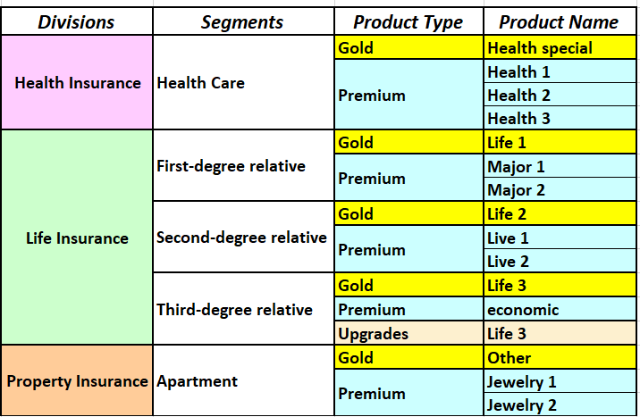
the company products –what are we selling ?
"Happy Insurance" Company operates in the field of insurance, and in particular in the following insurance fields
Health insurance
Life insurance
Property insurance
The company sells several sub types of insurance according to the following divisions :

Slide 9
Total Revenue Over Time
The data presents a clear picture of Happy Insurance's financial growth and operational trends over a three-year period from 2011 to 2013.
During this time, the company experienced a consistent year-over-year increase in total revenue, as follows:
2011: The company started with a revenue of $295,753.11, selling 13,147 units.
2012: Revenue saw a rise to $309,798.31, with a marginal increase in the total quantity of units sold to 13,164.
2013: Revenue climbed further to $321,649.07.
Interestingly, this increase came despite a slight decrease in the total quantity of units sold, which dropped to 12,901. A notable recovery in Q2 of this year was highlighted.
The overall total sales revenue across the three years amounts to $927,200.49, with 39,212 units sold, illustrating the company's financial trajectory.
Despite the total quantity of units sold slightly decreasing in 2013, the continued revenue growth suggests an improvement in either the average unit price or in the profitability of the units sold, or both.
This trend indicates not just growth in sales revenue but also an effective strategy in pricing and product mix, allowing the company to enhance its revenue even when selling fewer units.
The recovery observed in the second quarter of 2013 further signifies resilience and the ability to adapt to market changes, contributing to the overall positive performance.

Slide 10
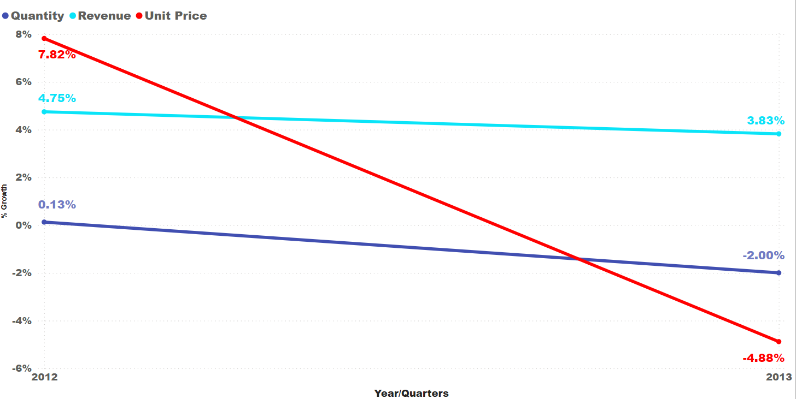
Total Revenue Over Time
This analysis also delves into the annual growth rates for three critical financial indicators: sales volumes, profit, and average unit price, comparing their performance year-over-year. For instance, a significant detail from 2012 shows a 7.82% increase in the average unit price compared to 2011. Such comparisons offer insights into the company's operational success and prevailing market trends.

Slide 11
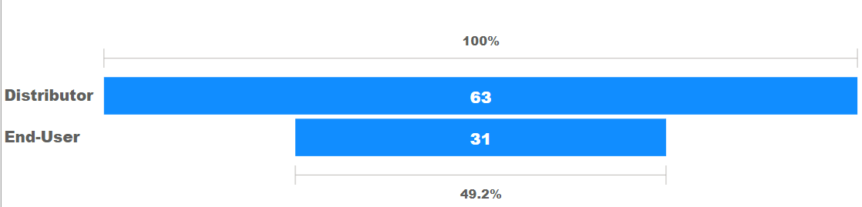
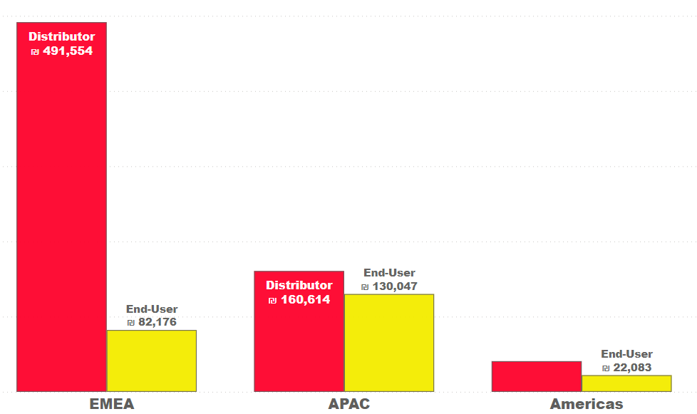
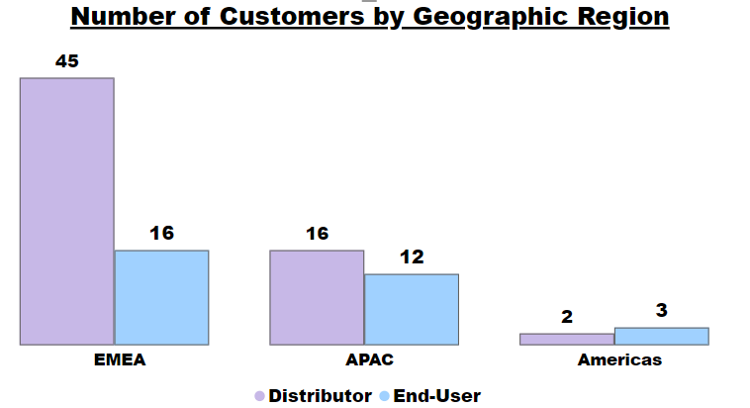
Customer Segmentation
Happy Insurance boasts a diverse and international clientele, serving 94 unique customers across 68 countries, demonstrating a robust global presence. One customer, Latasha, is noted for appearing twice under different roles: once in Italy as a Distributor and again in Nigeria as an End-User.
The company's business is significantly tilted towards the Distributor sector, which accounts for over two-thirds of its customer base, with 63 instances. This sector alone has generated 2,142 orders, contributing $692,894 in revenue, compared to the End-User sector's 840 orders and $234,306 in revenue.
The balance between Distributors and End-Users suggests a versatile market strategy, And highlight the significant impact of industry type on sales performance with a strong performance from distributors.

Slide 12
Customer Segmentation
Happy Insurance exhibits a strategic emphasis on the EMEA (Europe, the Middle East, and Africa) region, which hosts the majority of its clientele, numbering 61.
This focus underscores the company's adaptability and dedication to meeting diverse insurance needs across these varied regions. Notably, the company boasts an evenly distributed customer base across several countries, including the USA, Spain, Poland, South Africa, and others, with each of these nations hosting two customers. This distribution indicates a wide and balanced international presence, with 52 countries having two customers and 42 hosting one.
The analysis reveals that Happy Insurance performs strongly in the EMEA and APAC (Asia Pacific) regions, with room for strategic expansion in the Americas.
The EMEA region leads in sales and revenue, contributing significantly to the company's success.
The APAC region follows, showing strong activity and market presence. However, the Americas lag behind in performance metrics, suggesting potential for growth.
In terms of product performance, life insurance policies are the top revenue generators in both the EMEA and APAC regions, with health insurance following.
The UK, Switzerland, and Italy are key contributors in the EMEA, while India stands out in the APAC region.
In the Americas, health and life insurance are primary revenue sources, with the US and Canada being significant markets but showing different dynamics in terms of product profitability.
Overall, Happy Insurance's global footprint and customized service approach cater to a wide-reaching, distributor-based clientele, with a notable presence across EMEA, APAC, and potential for growth in the Americas.

Slide 13
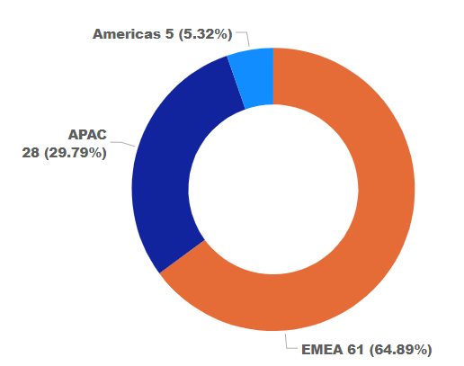
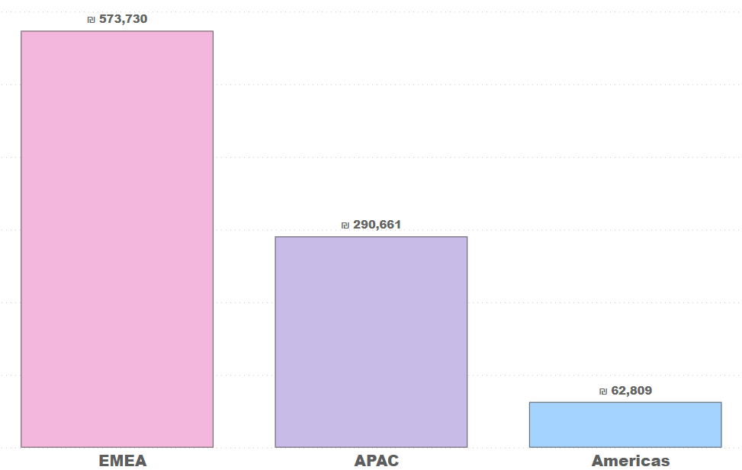
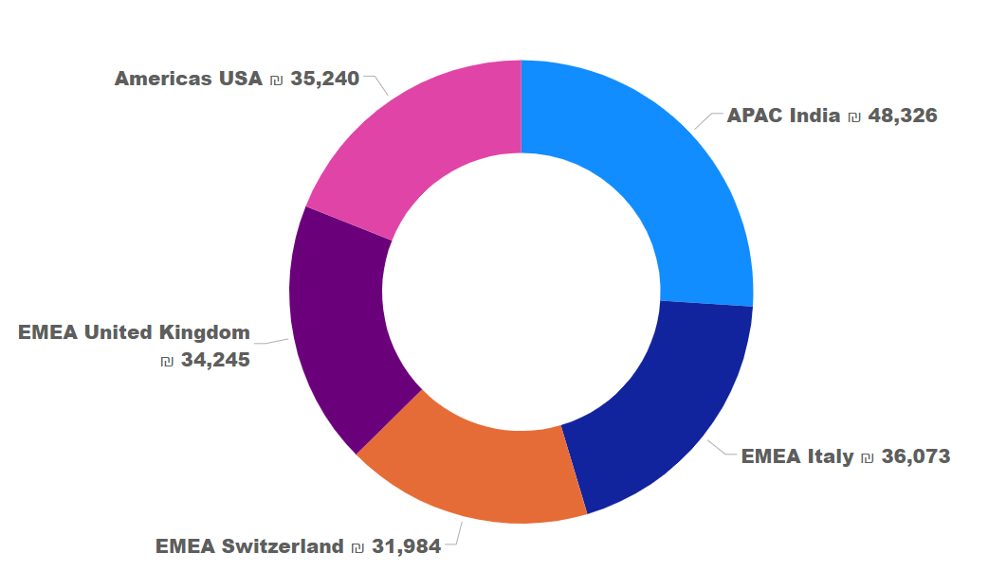
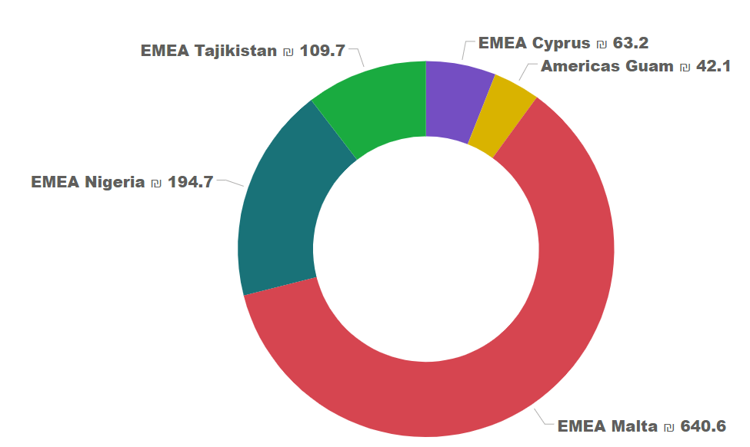
Customer Segmentation
Top/Bottom 5 Countries by Highest/Lowest Revenue

Slide 14
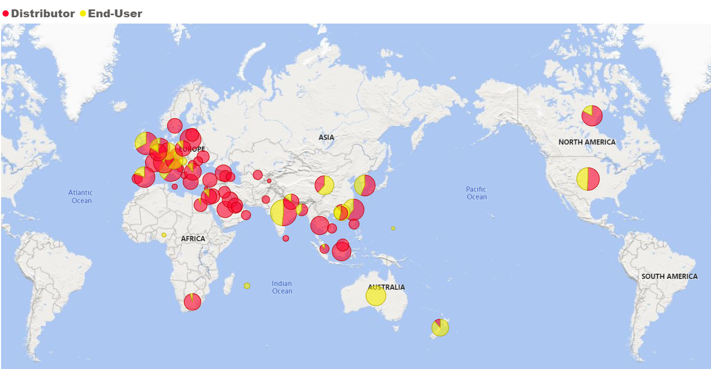
Customer Segmentation
This map highlights the countries and regions where our customers are located, with special emphasis on the EMEA region, illustrating our extensive international reach

Slide 15
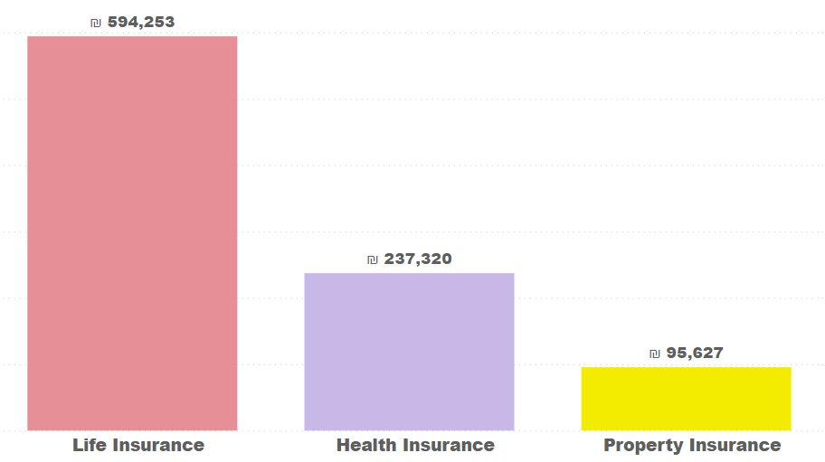
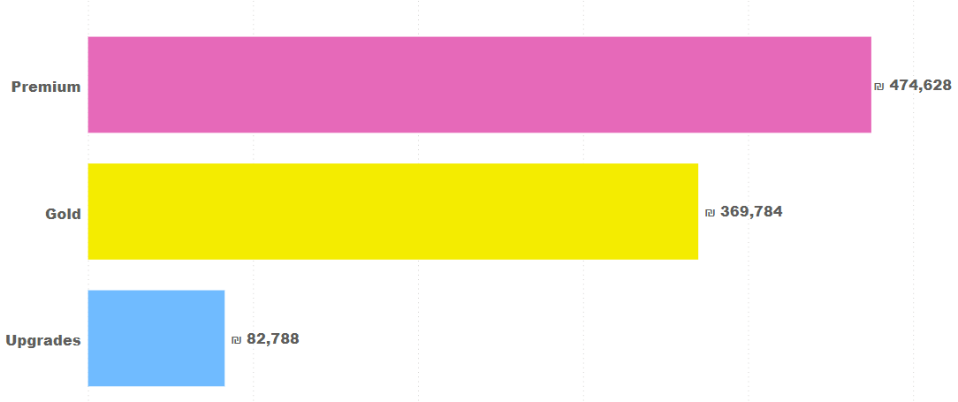
Product Analysis
Premium products are key to Happy Insurance's revenue, suggesting a focus on enhancing these offerings and marketing to boost revenue further.
The company, well-established in premium insurance products, is poised for growth by adapting to customer needs, especially within Life and Health Insurance. Strategic expansion and leveraging strengths in core markets are essential for future success.
Life Insurance is the top revenue generator, followed by Health Insurance, indicating the potential for growth through new or improved products and cross-selling opportunities. This approach, emphasizing Life Insurance due to its substantial revenue impact, can guide product development and marketing strategies

Slide 16
Product Analysis- Top 5
The product analysis for Happy Insurance highlights the top five products based on total revenue, showcasing a diversified portfolio with a strong inclination towards life and health insurance products. The sales figures for these top products are as follows:
Economic Premium: 2,713 sales.
Life 2 Gold: 4,018 sales.
Life 1 Gold: 2,458 sales.
Health 1 Premium: 3,003 sales.
Life 3 Upgrades: 2,779 sales.
The revenue generated by the top two products, "Economic Premium" and "Life 2 Gold," is approximately 150% of that brought in by the bottom two in this list, indicating a significant revenue disparity within the top performers. This disparity underscores the substantial revenue-generating capability of the leading products, particularly those within the life insurance category.
The dominance of Life insurance products ("Life 1 Gold," "Life 2 Gold," and "Life 3 Upgrades") in the top revenue generators reflects a strong market preference and demand for life insurance solutions. Additionally, the "Health 1 Premium" product's performance indicates a significant contribution from the health insurance sector, further emphasizing the market's inclination towards health and life insurance products. The "Economic" product's high sales volume and revenue contribution highlight its popularity and suggest that it offers an appealing value proposition to customers looking for economical insurance options.
Overall, these results illustrate Happy Insurance's ability to meet customer needs through a focused product offering, especially in the life and health insurance segments. The company's success with these products suggests a well-aligned product strategy with market demands and consumer preferences, positioning it strongly in its operational markets.

Slide 17
Product Analysis- bottom 5
The analysis of Happy Insurance's least-selling products identifies areas where strategic adjustments could significantly enhance product performance and overall sales. The sales figures for these products are as follows:
Major 1 premium: 2,007 sales
Live 1 premium: 1,642 sales
Jewelry 1 premium: 2,322 sales
Major 2 premium: 1,586 sales
Live 2 premium: 1,292 sales
The analysis suggests a strategic need to enhance their market performance.
The recommended approach involves conducting a thorough review of these products to identify the reasons behind their underperformance, including market research on consumer preferences and an examination of the cost structure.
Key strategies for improvement include enhancing the products based on consumer feedback, revisiting pricing strategies, increasing marketing efforts, targeting specific market segments more effectively, and potentially replacing underperforming products with new offerings that better meet market demands.
This comprehensive strategy aims to improve the sales and attractiveness of these products, aligning Happy Insurance's product portfolio more closely with consumer needs and market trends.

Slide 18
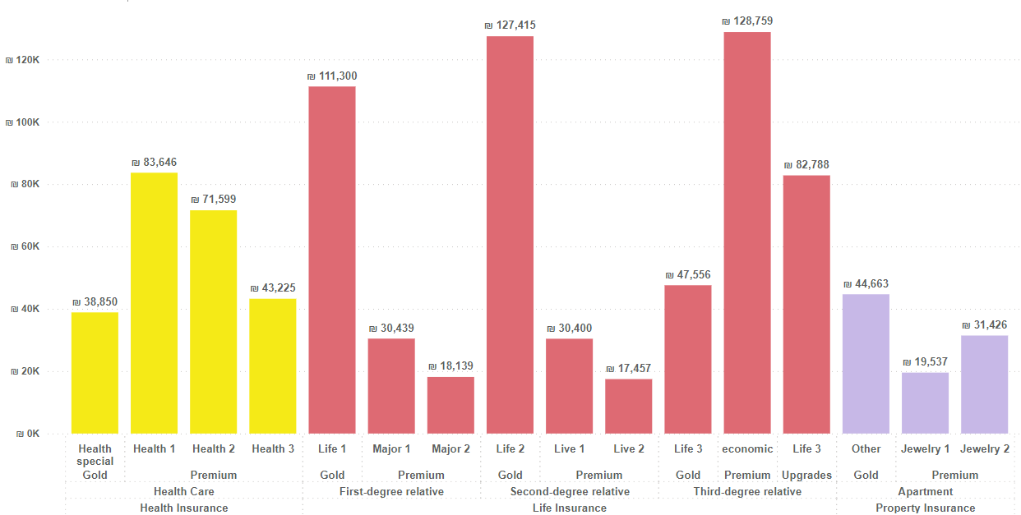
Product Analysis

Slide 19
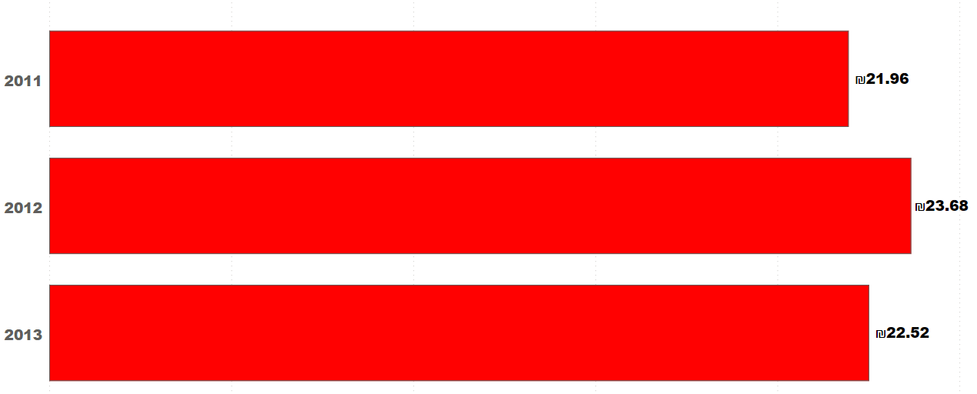
Unit Price Behavior Over the years 2011-2013
The analysis of unit price behavior over the years 2011 to 2013 reveals the following trends:
Average Unit Price by Year
From 2011 to 2013, Happy Insurance experienced notable changes in its average unit price, reflecting strategic pricing adjustments in response to market dynamics and internal cost considerations. In 2011, the average unit price was set at $21.96. In 2012, this price increased by about 7.8% to $23.68, suggesting strategic pricing adjustments possibly due to factors like inflation, increased operational costs, or a shift towards offering higher-priced products. This increase could also indicate an effort to improve profit margins or respond to market demand changes.
However, in 2013, the average unit price saw a slight decrease to $22.52, down by approximately 4.9% from 2012, but it remained above the 2011 level. This reduction might reflect a strategic move to enhance market competitiveness, adjust to market conditions, or shift the product mix towards more moderately priced offerings. It could also be a result of promotional activities or discounts aimed at boosting sales.
.

Slide 20
Unit Price Behavior Over the years 2011-2013
Average Unit Price of Top 5 Products by Year:
For the top 5 products by revenue, the average unit price trends over the years are as follows:
Health 1: Decreased from $30.52 in 2011 to $25.83 in 2013.
Life 1: Slightly decreased from $48.55 in 2011 to $44.86 in 2013, with a dip in 2012.
Life 2: Showed minor fluctuations, starting at $31.95 in 2011, peaking at $32.07 in 2012, and then decreasing to $30.52 in 2013.
Life 3: Increased from $27.67 in 2011 to $31.26 in 2013, indicating a steady increase in unit price.
economic: Had a significant increase from $33.97 in 2011 to $49.90 in 2012, followed by a decrease to $41.06 in 2013.
These trends suggest that while there were general fluctuations in the unit prices across the product range, specific products like "economic" and "Life 2" experienced notable variations in pricing, possibly reflecting changes in market demand, cost of provisioning, or strategic pricing adjustments. The increase in unit price for some products despite a general decrease in 2013 could indicate a focus on maintaining or increasing profitability in key product areas
.

Slide 21
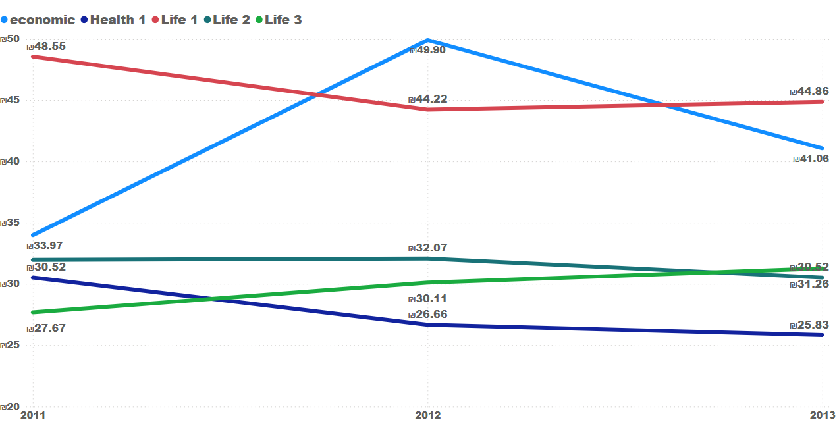
Unit Price Behavior Over the years 2011-2013

Slide 22
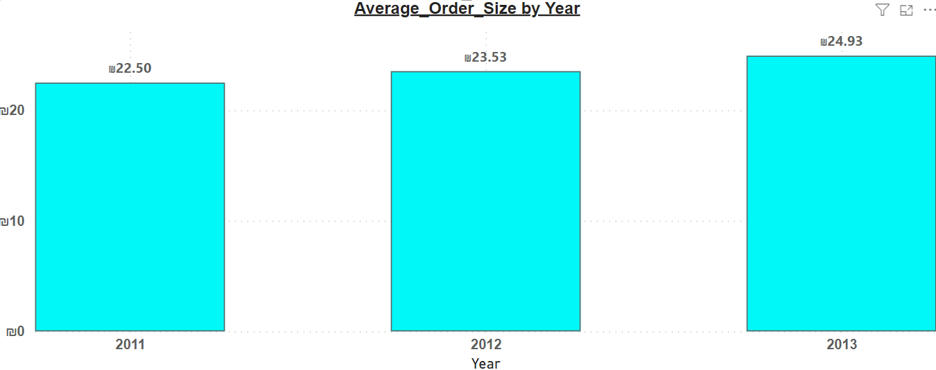
Average Order Size
The average order size can be an indicator of the customer spending behavior, while the total revenue reflects the company's financial performance
2011: The AOS was approximately $22.50.
2012: The AOS increased to approximately $23.53, indicating a rise of about 4.6% from the previous year.
2013: The AOS further increased to approximately $24.93, showing an additional increase of about 5.9% from 2012.
These figures reveal a consistent year-over-year increase in the average amount spent per transaction, despite the slight decrease in the number of units sold in 2013. This trend suggests that Happy Insurance's pricing strategies or changes in product mix—possibly a shift towards selling more premium policies—have successfully increased the revenue per sale. This could also reflect a customer base that values the offered insurance products and is willing to spend more on them, indicating effective product differentiation and value proposition by the company
Such insights into the average order size and its growth over time are valuable for guiding future business strategies, including product development, pricing adjustments, and marketing efforts aimed at further increasing the average spending per customer.

Slide 23
Price Sensitivity Analysis
The company's comprehensive price sensitivity analysis reveals the complex effects of pricing strategies across various demographic segments, highlighting the necessity for customized pricing approaches to meet the diverse needs of different target audiences. Reducing prices may attract younger customers looking for affordability, whereas older customers may value stability and reliability more highly. This insight is crucial for developing pricing strategies that not only aim to expand market share and enhance customer satisfaction but also ensure sustained profitability in a competitive landscape.
Key takeaways from the analysis include:
Target Audience Response: Recognizing how various demographic groups respond to price changes enables the company to refine its strategies to attract new customer segments without losing the loyalty of existing ones.
Market Share and Customer Satisfaction: By strategically setting policy prices, the company can grow its market share and heighten customer satisfaction. Aligning prices with the values and expectations of specific target audiences can bolster the company's market position.
Profitability and Competition: The balance between competitiveness and profitability is highlighted, emphasizing the importance of setting prices that not only cover costs but also minimize the risk of attracting a high-risk customer base prone to frequent claims, which could diminish profitability.
The impact of price adjustments on sales volumes and profitability is influenced by the volume of policies sold. Minor price modifications for policies sold in low volumes have a marginal effect on total revenue, whereas for high-volume policies, even slight price changes can significantly affect revenue. This underscores the importance of considering both the number of policies sold and their price elasticity when devising pricing strategies. The analysis serves as a foundation for informed decision-making, guiding the company to employ data-driven strategies that are in sync with its overarching business goals, ensuring a careful balance between market competitiveness, cost efficiency, and the risk profile of prospective customers.

Slide 24
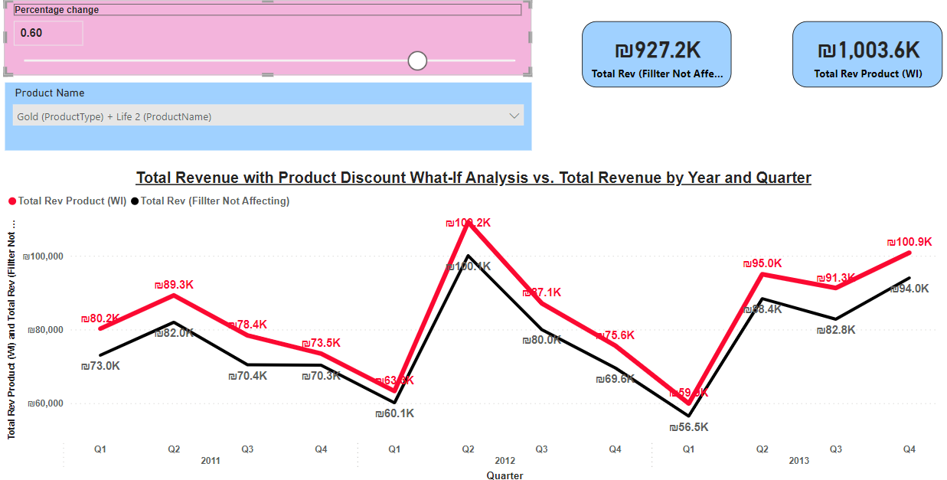
Price Sensitivity Analysis

Slide 25
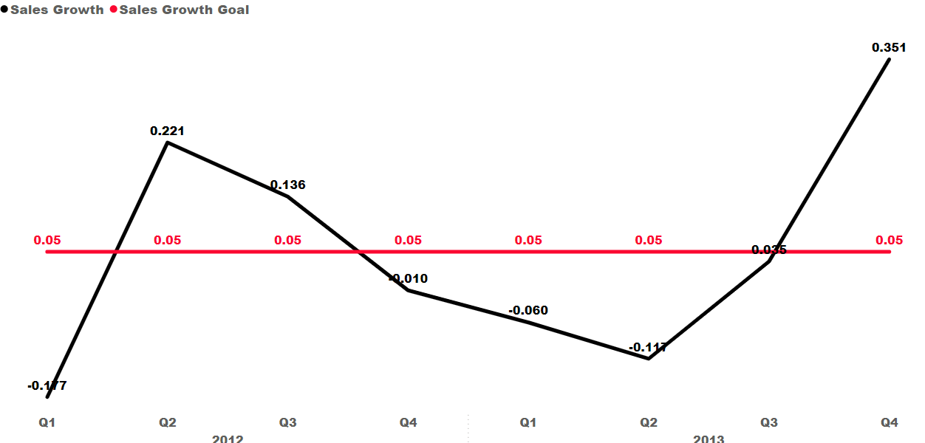
Kpi- Quarterly Year-over-Year (YoY) Sales Revenue Growth Rate
1. Quarterly Year-over-Year (YoY) Sales Revenue Growth Rate
This KPI measures the percentage increase in sales revenue for a specific quarter compared to the same quarter in the previous year. The target is set to achieve a 5% year-over-year growth rate in sales revenue, indicating steady and sustainable business growth. This KPI provides insight into the business's performance and growth trajectory over time, allowing for strategic decision-making and resource allocation.
Target: The target for the Quarterly YoY Sales Revenue Growth Rate with 5% Increase KPI is to achieve a 5% increase in the sales revenue growth rate for each quarter compared to the same quarter in the previous year. This target provides a specific and measurable goal for driving revenue growth and ensuring the business's continued success.

Slide 26
KPI- Total Sales Revenue Over Time
Importance:
Revenue Growth Evaluation: Tracking the YoY sales revenue growth rate allows businesses to evaluate revenue growth trends over time. Achieving a 5% increase in the growth rate demonstrates consistent revenue growth and reflects positively on the business's financial performance.
Goal Setting: Setting a target for a 5% increase in the YoY sales revenue growth rate provides a clear benchmark for performance evaluation and goal setting. It enables the business to track progress towards revenue growth targets and adjust strategies as needed to achieve desired outcomes.
Strategic Decision-Making: Insights derived from YoY sales revenue growth rate trends inform strategic decision-making processes. Businesses can use revenue growth trends to identify areas of opportunity, allocate resources effectively, and make informed decisions about pricing, marketing, and sales strategies.
Performance Benchmarking: Comparing the YoY sales revenue growth rate against industry benchmarks and competitors' performance provides valuable insights into the business's competitive positioning and market performance. It allows businesses to identify strengths and weaknesses relative to their peers and make strategic adjustments as needed.
Investor Confidence: Consistent revenue growth and achieving the target YoY sales revenue growth rate signal to investors that the business is on a path of sustainable growth and profitability. It enhances investor confidence, attracts potential investors, and may lead to increased investment opportunities for future expansion.

Slide 27
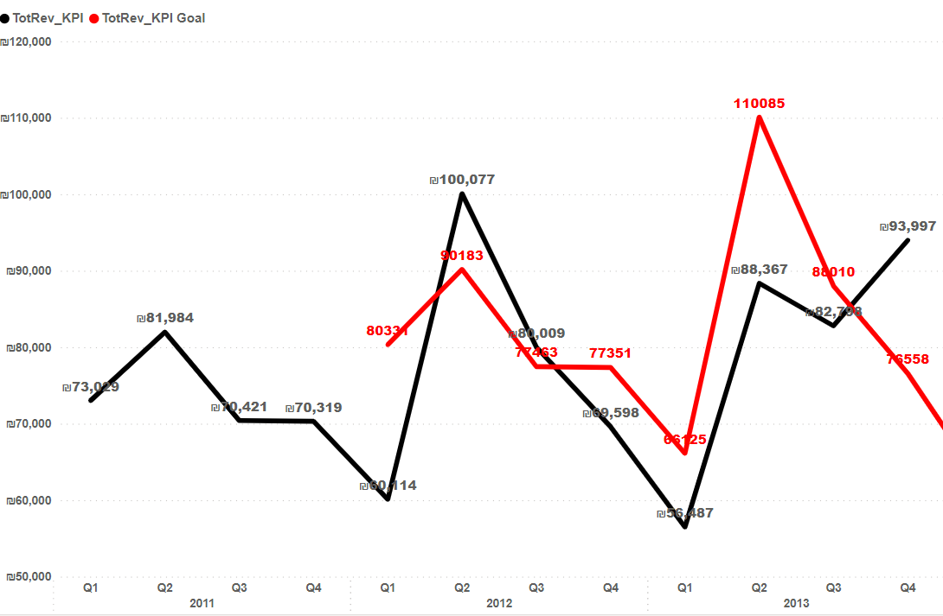
KPI- Total Sales Revenue Over Time
This KPI tracks the total sales revenue generated by the business over sequential periods, including quarters and years. The target is set to achieve a 10% increase in revenue from the previous period. This KPI provides valuable insights into the trend and growth trajectory of sales revenue over time, facilitating performance evaluation and strategic decision-making.
Target: The target for the Total Sales Revenue Over Time with 10% Increase KPI is to achieve a 10% increase in revenue compared to the previous period. This target provides a specific and measurable goal for driving revenue growth and ensuring the business's continued success.

Slide 28
KPI- Total Sales Revenue Over Time
Importance:
Financial Performance: Total sales revenue is a key indicator of the business's financial health and performance. Achieving a 10% increase in revenue demonstrates sustainable growth and reflects positively on the business's ability to generate sales and drive revenue.
Goal Setting: Setting a target for a 10% increase in total sales revenue over time provides a clear benchmark for performance evaluation and goal setting. It enables the business to track progress towards revenue targets and adjust strategies as needed to achieve desired outcomes.
Strategic Decision-Making: Insights derived from total sales revenue trends inform strategic decision-making processes. Businesses can use revenue growth trends to identify areas of opportunity, allocate resources effectively, and make informed decisions about pricing, marketing, and product development.
Competitive Positioning: Achieving a 10% increase in total sales revenue strengthens the business's competitive position within the market. It demonstrates market relevance, customer appeal, and the ability to capture market share from competitors.
Investor Confidence: Consistent revenue growth signals to investors that the business is on a path of sustainable growth and profitability. It enhances investor confidence, attracts potential investors, and may lead to increased investment opportunities for future expansio

Slide 29
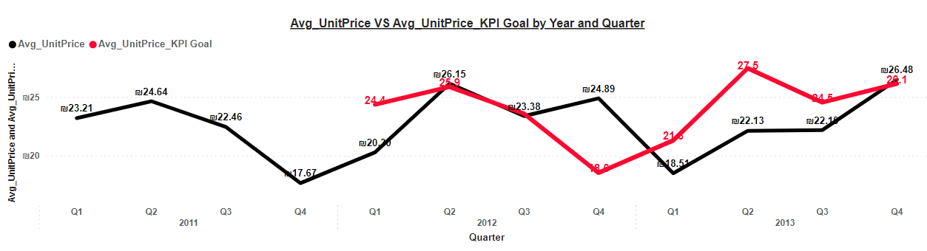
KPI- Average Unit Price
Target: The target for the Average Unit Price with 5% Increase KPI is to achieve a 5% increase in the average unit price compared to the previous period. This target provides a specific and measurable goal for driving revenue growth and ensuring pricing strategies align with business objectives.
2012
2013

Slide 30
KPI- Average Unit Price
Importance:
Pricing Strategy Evaluation: Monitoring the average unit price with a target of a 5% increase enables businesses to evaluate the effectiveness of their pricing strategies. It helps assess the impact of pricing adjustments on revenue generation and profitability.
Revenue Optimization: Achieving a 5% increase in the average unit price signifies revenue optimization efforts aimed at maximizing profitability. Businesses can strategically adjust prices to align with customer willingness to pay while maintaining competitiveness in the market.
Product Performance: Changes in the average unit price reflect shifts in product mix, demand, and perceived value. Aiming for a 5% increase in average unit price allows businesses to focus on promoting higher-margin products or services to drive overall revenue growth.
Market Competitiveness: Setting a target for a 5% increase in average unit price ensures that businesses remain competitive while pursuing revenue growth. It encourages businesses to differentiate their offerings based on value proposition rather than engaging in price wars.
Customer Value Perception: Achieving a 5% increase in average unit price can positively impact customer perception of product or service value. It signals quality and uniqueness, potentially leading to increased customer loyalty and willingness to pay premium prices
2012
2013

Slide 31
Conclusions and insights:
Sales Performance Trends:
Quarter-over-quarter sales growth rate shows a notable recovery in Q2 2013, indicating potential shifts in market conditions or company strategies.
Top-selling products are predominantly life and health-related, suggesting strong market preference for these products.
Least-selling products indicate areas where the company might need to reassess its product offerings or marketing strategies.
Product Performance:
Life insurance products and health insurance sectors are among the highest revenue generators, indicating significant demand in these areas.
The "Economic" product stands out as a high revenue generator, reflecting strong market demand.
Customer Distribution:
The majority of customers are in the EMEA region, followed by APAC, indicating a strong presence in these regions.
The broad distribution across 68 countries highlights the company's international reach and market penetration.
A diverse customer base, including both distributors and end-users, suggests a versatile market strategy.

Slide 32
Conclusions and insights:
Sales Performance Analysis:
EMEA leads in sales performance, followed by APAC, with Americas having the lowest figures.
Top-performing countries include India, Italy, USA, and the United Kingdom, reflecting key markets for the company.
Distributors dominate sales and revenue, emphasizing the importance of distribution channels in driving sales.
Order Analysis:
Average order size and revenue indicate healthy sales figures, contributing to overall revenue generation.
Total sales revenue and quantity sold provide insights into the company's performance and potential areas for growth.
Price Trends:
Average unit price trends over 2011-2013 show strategic adjustments in pricing, possibly in response to market dynamics and cost considerations.
Price increase in 2012 and slight decrease in 2013 reflect the company's efforts to balance revenue growth with market competitiveness.
Overall, the analysis highlights the company's strengths in product diversification, international presence, and sales performance, while also identifying areas for improvement and strategic considerations to maintain competitiveness and drive growth in the future.

