Slide 1


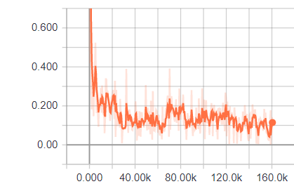
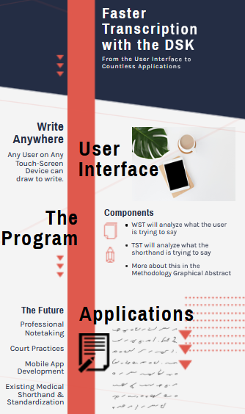
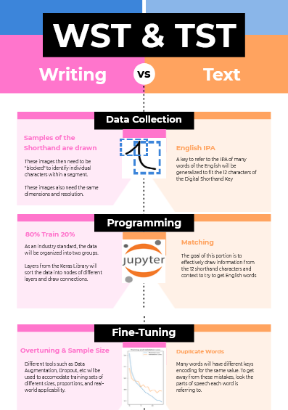
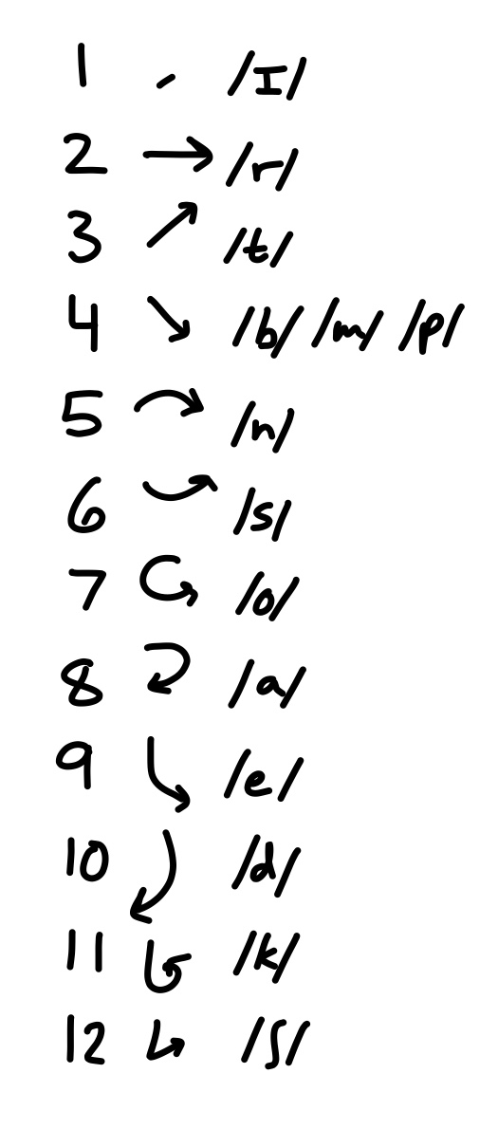
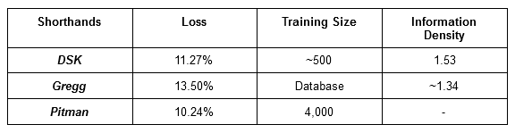
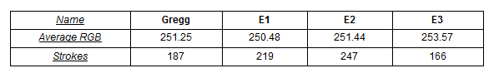
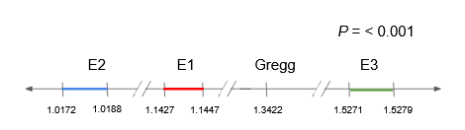




Faster Transcription Using Machine Learning & a New Shorthand
Ronit Avadhuta
Phrase 1
How can we reduce the time it takes digitally transcribe information?
Phrase 2
The final product should be able to reliably transfer written shorthand to digital text.
$$z= \frac{\hat{p}−p_{0}}{\sqrt{\frac{p_{0}(1−p_{0})}{n}}}$$
Introduction | Contribution to Field
Main Results
Analysis | One Proportion Z-Test
Figure 2-3
Write Digitally Faster
A new, custom, and efficient shorthand (loops, curls, and squiggles)
help people save time writing on touchscreen devices
write without the traditional keyboard (easier for the visually impaired)
standardize or facilitate shorthands in the medical industry.
Observed = 154/174 (Calculated via loss)
z-score of ~39.08 standard deviations from the mean
p≤0.00001 (p≤0.05).
The algorithm is effective with loss of ~0.11.
$$\hat{p}=Observed Population$$
$$p_{0}=Null Hypothesized Value$$
$$n=Sample Size$$
$$z=Z Score$$
Figure 1. Total Loss from 0 Steps to 160,000 Steps
This is a graph of the progression of Loss (inaccuracy) on the y-axis over time measured in training steps on the x-axis.
Abstract
Methods
Conclusion
Table 1. Comparison of Models Across Shorthands
This Table compares the Digital Shorthand Key, Gregg, and Pitman in Loss, Training Size, and Information Density. Higher Information Density indicates a more efficient Shorthand and more efficient Algorithm as well.
Info Density: 1.52
Loss = 11.37%
Steps = 160,000
Images = 500
Superior speed score
Information Density
Novel ML algorithm to digitally transcribe information with Novel Shorthand.
Table 2. Comparison of Average RGB and Stroke Count (Speed Score)
Dividing these two qualities for each experimental groups its own speed score, representative of Information Density
Supporting Documentation
QR Code to
Literature Review
Project Proposal
Project Notes
& More!
Figure 2. Ranges of Information Density Between Groups
This number line shows where the Information Density of each group (±3 standard deviations) lies.

