Slide 1

Using Machine Learning and a New Shorthand for Faster Transcription
Ronit Avadhuta

Slide 2

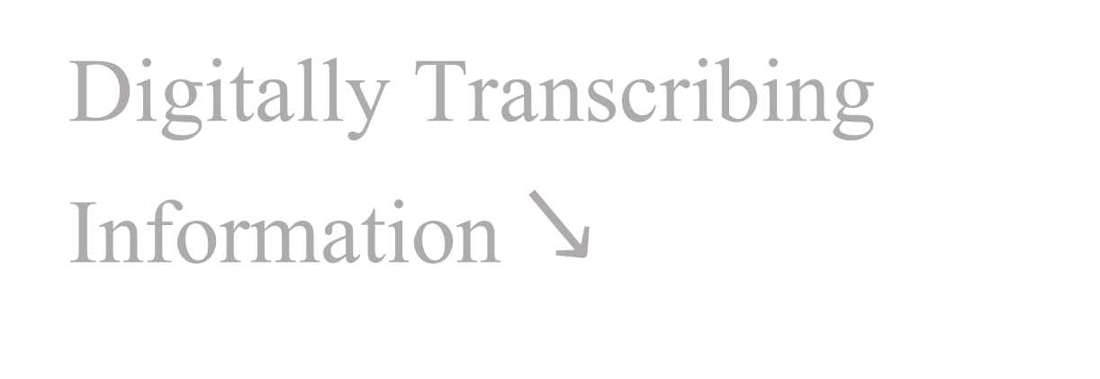
Phrase 1
Digitally Transcribing Information $↘$
Fast-Paced World
Since 1874

Slide 3
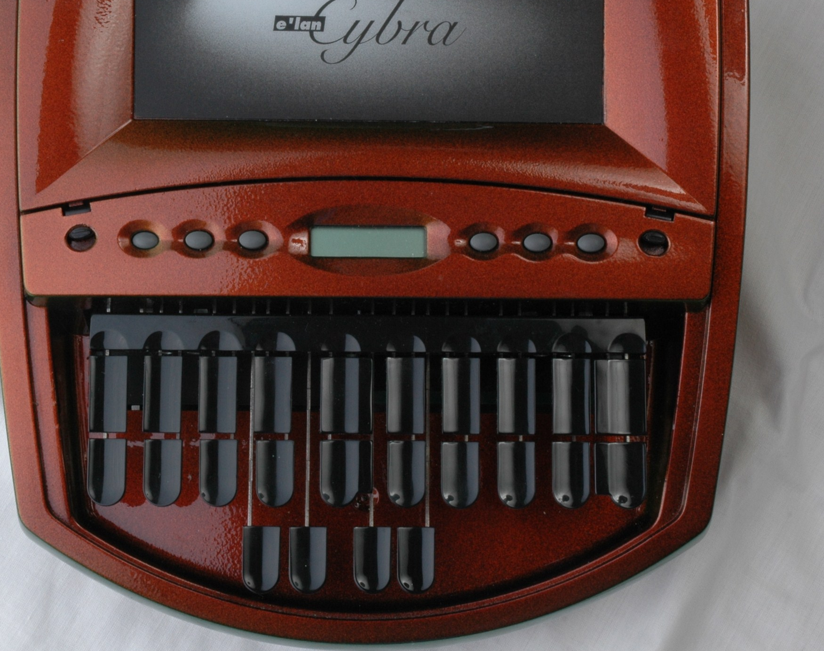
Phrase 2
Faster Method for Data Input
No Equipment
Accessible to all

Slide 4
Calamari - A High-Performance Tensorflow-based Deep Learning Package for Optical Character Recognition Segmentation and recognition of phonetic features in handwritten Pitman shorthand Statistical review of Online/Offline Gregg Shorthand Recognition using CANN and BP - A Comparative analysis
Existing Solutions

Slide 5
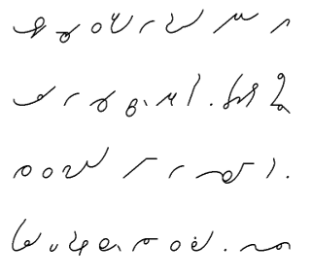
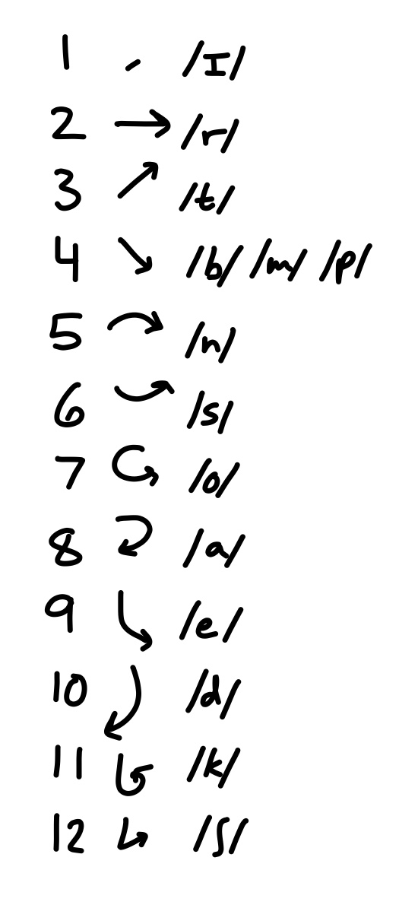
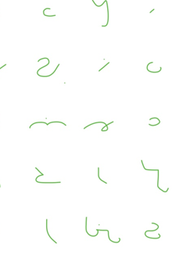
Write Fast. Since the 18th Century
Shorthands
Notes:
INTRO

Slide 6


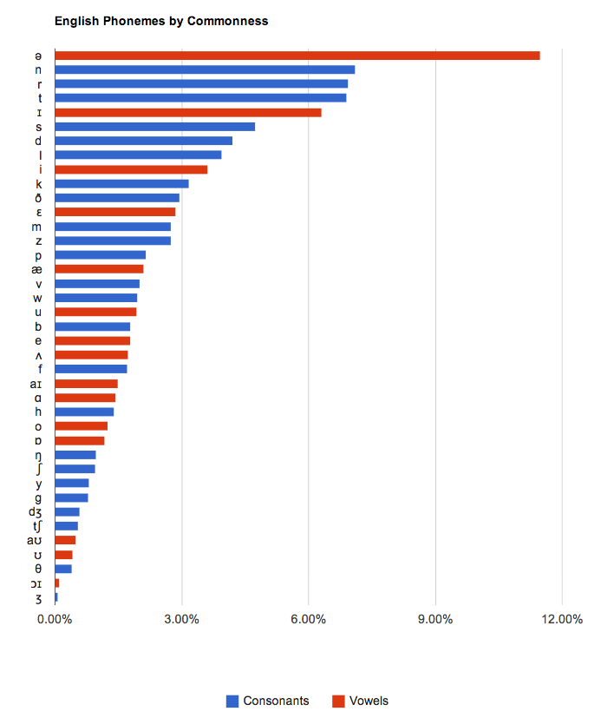
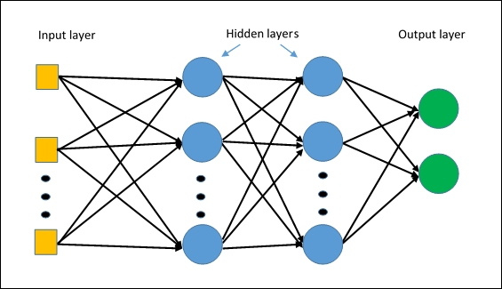
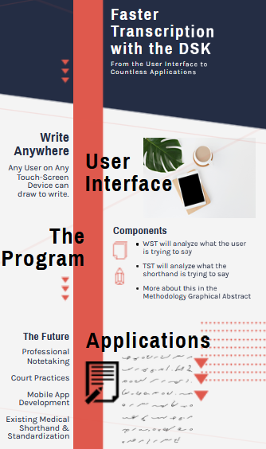
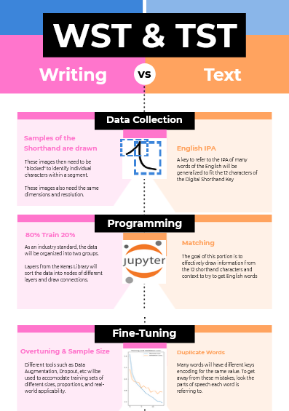

Machine Learning & a New Shorthand for Faster Transcription
Ronit Avadhuta | Advisor: Dr. Crowthers
Phrase 1
How can we reduce the time it takes digitally transcribe information?
Phrase 2
The final product should be able to reliably transfer written shorthand to digital text.
Background
Main Results
Figure 2-3
Zipf’s Law
In addition to measuring several metrics such as Loss, I will take the performance of the algorithm and closely monitor how the data size affects the final outcome.
In order to also try to make improvements to the model, I will also employ two main tests in order to reduce the loss: Dropout and Data Augmentation. The former will take advantage of the fact that Tensorflow operates using tensors that make up layers, Keras layers. By taking one layer out and observing the data and training it accordingly, each layer becomes more accurate. Data Augmentation is likewise used to produce new outputs using existing images because I can only produce so many written samples.
26 Letters → 12 Characters
Our society demands efficiency. This is evident with several recent inventions, such as with 5G and online medical treatment. However, while text messages can take less than 5 seconds, we are still typing on the same QWERTY keyboard since 1874. We are not limited by speed technology works but rather the speed at which we type with our fingers. And as part of the Information Age, I believe it’s time to change that.
General Structure of ML Algorithms
Abstract
Methods
Summary
Not only is this helpful for individuals in occupations that require fast response times such as in the ER or in court, but it can also be used for professional notetaking. An app that employs this software can also be created as well as applying this Shorthand In the medical industry and taking advantage of existing shorthands
The process of digitally transcribing information does not meet our current needs of efficiency in our fast-paced world. How can we find/develop a faster method for data input that does not need specialized equipment such as a steno and is accessible to everyone? This is where this project comes into picture. To better understand this project, some background knowledge on shorthands and machine learning would be beneficial.
References

Slide 7
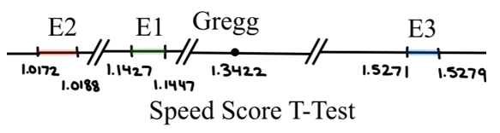
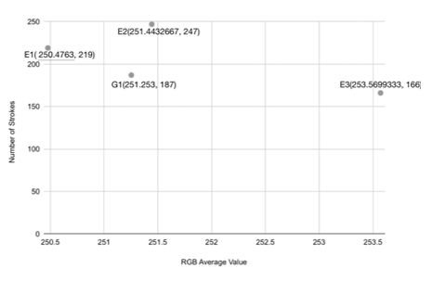
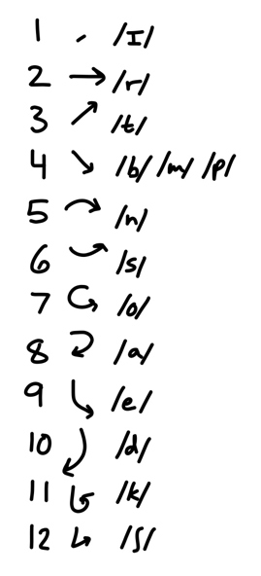
The Digital Shorthand Key

Slide 8
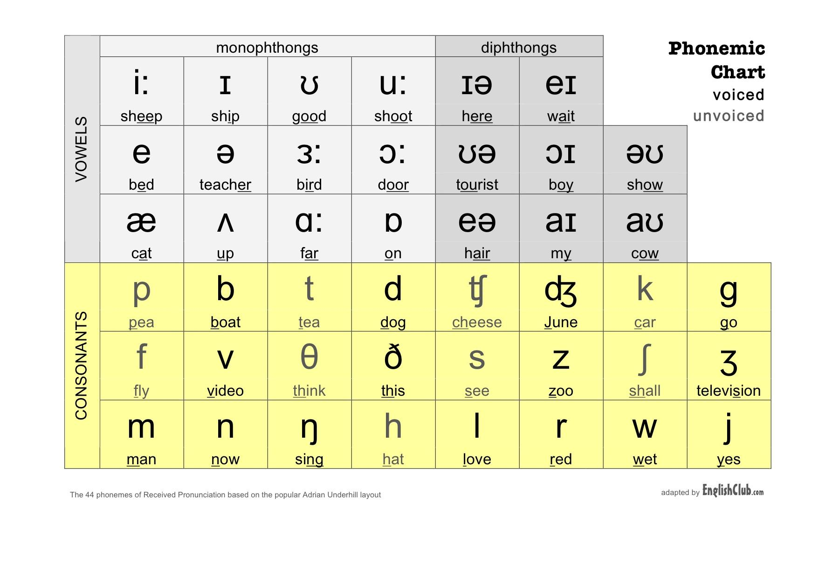
Translation
26 English Letters

Slide 9
Zipf’s Law

Slide 10
Methodology Graphical
Abstract Graphical
D igital
S horthand
K ey
W riting
S horthand
T ext
T ext
S horthand
T ext

Slide 11


Slide 12
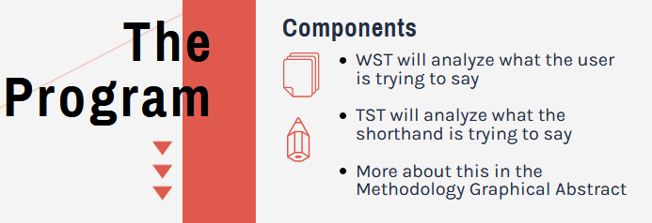

Slide 13
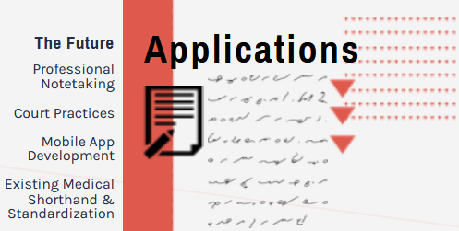

Slide 14
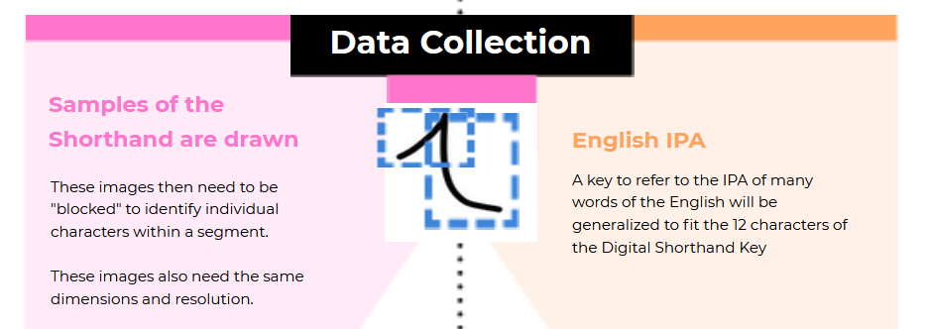
WST TST

Slide 15
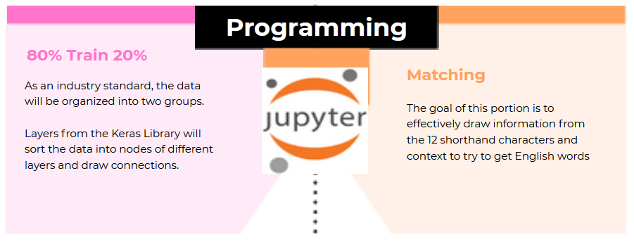
WST TST

Slide 16
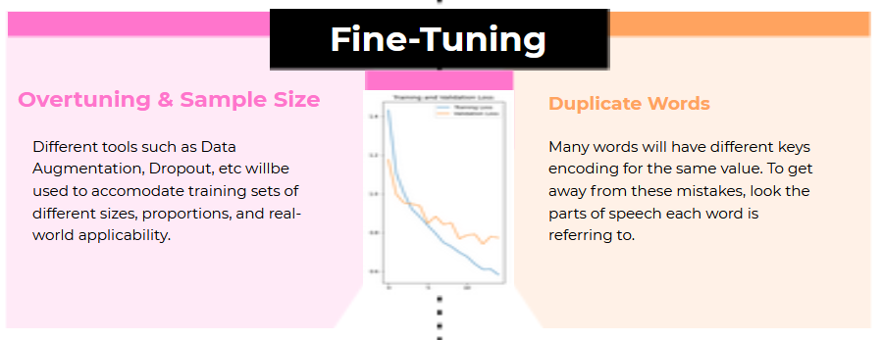
WST TST

Slide 17
Criteria
Category | Importance | My Project
Efficiency | 9 | 10
Adaptability | 10 | 9
Easy to Learn | 9 | 8
Wide User Range | 8 | 9

Slide 18
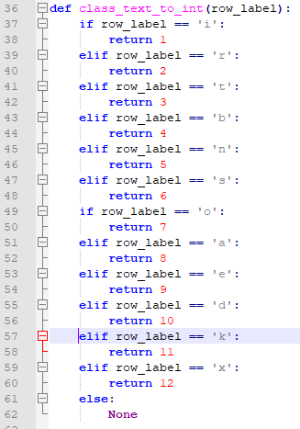
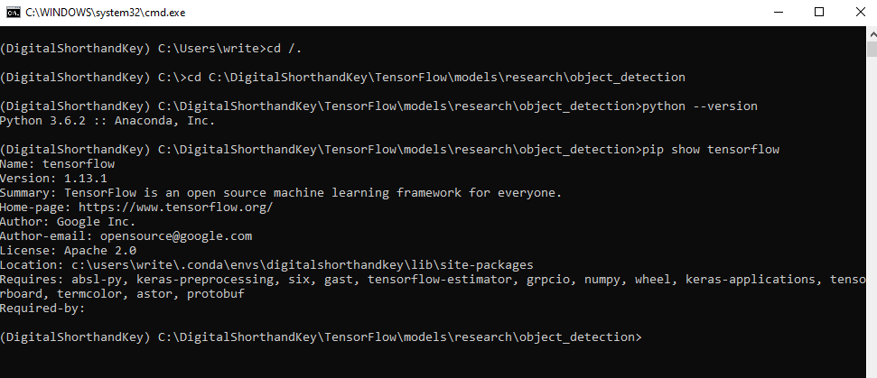
What I’m Working On

Slide 19
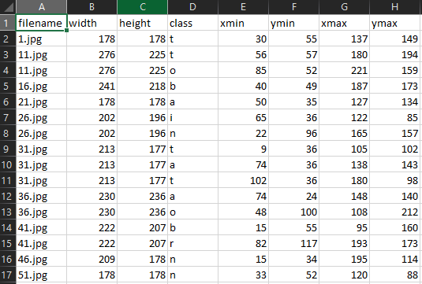
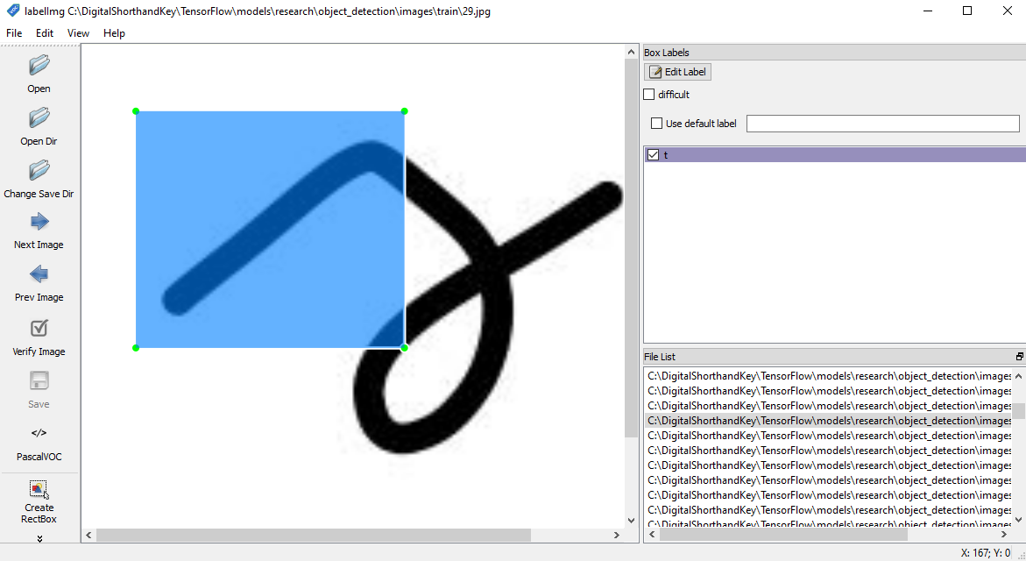
What I’m Working On

Slide 20
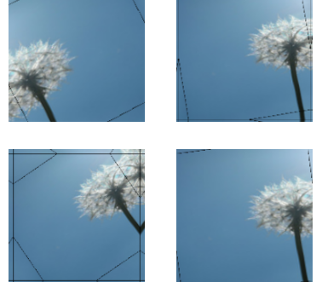
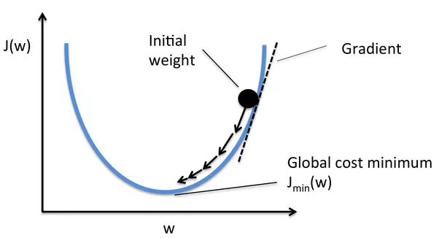
Data Analysis & Future Results
Dropout
Data Augmentation
Loss

Slide 21
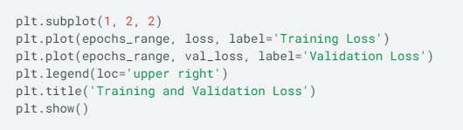

Discussion/Conclusion
Loss < 0.10 || 0.05
Testing with sentences in Context

Slide 22
References
https://weheartit.com/entry/348531353
https://unsplash.com/images/things/typewriter
https://www.121captions.com/tag/stenographer/
Architectures — ML Glossary documentation (ml-cheatsheet.readthedocs.io)
Tensorflow
Check References Slide

Slide 23
Thank You! Questions?
Using Machine Learning and a New Shorthand for Faster Transcription

