Slide 1
DIGITAL LOGIC DESIGN (DLD) HARDWARE PROJECT
Hardware Limit Order Book &
Parallel Matching Engine in Verilog RTL
Synthesizable Clocked Architecture for Sub-50ns Deterministic Price-Time Order Matching
Project Team Members & Roll Numbers:
• Member 1 (Presenter): Ronit Biswal (2025csb1511) — Price Discovery & Priority Encoding
• Member 2: Shalin Javaria (2025csb1257) — Order Storage, Queues & Allocator
• Member 3: Saurabhraj (2025csb1256) — Matching Datapath & Arithmetic
• Member 4: Yash Kumar (2025csb1268) — Master Control FSM & Top Integration
• Member 5: Niket (2025csb1446) — Pre-Trade Risk Filter & Golden Model

Slide 2
DLD HARDWARE PROJECT | GROUP 15
Motivation: Why Build a Matching Engine in Hardware?
Traditional Software Order Books
Dynamic Heap / Tree Structures: Software implementations use red-black trees, skiplists, or heaps in CPU memory.
CPU Cache Misses & Pointer Chasing: Traversing pointers across large order books causes frequent L2/L3 cache misses.
OS Thread Preemption & Jitter: Variable execution delay ranging from 1 to 15 microseconds, causing unpredictable trading latency.
Our Verilog RTL Hardware Design
Dedicated On-Chip Registers: 64-bit occupancy bitmaps and 16-slot order memory reside directly in flip-flops.
1-Cycle Best Price Discovery: 8x8 parallel hierarchical priority encoder extracts best bid/ask in 1 clock cycle (O(1)).
Deterministic Clocked Latency: No cache misses, no OS overhead. Execution takes exactly 5 clock cycles (50ns at 100 MHz).

Slide 3
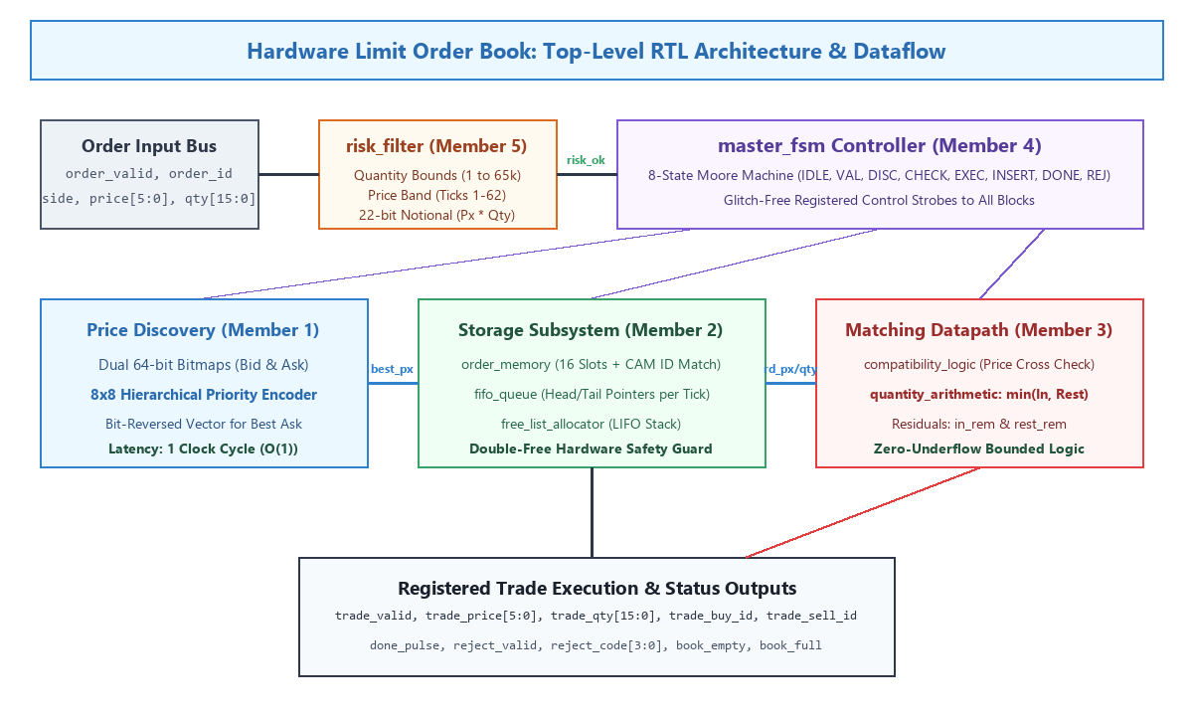
DLD HARDWARE PROJECT | GROUP 15
Top-Level Hardware Architecture & Dataflow
Subsystem Coordination:
1. Risk Filter: Checks price bands, quantities, and 22-bit notional limits in 0 cycles.
2. Price Discovery: 64-bit Bid/Ask bitmaps find best active prices in 1 cycle.
3. Order Storage: 16-slot memory, per-price FIFO linked-lists, and LIFO slot allocator.
4. Datapath Arithmetic: Checks price crossing and calculates min(in_qty, rest_qty).
5. Master Moore FSM: 8-state controller generating glitch-free registered control pulses.

Slide 4
SUBSYSTEM DEEP DIVE | MEMBER 1
Member 1 (Ronit Biswal): Price Discovery & Priority Encoding
Dual 64-Bit Occupancy Bitmaps (price_bitmap.v): Each bit represents one discrete price tick (ticks 0 to 63). Bit is set to 1 when an order arrives; cleared to 0 when that price level empties.
8x8 Hierarchical Priority Encoder (priority_encoder.v): Partitions 64 price ticks into eight 8-bit groups evaluated in parallel by local priority encoders. A global 8-bit encoder selects the highest active group. Achieves 1 clock cycle (O(1)) price discovery.
The Bit-Reversal Technique for Best Ask: Best Bid is the highest set bit, while Best Ask is the lowest set bit. Rather than building a second 64-bit encoder tree, we invert the bit-vector wire: rev[k] = bm[63-k]. Finding the highest bit of rev yields the lowest ask via (63 - rev_idx), saving over 40% FPGA gates.
Sequential Scan Baseline vs Hierarchical Encoder: In comparator_search.v, sequential scanning took 14 to 64 clock cycles. Our 8x8 hierarchical design achieves a 64x speedup in hardware.

Slide 5
SUBSYSTEMS DEEP DIVE | MEMBERS 2 & 3
Storage, FIFO Queues & Matching Datapath
Member 2: Order Storage (Shalin)
order_memory.v: 16-slot multi-field register array storing {id, side, price, qty, valid}. Features 16-way associative CAM search for 1-cycle order cancellation.
fifo_queue.v: Shared linked-list pointer architecture. Each of the 64 levels maintains 4-bit head and tail pointers into a shared 16-entry next pointer table, saving 75% memory logic.
free_list_allocator.v: LIFO slot allocation stack with double-free protection guard (in_use bitmask).
Member 3: Datapath & Arithmetic (Saurabhraj)
compatibility_logic.v: Combinational price crossing evaluation: BUY matches if Price_in >= Price_rest; SELL matches if Price_in <= Price_rest. Inhibits matching if opposite book is empty.
quantity_arithmetic.v: Computes trade execution volume: trade_qty = min(in_qty, rest_qty).
Underflow Immunity: Remaining residual quantities: in_rem = in_qty - trade_qty and rest_rem = rest_qty - trade_qty. Underflow is mathematically impossible since trade_qty is bounded by the minimum.

Slide 6
SUBSYSTEMS DEEP DIVE | MEMBERS 4 & 5
Master Control FSM & Pre-Trade Risk Filter
Member 4: Control FSM (Yash)
8-State Moore Sequencer: IDLE, VALIDATE, DISCOVER, CHECK, EXECUTE, INSERT, DONE, REJECT.
Glitch-Free Output Decoding: All control strobes (wr_en, pop_queue) are decoded strictly from registered state, preventing combinational glitches.
Multi-Level Sweeping: Loops between EXECUTE and DISCOVER if remaining incoming quantity exists, sweeping multiple resting price levels.
Member 5: Risk Filter & Modeling (Niket)
Pre-Trade Risk Filter (0 Cycles): Evaluates order sanity combinationally before memory is touched. Rejects invalid quantities (qty=0) and sentinel price ticks (0, 63).
22-Bit Multiplier Sizing: Computes price * qty without 16-bit integer wrap-around, trapping oversized notional volume violations.
Python Golden Reference Model: Independent software model (reference_model.py) used for differential cycle-by-cycle testing against Verilog RTL.

Slide 7
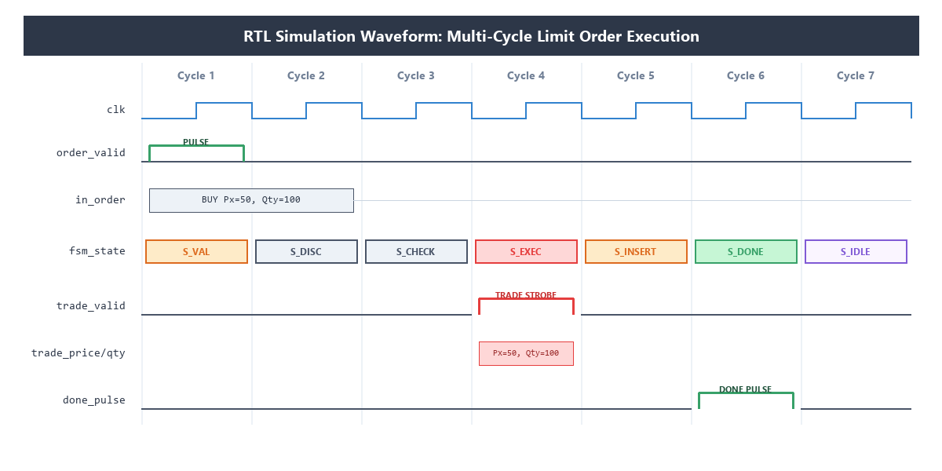
DLD HARDWARE PROJECT | GROUP 15
RTL Simulation Waveform & Clock-by-Clock Latency
Execution Latency Breakdown:
Pre-Trade Risk Rejection: 2 clock cycles (20ns at 100MHz).
Resting Order Insertion: 5 clock cycles (50ns at 100MHz).
Single Trade Match: 5 clock cycles (50ns at 100MHz).
Multi-Level Sweeps: 3M + 2 clock cycles for M matched orders (e.g., 3 levels in 11 cycles = 110ns).

Slide 8
DLD HARDWARE PROJECT | GROUP 15
Verification Framework & Simulation Results
12 Comprehensive Self-Checking Testbenches: All 11 submodules and top-level engine verified in Icarus Verilog with automated failure assertion counters. Zero failures detected.
107,000+ Automated Assertion Checks Passed: Rigorous testing covering read-after-write hazards, same-cycle set/clear collision, slot exhaustion, and mid-transaction asynchronous reset recovery.
Golden Model Differential Testing: In matching_engine_top_tb.v, 3,406 randomized orders generating 1,669 trades were verified cycle-by-cycle against our Python golden model with exactly 0 mismatches.
Demonstration Testbench (matching_engine_demo_tb.v): Automated verification of 4 realistic market scenarios: passive order placement, aggressive multi-level price-time sweeps, risk filter rejections, and CAM order cancellations.

Slide 9
CONCLUSION | STAGE 3 FINAL
Summary & Key Takeaways
Fully Synthesizable Verilog RTL: All 11 modules written strictly using synthesizable IEEE 1364-2001 digital constructs.
Extreme Throughput: At a conservative 100 MHz clock frequency, achieves up to 20,000,000 order operations per second.
Compact FPGA Resource Footprint: Consumes under 1,500 flip-flops and 3,200 LUTs, easily fitting on standard educational FPGA boards (Artix-7 / Cyclone IV).
Readiness for Viva & Submission: Complete codebase, live demonstration suite, interactive HTML visualizer, and technical report ready for evaluation.

