Slide 1
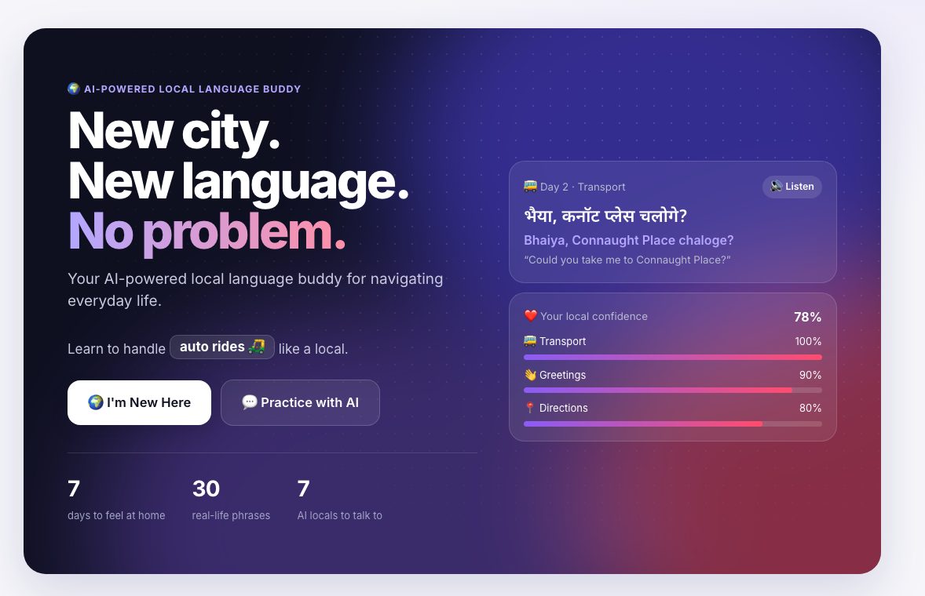
● LingoBuddy
New city.
New language.
No problem.
Your AI-powered local language buddy for navigating everyday life in a new city.
TCS Tech Day Hackathon · Live demo: localhost:8000
Notes:
Open with the one-liner: LingoBuddy helps newcomers survive their first week in a new city — not by teaching a language, but by teaching how to live there.

Slide 2
THE PROBLEM
Newcomers can't talk to their new city
Students and professionals relocating within India land in a place where the everyday language, phrases and etiquette are new.
1
2
3
Everyday tasks become stressful
Textbook language doesn't match the street
No way to rehearse real situations
Hailing an auto, ordering lunch or asking directions turns into guesswork and gestures.
Apps teach “Where is the library?”. Delhi says “Bhaiya, Connaught Place chaloge?”.
You only practise when it matters — with a driver waiting and a meter running.
Notes:
Frame the pain around real moments: transport, food, shopping, directions, college.

Slide 3
OUR INSIGHT
Newcomers don't need a language course. They need survival skills.
TRADITIONAL LANGUAGE APPS
LINGOBUDDY
Teach you a language.
Teaches you to live there.
Generic vocabulary and grammar drills
Progress measured in XP and streaks
Same content for every city
Practice happens in a vacuum
Phrases locals actually use, by situation
Progress measured in Local Confidence
City-specific: Delhi's metro, autos, markets
Rehearse with AI locals before the real thing
Notes:
This is the core positioning line — say it word for word.

Slide 4
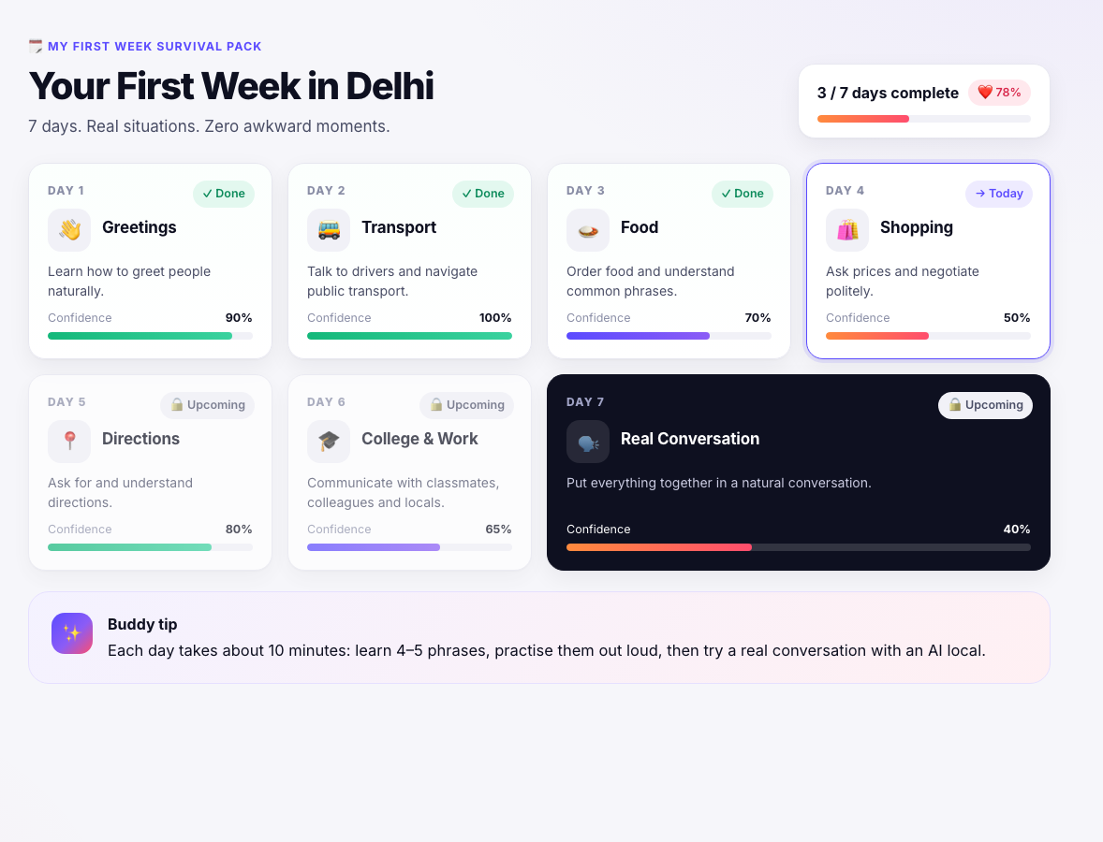
HERO FEATURE 1 · “I'M NEW HERE” MODE
A first-week survival pack for your city
Pick a city and a language. LingoBuddy builds a 7-day plan around the situations you'll actually face.
1
Day 1 Greetings
2
Day 2 Transport
3
Day 3 Food
4
Day 4 Shopping
5
Day 5 Directions
6
Day 6 College & Work
7
Day 7 Real Conversation
Notes:
Demo: I'm New Here → Delhi → Hindi / Hinglish → Build My Survival Pack. Delhi is fully built; the architecture supports 10 languages and more cities.

Slide 5
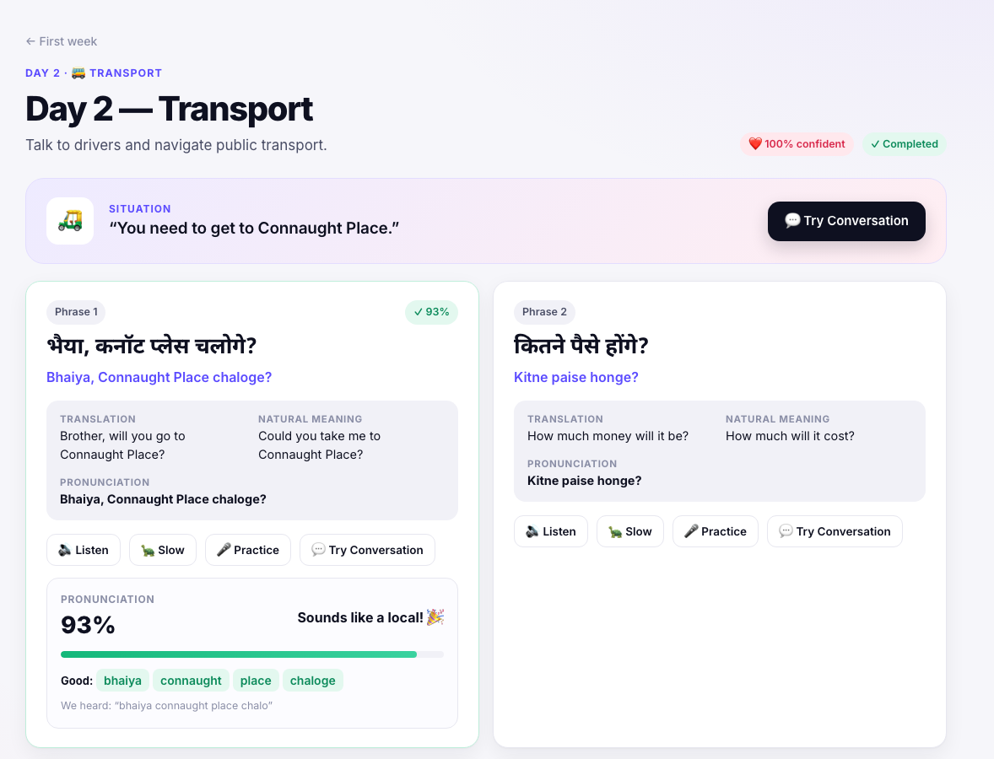
DAILY LESSONS
Real phrases, real situations
Day 2 · Transport: “You need to get to Connaught Place.”
भैया, कनॉट प्लेस चलोगे?
Bhaiya, Connaught Place chaloge?
“Could you take me to Connaught Place?”
Devanagari + pronunciation + natural meaning
Listen at normal or slow speed (browser text-to-speech)
Practice with speech recognition and word-level feedback
Local tips, e.g. why you call drivers “bhaiya”
Notes:
Click Listen, then Practice — the feedback shows which words were good and which need work.

Slide 6
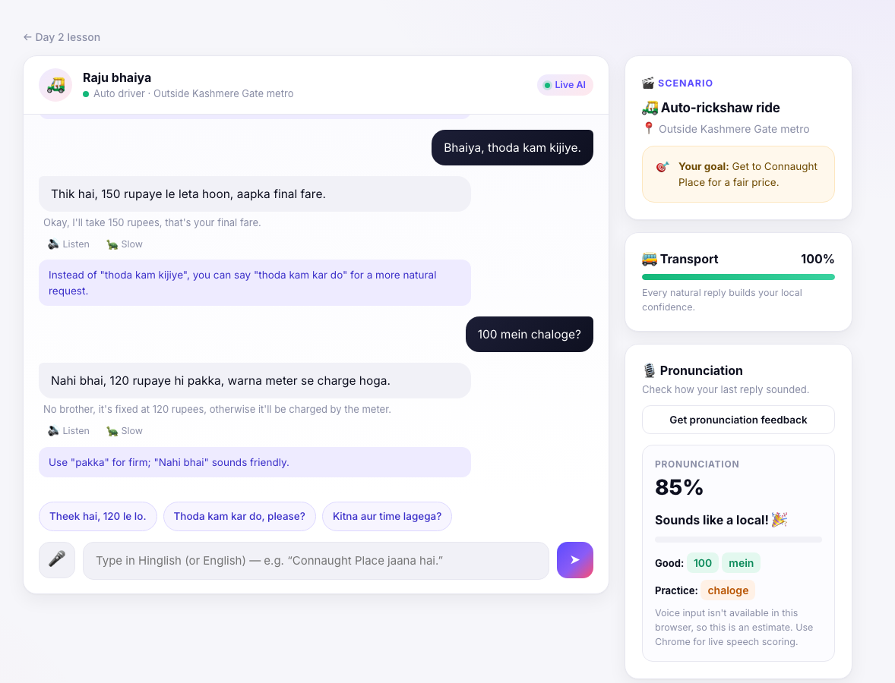
AI ROLEPLAY
Rehearse with AI locals before the real thing
🛺
Raju bhaiya
Auto driver · negotiate a fare
☕
Priya
Classmate · chai small talk
🍛
Sethi ji
Street food stall · order lunch
🛍️
Vicky
Sarojini market · bargain
Live LLM replies stay in character and coach you after every message. Suggested replies keep beginners moving.
Notes:
7 scenarios. Replies come from Groq (gpt-oss-120b); if the API is unavailable a scripted engine takes over seamlessly, so the demo never breaks.

Slide 7
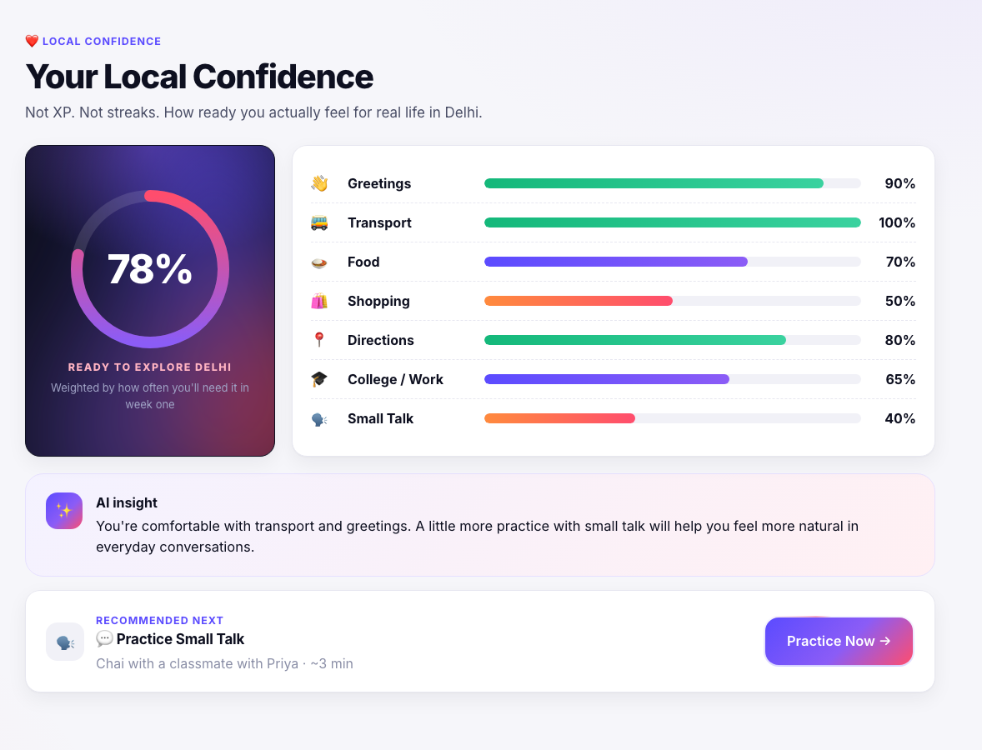
HERO FEATURE 2 · LOCAL CONFIDENCE
We measure readiness, not XP
78%
READY TO EXPLORE DELHI
Confidence per real-life situation: greetings, transport, food, shopping, directions, college, small talk
Weighted by how often you'll need each one in week one
Rises as you practise phrases and finish conversations
AI insight + “Recommended next” turn weak spots into action
Notes:
Demo: open Confidence → read the AI insight → Practice Now → small talk with Priya. Watch the Small Talk bar move.

Slide 8
A COMPLETE LEARNING LOOP
Everything a newcomer needs, in one place
💬
AI Tutor
🃏
Flashcards
📖
Reading
Describe a situation, get the exact words. Remembers the conversation.
Spaced repetition (SM-2 style) built from your survival pack.
Beginner Delhi stories with translations and comprehension checks.
🎧
Listening
🎯
CEFR placement
🏆
Progress
Hear a phrase, pick its meaning. Slow mode for beginners.
5-question level check, A1 → C2 structure.
Weekly goal, streak, skills, XP and achievements.
Notes:
Mention: voice input and text-to-speech use browser APIs, with text fallback when unavailable.

Slide 9
HOW IT'S BUILT
Simple, fast, and it never breaks in a demo
1
Frontend
2
Backend
3
AI
Single-page app · HTML/CSS/JS, no build step
React Bits components ported to vanilla JS
Web Speech API: TTS + speech recognition
FastAPI (Python)
SQLite persistence for learner state
/api/ai proxy + /api/state
Groq · openai/gpt-oss-120b
Also supports Claude, OpenAI, Ollama
Offline engine as automatic fallback
Reliability by design: no signup, a pre-loaded demo learner, curated phrases for known situations, and a scripted AI fallback, so judges never see an error.
Notes:
Adding a city or language = adding content to content.js; the engine is language-agnostic.

Slide 10
WHAT'S NEXT
From Delhi to every city a student moves to
Now
Next
Later
Delhi · Hindi / Hinglish
7-day pack, 7 AI roleplays,
Local Confidence
Mumbai, Bengaluru, Hyderabad,
Chennai with Marathi, Kannada,
Telugu and Tamil packs
Server-side pronunciation scoring,
campus partnerships, peer
buddies who are real locals
Traditional language apps teach you a language. LingoBuddy teaches you how to live in a new place.
Thank you · Live demo at localhost:8000
Notes:
Close on the positioning line, then switch to the live demo.

