Slide 1

Project -2 Sentiment Analysis Using Drug Data
Group No 4
Arya Pathak
Hiba Kabeer
Shiva Prasad
Kuldeep Jeengar
Monika Choudhary
Abhay Suresh
Laxmi priya

Slide 2
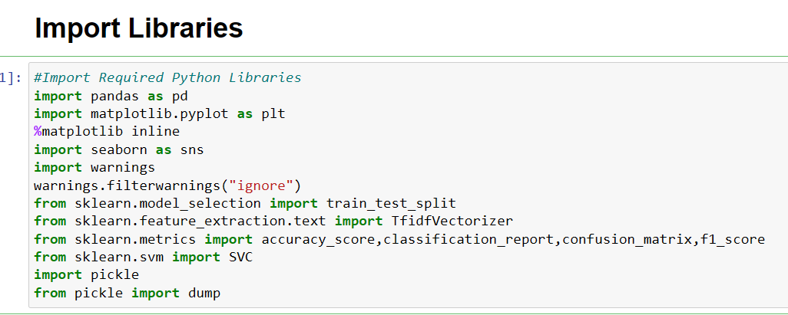
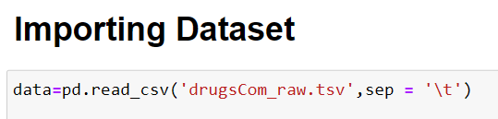
Patients Condition Classification Using Drug Reviews
This is a sample dataset which consists of 161297 drug name, condition reviews and ratings from different patients and our goal is to examine how patients are feeling using the drugs their positive and negative experiences so that we can recommend him a suitable drug. By analyzing the reviews, we can understand the drug effectiveness and its side effects.
The dataset provides patient reviews on specific drugs along with related conditions and a 10 star patient rating reflecting overall patient satisfaction.

Slide 3
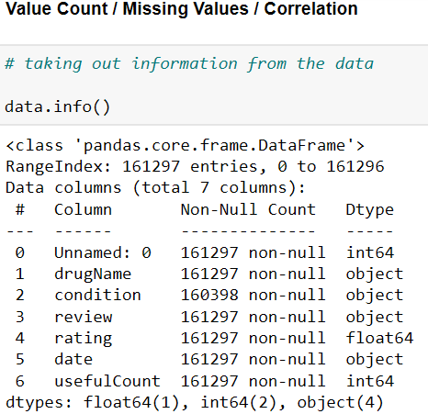
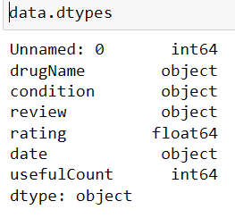
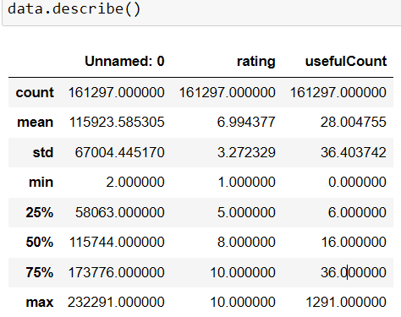
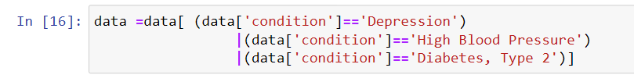
DATA PREPROCESSING
In which we see null values and what is the datatypes of the column and column name and describe the data.
Since, data is huge so only data belongs to conditions like depression, high blood pressure and diabetes are taken as final data.

Slide 4
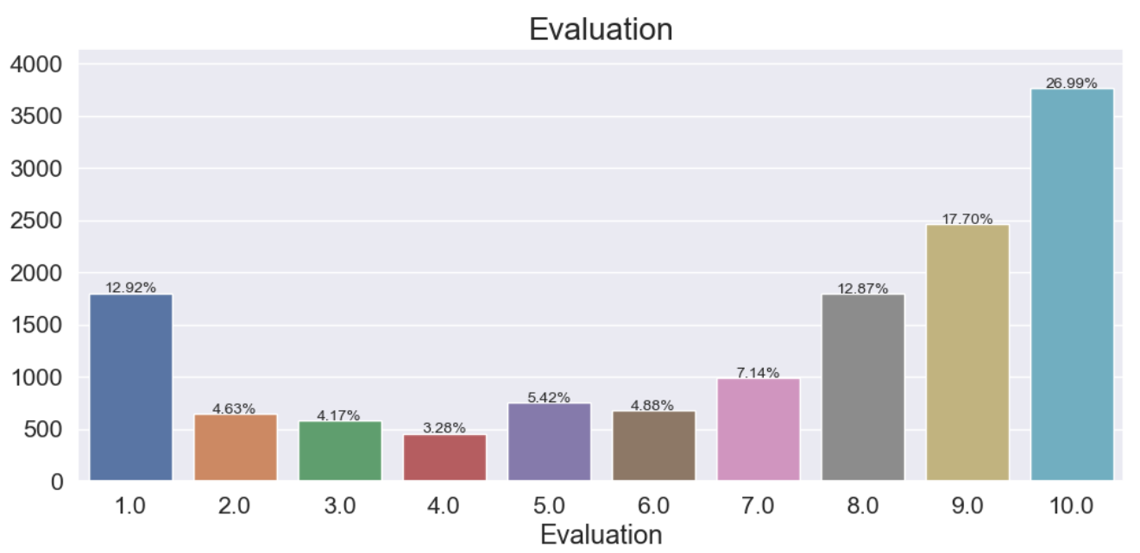
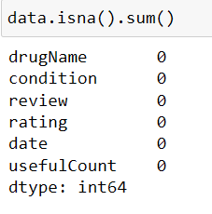
This is the evaluation of the drug rating and the percentage of the drug using count plot.

Slide 5
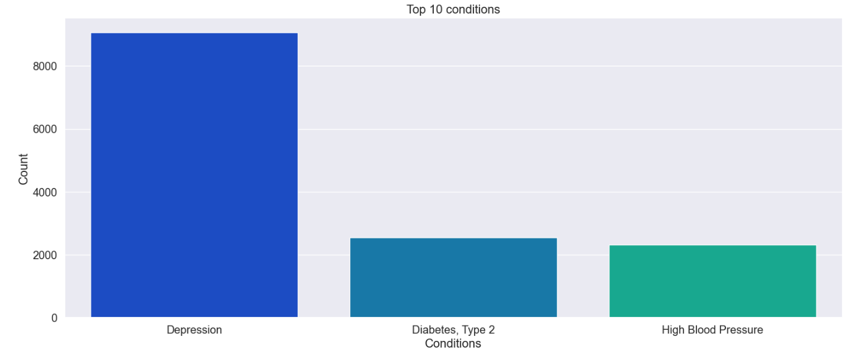
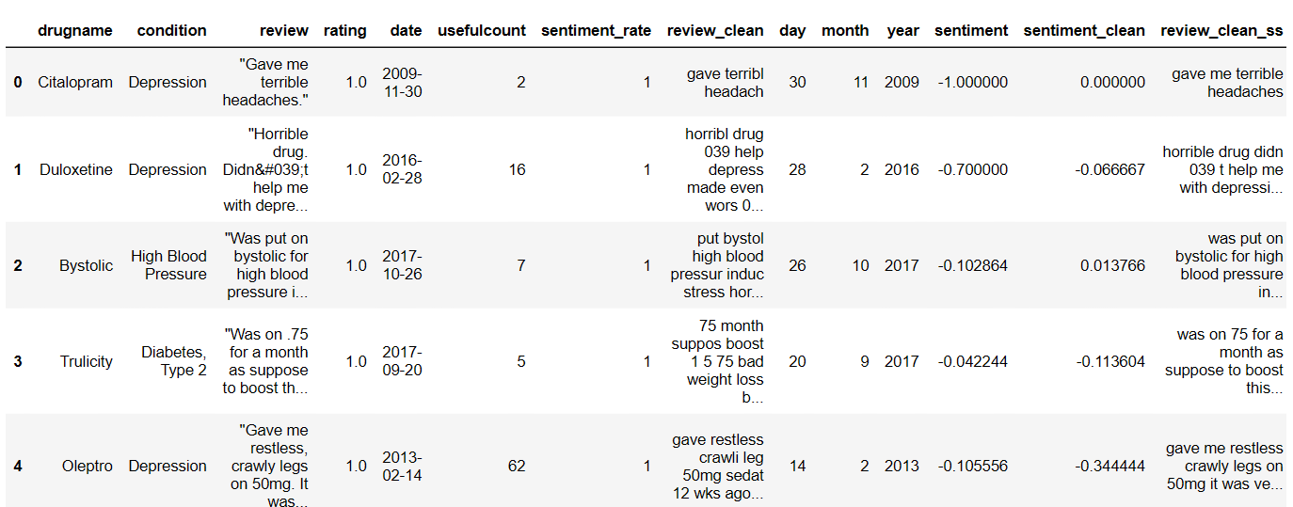
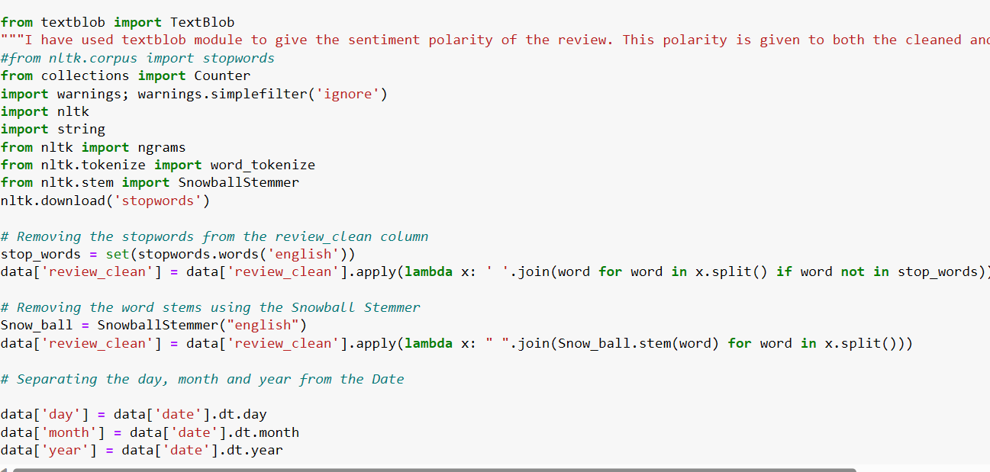

Slide 6
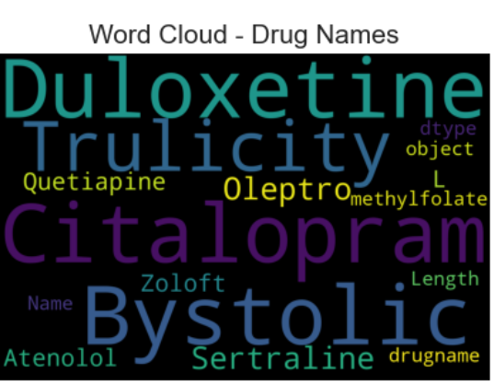
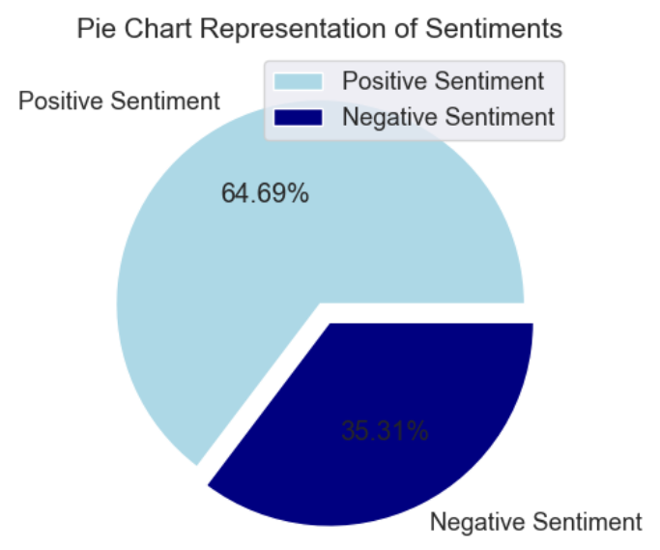
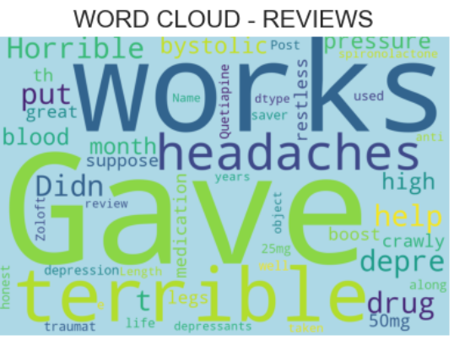

Slide 7
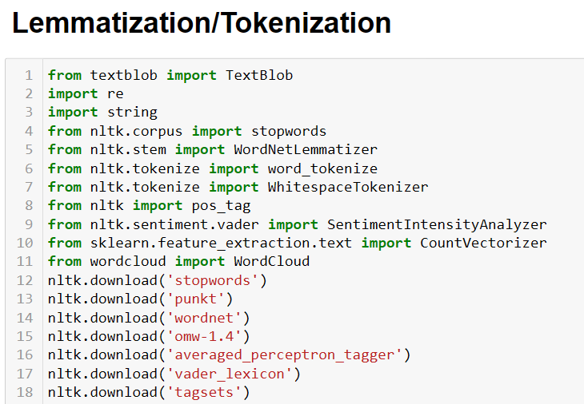
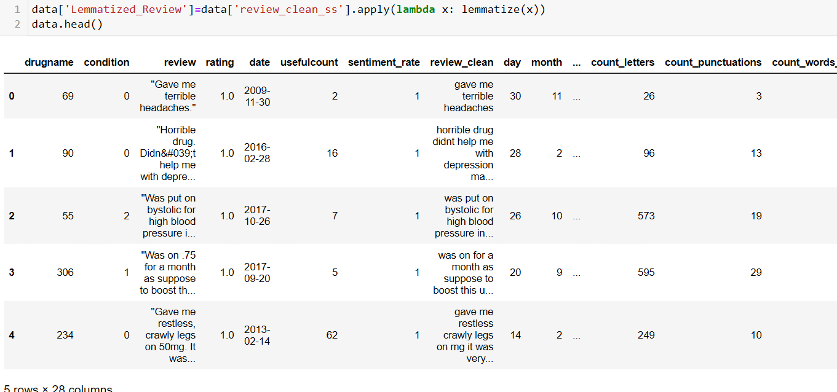
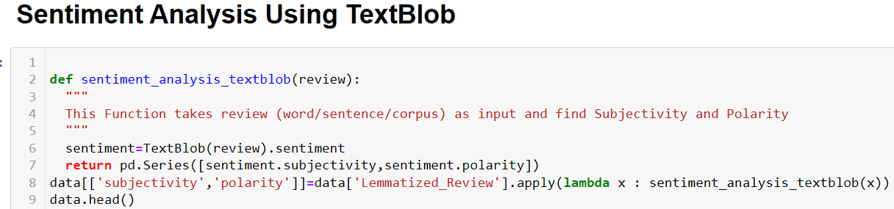
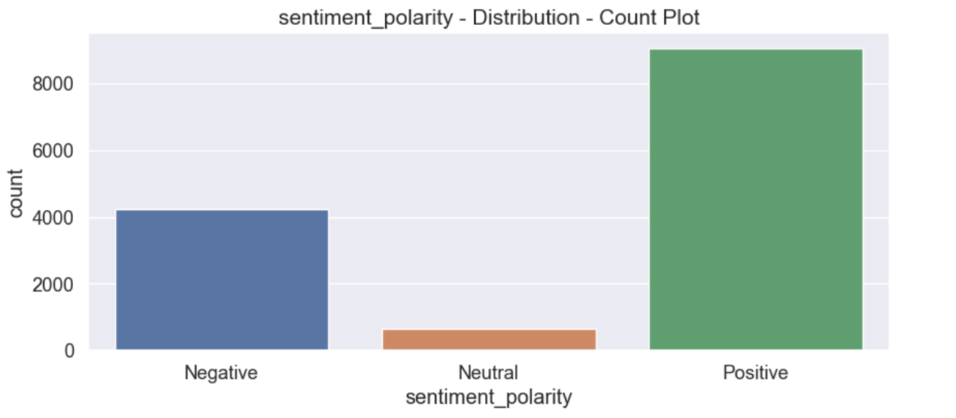

Slide 8
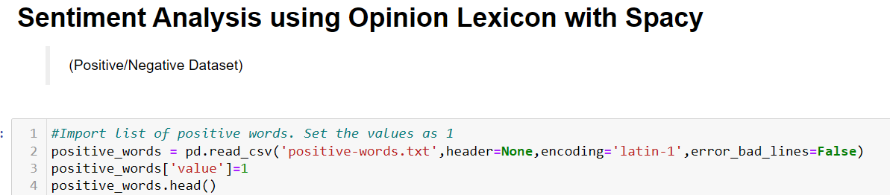
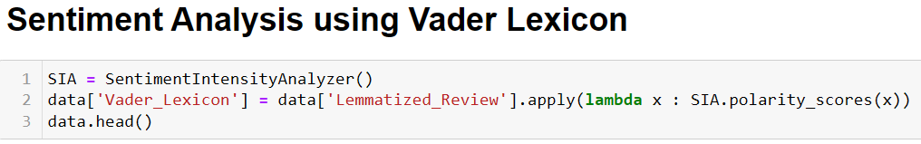
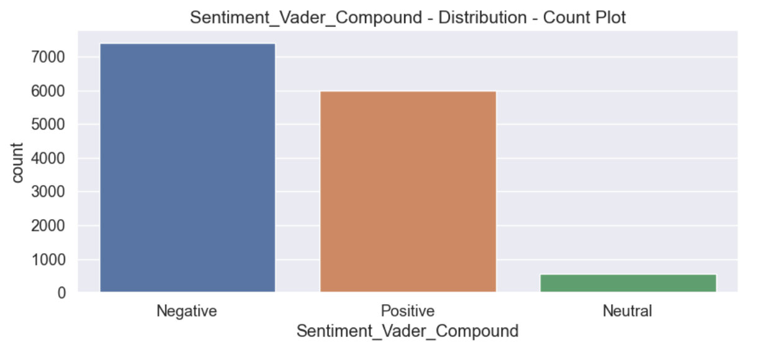
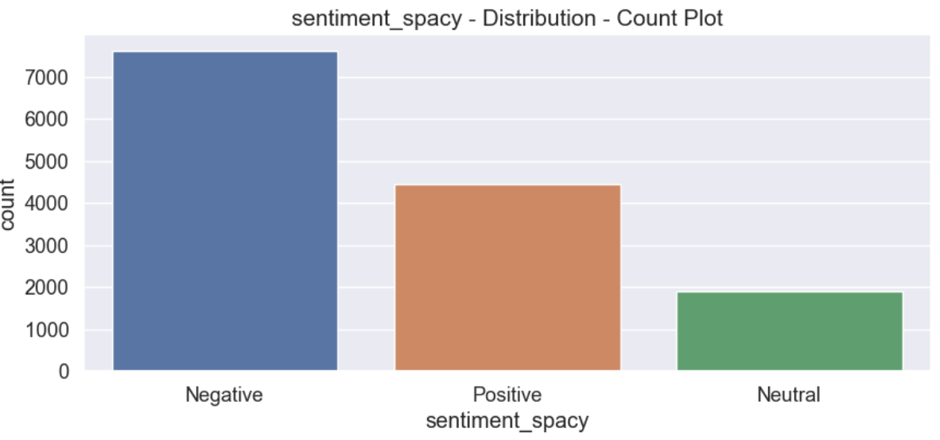
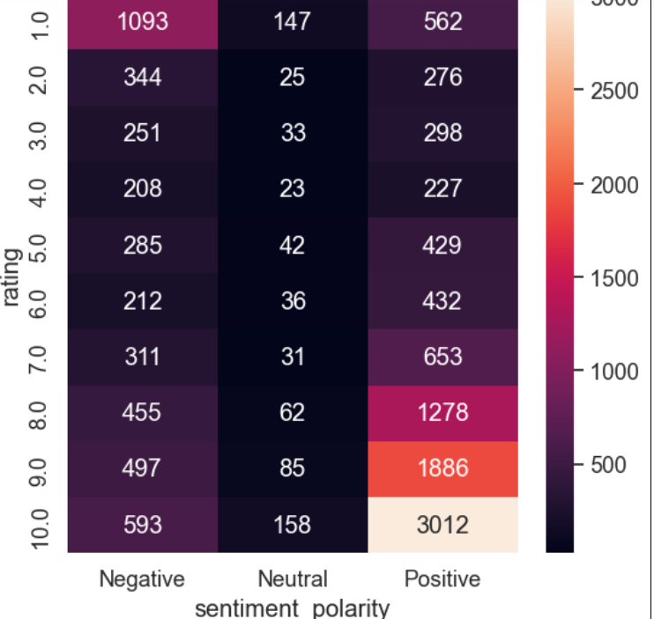
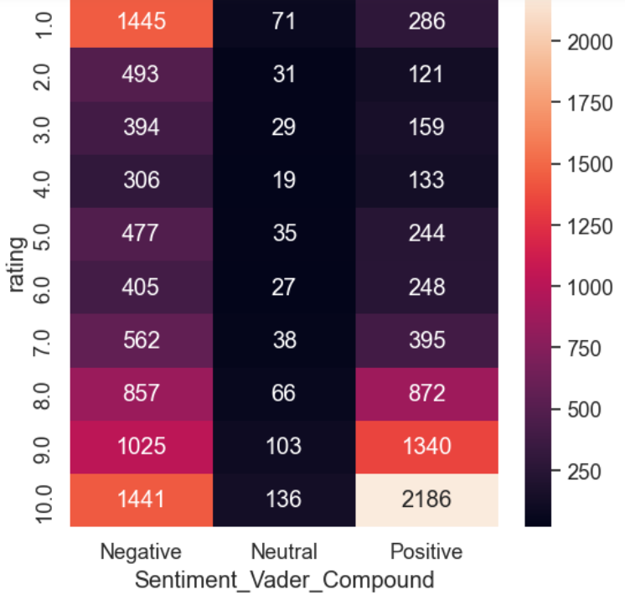
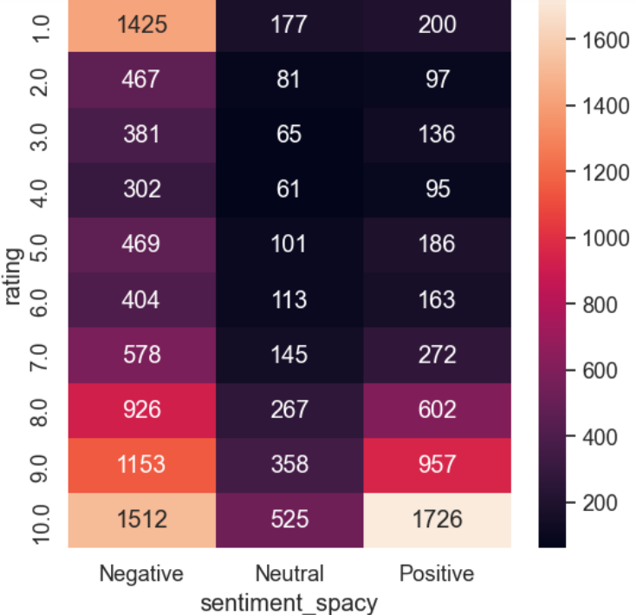

Slide 9
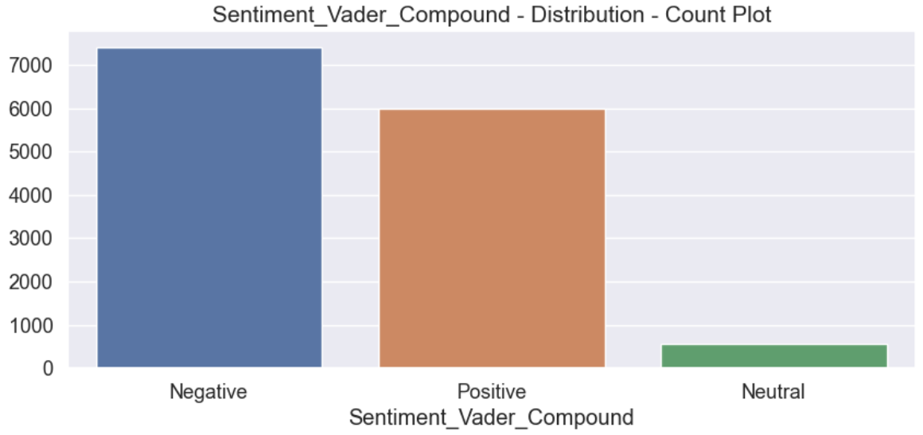
VADER (Valence Aware Dictionary and Sentiment Reasoner) is a lexicon and rule-based sentiment analysis tool that is specifically attuned to sentiments expressed in social media. VADER uses a combination of A sentiment lexicon is a list of lexical features (e.g., words) which are generally labeled according to their semantic orientation as either positive or negative. VADER not only tells about the Positivity and Negativity score but also tells us about how positive or negative a sentiment is.

Slide 10
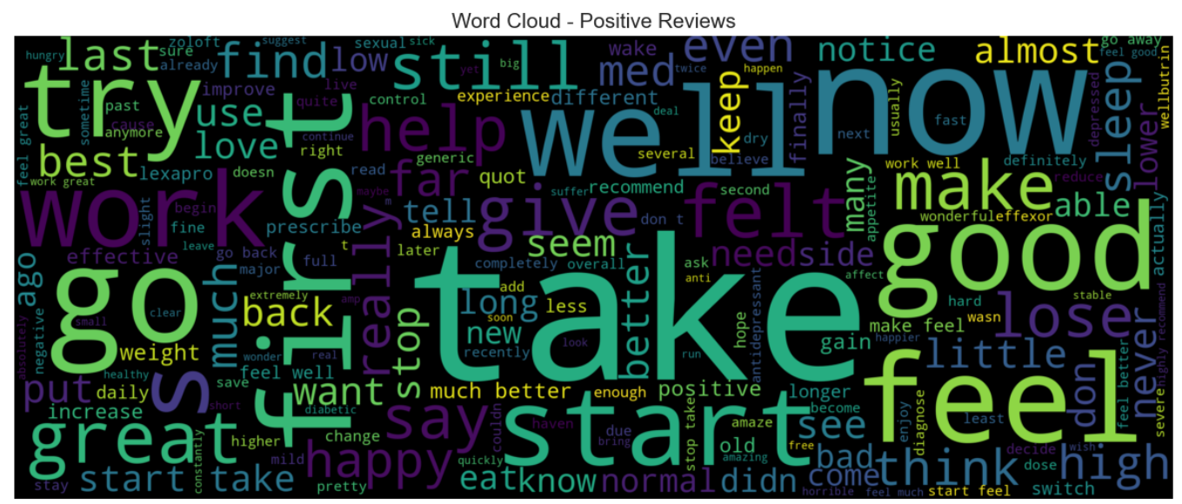
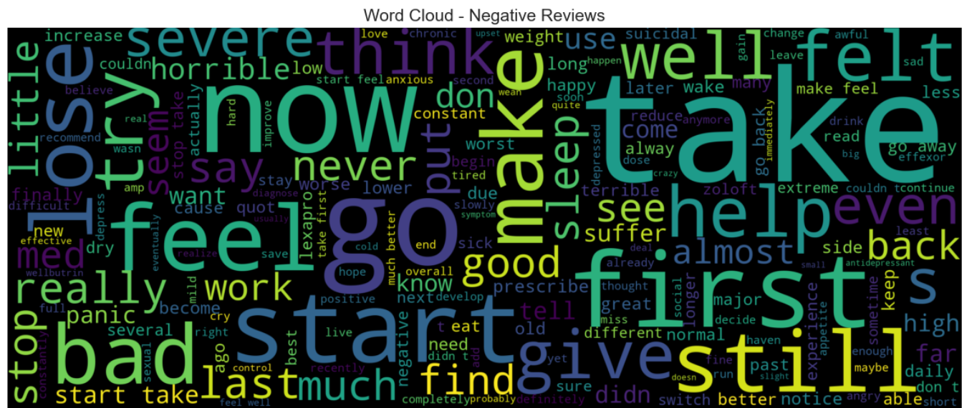

Slide 11
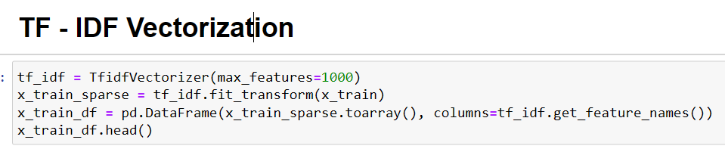
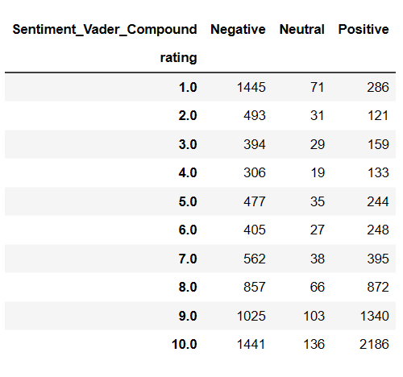
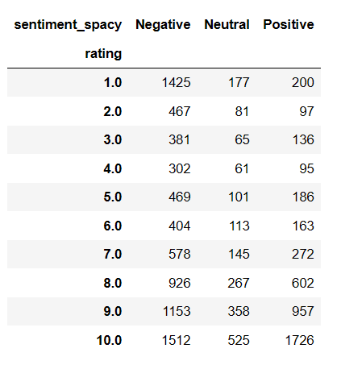
Rating Vs Sentiment using TextBlob Polarity
Rating Vs Sentiment using Vader Lexicon¶

Slide 12
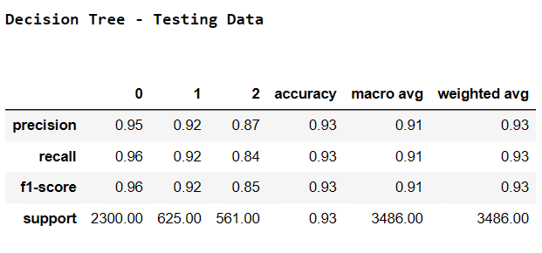
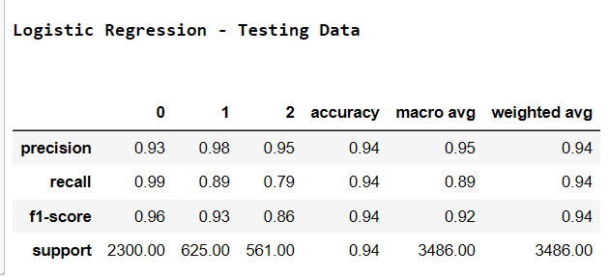
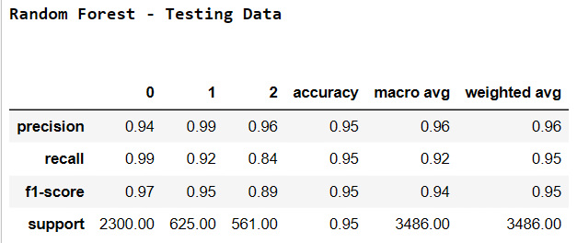
Model Building
We create our model using Various ML Algorithms like Logistic Regression, Decision Tree, Random Forest, XG Boosting, LightGBM and Support Vector Machine in which we get the hightest accuracy and f1 score in SVM so we created our final model SVM and Deploy the model using SVM.

Slide 13
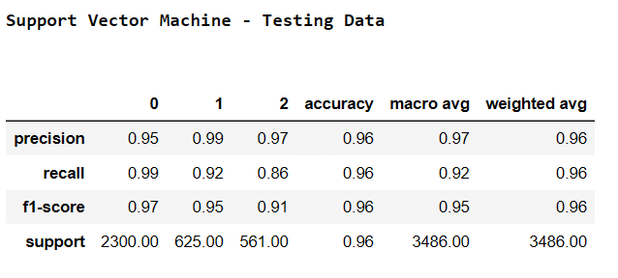
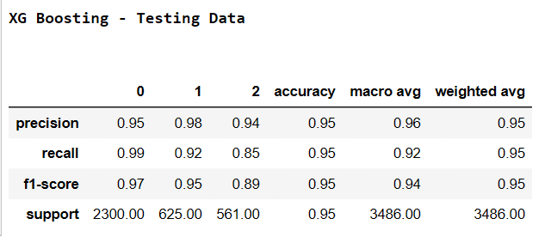
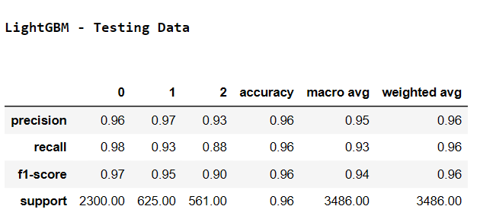

Slide 14
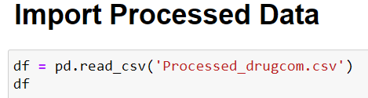
Term frequency-inverse document frequency is a text vectorizer that transforms the text into a usable vector.
The higher is the value, the more relevant the term is in that document.
FINAL DRUGCOM

Slide 15
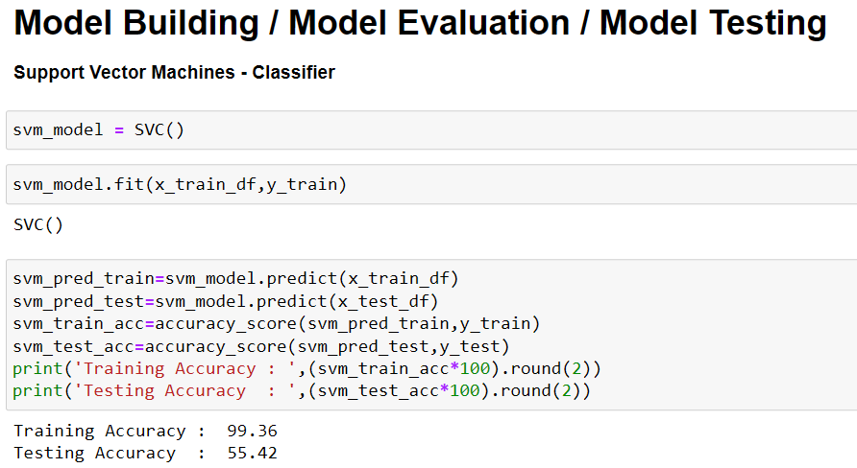
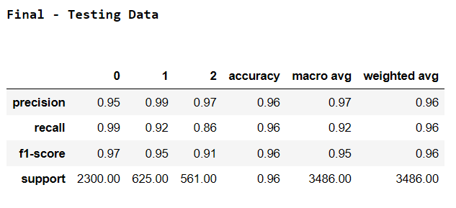

Slide 16
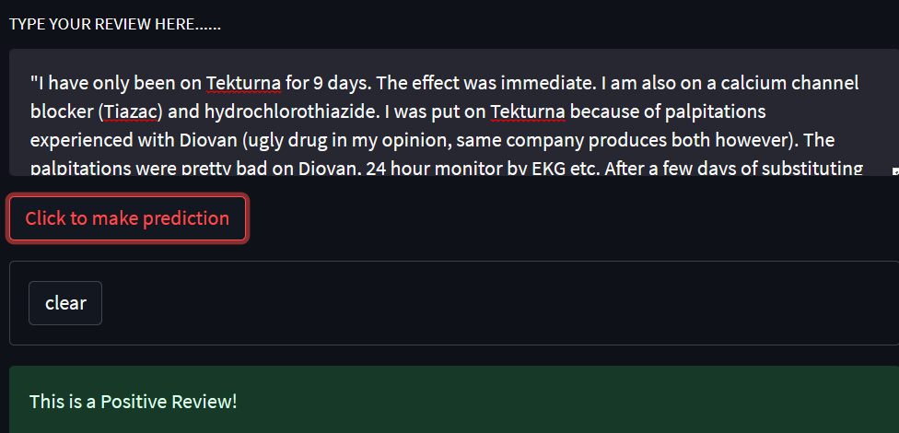
Here we deploy the our model using Streamlit Library and do the sentiment analysis .
We Deploy our model in that way so it can predict the reviews weather It is positive ,negative or neutral.

Slide 17
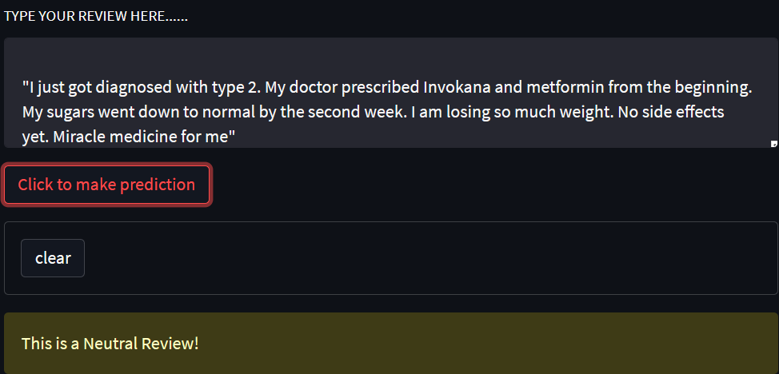
When we change the review then it is predicting the review is neutral review.

Slide 18
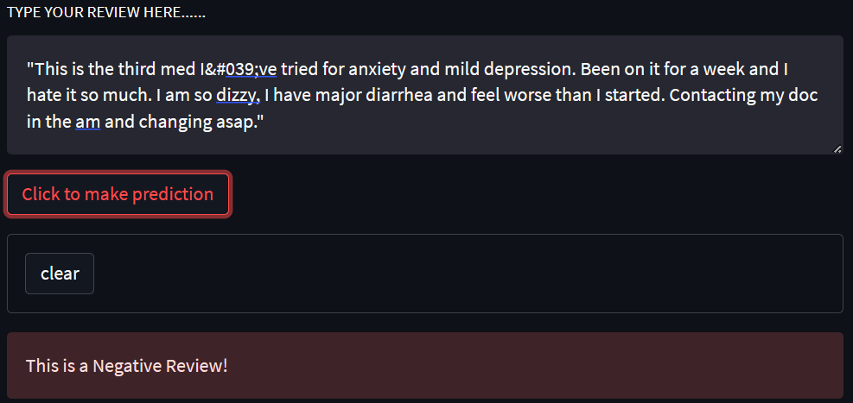
When we change the review then it is predicting the review is Negative review.

