Slide 1
Ronit Prasad, Julian Tapia, and Christian Solomon Concordia University Chicago: Computer Networking & Communic - CSC-3440-1 Dr. Selvanayaki KS April 26th, 2021
SNIPE

Slide 2
Objective
The objective is to develop a project in which multiple people can communicate with each other. Essentially, we want to develop a tool where people would be able to respond to each other and individually message each other. The entire purpose of a group chat platform would be to share information with several people while being organized. Besides sharing information, communication would be another reason why group chat platforms are prevalent in our modern-day society. Having a well-developed group chat platform would benefit people from industrial companies down to the average person.

Slide 3
Scope
The scope of this project is to create a group chat platform that can be efficient, easy to understand and have a feasible User Interface. There are a lot of reasons why a messaging platform would benefit modern-day society, such as how information and communication would be manipulated.
Even though this sounds amazing, and it is, there are still things that our project wouldn’t cover. One of the things that our project wouldn’t cover is the idea of video and voice chatting. Since this is a simple chatting platform, it would require us a lot of changes to add voice and video. We would then have to develop our way into Artificial Intelligence to capture physical movement (video) and a simple connection for voice.

Slide 4
Project Management Plan
Time: Approximately 2-2.5 months to create Snipe.
Cost: Based on all of the requirements, approximately $20,000-25,000.
Maintenance of the Server – [API’s, Cloud Messaging, Socket Protocol, and the Database]
Resources Needed: To be very frank, the only resource that would be used is time. We would need time to create the product, time to plan the product, time to design the product, and eventually we would use our time to market the product. However, money would also be used to market the product since we could create blogs, ads, and find other ways to list our messaging platform (Snipe).

Slide 5
Future Tech to use
Google Cloud messaging (GCM): This essentially allows for applications such as snipe, to send information from servers to users. This can include push notifications, application data, etc.
XMPP (IM Tool): XMPP is an instant messaging tool that allows for near-real-time exchange of data between two or more network entities.

Slide 6
Requirements of the Project
To Develop:
General workstations to properly program.
Windows in order to develop with C++.
Proper testing equipment in order to ensure quality of application.
Servers which are capable of handling multiple groups of users (starting with 1-to-1).
To execute:
A computer or laptop capable of downloading software with Internet.

Slide 7
Hardware Requirements for the Project
In any system where a messaging platform would be used, whether this can be only used online or as an app, you still need the basic qualifications. The basic qualifications would be CPU, GPU, RAM, and an Operating System. We would also need basic cabling and infrastructure to program the platform. However, if this were to ever become on an app (Google or Apple), its Hardware requirements would most likely be the same. We would need to have a cellular device and a software program to be able to shift it to be an app.

Slide 8
Software Requirements
Server: storing data (SQLite), Socket Protocol, API’s, Cloud Messaging, and actually programming the messaging platform itself.
Model: Client-server-client model (this is where the data goes through the server and the information is stored there).
Security: HTTPS and SSL Protocols. This would ensure that messages are sent through an encrypted format. Logically, this way messages are sent encrypted and then transmitted to the program in which it would be sent decoded as the message itself.
IM Tool: Instant Messaging is a simple text-based tool that provides real-time transmission of some sort of text over the internet.
Design: Some sort of UI/UX design.
75% of users trust a platform based on the design of it.
Software:
Visual Studio, Window Terminal, and PowerShell terminal
Language: C++

Slide 9
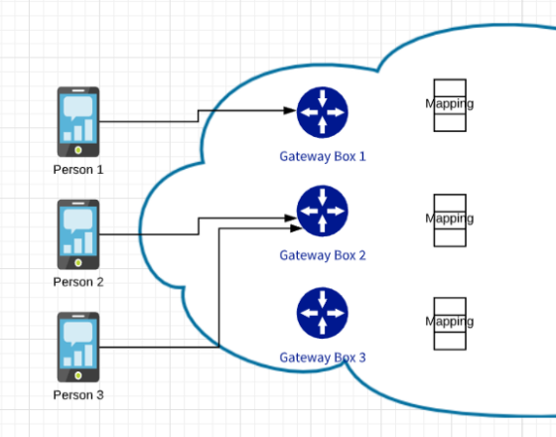
Architecture of the Project
Connecting to Snipe’s Gateway by using an external protocol.
A person sends a Message, the Gateway then Stores and Sends the Message to the Recipient

Slide 10
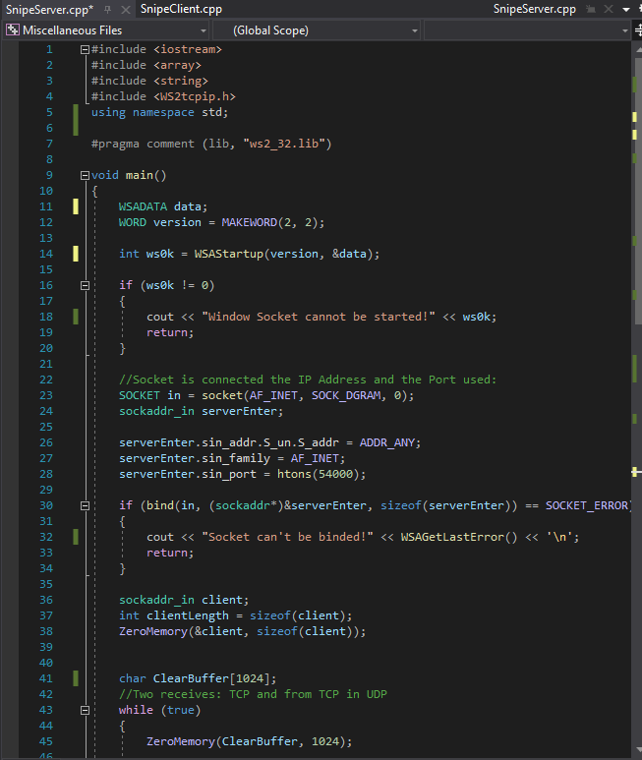
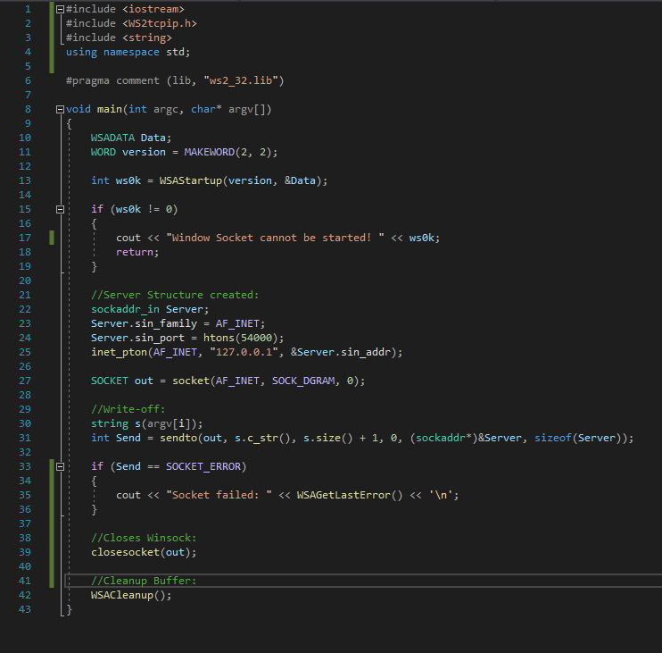
Project Demo
Server
Client

Slide 11
Conclusion
The creation of Snipe gave us a deeper look into the fundamentals of Messaging Systems.
Using a Messaging App everyday shows how important Networking is and the implications it has to our everyday lives.

Slide 12
Expectations – Future Enhancements
Once XMPP is implemented into the software, video chat and voice chat will become possible.
Screen sharing
File Transferring

Slide 13
References
https://www.ibm.com/docs/en/i/7.1?topic=sscaaiic-example-accepting-connections-from-both-ipv6-ipv4-clients
https://docs.microsoft.com/en-us/windows/win32/winsock/complete-client-code
https://docs.microsoft.com/en-us/windows/win32/winsock/using-winsock
https://docs.microsoft.com/en-us/windows/win32/winsock/finished-server-and-client-code
https://blog.usejournal.com/whatsapp-system-design-and-chat-messaging-architecture-part-1-29fb4f0d14af

