Slide 1
CS542:Project Link State Routing Simulator
By,
Rudra, Ronit
Ajmire, Shushupti
Instructor: Prof. Michael Choi

Slide 2
Objective
Generate connection table for each router in a given network.
Compute Shortest path between any two specific routers.
Topology Graph for input file.
Manipulate edges/weights between nodes.
Add new routers in graph.
Remove and recover routers in graph.
Graphical User Interface(GUI)

Slide 3
Problem Description
The network topology is given by matrix, which only gives the cost of link between directly connected routers. It only has the data about directly connected routers.
In this project, we need to implement Link-State Protocol, first your program is required to create the state of the links by each router after the input file been loaded. By reading the file a network graph can be determined. A Dijkstra’s algorithm could be applied to find shortest path between two entities: source and destination nodes. Finally, your program should be able to output the connection table of any router, and output the optimal path between any two selected routers.

Slide 4
Workload Distribution
Rudra, Ronit :
Responsible for the entire back-end design and debugging of front-end and back-end code. Also responsible for generating executable packages for both Linux and Windows operating systems.
Wrote Python Code for performing read operations; graph formation from data; visualization; routing algorithm (Dijkstra's Shortest Path); edge modication; routing table formation; node addition; deletion and recovery.
Generated standalone executable les for Linux using Pyinstaller and for Windows using CX-Freeze.
Debugged back-end code over multiple revisions to ensure compatibility with front-end
GUI in response to testing.
Helped in design of GUI.
Front-end/back-end interfacing by modication of back-end functional code.

Slide 5
Continued…
Ajmire, Shushupti :
Responsible for the front-end design, interfacing and testing outputs of final product with test cases.
Designed the GUI using Tkinter package for python which included le navigation,
visualization, user inputs, outputs through embedded widgets.
Modfied back-end code to accept callbacks from front-end.
Performed testing on iterative versions of program to ensure correct operatibility.
Performed testing of Final Product using network inputs with 10 or more nodes.

Slide 6
Link State Routing Protocol
Link State Routing Protocol used in packet switching networks for computer communications.
The link-state protocol is performed by every switching node in the network that means nodes that are prepared to forward packets in the Internet, these are called routers.
The basic concept of link-state routing is that every node constructs a map of the connectivity to the network, in the form of a graph, showing which nodes are connected to which other nodes.
Each node then independently calculates the next best logical path from it to every possible destination in the network.

Slide 7
Continued…
The collection of best paths will then form the node's routing table.
This protocol is used to find the shortest paths between nodes in graph.
It will find the shortest path from source node to every other node.
It can also be used for finding the shortest paths from a single node to a single destination node by ending the algorithm once the shortest path to the destination node has been determined.
Examples of link-state routing protocols include Open Shortest Path First (OSPF).

Slide 8
Dijkstra’s algorithm
Let the node at which we are starting be called the initial node. Let the distance of node Y be the distance from the initial node to Y. Dijkstra's algorithm will assign some initial distance values and will try to improve them step by step.
Assign to every node a tentative distance value: set it to zero for our initial node and to infinity for all other nodes.
Set the initial node as current. Mark all other nodes unvisited. Create a set of all the unvisited nodes called the unvisited set.
For the current node, consider all of its unvisited neighbors and calculate their tentative distances. Compare the newly calculated tentative distance to the current assigned value and assign the smaller one.

Slide 9
Continued…
When we are done considering all of the neighbors of the current node, mark the current node as visited and remove it from the unvisited set. A visited node will never be checked again.
If the destination node has been marked visited or if the smallest tentative distance among the nodes in the unvisited set is infinity then stop. The algorithm has finished.
Otherwise, select the unvisited node that is marked with the smallest tentative distance, set it as the new "current node", and repeat the procedure again.

Slide 10
Simulator Features
Read in data from a text file
Run a path finding algorithm to establish paths between nodes
Form routing tables for each node
Add, modify or delete connections between nodes
Add new nodes
Remove nodes
Recover deleted nodes
Visualize Graph

Slide 11
Functions written for Back-end design
open_file()
It will open the file dialog box and we can choose any network file to process.
Input: None
Output: Open the file
Read_data (file_name)
It will use pandas to read the given text file.
Input: file_name(File selected from open_file)
Output: Read the file and print adjacency matrix into GUI

Slide 12
Continued…
mat2dict(data,adj mat)
It will convert the matrix into python dictionary, as we are using dictionary for every other function to process the data.
Input: data(table of data), adj_mat(array of the given data)
Output: Create a dictionary of data named graph
visualize(graph)
This function is used to display the topology graph in the canvas.
Input: graph
Output: Topology graph printed on canvas

Slide 13
Continued…
Mod_weight(graph)
It will add or modify an edge between two nodes.
Input: graph
Start_node, end_node, weights are taken from GUI
Output: It will add or modify the weight
del_edge(graph)
It will delete an edge between two nodes according.
Input: graph
Start_node, end_node, are taken from GUI
Output: It will delete the edge

Slide 14
Continued…
Add_node(graph)
It will add a new available node to the graph.
Input: graph
Output: Node will be added to graph
remove_node(graph)
It will delete the node from the graph given by user.
Input: graph
Del_node (name of node) taken from GUI
Output: Node will be deleted from the graph

Slide 15
Continued…
Recover_node()
It will recover the graph to the original graph before deleting any node.
Input: None
Output: Original graph before deletion will be produced.
Node_interface(graph)
It will assign an interface number to each outgoing link of each node.
Input: graph
Output: Interface table for each node

Slide 16
Continued…
Process_dijkstra()
It will the run the Dijkstra’s algorithm on entire graph.
Input: None
Output: all distances, parent (parent for each node), path (path from every node), route (routing table)
dijkstra(graph,start)
Dijkstras algorithm core function
Input: graph, start (starting node)
Output: all distances, parent (parent for each node)

Slide 17
Continued…
Shortest_path(src,parent,distances)
In this function all the possible paths will be found from each node to every other possible node.
Input: Src (Source), parent (parent of node) distances (distances of source to every other possible node)
Output: path (path from every node)
routing(Path,src,interface)
It will find the routing table for each node present in the graph
Input: path (path from every node), Src (Source), interface (interface of the node)
Output: route (routing table)

Slide 18
Continued…
Single_path(all path,all distances)
It will give the single shortest path from source node to destination node.
Input: all path (all possible paths), all distances (all given distances given in the graph)
Src (source node), dest (destination node) taken from GUI.
Output: Shortest path with the distance will be displayed.
find_all_paths(graph)
It will give all possible paths from source node to destination node.
Input: graph
Src (source node), dest (destination node) taken from GUI.
Output: All paths with the distance will be displayed.

Slide 19
Continued…
Create_routing_table(routes)
It will display the routing table for all nodes in graph.
Input: routes (routing table)
Output: It will display the routing table

Slide 20
Front-END Design
Tkinter:
It is the standard library for GUI in python programming.
Python when combined with tkinter provides a quick and simple way to create GUI application.
To create GUI you need to import tkinter module
Create the GUI application main window.
Add one or more widgets to you application
Enter the main event loop to take action against each widget used by user.

Slide 21
Continue…
import Tkinter
top = Tkinter.Tk()
# Code to add widgets will go here...
top.mainloop()

Slide 22
Widgets used in program
Frame:
This widget is used as a container widget which is used to organize the other widgets. This is responsible for arraigning the position of other widgets in friendly way.
LabelFrame:
A LabelFrame is a simple container widget. Its primary purpose is to act as a spacer or container for complex window layouts. It means is same as Frame, but it will additionally give border to the frame.

Slide 23
Continued…
Entry:
This widget is used to display text string field for accepting values from user. If we want to display multiple lines of text that can be edited, then we can use this widget.
Spinbox:
The Spinbox widget is a variant of the standard Tkinter Entry widget, which can be used to select from a fixed number of values.

Slide 24
Continued…
Label:
The Label widget is used to provide a caption for other widgets. It can also contain images. The text displayed by this widget can be updated at any time we want. It is also possible to underline part of the text and span the text across multiple lines.

Slide 25
Continued…
Button:
This widget will used to add button in the application. We can attach a function or method to button which will be call automatically when we click the button.
Canvas:
This widget will create rectangular area for drawing pictures or other complex diagrams. This will be used to create the graph in the program. We can also place other widgets on canvas.

Slide 26
GUI layout

Slide 27
GUI Functions
Browse Data File:
It contains a text field to specify full path of the file to be read. User
can type in the entire path or alternatively use the Browse button to bring up a directory window to interactively select a network text file. Press the OK button to process the file.

Slide 28
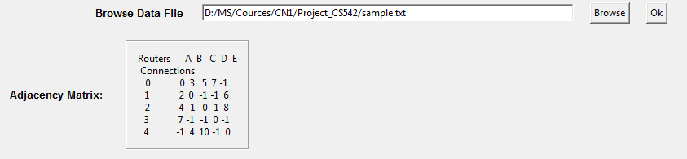
Continued…
Adjacency Matrix:
It displays the network matrix once the le has been processed.

Slide 29
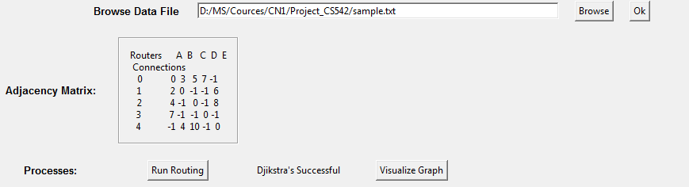
Continued…
Run Routing:
It starts the routing process on the graph. This includes assigning interfaces to each outgoing edge of a node, running the Dijkstra's Shortest Path algorithm and creating a Routing Table for each node.

Slide 30
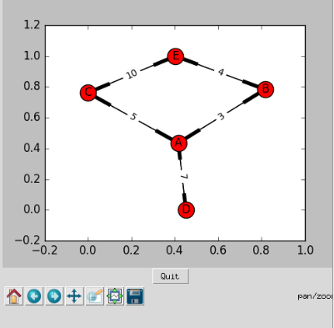
Continued…
Visualize Graph:
It will plot the network in the Plot Widget on the right. One can use the toolbar to change orientation or save the graph.

Slide 31


Continued…
Routing Table:
This will let you choose the node for which you wish to view the routing table. Select the appropriate node from the Up and Down arrows and click on Submit. The Table will be displayed on the right side of the window.

Slide 32

Continued…
Shortest Path:
This lets you choose the source and destination nodes for whom you want the shortest path displayed. Click on Single Shortest Path to display the shortest path and distance or click on All Shortest Paths to display multiple shortest paths and distances (if available). Both the outputs are displayed on the right side of the window.

Slide 33
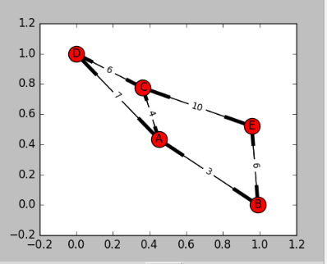
Continued…
Add/Modify Weight:
This lets you modify the weight between the start and end node. If an edge already exists then it is modified otherwise a new edge is added. Click on Submit to apply changes.

Slide 34

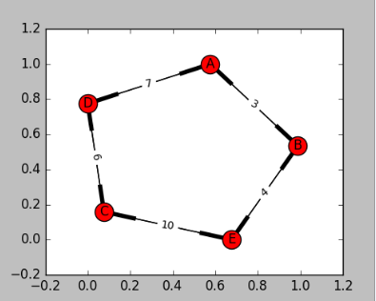
Continued…
Delete Weight:
This lets you delete an edge between the start and end node. Click of Submit to apply changes.

Slide 35

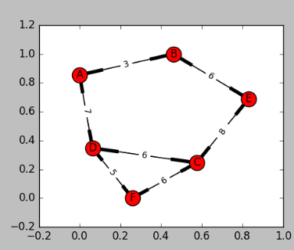
Continued…
Add Node:
This will add a new node to the network. The name of the node is automatically assigned as the next alphabet in sequence. This outputs which node has been added.

Slide 36

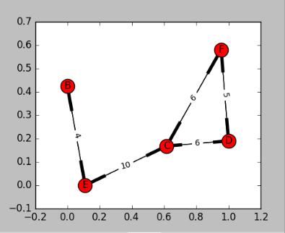
Continued…
Delete Node:
This lets you delete a particular node you selected. Click on Submit to apply changes.

Slide 37

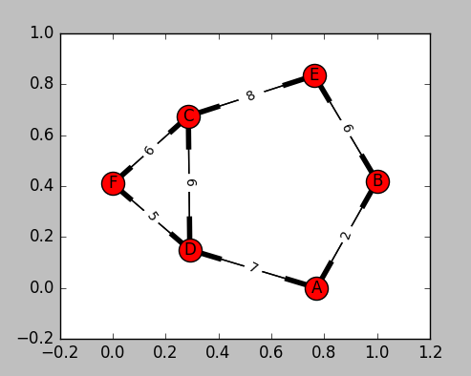
Continued…
Recover Graph:
This will add back all the nodes that had been previously deleted.

Slide 38
Continued…
Quit:
It will close the program. Alternatively, one can use the standard close button on the top right corner.

Slide 39
References
http://www.tutorialspoint.com/python/python_gui_programming.htm
https://en.wikipedia.org
Computer Networking A top-Down Approach by Kurose Ross
CS542 Project 2016F.pdf

Slide 40
Thank You
Any Questions ? ?

