Slide 1


INTERNSHIP PROJECT
Predicting covid test result

Slide 2
INTRODUCTION
Data analysis is a process of inspecting, cleansing, transforming, and modelling data with the goal of discovering useful information, informing conclusions, and supporting decision-making.
Machine Learning algorithms are used to create models. These models are used to make predictions, and form conclusions.

Slide 3
ABOUT THE DATASET
The dataset contains covid tests results for many patients in the form of positive and negative.
Because of the nature of the disease, a large number of tests are required to identify the presence of covid in a person.
Several other tests results are also included in the dataset like Hemoglobin, Platelets, Red blood cells, etc.

Slide 4
PROBLEM
For the given dataset, come up with the following analysis:-
Analyze the given dataset and create a subset of accurate and valid data points.
Create a model using the same data with KNN, SVM and Decision Tree classifier to classify the presence of covid patients.
Create confusion matrix and find the accuracy of each model.
Choose the best model based on the accuracy.

Slide 5
SOLUTION
Data Cleaning
Handling Missing Data
Finding Relation Between Variables
Creating Model using : KNN, SVM, Decision Tree Algorithms
Creating Confusion Matrix
Finding Accuracy

Slide 6
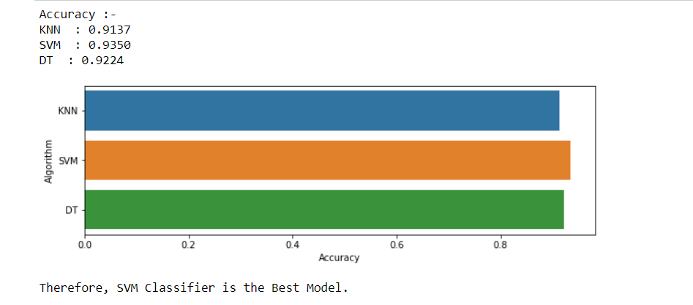
OUTPUT AND CONCLUSION

Slide 7
Thank you - ronit jain

