Slide 1
Electricity Consumption Monitor
Name:- Ronit Kumar
Roll no:- 2312res541

Slide 2
Problem Statement
Households and companies often struggle to track electricity usage over time.
Without visualization, it’s difficult to identify waste or overuse.
Lack of insights leads to higher costs and inefficient energy usage.

Slide 3
Key Question
How can we monitor and visualize electricity usage to identify high-consumption periods?
How can we suggest effective reduction strategies based on usage patterns?

Slide 4
Project Summary
Tracks electricity usage on a daily, weekly, and monthly basis.
Plots consumption trends for better understanding.
Supports cost analysis to forecast electricity bills.
Provides data-driven energy efficiency suggestions.

Slide 5
Methodology
1. Input daily/hourly electricity readings with date and time.
2. Group and summarize the data by day, week, and month.
3. Calculate total and average units consumed.
4. Generate line charts for trends and pie charts for appliance-wise usage.
5. Suggest actionable tips based on peak consumption hours.

Slide 6
Functional Components
Dataset containing timestamp and unit consumption values.
Computation of total and average electricity usage.
Time-series visualization of energy usage patterns.
Electricity cost estimation using unit rate multiplication.
Detection of peak consumption periods for targeted advice.

Slide 7
Sample Dataset
Example Data:
2025-07-01 09:00 AM | 2.3 units
2025-07-01 10:00 AM | 1.8 units
Dataset will be used to compute total usage, average usage, and cost.

Slide 8
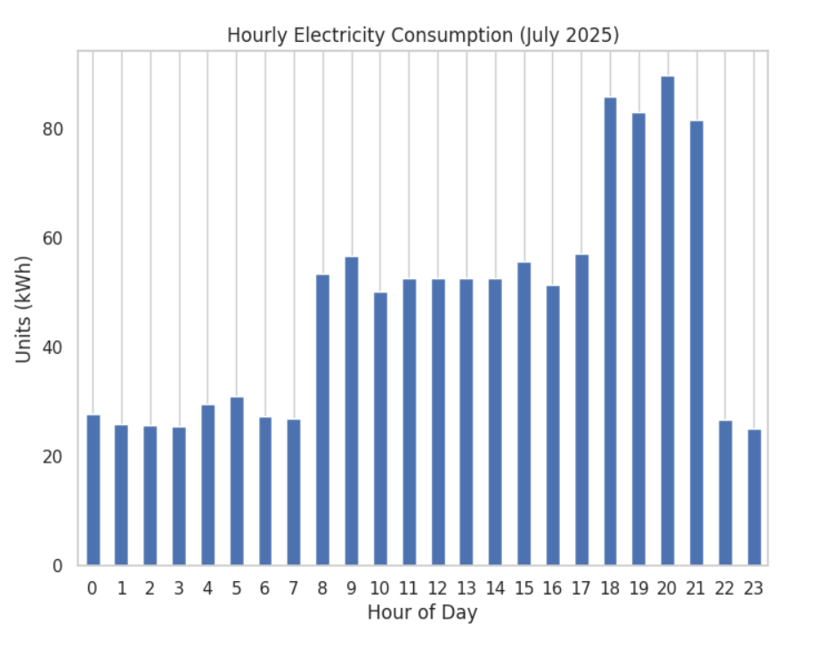
24 hours data for electricity consumption

Slide 9
Expected Output
Total Units Consumed: 520 kWh (July).
Peak Usage Time: 6 PM – 9 PM.
Estimated Electricity Bill: ₹3120.
Visual Reports:
- Line Chart for daily consumption trends.
- Pie Chart for appliance-wise energy distribution.

Slide 10
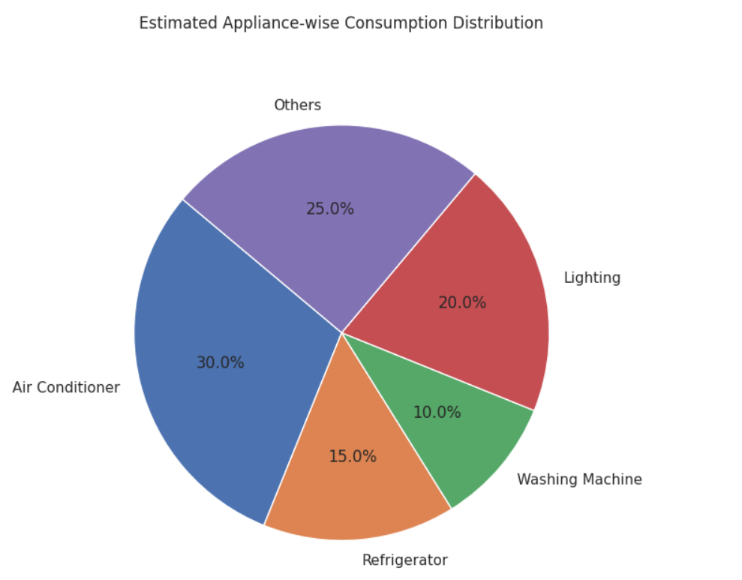
APPLIANCE-WISE CONSUMPTION

Slide 11
Benefits
Provides awareness about electricity consumption habits.
Helps in identifying wastage and reducing unnecessary usage.
Facilitates cost savings through data-driven recommendations.
Encourages sustainable and energy-efficient practices.

Slide 12
Future Enhancements
Integration with IoT devices for real-time electricity monitoring.
Development of a mobile application for instant alerts.
AI-powered predictions for future electricity consumption.
Integration with smart meters for automated data collection.

