Slide 1
Handwritten Digit Recognition using Deep Learning
Project using CNN and MNIST Dataset
By Ronit Kumar

Slide 2
📌 Project Overview
CNN-based model to classify handwritten digits (0–9) using MNIST dataset.
✔ Preprocessing & Normalization
✔ CNN Model Training
✔ Visualization & Evaluation
✔ High Accuracy (~99%)

Slide 3
📂 Dataset & Preprocessing
• Dataset: MNIST (70,000 grayscale images, 28x28 pixels)
- Training: 60,000 images
- Testing: 10,000 images
• Preprocessing Steps:
- Reshaped images to (28,28,1)
- Normalized pixel values (0–255 → 0–1)
- Labels: Digits 0–9

Slide 4
⚙️ Project Workflow
1️⃣ Load MNIST dataset
2️⃣ Preprocess images
3️⃣ Visualize samples
4️⃣ Define CNN architecture
5️⃣ Train the model
6️⃣ Evaluate accuracy
7️⃣ Predict new digits

Slide 5
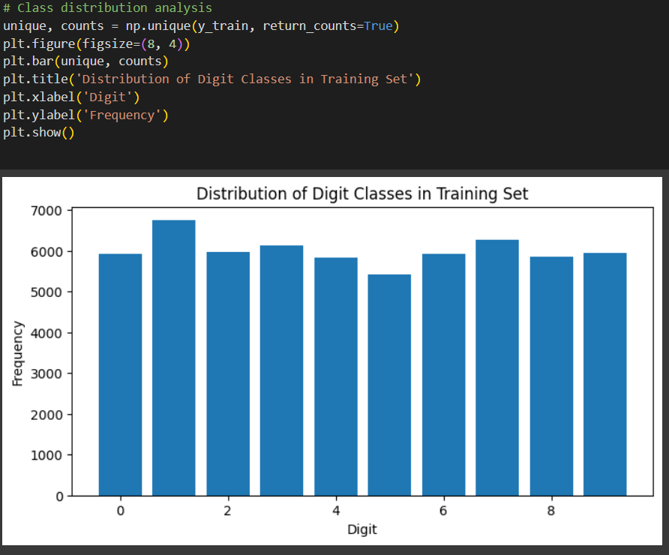
Class Distribution: Balanced dataset across all digits (0–9).

Slide 6
🧠 CNN Model Architecture
• Convolutional Layers
• MaxPooling Layers
• Flatten Layer
• Dense Layers
• Softmax Output Layer (0–9 classification)

Slide 7
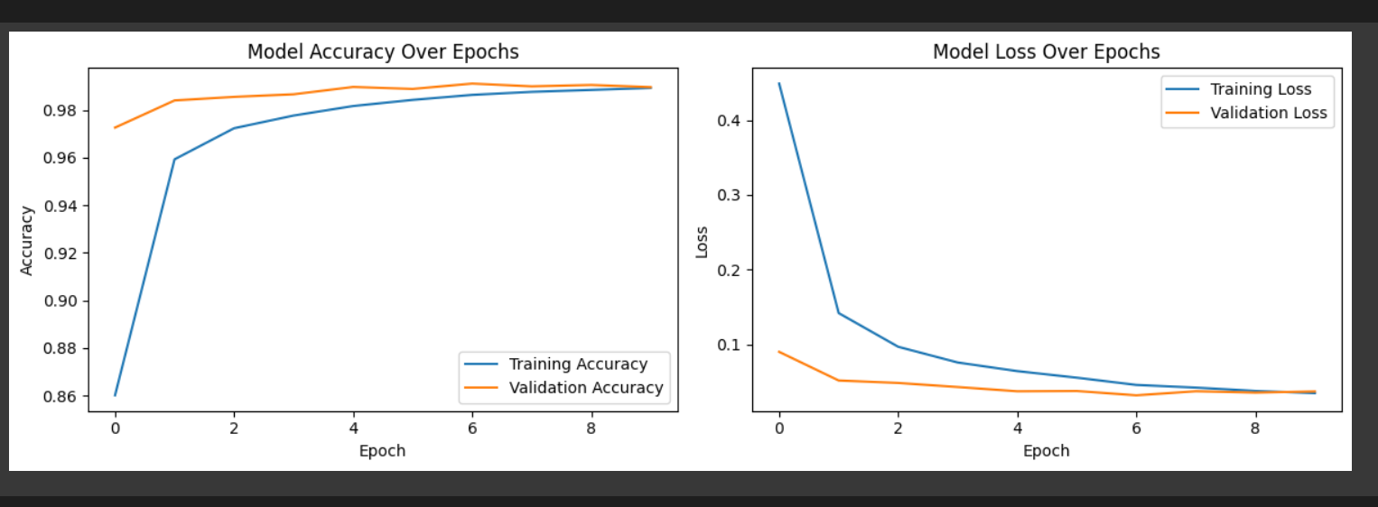
Accuracy/Loss Curves: Accuracy ~99% with low loss, showing no overfitting.

Slide 8
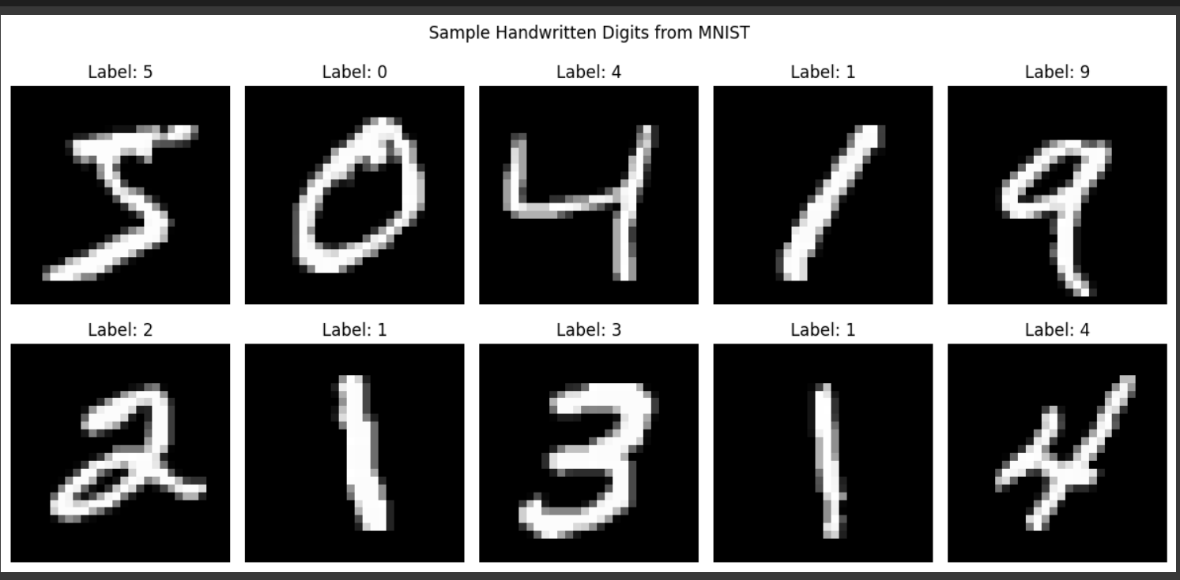
Sample Digits: Raw MNIST images showing varied handwritten digit styles.

Slide 9
📊 Results
• Test Accuracy: ~98–99%
• Training & validation curves show convergence
• Model generalizes well on unseen digits
✔ Example: Correctly classifies digits in MNIST test set

Slide 10
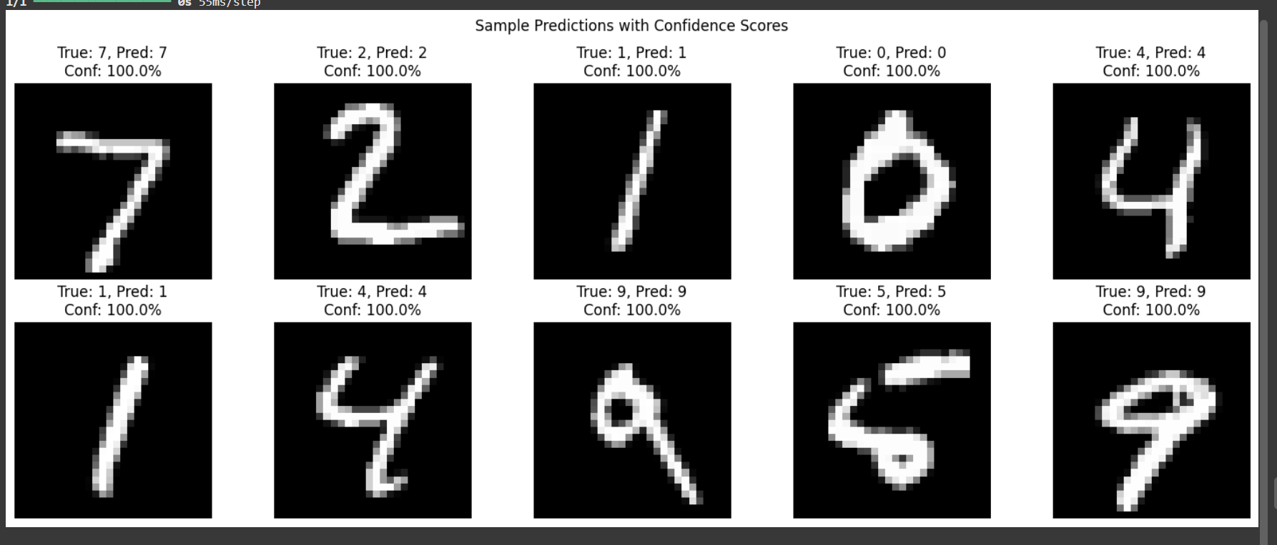
Correct digit predictions with 100% confidence on test samples.

Slide 11
💡 Uses & Applications
✔ Automated form & document digitization
✔ Postal code recognition in mail sorting
✔ Bank cheque digit reading
✔ Real-time handwriting recognition
✔ AI learning & education

Slide 12
✅ Conclusion
• CNN achieves ~99% accuracy on MNIST
• Effective for computer vision tasks
• Can be deployed in real-world apps
🔮 Future Work: Web/mobile deployment, deeper CNNs, transfer learning.

