Slide 1

Linear Method in VQE’s
By: Ronja Zijderveld Supervised by: David Wierichs

Slide 2
Content
Introduction VQE’s
LM algorithm
H & S Matrix
Regularization
Results
Conclusion

Slide 3
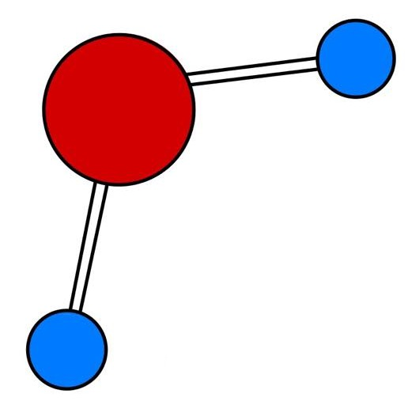

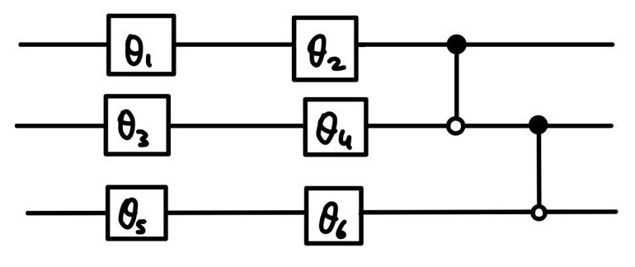
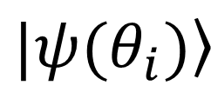
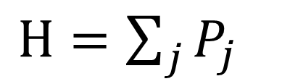
Introduction: VQE
$H=\sum_{j}{P_{j}}$
$$\left.|ψ(θ_{i})\right\rangle$$
Notes:
-goal: in variational quantum eigensolvers (in the context of quantum chemistry) is to iteratively minimize the energy using both a classical and quantum computer
-wavefunction of molecule can be parameterized on a variational circuit
-variational circuit exists out of observables, which in our case is mostly rotation gates
-similarly the Hamiltonian of the molecule can be put into pauli basis where it is then a sum of pauli words.
-Combinig these two things a quantum computer is able to calculate then energy of a variational circuit in a particular point in parameter space
-advantage vqe: already works on very shallow circuits

Slide 4
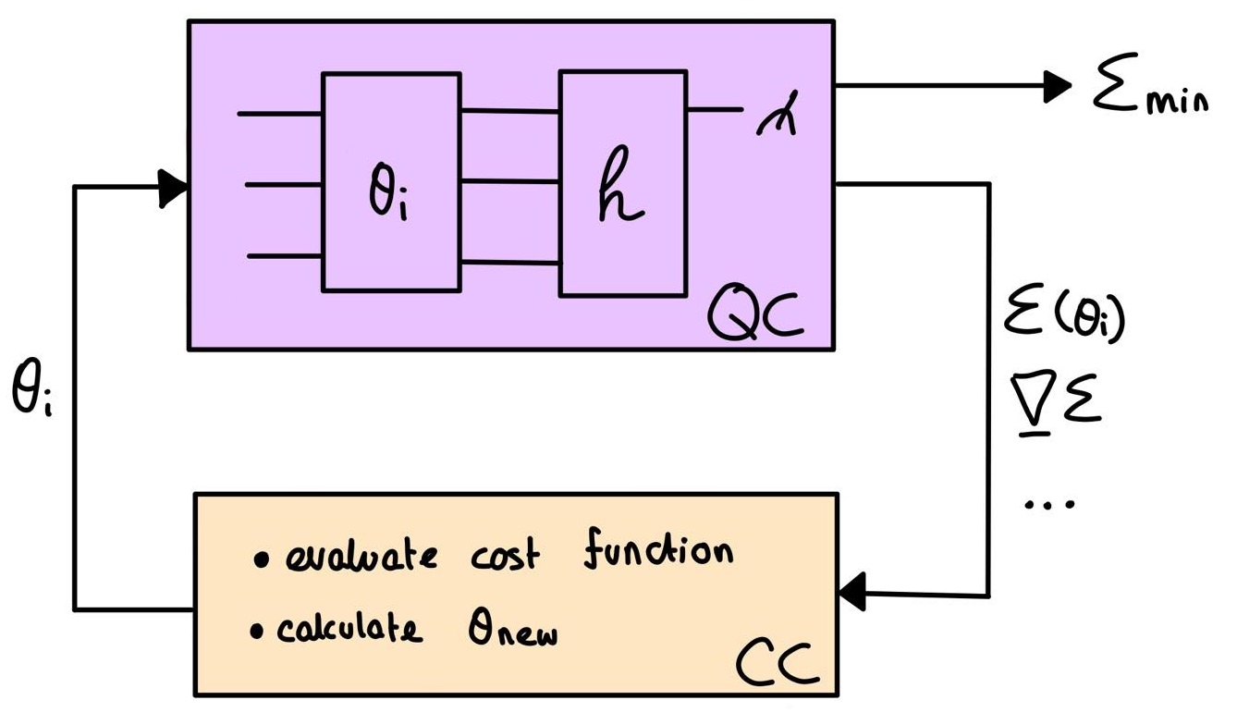
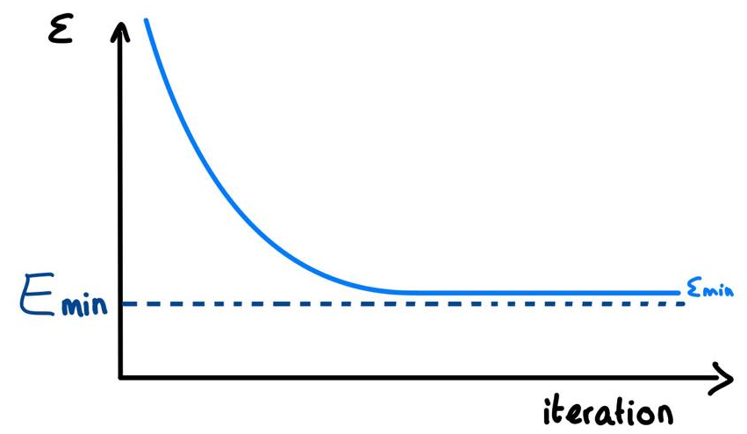
Introduction: VQE
Goal:
Notes:
-quantum computer is able to measure the current energy, but also the grad of the energy and any other information
-all this information gets outputted to the classical computer which then calculates the updatestep using some cost function
-this process is iteratively repeated until convergence of the minimum energy is reached
-this minimum energy is not always guaranteed to be the exact energy, especially if the variational circuit is too small to fully describe the wavefunction of the molecule

Slide 5
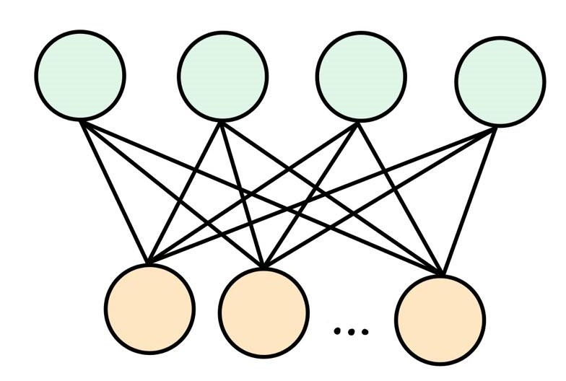
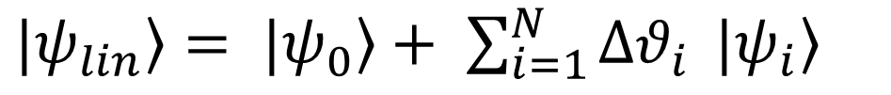
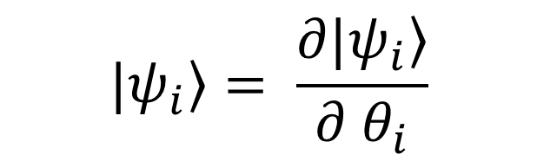

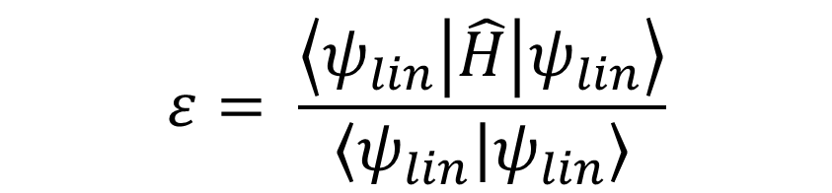
Linear Method
$$|\left.ψ_{i}\right\rangle = \frac{∂|\left.ψ_{i}\right\rangle }{∂ θ_{i}}$$
$\left.|ψ_{lin}\right\rangle =\left. |ψ_{0}\right\rangle + \sum_{i=1}^{N}{Δθ_{i}} |\left.ψ_{i}\right\rangle$
$$ε= \frac{\left\langle ψ_{lin} | \hat{H} | ψ_{lin}\right\rangle }{\left\langle ψ_{lin} | ψ_{lin}\right\rangle }$$
$$\tilde{H} v = ε \tilde{S} v$$
*J.Thorben Frank, 2021, arXiv:2104.11011v1
Notes:
-Then unto the next part, which is the linear method. The linear method was first developed in the context of variational monte carlo
-but the particular linear method we followed was described by Thorben in 2021 in the context of neural network quantum states
-in the linear method we first linearize the wavefunction by separating it into the current normalized wavefunction and its first order expansion
-then the energy approximation is given by this expression, where the H here is the Hamiltonian of the system
-this can then in turn, with a few steps inbetween, be turned into a generalized eigenvalue equation which looks like:
-the eigenvector of this eigenvalue problem then provides the updatestep of the parameters

Slide 6
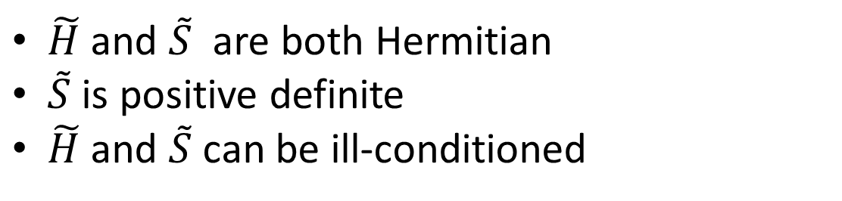
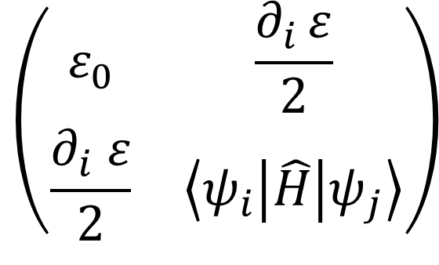
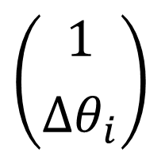
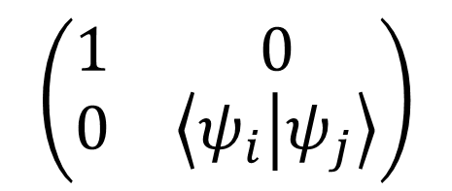

Linear Method
$$\tilde{H} v = ε \tilde{S} v$$
$$\left(\begin{matrix}1 & 0 \\ 0 & \left\langle ψ_{i} | ψ_{j}\right\rangle \end{matrix}\right)$$
$$\left(\begin{matrix}ε_{0} & \frac{∂_{i }ε}{2} \\ \frac{∂_{i} ε}{2} & \left\langle ψ_{i} | \hat{H} | ψ_{j}\right\rangle \end{matrix}\right)$$
$$\left({1 \atop Δθ_{i}}\right)$$
$\tilde{H}$ and $\tilde{S}$ are both Hermitian
$\tilde{S}$ is positive definite
$\tilde{H}$ and $\tilde{S}$ can be ill-conditioned
Notes:
-Just a bit more clarification on the exact contents of these matrices
-in the 0,0th element we have the current energy of the system
-and along the first row and column the derivative of this energy
-the remainder of the matrix is the inner product, with the Hamiltonian inbetween, of the derivative of the wavefunction wrt the ith and jth parameter
-similarly the S-tilde matrix has a 1 in its first element and 0 along first column and row
-and the remainder is the once again the inner product, however this time without a Hamiltonian inbetween
-the eigenvector is scaled so that the first element is equal to 1 and the remaining elements provide the updatestep
-some facts about the matrices are that: h and S are both Hermitian
-that S tilde is positive definite, and these two ensure that the eigenvalues e are real
-furthermore h and s can be ill conditioned , which is a point where we will come back to later

Slide 7
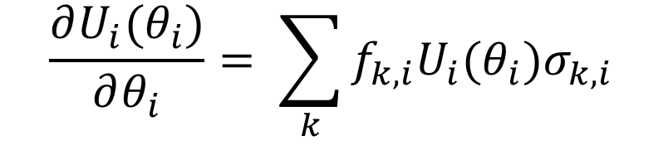


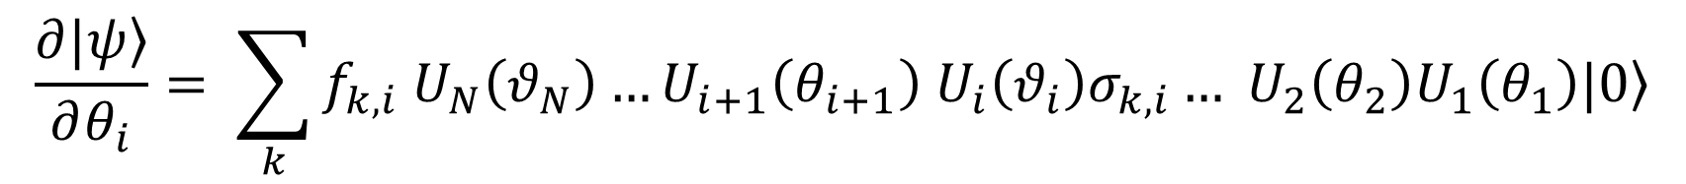
H and S Matrix
$$\frac{∂U_{i}(θ_{i})}{∂θ_{i}}= \sum_{k}{f_{k,i}U_{i}(θ_{i})σ_{k,i}}$$
$$\frac{∂|\left.ψ\right\rangle }{∂θ_{i}}= \sum_{k}{f_{k,i} U_{N}\left(θ_{N}\right)…U_{i+1}\left(θ_{i+1}\right) U_{i}\left(θ_{i}\right)σ_{k,i}… U_{2}\left(θ_{2}\right)U_{1}\left(θ_{1}\right)|\left.0\right\rangle }$$
$$V_{k,i}$$
$$\left\langle ψ_{i} | ψ_{j}\right\rangle =c \left\langle 0 | V_{k, i}^{†}V_{l,j} | 0\right\rangle =c \left\langle 0 | U_{1}^{†}… U_{i−1}^{†}σ_{k,i}^{†}U_{i}^{†}… U_{N}^{†}U_{N}… U_{j}σ_{l,j}U_{j−1}…U_{1} | 0\right\rangle$$
Notes:
-Needs to be sourced
-Better brackets

Slide 8
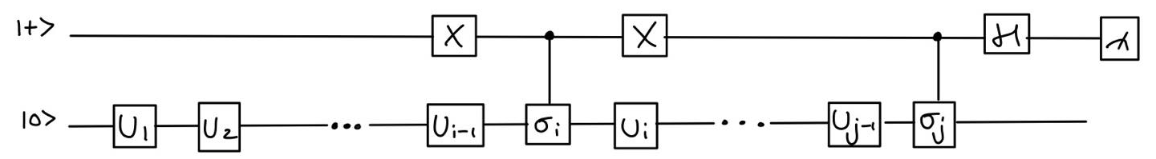
S Matrix
S = $\left\langle ψ_{i} | ψ_{j}\right\rangle =c\left\langle 0 | U_{1}^{†}… U_{i−1}^{†}σ_{k,i}^{†}U_{i}^{†}U_{j}σ_{l,j}U_{j−1}…U_{1} | 0\right\rangle$
*Ying Li, 2017, DOI: 10.1103/PhysRevX.7.021050
Notes:
-Now for how the S matrix is actually calculated, we calculate it on a quantum computer using an auxiliary qubit.
Up here you can see the expression which needs to be evaluated.
In this Ui are the gates of the variational circuit, and sigma_i is the egenerator of the gate U-i. In our case all the U’s are rotational gates which means that our generators are paulis

Slide 9
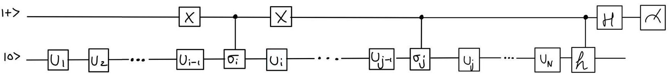
H Matrix
$$H= \left\langle ψ_{i} | \hat{H} | ψ_{j}\right\rangle =c\left\langle 0 | U_{1}^{†}… U_{i−1}^{†}σ_{k,i}^{†}U_{i}^{†}… U_{N}^{†}{\hat{H}U}_{N}… U_{j}σ_{l,j}U_{j−1}…U_{1} | 0\right\rangle$$
Notes:
-

Slide 10

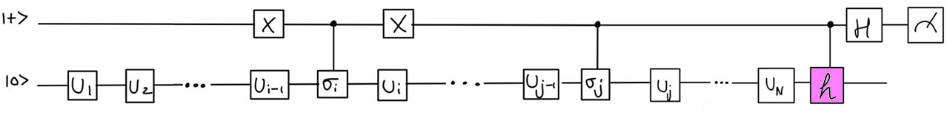
H Matrix
$$H= \left\langle ψ_{i} | \hat{H} | ψ_{j}\right\rangle =c\left\langle 0 | U_{1}^{†}… U_{i−1}^{†}σ_{k,i}^{†}U_{i}^{†}… U_{N}^{†}{\hat{H}U}_{N}… U_{j}σ_{l,j}U_{j−1}…U_{1} | 0\right\rangle$$
Notes:
-in a very similar way the H matrix is calculated. The only differences are highlighted here.
-and in the quantum circuit it’s the

Slide 11



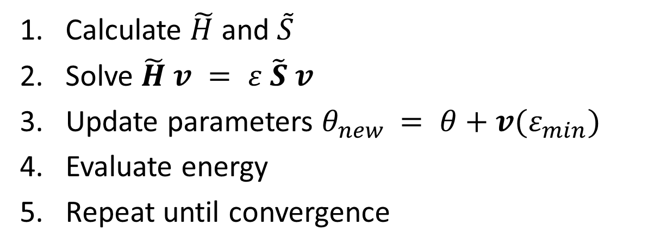
Linear Method Algorithm
Calculate $\tilde{H}$ and $\tilde{S}$
Solve $\tilde{H} v = ε \tilde{S} v$
Update parameters $θ_{new }= θ+v(ε_{min})$
Evaluate energy
Repeat until convergence

Slide 12
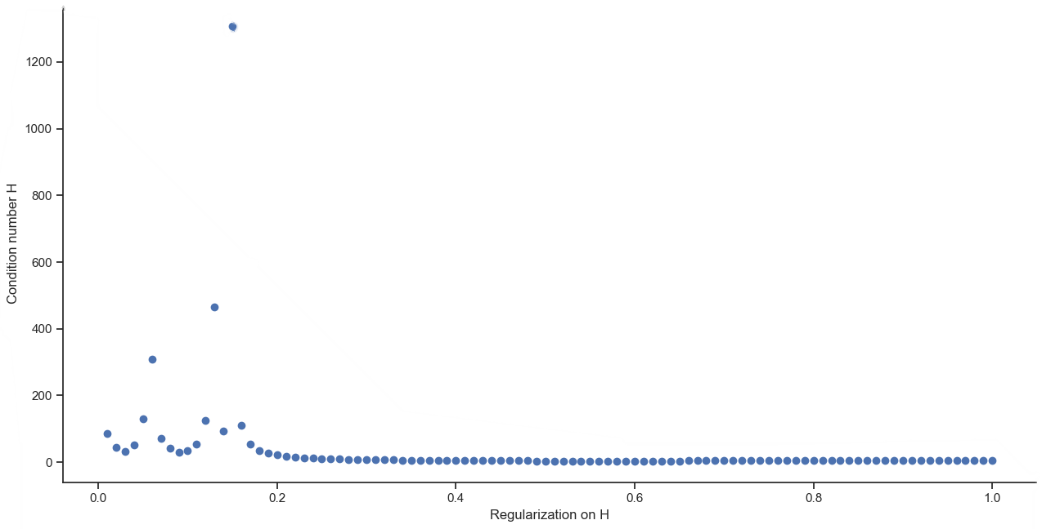
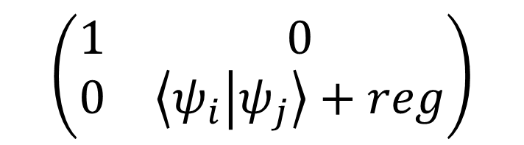
Regularization
$$\left(\begin{matrix}1 & 0 \\ 0 & \left\langle ψ_{i} | ψ_{j}\right\rangle +reg\end{matrix}\right)$$
On S: 0.01
On H: 100 values between 0 and 1
Eigensolvers:
scipy.linalg.eig()
scipy.linalg.eigh()
Notes:
-Small regularization on S to ensure positive definiteness
-multiple regularizations on H, to make sure that not accidentally a regularization is chosen which has a very high condition number
-the generalized eigenvalue problem was solved using a scipy module. Originally we only did it with linalg.eig(),, however because this solver did not always converge, we started looking
At linalg.eigh() which is meant specifically for Hermitian matrices. Curiously enough the two eigensolvers give very different results and that is why we will showcase both

Slide 13
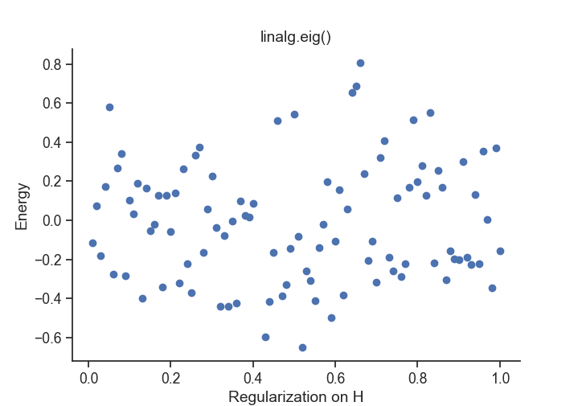
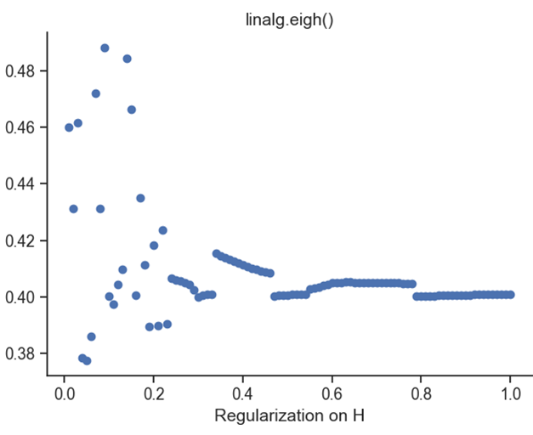
Regularization

Slide 14
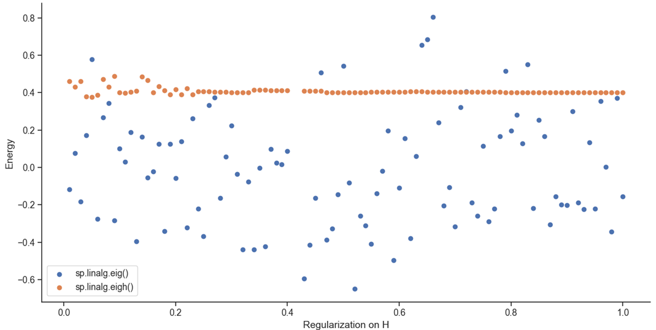
Regularization
Notes:
here you can see the effect of the regularization on H in one iteration step for both eigensolvers used.
-for the linalg.eig solver a very small difference in regularization already causes a big jump in the energy spectrum. It is very chaotic, but because of that it is able to pierce through to low energies
Quite quickly.
-The Linalg.eigh solver in contrast is a lot more regular and stays within the same energy range

Slide 15

Final algorithm
Calculate $\tilde{H}$ and $\tilde{S}$
Add regularization $s=0.01$and k
For each k:
Solve $\tilde{H}(k) v = ε \tilde{S} v$
Calculate parameters $θ_{new }(k)$
Evaluate energy E(k)
Choose $θ_{new }$ with lowest energy
Repeat
Notes:
-as a little summary here of the full process

Slide 16
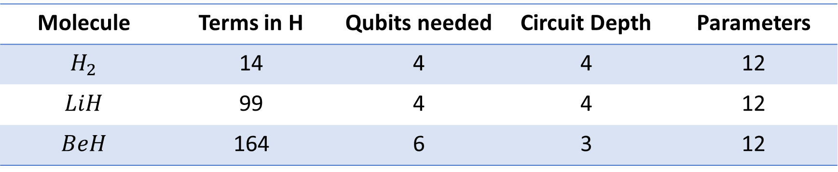
Results: systems used
Molecule | Terms in H | Qubits needed | Circuit Depth | Parameters
$$H_{2}$$ | 14 | 4 | 4 | 12
$$LiH$$ | 99 | 4 | 4 | 12
$$BeH$$ | 164 | 6 | 3 | 12
Notes:
-this is a table with the different systems which we used/tested and some statistics about them. Our smallest system was Hydrogen and our biggest system was berilium, as you can see from the terms in the Hamiltonian and the fact that BeH needed 6 qubits. And all three systems had 12 parameters

Slide 17
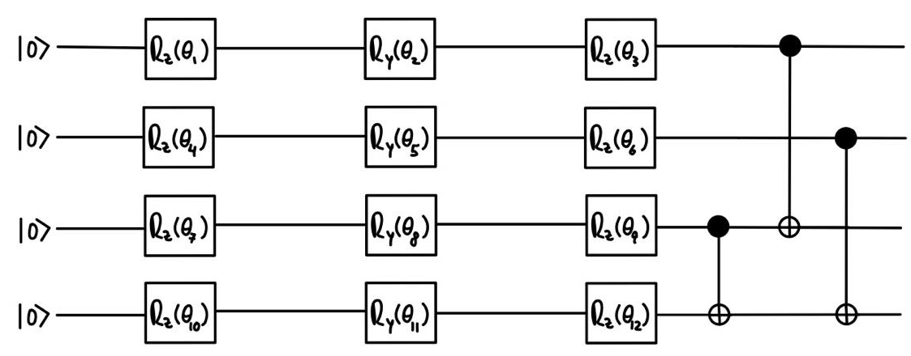
Results: variational circuit

Slide 18

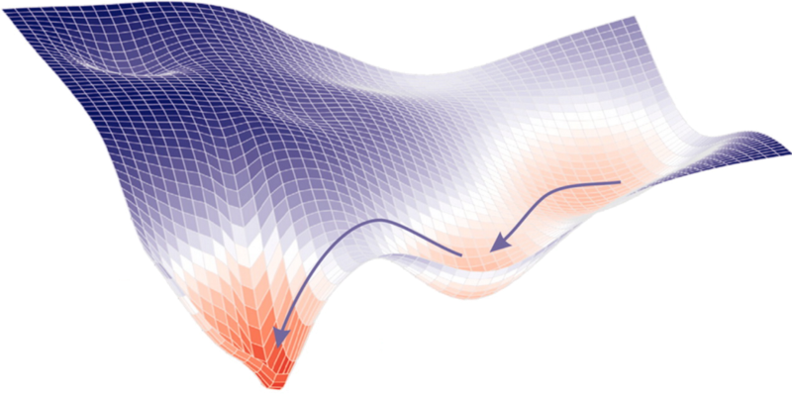
Results: optimizers
SciPy: BFGS
ADAM
Gradient Descent
Linear Method Eig
Linear Method Eigh
Notes:
-why did we choose to compare it to these optimizers?

Slide 19
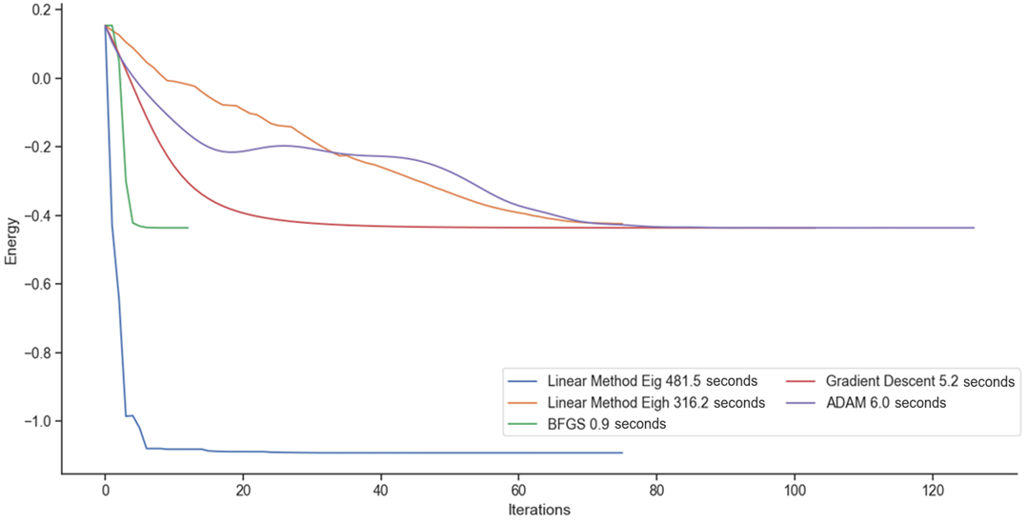

Results: $H_{2}$

Slide 20
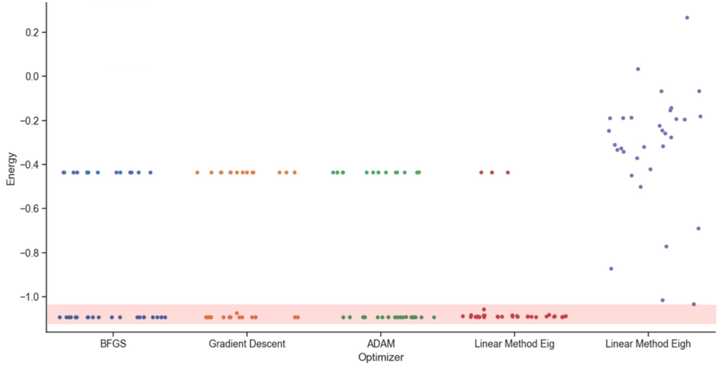
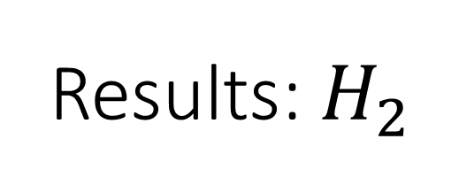
Results: $H_{2}$
Optimizer | Percentage in pink
BFGS | 59
Gradient Descent | 56
ADAM | 62
Linear Method Eig | 91
Linear Method Eigh | 3
Notes:
-annotate number
-or percentages
-make it into a table

Slide 21
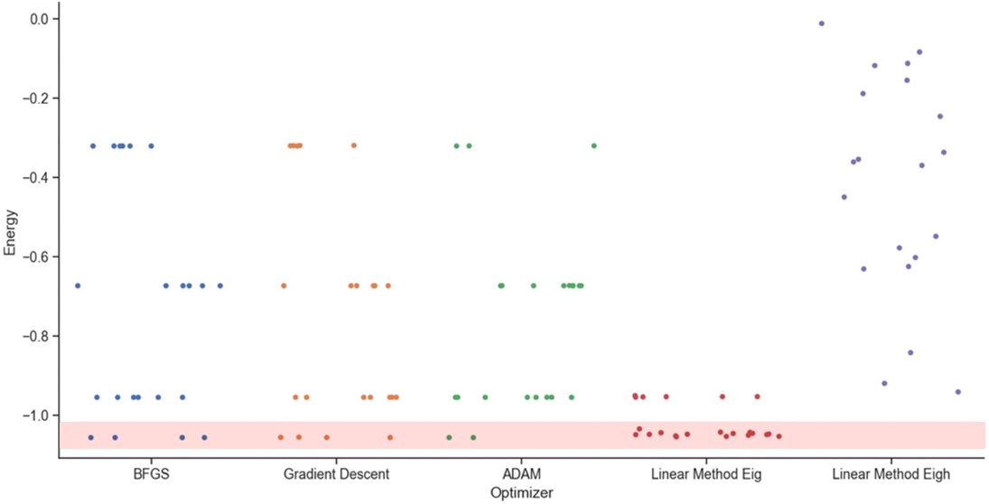

Results: $LiH$
Optimizer | Percentage in pink
BFGS | 18
Gradient Descent | 18
ADAM | 9
Linear Method Eig | 73
Linear Method Eigh | 0
Notes:
-show BeH and H4

Slide 22
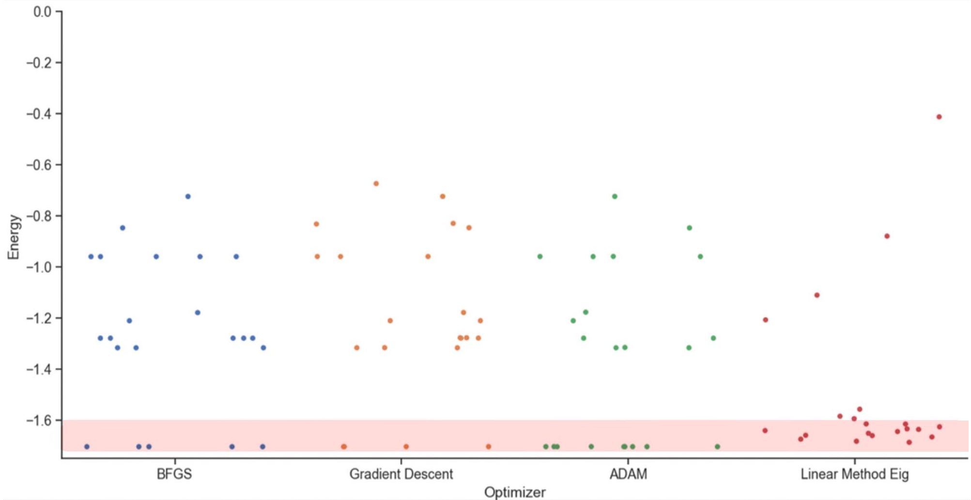
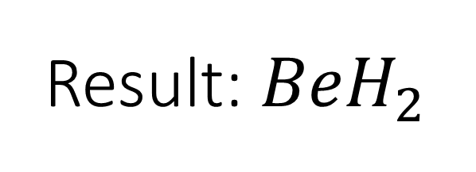
Result: ${BeH}_{2}$
Optimizer | Percentage in pink
BFGS | 22
Gradient Descent | 18
ADAM | 41
Linear Method Eig | 68

Slide 23
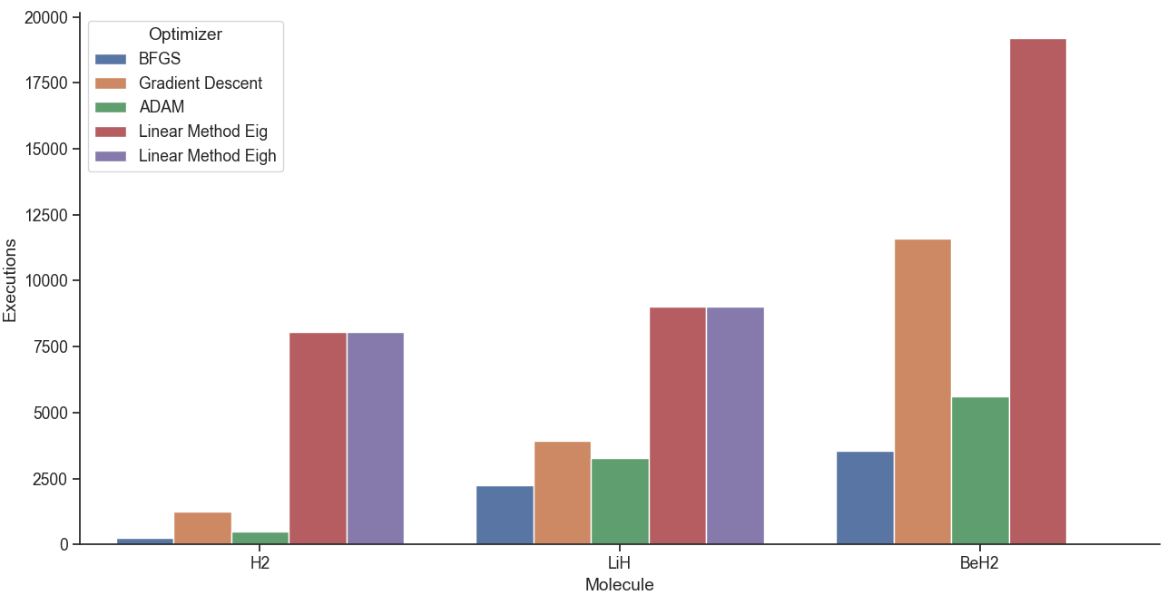
Results: Cost

Slide 24
Conclusion
Eigh:
Less effective
More costly
Correct Eigensolver
Eig
More effective
More costly
Randomness
Overall:
Further Research
Good time
Notes:
-missing a plot or at least a picture

