Slide 1
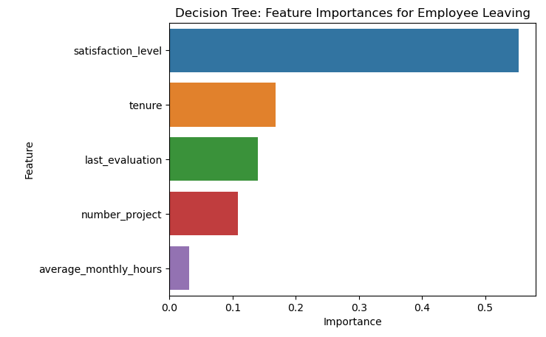
Salifort Motors
Employee Retention Project
Project Overview
Salifort Motors seeks to improve employee retention and answer the following question: What’s likely to make the employee leave the company?
Approximately 17% of employees left Salifort Motors
Most common number of projects assigned to employees range between 3 and 4. Employees who were assigned 7 projects left the company
4-year employees who left the company have very low satisfaction level
Categories of employees who left are dissatisfied employees with very short tenure and very satisfied employees with medium length tenures
Barplot above shows the most relevant variables that can help predict the outcome variable: ‘satisfaction_level’, ‘tenure’, ‘last_evaluation’, ‘number_project’, and ‘average_monthly_hours’. ‘satisfaction_level’ has the highest importance.
MODEL AND IMPACT
Since the variable we are trying to predict is a categorical variable, we could use a logistic regression model or a tree-based machine learning model. In this case, I used both logistic and decision tree models and chose a better performing one.
The decision tree model greatly outperforms the logistic regression.
This model helps predict whether an employee will leave and identify which factors are most influential.
I recommend the following:
The HR department can conduct a workplace survey on factors that can boost their employees morale in the workplace and improve on them. This in return can increase their satisfaction levels
Set a limit to the number of projects employees can work on so that they are not overworked
Investigate why 4-year tenured employees are so dissatisfied

