Slide 1
Intel DAL Extended Storage Mechanism
By Shai Falach and Ron Keinan
Instructor – Mr. Barak Einav

Slide 2
The need
Intel’s DAL is a TEE (Trusted Execution Environments) that has a very small amount of flash storage.
There is a need for an infrastructure that can be used by other TAs to store data with integrity, confidentiality and replay protection without the size limitation of the physical storage.

Slide 3
Purpose – why, what, and how:
So, when we need more storage to store critical data, we need to use the Host Mounted Disk Space in order to save encrypted information there.
The classes should supply a similar interface to the regular flash memory used by applet, and Jhi session handle used by host, to simplify the use of the extended storage for all users.

Slide 4
Purpose – why, what, and how:
To create a java class that will connect to host and handle all the extended memory including encryption and decryption of the data. This class will be used by the applet.
In advance, to create a c# class that will connect to the applet and handle all the communication to get, change and send files. This class will be used by the host.

Slide 5
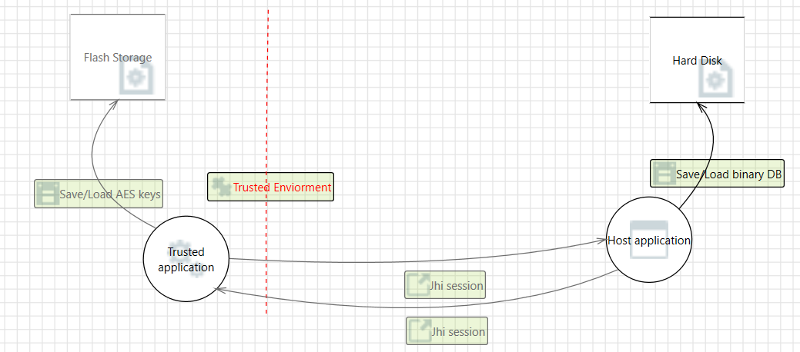

Slide 6
Advantages:
This solution is better than the flash storage memory that can save only few bytes (can go to few KB in extreme cases), and our solution is open this limitation. (This current version is set to a buffer of 16 KB, but it can be extended by demand(see future work).
The memory is saved in the Hard Disk only when it is encrypted – and every action made on the DB is only in the applet – it is the only process that decrypt & encrypt, write, change, or delete from the file.

Slide 7
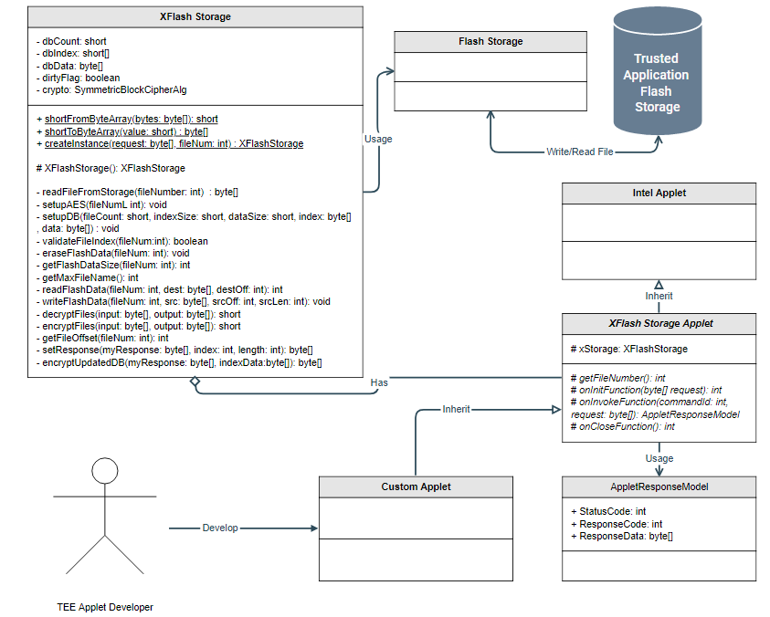
Architecture – Trusted Application (Java)

Slide 8
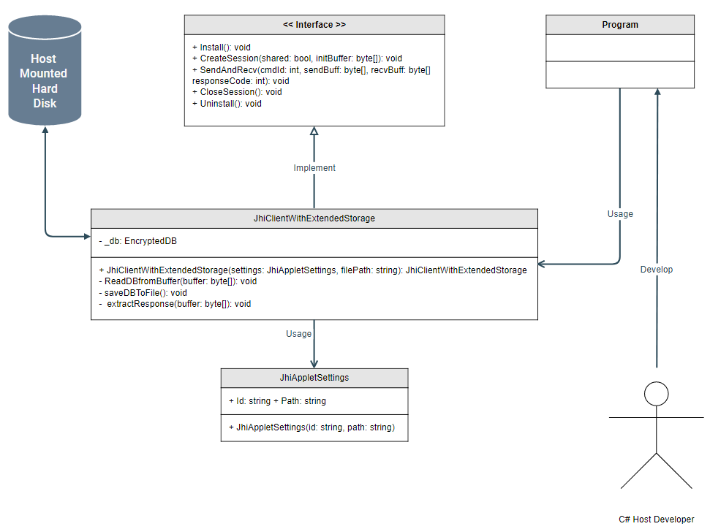
Architecture – Host Application (C#)

Slide 9
DEMO

