Slide 1
Crop Yield Prediction
999
5
<1%
Using machine learning to separate business insight from algorithmic noise
clean records
model tests
yield variation explained
Business headline
The prototype works, but the current data is not yet strong enough for reliable yield decisions.
Gamma 2
Recommendation: invest first in richer farm, soil, location and season data.
Aderonke • Rufaro • Marina • Emmanuel • Simon • Parfait
01
Notes:
Open by stating that this is a crop yield prediction project completed by Gamma 2. The key business message is honest: we built the full data science and deployment workflow, but the current dataset is not strong enough for a reliable production decision tool.

Slide 2
The business question
Gamma 2 • Crop Yield Prediction
Can the current dataset support reliable crop-yield prediction?
8
5
3
Answer
Not reliably yet.
original variables
engineered features
model families
The best model explains less than 1% of unseen yield variation, so the biggest opportunity is better data, not a more complex algorithm.
2.525
2.922
0.009
RF test MAE
XGB test RMSE
best test R²
Business implication: deploy only as a proof of concept, while improving the data foundation for a future production tool.
02
Notes:
Frame the problem for business stakeholders. We are not just asking which model has the best score. We are asking whether the current data can support reliable decisions. The answer is not yet. The prototype is useful, but the production opportunity is better data.

Slide 3
What we built from start to finish
Gamma 2 • Crop Yield Prediction
1
2
3
4
5
Clean
→
Explore
→
Engineer
→
Model
→
Deploy
1000 → 999 records
weak yield signals
5 agronomic features
5 experiments
Streamlit prototype
Pipeline discipline mattered
The same cleaned data, split convention and reusable feature-engineering function were used to keep model comparison fair and prevent leakage.
03
Notes:
Summarise the end-to-end workflow. We did not stop at a notebook. We cleaned the data, explored it, engineered features, compared models, interpreted the selected model, and built a Streamlit prototype.

Slide 4
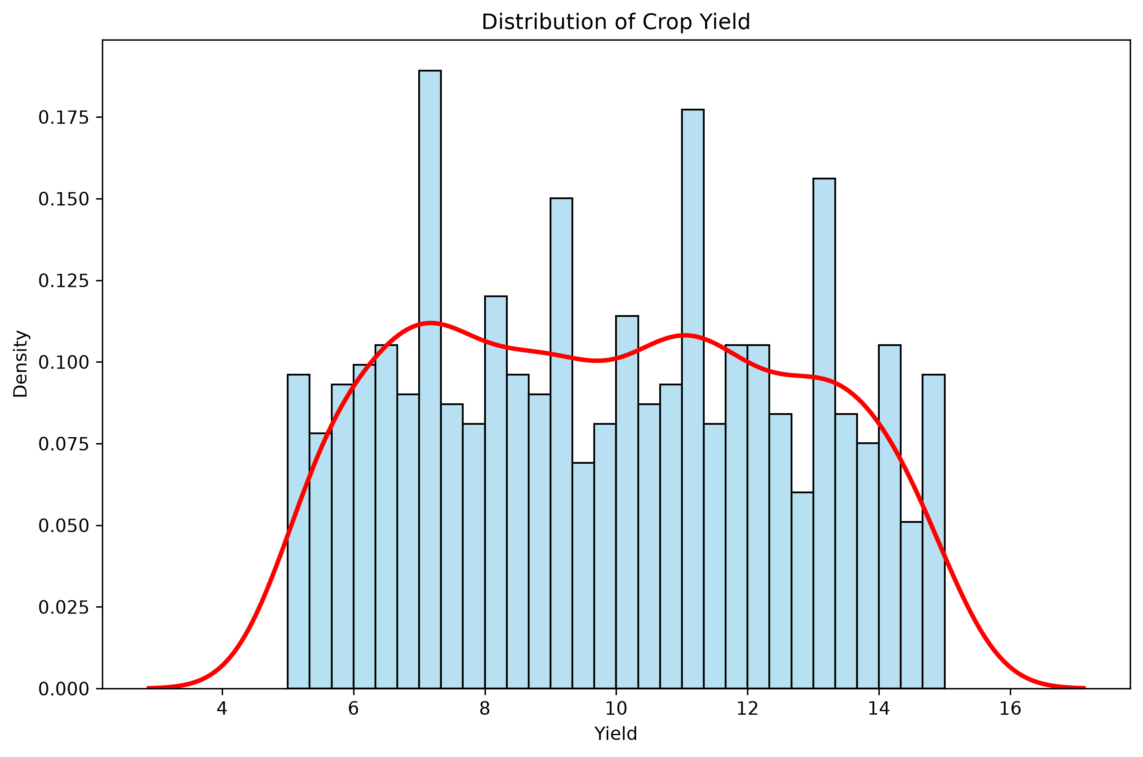
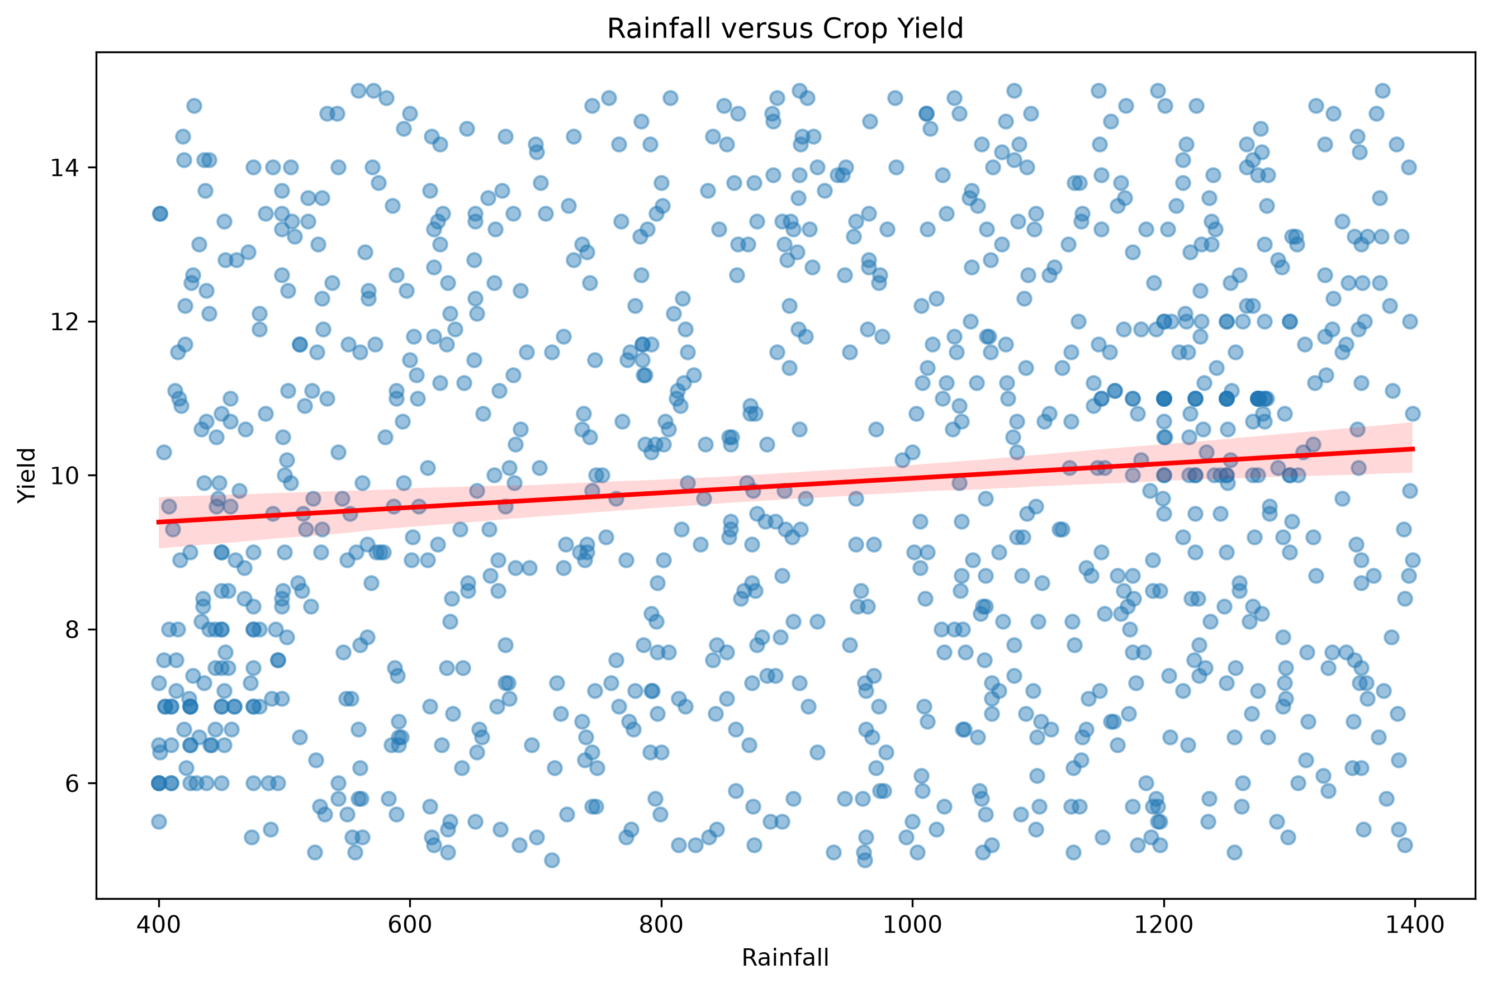
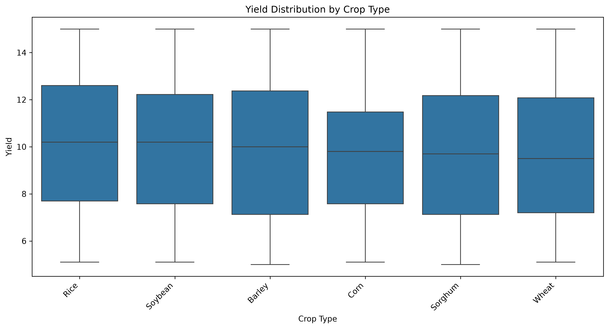
EDA reality check: the data was clean, but the signal was weak
Gamma 2 • Crop Yield Prediction
Yield distribution: no severe skew
Rainfall relationship: statistically significant but weak
Crop categories: large overlap
1.05%
2.25%
0.33%
Takeaway: the supplied variables individually explain very little of crop-yield variation.
yield variation explained by rainfall alone
yield variation explained by quadratic temperature
yield variation explained by crop type
04
Notes:
Use this slide to explain why the model scores were not a surprise. The EDA already showed weak relationships. The data was not dirty. The issue is that the variables do not capture enough of the real drivers of yield.

Slide 5
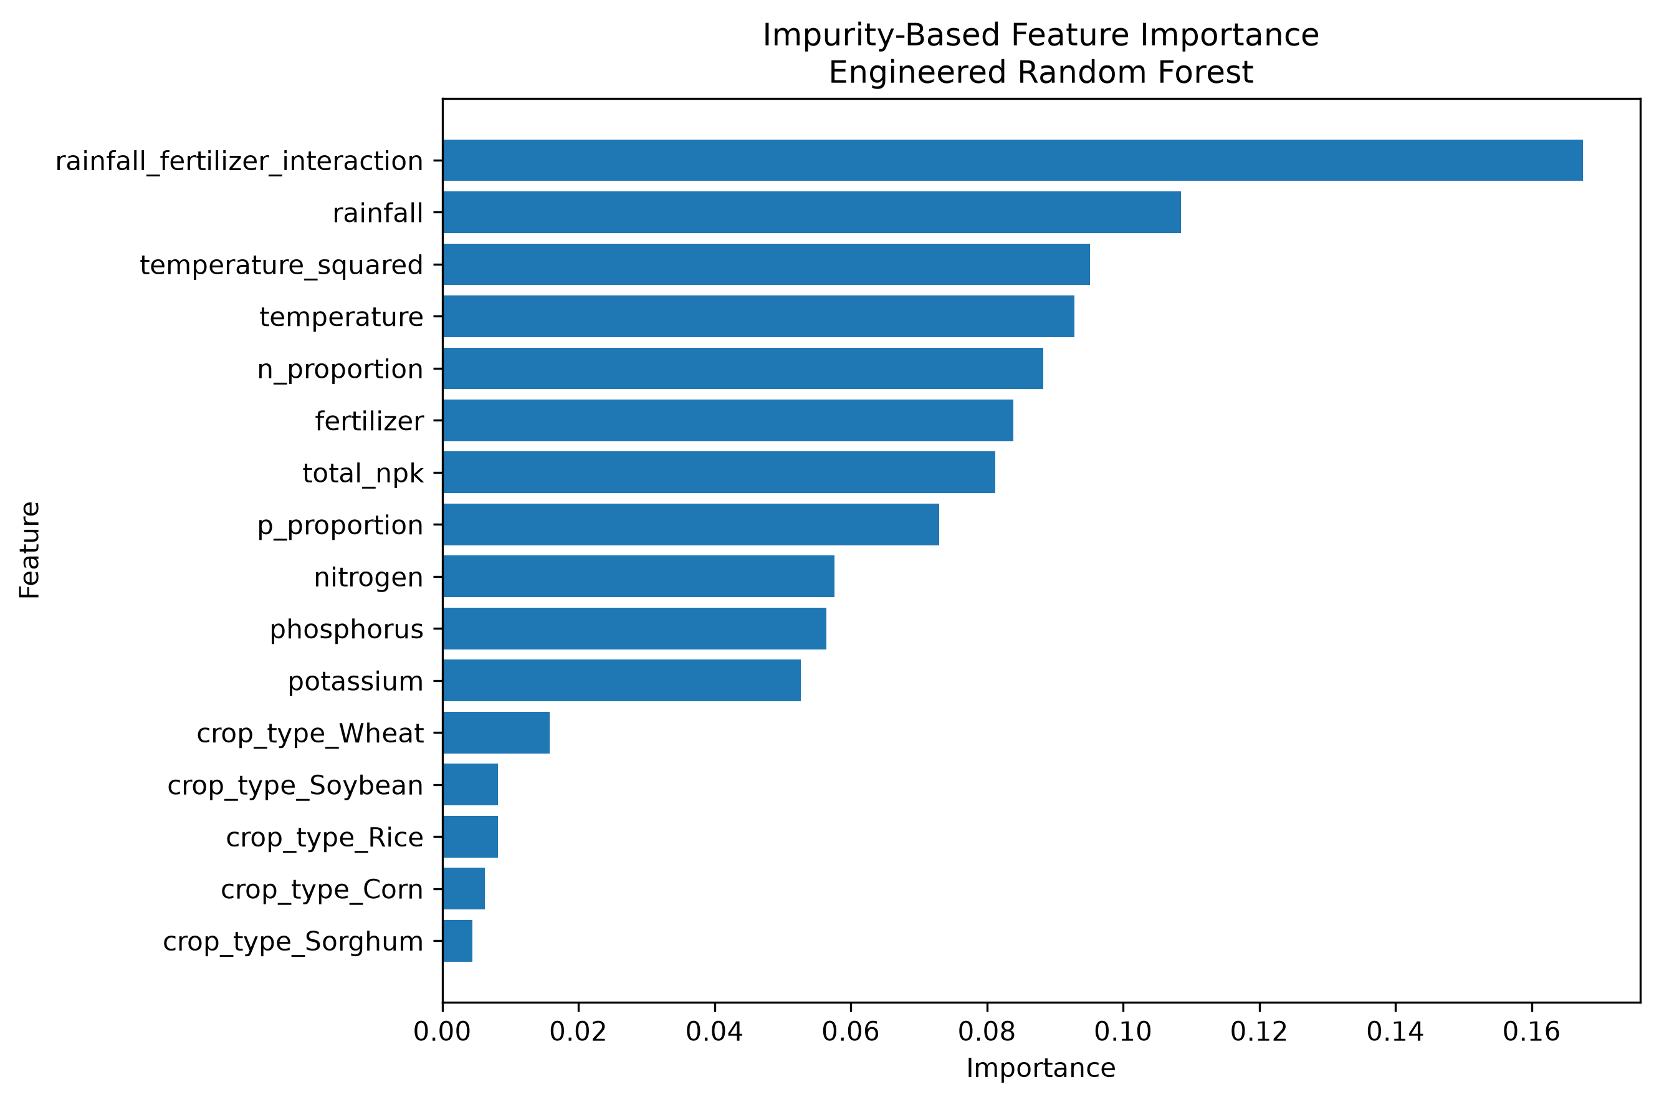
Feature engineering added agronomic structure
Gamma 2 • Crop Yield Prediction
Raw input variables
Total NPK
N + P + K
combined nutrient level
crop type • rainfall • temperature • fertilizer • N • P • K
→
N proportion
N / (N+P+K)
nutrient balance
P proportion
P / (N+P+K)
nutrient balance
Feature engineering made the data more agronomically meaningful, but it could not create information that was missing from the original dataset.
Temperature²
temperature × temperature
nonlinear heat effect
Rainfall × fertilizer
rainfall × fertilizer
input synergy
This helped interpretation more than prediction.
05
Notes:
Explain feature engineering in simple terms. We gave the models extra variables that represent nutrient balance, possible nonlinear temperature response, and rainfall-fertilizer interaction. But these are still built from the same limited information.

Slide 6
We compared five modelling experiments
Gamma 2 • Crop Yield Prediction
Model family
Feature set
Business purpose
Multiple Linear Regression
Original
baseline linear relationship
Multiple Linear Regression
Engineered
tests whether derived features help linear model
Random Forest
Original
nonlinear bagging benchmark
Random Forest
Engineered
selected for deployment prototype
XGBoost
Engineered
boosting comparison
Evaluation: MAE, RMSE, R² and five-fold cross-validation.
Same cleaned 999-row dataset used for final comparisons.
06
Notes:
Walk through the five experiments. Multiple Linear Regression was the baseline, Random Forest tested nonlinear bagging, and XGBoost tested boosting. The important point is that the comparisons used the cleaned dataset and consistent evaluation.

Slide 7
Results: the models were very close, and all were weak
Gamma 2 • Crop Yield Prediction
Model
MAE
RMSE
R²
2.525
2.9219
MLR Original
2.534
2.939
-0.003
lowest MAE: RF engineered
lowest RMSE: XGBoost
MLR Engineered
2.553
2.945
-0.007
0.0041
<1%
RF Original
2.546
2.939
-0.003
RMSE difference: XGB vs RF
best variation explained
RF Engineered
2.525
2.926
0.006
XGBoost Engineered
2.540
2.922
0.009
Decision: model choice changed scores only marginally. The real bottleneck was data signal quality.
Lower is better for MAE/RMSE; higher is better for R².
07
Notes:
Explain the table in business language. XGBoost had the best RMSE and R-squared, but the improvement over Random Forest was tiny. Random Forest had the best MAE and slightly better cross-validation mean RMSE. All R-squared values were close to zero, so no model was strong.

Slide 8
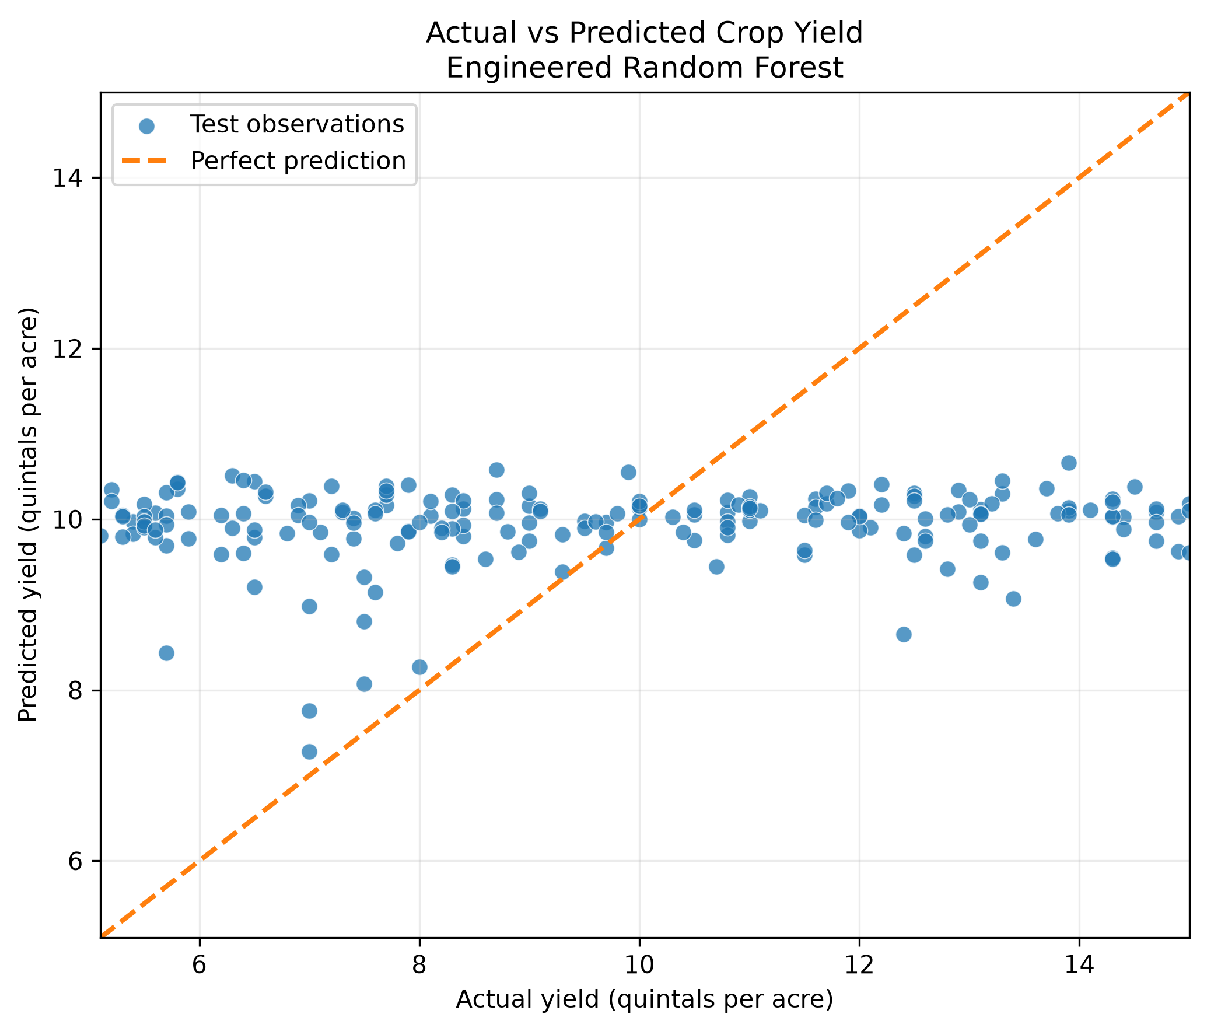
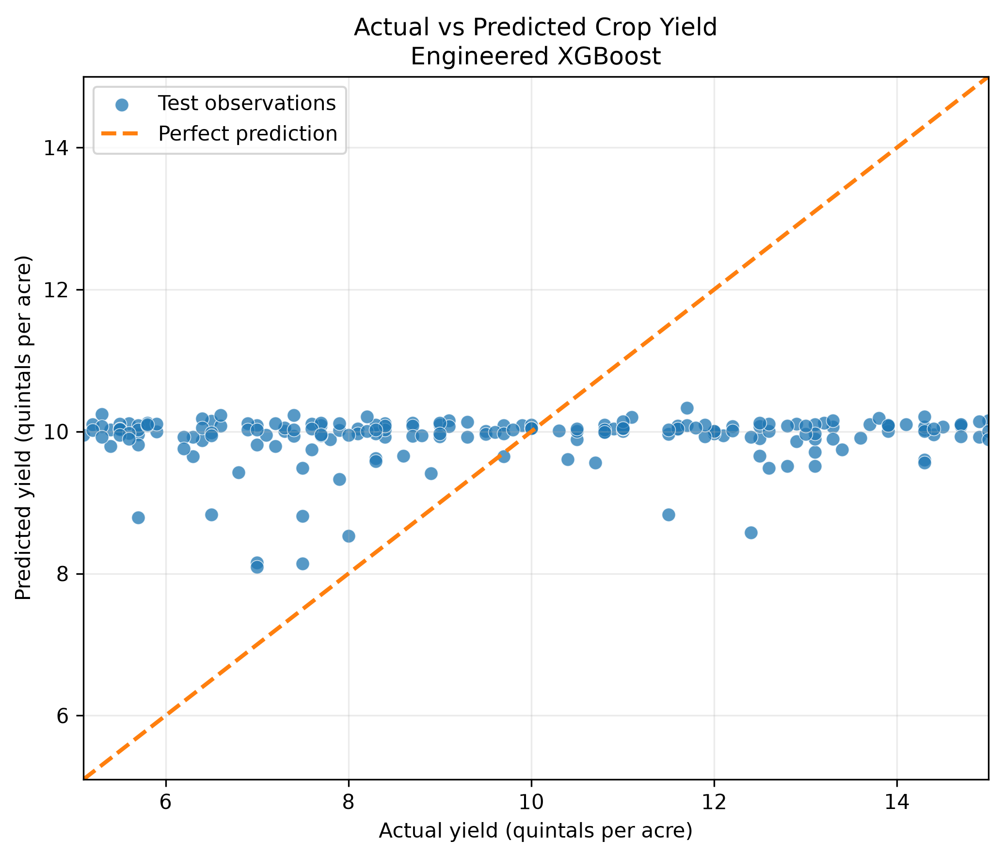
Final selection: Random Forest for prototype deployment
Gamma 2 • Crop Yield Prediction
Both models predicted around the middle of the yield range
Random Forest was retained because it had the lowest MAE, slightly better mean CV RMSE, clearer interpretation workflow and was already integrated into Streamlit.
Selected for a technical prototype, not as a production-ready prediction engine.
08
Notes:
Use the actual versus predicted plots to show that predictions were clustered around the average yield. This is why we are careful: the model is useful as a technical prototype, but it is not yet reliable for real operational decisions.

Slide 9
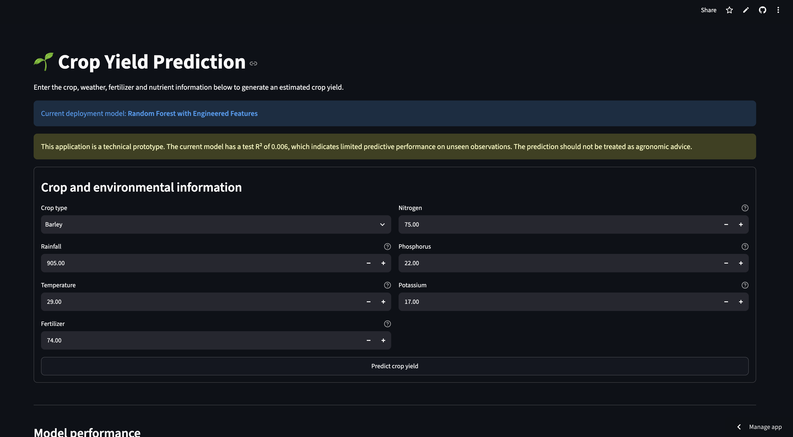
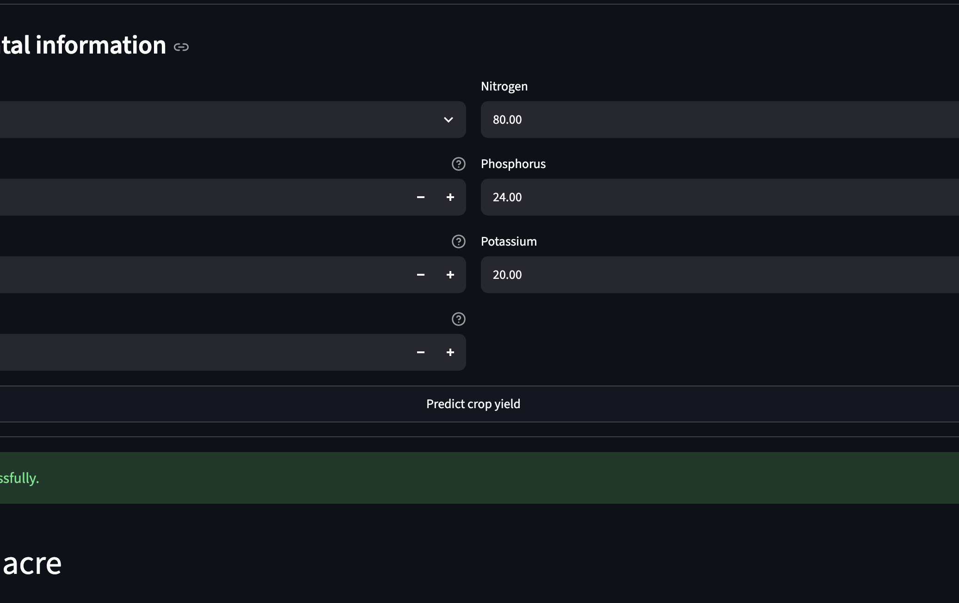
Prototype: analysis turned into an interactive tool
Gamma 2 • Crop Yield Prediction
Streamlit workflow
User input
→
Feature engineering
→
RF pipeline
→
Yield estimate
Verified: 10.054 Q/acre
09
Notes:
Show that the team moved from analysis to a usable interface. The user enters the original variables and the app automatically creates the engineered features, loads the saved pipeline, and returns a yield estimate. The saved model was verified before deployment.

Slide 10
Business recommendation: invest in better data
Gamma 2 • Crop Yield Prediction
The next leap will come from data, not from adding another algorithm.
1
Collect richer farm data
location • season • soil • irrigation • variety • management
Final message
Integrate external data responsibly
A transparent weak model is more valuable than an artificially impressive model with weak evidence.
2
weather • soil • satellite data only with reliable IDs
3
Validate before operational use
Use the prototype to demonstrate capability. Use better data to build the real product.
independent data • uncertainty intervals • expert review
4
Monitor model performance
actual harvest outcomes • drift • retraining plan
EXPLORE THE PROJECT
GitHub repository ↗
github.com/Ronkecrown/gamma2-crop-yield-prediction
Live Streamlit app ↗
gamma2-crop-yield-predictor.streamlit.app
10
Notes:
Close with the business recommendation. The work is not a failure because the model was weak. It is a useful finding: the firm needs richer data before crop yield prediction can become a reliable business tool.

