Slide 1
TouchStone
Janssen Interactive Multi-media Module (JIMM)
Joe Higley, Ronny Rodriguez, Morgan Holbert

Slide 2
Client Interview Key Points:
Uses the south side entrance
Needs to be an attraction
Used for learning about the school
Interactive, Inviting, Cutting edge
Useful information for new and old students as well as alumni
Speaks “Engineering”
Honors Dean Jensen in some way

Slide 3
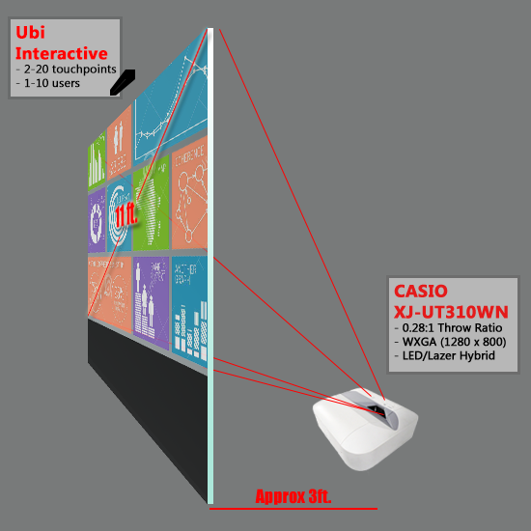
Design Concept:
Large glass panel/panels covered in rear-projection film act as screen.
Ultra-short throw projector projects UI onto glass from other side.
Ubi interactive detects hand motion and touch gestures.

Slide 4
Major Components Specs:
Ubi Interactive
2 to 20 touchpoints
Uses camera to register touch gestures
Hardware and software already built
Requires integration with out software
Casio XJ-UT310WN
0.28:1 throw ratio
1280 x 800 resolution
LED/Laser hybrid lamp
20,000hr. halflife or 2.28yrs.
Glass Panel
1 XL horizontal glass panel or 3 L vertical glass panels.
Rear-projection film
Glair resistance for sunny hallway

Slide 5
Language Options
HTML/JavaScript
Pros:
Information available online
Can transfer current page via QR scan
Cons:
Creating from scratch will be time consuming
Any late changes may have trickle effect
JavaScript not very secure
Unity
Pros:
Can develop as a web app
Easily add/change features
More graphical complexity
More easily create interface for adding information.
Cons:
May cost money for license

Slide 6
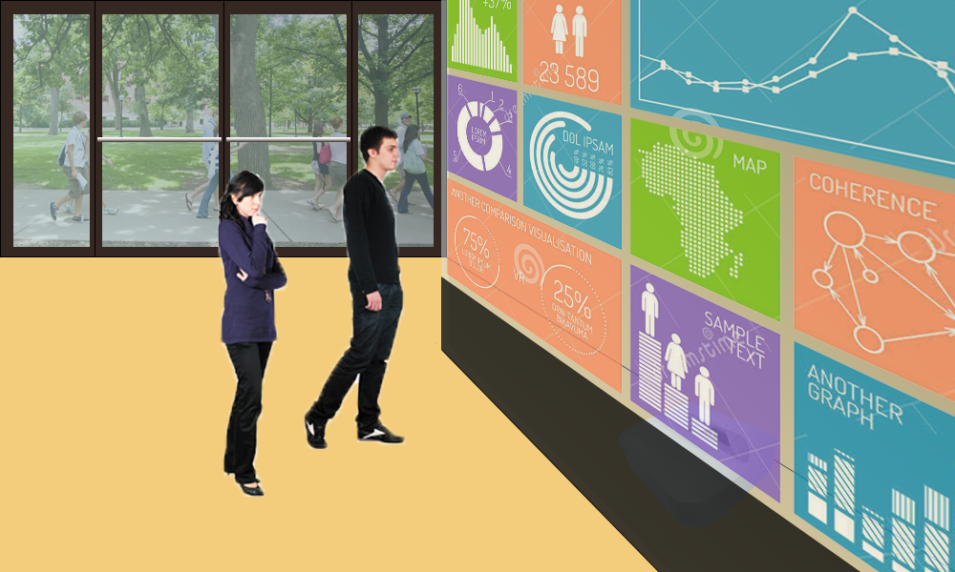
Questions?

