Slide 1
Lower Bound for Min Graph Coloring
Hoffman Lower Bound

Slide 2
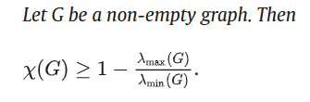
Formula
x(G) represents the chromatic color
𝜆 represents the graphs eigenvalues

Slide 3
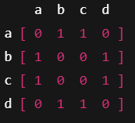
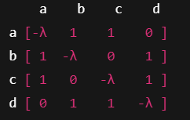
Uses the adjacency matrix

Slide 4
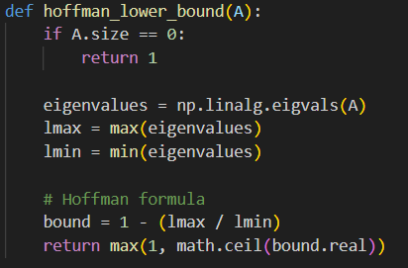
How this looks as code
The math for the eigenvalues is handled by NumPy
A is the adjacency matrix
Ceil rounds them up

Slide 5
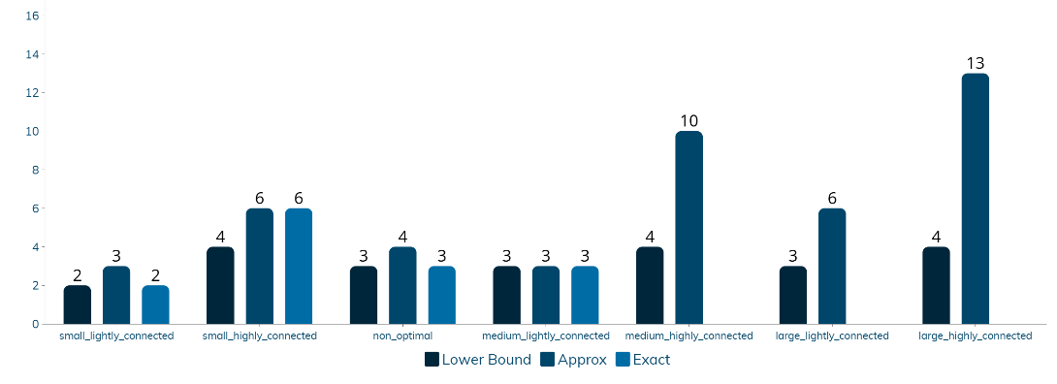
Graph with lower bound added

