Slide 1
Minimum Vertex Coloring
Exact Solution
By: Ronnie Harshbarger

Slide 2
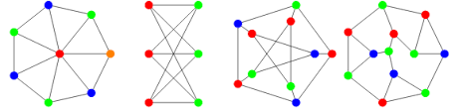
Problem: Minimum Vertex Coloring
Goal: minimize number of colors
Assign colors to vertices
Adjacent vertices must have different colors

Slide 3
Decision vs. Optimization
Decision Version (k-Coloring)
Does G have a valid coloring using ≤ k colors?
Input:
graph G
k = 3
Output:
Yes/No
Optimization Version
Find χ(G) and give a coloring achieving it
Input:
Graph G
Output:
χ(G)
Valid coloring using exactly χ(G) colors

Slide 4
Certifier Process
Certifier Process for k-coloring:
- Certificate = an array color[v] for every vertex
Must use colors in {0, …, k−1}
Certificate verification runs in polynomial time, so k-Coloring ∈ NP
for each v in V:
if color[v] not in 0..k-1: reject
for each (u,v) in E:
if color[u] == color[v]: reject
accept
Total work = O(|V| + |E|)

Slide 5
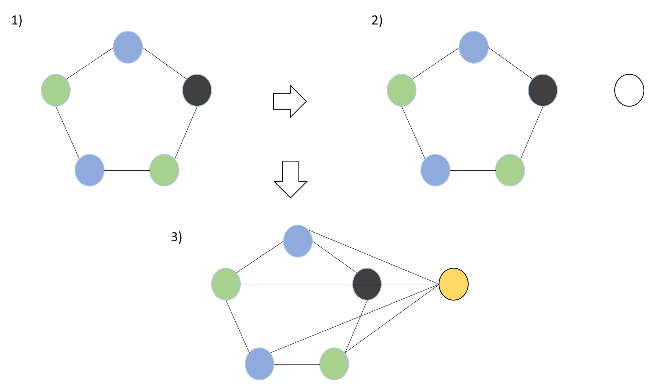
Reduction: 3-Coloring NP-hard Problem
3-Coloring
Input: graph G
Can G be colored with ≤ 3 colors?
3-Coloring is NP-complete
Minimum Coloring
Give the same graph G to minimum coloring solver
If solver returns χ(G) ≤ 3 → YES
If solver returns χ(G) ≥ 4 → NO
The minimum coloring solver’s output directly answers the 3-Coloring instance
Running the solver on G is polynomial-time

Slide 6
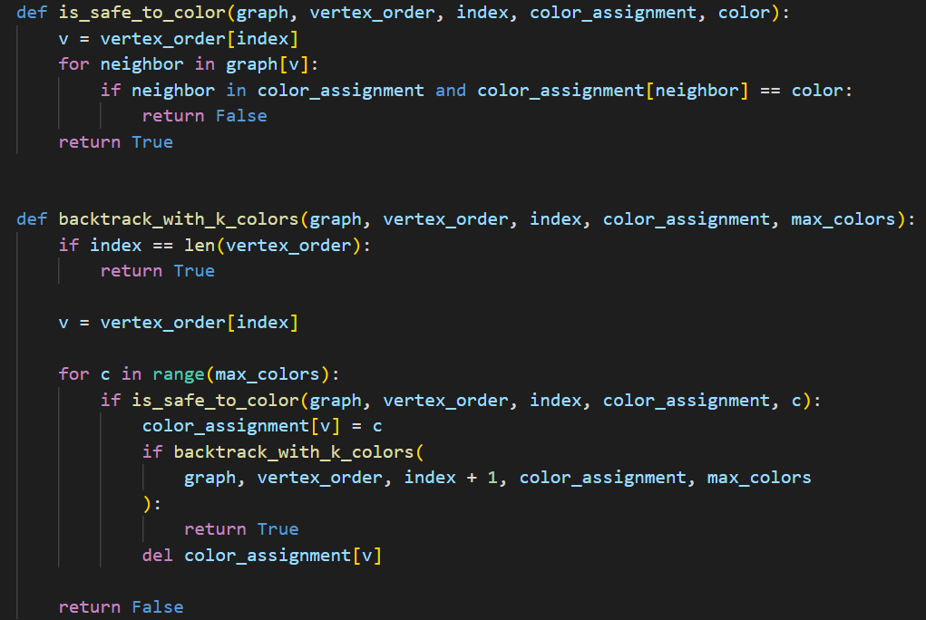
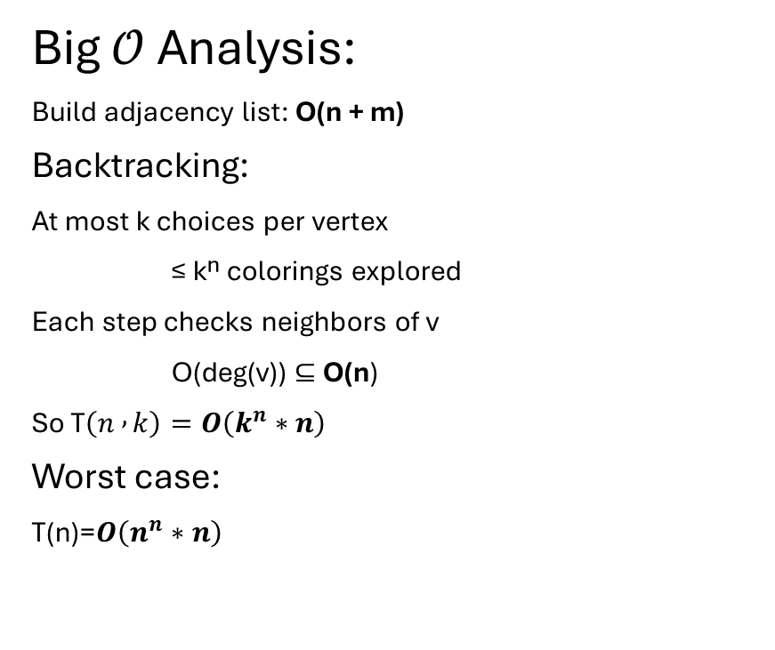
Analytical Runtime Analysis
Big $𝒪$ Analysis:
Build adjacency list: O(n + m)
Backtracking:
At most k choices per vertex
≤ kⁿ colorings explored
Each step checks neighbors of v
O(deg(v)) ⊆ O(n)
So T$\left(n , k\right)=O\left(k^{n}∗n\right)$
Worst case:
T(n)=$O\left(n^{n}∗n\right)$

Slide 7
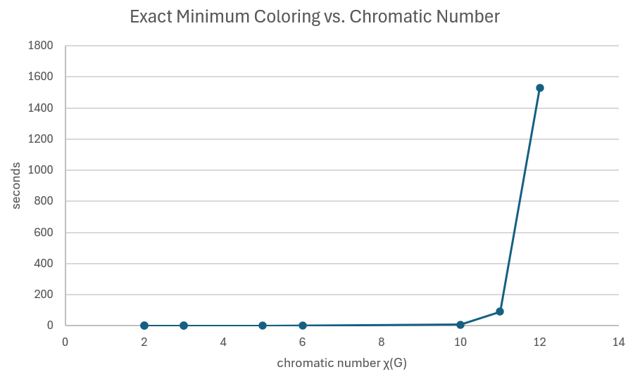
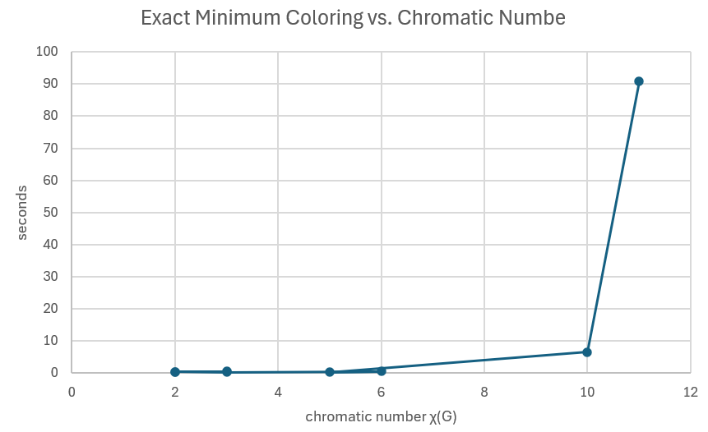
Empirical Runtime Analysis

