Slide 1
Minimum Vertex Coloring
Exact Solution
By: Ronnie Harshbarger

Slide 2
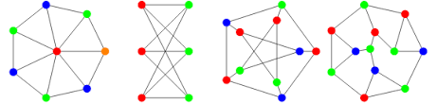
Problem: Minimum Vertex Coloring
Goal: minimize number of colors
Assign colors to vertices
Adjacent vertices must have different colors

Slide 3
Decision vs. Optimization
Optimization Version
Find χ(G) and give a coloring achieving it
Input:
Graph G
Output:
χ(G)
Valid coloring using exactly χ(G) colors
Decision Version (k-Coloring)
Does G have a valid coloring using ≤ k colors?
Input:
graph G
k = 3
Output:
Yes/No

Slide 4
Certifier Process
Certifier Process for k-coloring:
- Certificate = an array color[v] for every vertex
Must use colors in {0, …, k−1}
Certificate verification runs in polynomial time, so k-Coloring ∈ NP
for each v in V:
if color[v] not in 0..k-1: reject
for each (u,v) in E:
if color[u] == color[v]: reject
accept
Total work = O(|V| + |E|)

Slide 5
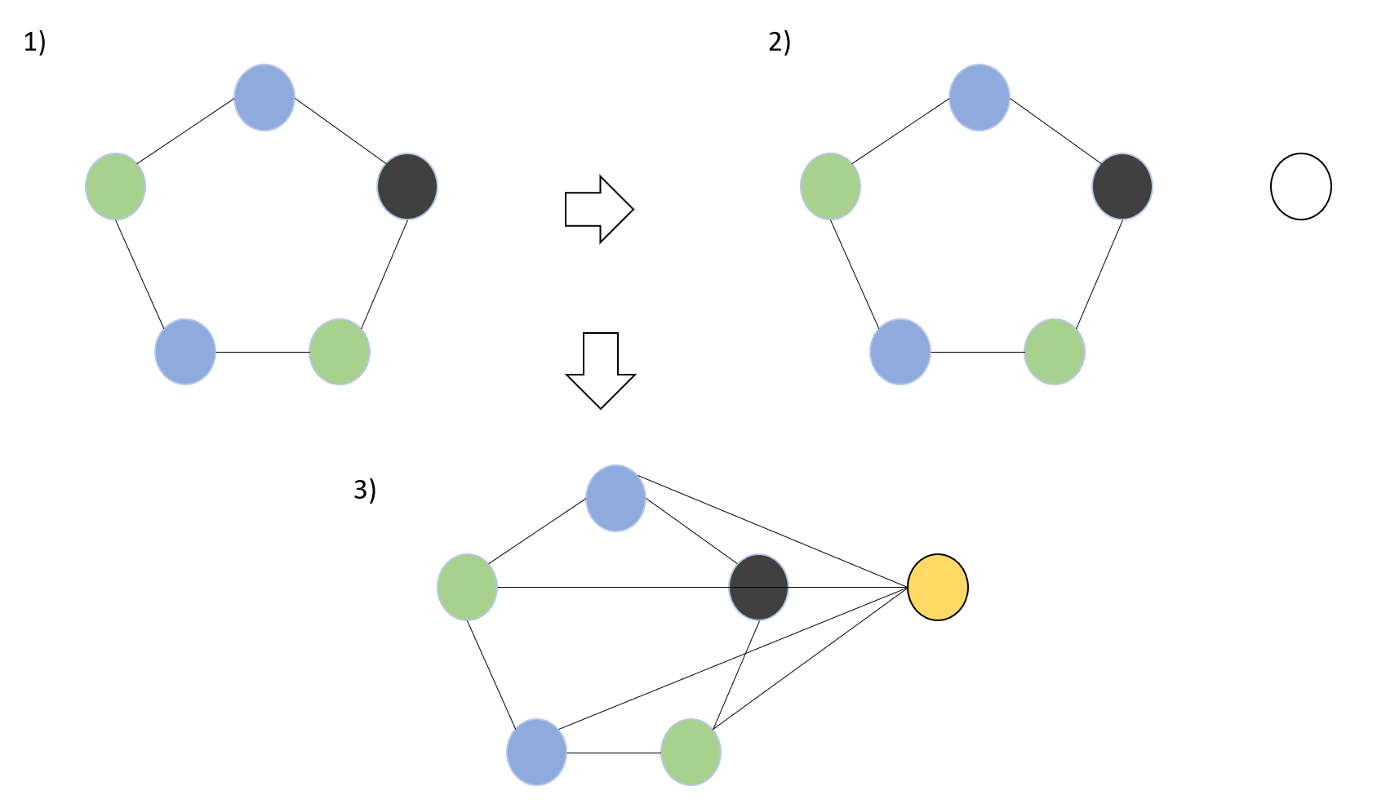
Reduction: 3-Coloring NP-hard Problem
3-Coloring
Input: graph G
Can G be colored with ≤ 3 colors?
3-Coloring is NP-complete
Minimum Coloring
Give the same graph G to minimum coloring solver
If solver returns χ(G) ≤ 3 → YES
If solver returns χ(G) ≥ 4 → NO
The minimum coloring solver’s output directly answers the 3-Coloring instance
Running the solver on G is polynomial-time

Slide 6
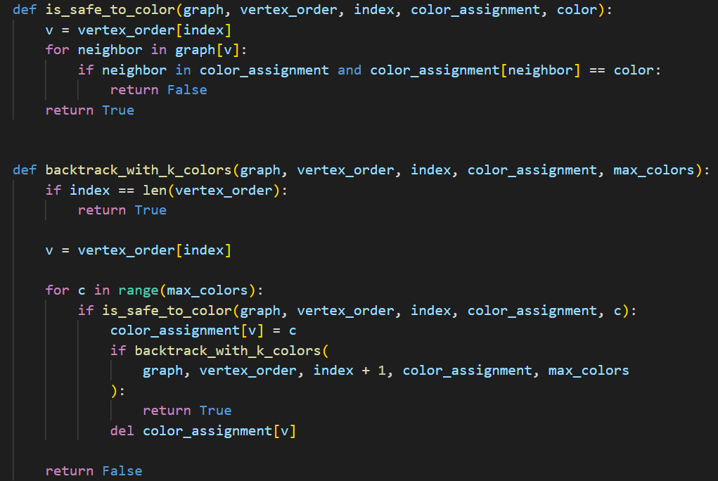
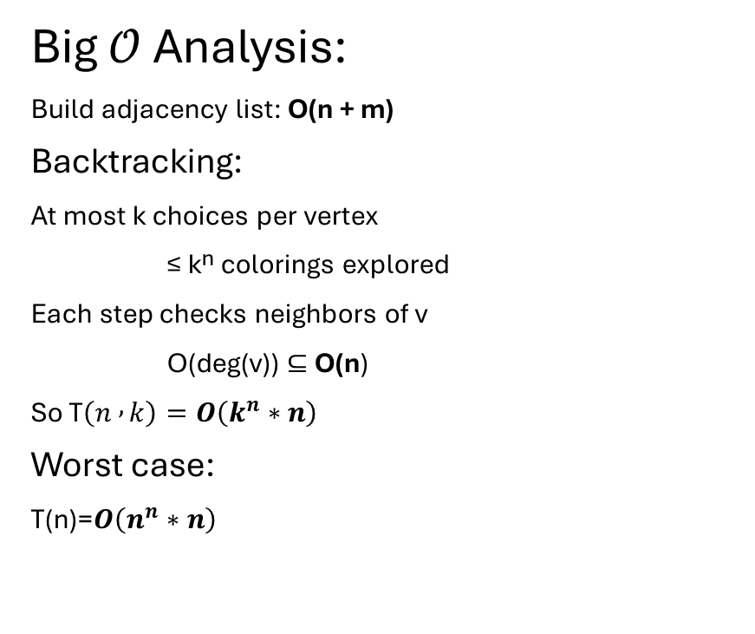
Analytical Runtime Analysis
Big $𝒪$ Analysis:
Build adjacency list: O(n + m)
Backtracking:
At most k choices per vertex
≤ kⁿ colorings explored
Each step checks neighbors of v
O(deg(v)) ⊆ O(n)
So T$\left(n , k\right)=O\left(k^{n}∗n\right)$
Worst case:
T(n)=$O\left(n^{n}∗n\right)$

Slide 7
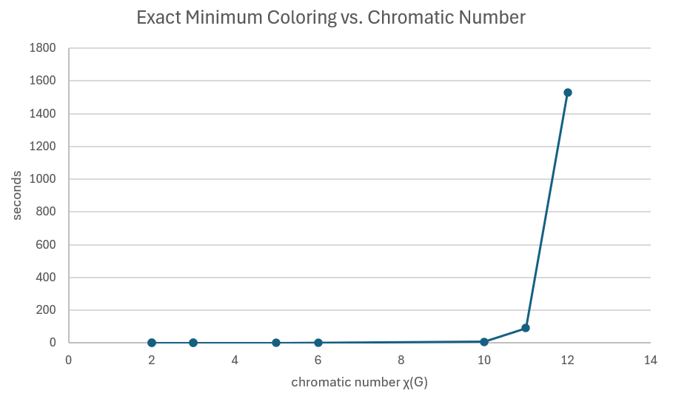
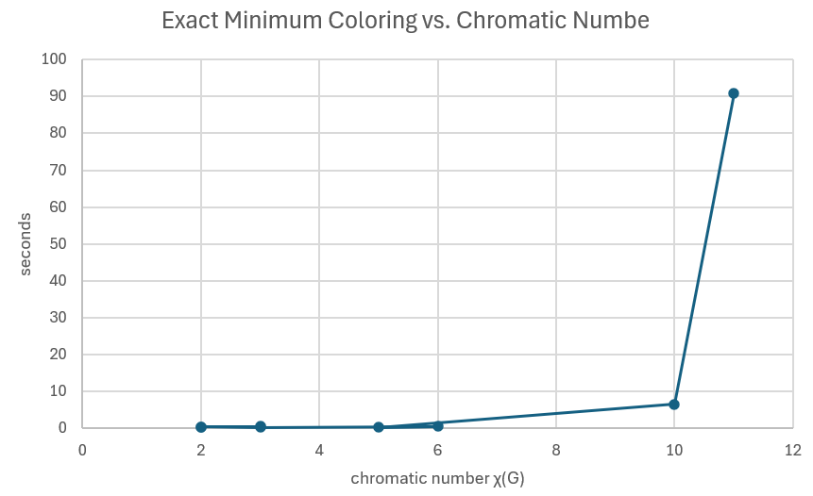
Empirical Runtime Analysis

Slide 8
Min Graph Coloring: Approximate Solution
By: Braden Drake

Slide 9

Strategy and Pseudocode
Randomized Greedy Strategy
Randomizes the vertex order
Assign the smallest color not used by neighbors
This always produces a valid coloring
Reason for Randomization
Greedy being optimal or near optimal depends on the order the vertices are visited
Use randomness to reduce worst case behavior
This greedy solution is O(V + E)
Optimal or near optimal for normal graphs
Scales well (n > 1000 vertices)
Approx Solution:
Shuffle the vertices randomly
For each vertex v in the shuffled vertices:
used_col = colors of neighbors
assign v the smallest color not in used_col

Slide 10
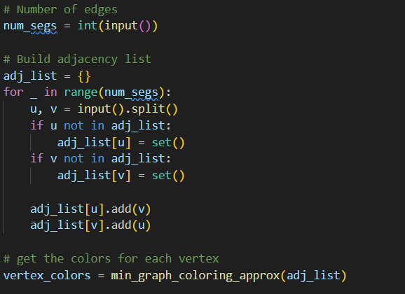
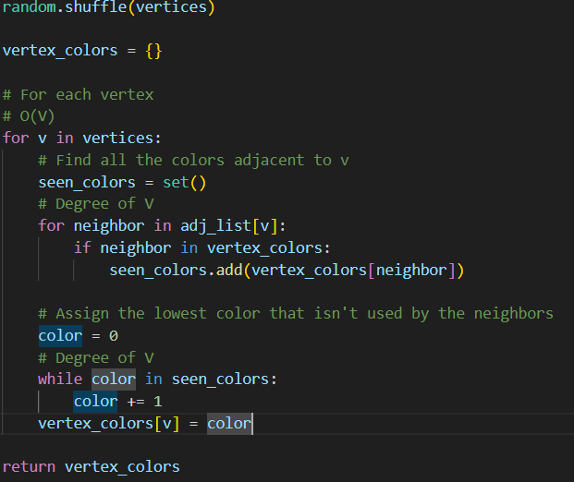
Analytical Runtime
Building adjacency list: O(E)
Shuffling vertices: O(V)
Outer loop runs V times, each time: O(deg(V) + deg(V)) = O(deg(V)
This becomes O(2E) = O(E)
So algorithm = shuffle + loop = O(V) + O(E) = O(V + E)
Total Runtime = build + algorithm = O(E) + O(V + E) = O(V + E)

Slide 11
Non-Optimal Result
Greedy fails when unlucky
The greedy solution depends on the order
If it randomizes to an unlucky vertex order, it can produce more colors than what is optimal
Imagine the order is:
A->B->C->E->F->D
Optimal:
0
0
1
0
0
1
A
B
C
A
B
C
D
E
F
D
E
F
1
2
2
3
2
1

Slide 12
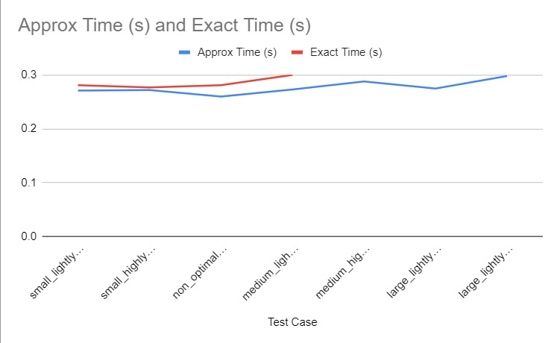
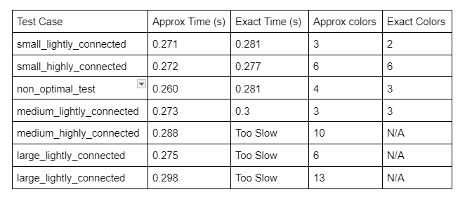
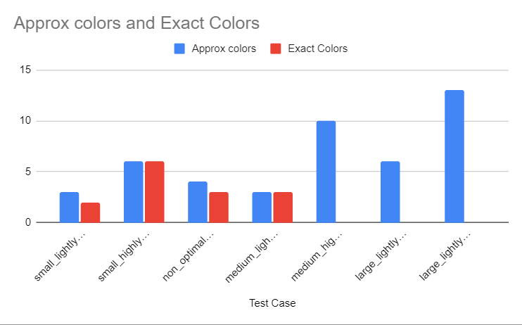
Runtime Performance Exact vs Approx

Slide 13
Lower Bound for Min Graph Coloring
Hoffman Lower Bound

Slide 14
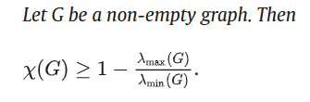
Formula
x(G) represents the chromatic color
𝜆 represents the graphs eigenvalues

Slide 15
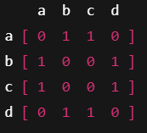
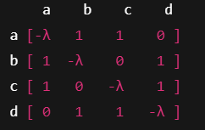
Uses the adjacency matrix

Slide 16
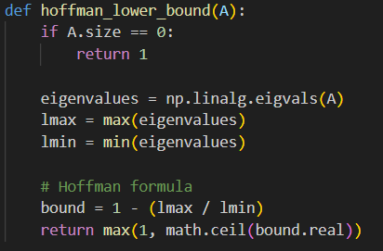
How this looks as code
The math for the eigenvalues is handled by NumPy
A is the adjacency matrix
Ceil rounds them up

Slide 17
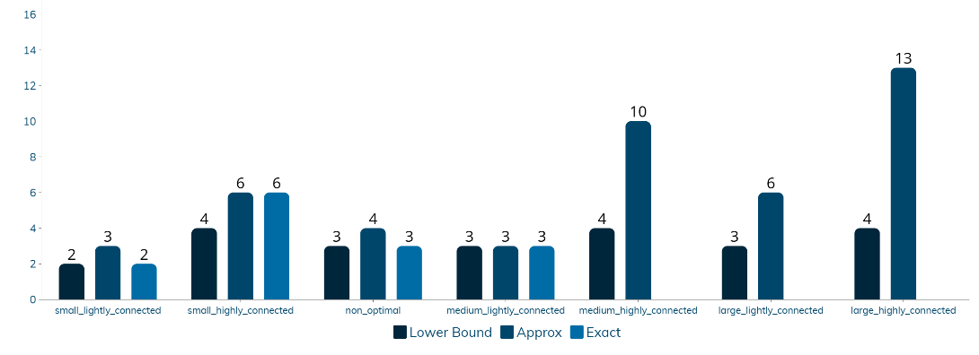
Graph with lower bound added

