Slide 1
Multimedia Storage Transmission and Acquisition Techniques

Slide 2
Outline
Data Storage
Data Transmission
Data Acquisition
Multimedia data acquisition
Data Acquisition Hardware and Software

Slide 3
Definitions
Data Storage
Data need storage space before, during or after processing in terms of temporary or permanent storage.
Data transmission
After or during processing, data may need to be transmitted between different devices on the same system/machine or at a distant through the internet or intranet

Slide 4
Definitions
Data acquisition
Data acquisition is the process of sampling signals that measure real world physical conditions and converting the resulting samples into digital numeric values that can be manipulated by a computer. The components of data acquisition systems include:
Sensors, to convert physical parameters to electrical signals.
Signal conditioning circuitry, to convert sensor signals into a form that can be converted to digital values.
Analog-to-digital converters, to convert conditioned sensor signals to digital values.

Slide 5
Multimedia Data Acquisition
For multimedia data analysis, we need to store the multimedia data and process it. During processing, multimedia data may need to be transmitted through networks or between devices.
Acquisition is directly related to both storage and transmission because whatever is acquired is directed to either storage or transmission.
The examples of multimedia data sources are:
audio sources (e.g. microphones)
image sources (e.g. Camera)
These produce continuous time analogy signals (e.g. output voltages)
In order to store audio or video data into a computer, we must sample and digitize the data.

Slide 6
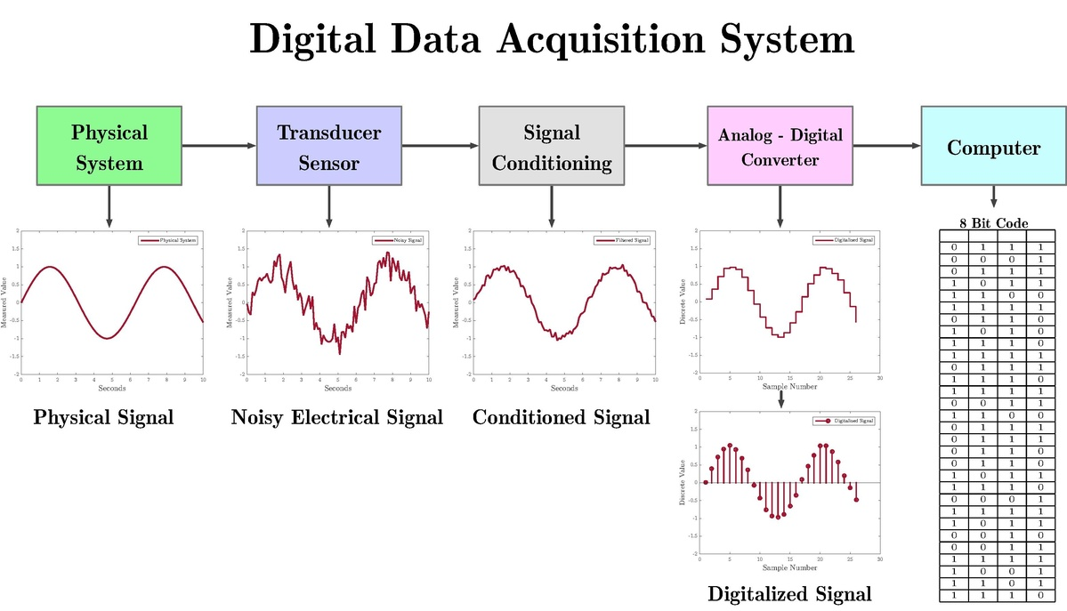
Source: Enrique Z.L., 2019

Slide 7
Data Acquisitision Hardware and Software

Slide 8
DAQ hardware
DAQ hardware is what usually interfaces between the signal and a PC.
It could be in the form of modules that can be connected to the computer's ports (parallel, serial, USB, etc.) or cards connected to slots (S-100 bus, PCI, PCI-E, etc.) in the motherboard.
Usually the space on the back of a PCI card is too small for all the connections needed, so an external breakout box is required.
The cable between this box and the PC can be expensive due to the many wires, and the required shielding.

Slide 9
DAQ hardware
DAQ cards often contain multiple components (multiplexer, ADC, DAC, TTL-IO, high speed timers, RAM).
These are accessible via a bus by a microcontroller, which can run small programs.
A controller is more flexible than a hard wired logic, yet cheaper than a CPU so that it is permissible to block it with simple polling loops.

Slide 10
DAQ device drivers
DAQ device drivers are needed in order for the DAQ hardware to work with a PC.
The device driver performs low-level register writes and reads on the hardware, while exposing API for developing user applications in a variety of programs.

Slide 11
Input devices
Examples of input devices in the DAQ system are:
3D scanner
Analog-to-digital converter
Time-to-digital converter

Slide 12
Other Hardware
Computer Automated Measurement and Control (CAMAC)
Industrial Ethernet
Industrial USB
LAN eXtensions for Instrumentation
PCI eXtensions for Instrumentation
etc

Slide 13
DAQ software
DAQ software tools used for building large-scale data acquisition systems include Experimental Physics and Industrial Control System (EPICS).
Other programming environments that are used to build DAQ applications include,Visual C++, Visual Basic, LabVIEW, and MATLAB etc

