Slide 1
AI-Based FDM 3D Printing Defect Detection
CNN transfer learning system for automated print quality inspection
96.52%
Test Accuracy
8
Detected Classes
4405
Images
96.50%
Weighted F1
Application Purpose
- Automatically classify FDM 3D printing defects from camera images
- Provide confidence score, likely causes, and corrective actions
1

Slide 2
Problem Statement
Manual inspection limitations
- Slow and inconsistent
- Defects may appear while print is still running
- Failed prints waste time, filament, and machine usage
AI solution
- Camera image is passed to a CNN
- Model predicts defect category
- System gives feedback for quality control
2

Slide 3
Dataset
Expanded dataset
- Merged Kaggle FDM defect datasets
- Folder-per-class image classification format
- 0 corrupt images found
- Classes: Cracking, Layer_shifting, No_defect, Off_platform, Spaghetti, Stringing, Under_extrusion, Warping
3083
Training
661
Validation
661
Testing
224x224
Input Size
3

Slide 4
Defects Detected
Detected classes
- Cracking
- Layer_shifting
- No_defect
- Off_platform
Detected classes
- Spaghetti
- Stringing
- Under_extrusion
- Warping
4

Slide 5
Model Architecture
EfficientNetB0 transfer learning
Pipeline
- Input image resized to 224 x 224
- Data augmentation improves robustness
- EfficientNetB0 backbone extracts visual features
- Dense softmax layer predicts 8 classes
- Class weighting handles imbalanced classes
- Fine-tuning adapts ImageNet features to FDM defects
5

Slide 6
Training Workflow
Workflow
- Load and inspect dataset
- Stratified train/validation/test split
- Train classifier head
- Fine-tune final EfficientNet layers
- Save best validation model
- Evaluate on held-out test set
- Generate confusion matrix and classification report
6

Slide 7
Final Results
96.52%
Test Accuracy
96.95%
Macro F1
96.50%
Weighted F1
0.1058
Test Loss
Key observation
- Most defect classes achieved high F1-score
- No_defect and Under_extrusion are comparatively harder due to visual similarity
- Result is strong for mixed datasets and real-world image variation
7

Slide 8
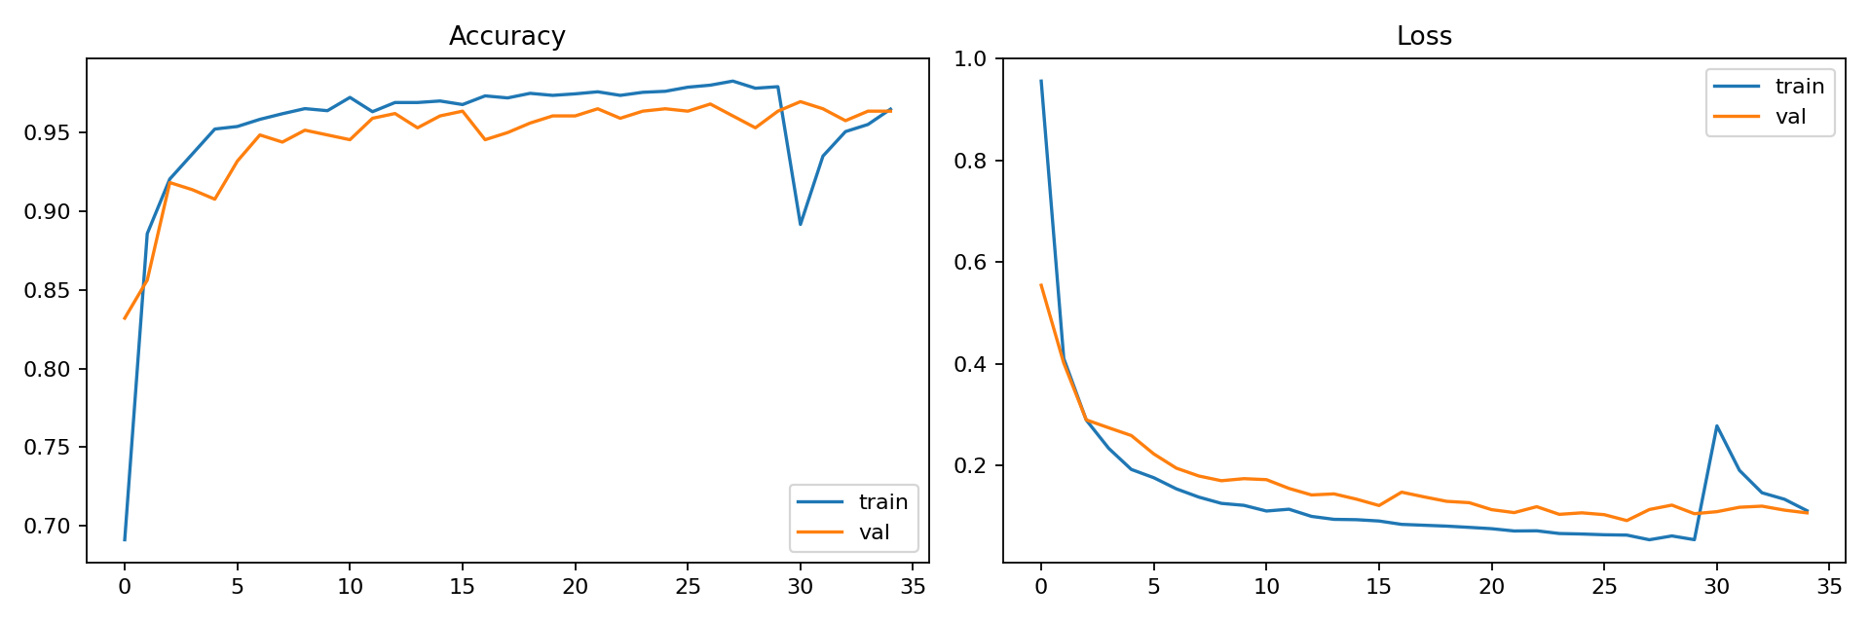
Training Curves
Training and validation accuracy/loss across training phases
8

Slide 9
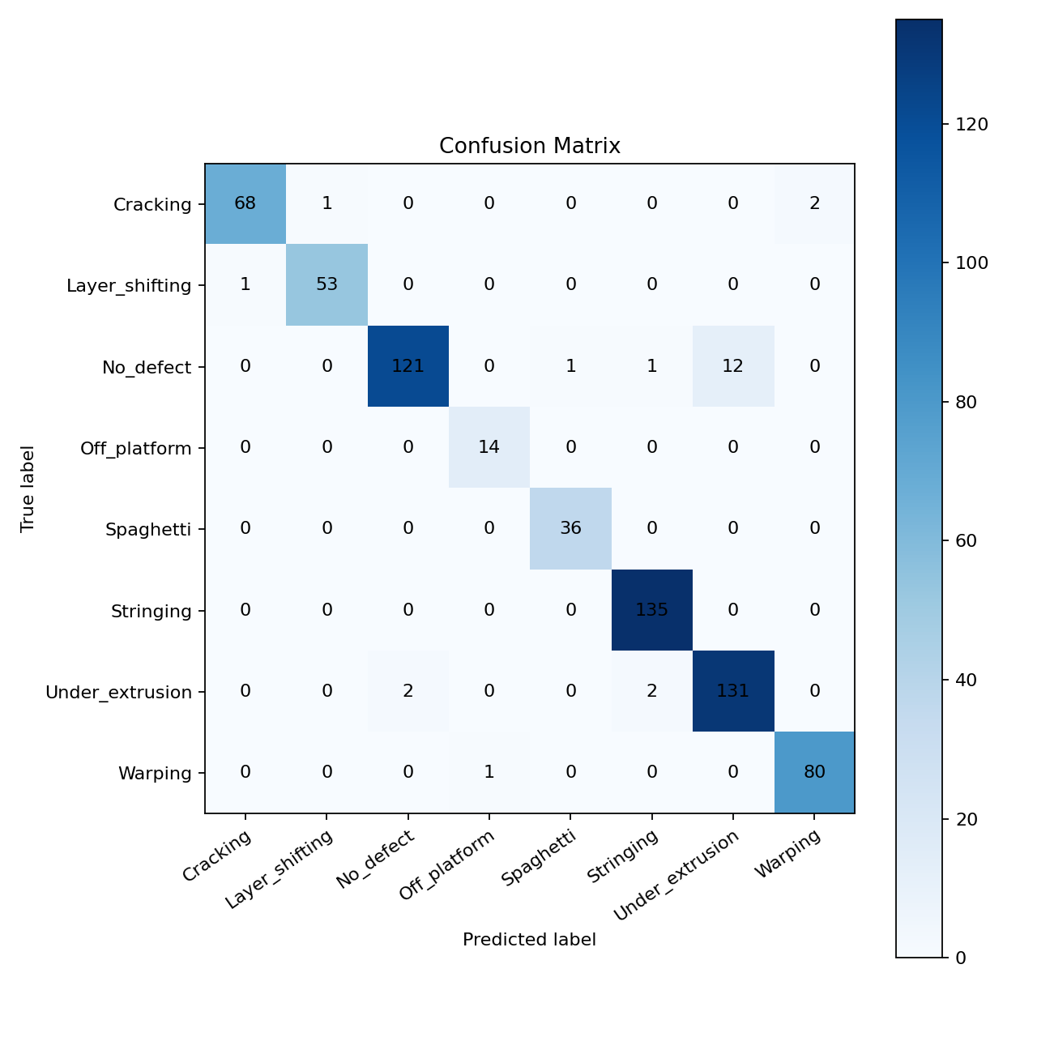
Confusion Matrix
Class-wise correct and incorrect predictions on the test set
9

Slide 10
Per-Class Performance
precision recall f1-score support Cracking 0.9855 0.9577 0.9714 71 Layer_shifting 0.9815 0.9815 0.9815 54 No_defect 0.9837 0.8963 0.9380 135 Off_platform 0.9333 1.0000 0.9655 14 Spaghetti 0.9730 1.0000 0.9863 36 Stringing 0.9783 1.0000 0.9890 135 Under_extrusion 0.9161 0.9704 0.9424 135 Warping 0.9756 0.9877 0.9816 81 accuracy 0.9652 661 macro avg 0.9659 0.9742 0.9695 661 weighted avg 0.9662 0.9652 0.9650 661
10

Slide 11
Interactive Demo
App features
- Continuous OpenCV camera scanning
- Five-prediction temporal averaging
- Uncertainty warning below 60%
- AI feedback and risk level
- Axis and nozzle inspection guidance
- Optional OctoPrint telemetry
Recommended launch
cd /home/ron/ml/fdm_defect_detection
.venv/bin/python src/live_dashboard.py
Open:
http://127.0.0.1:8765
Camera releases when page closes
11

Slide 12
AI Feedback and Telemetry
Beyond classification
- Predicts class, confidence, and operational risk
- Maps defects to likely causes and corrective actions
- Marks low-confidence frames as uncertain
- Shows temperature and progress when OctoPrint is connected
- Keeps unavailable values explicit instead of fabricating telemetry
- Never moves axes or changes heaters automatically
12

Slide 13
Limitations
Current limitations
- Model predicts image-level class, not bounding-box location
- 96.52% is an image-level held-out result
- Cross-printer and cross-recording generalization is not yet established
- Accuracy may change with camera angle, lighting, printer, or material
- Monitoring is decision support, not closed-loop control
13

Slide 14
Future Work
Possible improvements
- Add more classes: over-extrusion, nozzle clog, blobs/zits, layer separation
- Add YOLO-based defect localization
- Use Grad-CAM in live feedback
- Collect own printer-camera dataset
- Add human-approved closed-loop correction
14

Slide 15
Conclusion
Conclusion
- Built an eight-class AI system for FDM defect detection
- EfficientNetB0 achieved 96.52% image-level test accuracy
- OpenCV dashboard provides continuous monitoring and uncertainty handling
- Explainability, feedback, and optional telemetry support operator decisions
- External printer-session validation remains the next research step
15

