Slide 1

WATER WELLS FUNCTIONALITY CONDITION

Slide 2
Problem Statement
Access to clean and functional water sources remains a major challenge in Tanzania, especially in rural and underserved regions. Although thousands of water wells have been installed across the country, a significant number are either non-functional or in need of repair. The lack of timely maintenance, poor infrastructure planning, and limited resource allocation contribute to this issue, leaving many communities without reliable access to safe water.

Slide 3
GOALS
Build a predictive model that classifies the condition of water wells in Tanzania as . Functional . Functional but needs repair . Non-functional Purpose : Help NGOs prioritize well repairs and plan new installations.

Slide 4
Business Understanding
Tanzania struggles with providing reliable access to clean water, especially in
rural areas. Many existing water wells are non-functional or in need of repair,
impacting millions. This project aims to build a machine learning model that
predicts the condition of water wells based on features like pump type,
construction year, and location. The model will support NGOs, government
agencies, and donors in identifying at-risk wells and prioritizing repairs
ultimately improving water access and resource allocation.

Slide 5

Data Understanding
The dataset comprises information about over 59,000 water points across Tanzania,
collected to assess their operational status. The target variable, Status_group,
represents, functional, functional needs repair, or non functional.
A preliminary analysis revealed data quality issues such as missing
values,inconsistent labels, and class imbalance especially underrepresentation of the
functional needs repair category. Understanding these variables and their
relationships is critical to building a model that can help NGOs and government agencies target interventions effectively.

Slide 6
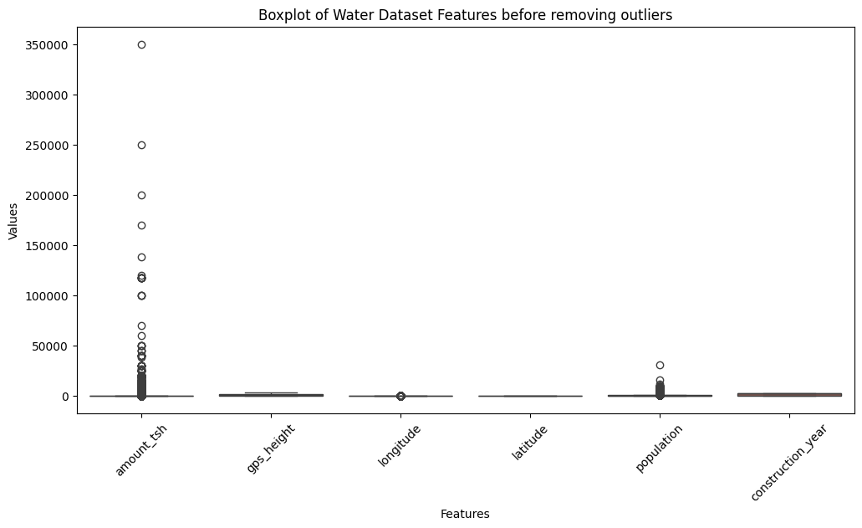
Data Challenges
Missing values in key features
Imbalanced classes
Textual inconsistencies

Slide 7
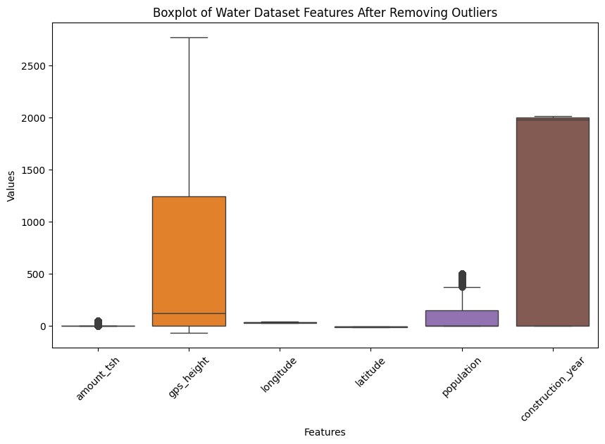
Data Preparation
Removed outliers and irrelevant fields.
Handled missing data with imputation.
Encoded text fields using one-hot encoding.
Scaled numeric fields for better model performance.

Slide 8
To predict the condition of water wells in Tanzania, I applied a variety of classification models. These models help us group wells into categories like functional, needs repair, or non functional. Baseline Model -Logistic Regression Chosen Logistic Regression as a starting point due to its simplicity and interpretability.
It provides a clear relationship between input features and predictions, which helps in understanding the influence of each factor. Acts as a benchmark to evaluate whether more complex models offer improvements.
Modeling Approaches

Slide 9
Decision Tree
Decision tree model makes decisions based on a series of if-then rules, like a flowchart.
Easy to interpret visually and helpful in understanding which features lead to well failure
or functionality.
However, it can overfit the data, which means it may not perform as well on new unseen data.

Slide 10
Random Forest
Random Forest is an ensemble model made by combining many decision trees.
Offers more robust and accurate predictions than a single decision tree.
Naturally handles missing values and class imbalance better, and it reduces the overfitting problem.
Especially useful in our case where we have complex interactions between features.

Slide 11
Evaluation Metrics
Accuracy - How often the model was right overall.
F1 Score - Balance of precision and recall – good for imbalanced data.
Precision - The proportion of correct positive predictions out of all positive predictions made.
Recall - The proportion of actual positives that were correctly identified.
Confusion Matrix - Shows model’s strengths and weaknesses by class.

Slide 12
Model Performance Comparison
Logistic Regression Accuracy was 69%
Decision Tree Slight improvement 70%
Random Forest Best results with 79% accuracy and strong F1 score
Chosen Model Random Forest (after tuning)

Slide 13
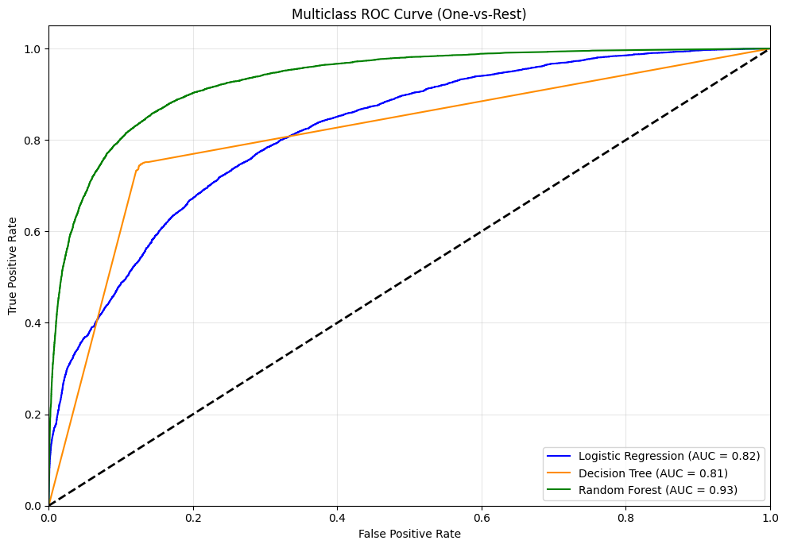
Random forest was the best

Slide 14
Recommendations
Adopt Random Forest as the Preferred Model
As Among the three, `Random Forest` delivers the best overall F1 score (79.53%), indicating a strong balance between identifying pumps correctly while limiting false predictions.
It outperforms Decision Tree and Logistic Regression especially on the most critical class: `functional needs repair` where early detection can prevent full pump failure.
Prioritize Improvement on 'Needs Repair’ Predictions
This class has the lowest precision across all models, meaning many predictions in this category may not actually need repair.
Business risk Sending technicians unnecessarily, increasing operational costs.
If these borderline pumps are not flagged, they may soon fail, affecting water availability and user satisfaction.

Slide 15
Limitations
Model is only as good as the input data.
Incomplete or outdated information may reduce prediction accuracy.
Rare class Needs Repair remains harder to predict confidently.

Slide 16
Thank You!
Questions?

