Slide 1
Tango
Distributed data systems over a shared log

Slide 2
Common design pattern: distribute data, centralize metadata.
ex. Name node for a distributed file system , allocators, shedulers.

Slide 3
What it is
Abstraction for metadata services in distributed systems.
Built in c++, with bindings for java and c#
Tango consists of Two parts
1: history (ordered sequence of updades)
2: view (locally constructed data structure, populated from history)
Data structutes bulit with tango:
ZooKeeper (TangoZK, 1Klines)
BookKeeper (TangoBK, 300 lines)
implementations of the Java and C# Collections interfaces TreeSets and HashMaps (100 to 300 lines each

Slide 4
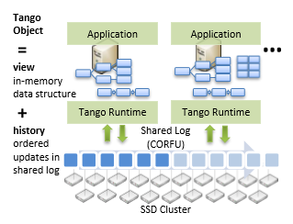

Slide 5
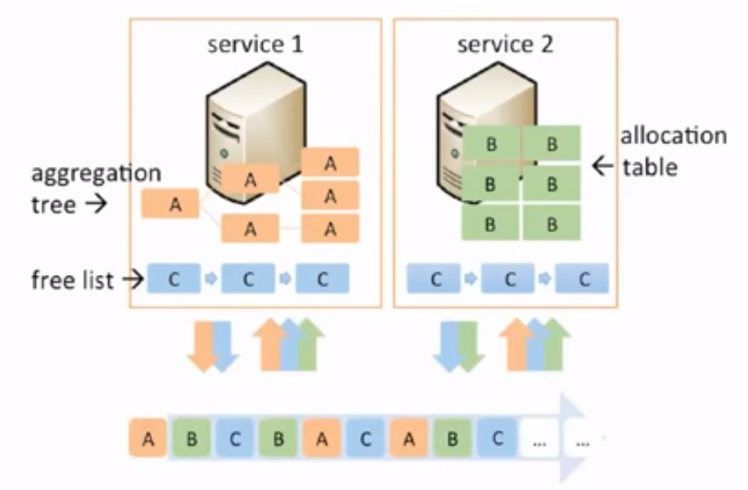

Slide 6
What it was made for
Made to handle and decentralize metadata such as indices, namespaces, membership, locks, or resource lists.
data structures such as maps, trees, counters, queues, or graphs (not limited to one)
Ease of use
allowing developers to convert a centralized system to a distributed system whitout rewriting most of the code.
Speed
An alternative to paxos algorithm

Slide 7
How it works
provides applications with abstraction of an in memory data structure backed by a shared log
The state of an application is shared
provides a set of objects, similar to java collections or C++ STL

Slide 8
CORFU
CORFU, a high-throughput distributed shared logging service
4 basic calls
Read
Append
Check (current tail of the log)
Trim (garbage collection)

Slide 9
Tango object components
-it contains the view, which is an inmemory representation of the object in some form, such as a list or a map
-it implements the mandatory apply upcall which changes
the view when the Tango runtime calls it with new entries
from the log.
-an external interface consisting of object-specific mutator and accessor methods (get/put , read/write)

Slide 10
Provides
Strong consistency
Durability
History
Elasticity
Atomicity
Isolation

Slide 11
Durability:
If a clients goes down and loses all data, it can reconstruct the data structure by playing the log forward.
History:
Client can access previous states of the system trough the log, making a new view within the timeframe of the desired state

Slide 12
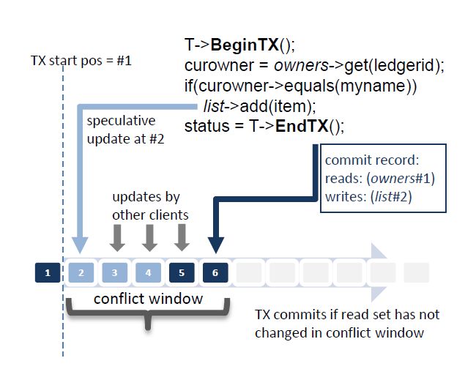
Elasticiety:
New instances can be created on new machines by playing the shared log
Atomicity and isolation:

Slide 13
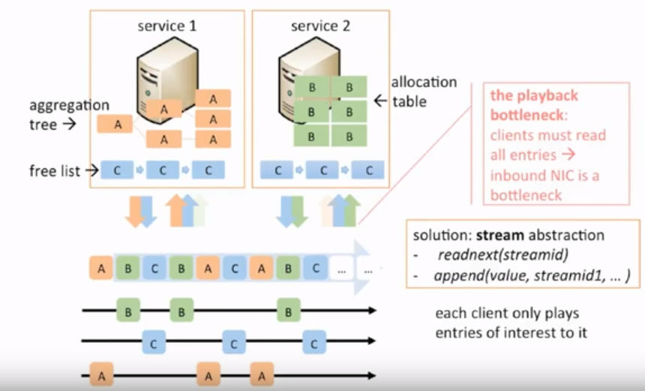
Decreasing network interface load

Slide 14
Conclusion
Tango objects are easy to program
Most key features provded the shared log

