Slide 1
Customer Crunch Analysis
Understanding Retention & Subscription Behavior
By – Ranajit Dey

Slide 2




Problem Statement:
I wanted to understand how customers interact with a subscription-based service and answer the following questions -
01
02
03
04
How many signups actually convert?
How many customers come back for a second purchase?
How quickly do people churn?
Is the revenue growth of streaming service sustainable?

Slide 3
Source:
CSV file with 2,800+ unique customers and 3,000+ subscriptions
Dataset
Overview
Columns included:
Customer ID, signup date, subscription start/end, price, paid/unpaid flag, etc.
Timeframe:
Covers subscriptions over multiple months
Goal:
Find trends in retention, churn, and revenue contribution

Slide 4
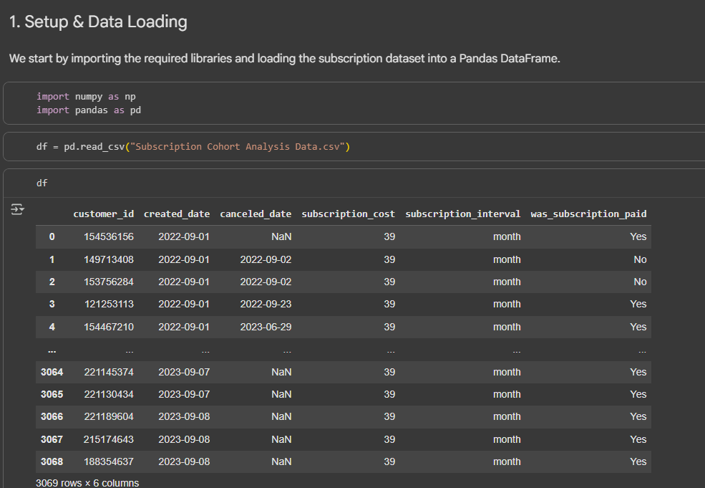
Data
Loading

Slide 5
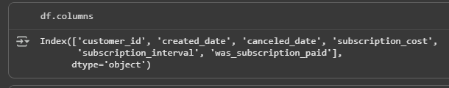
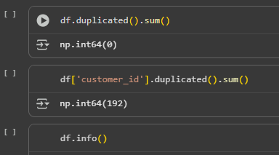
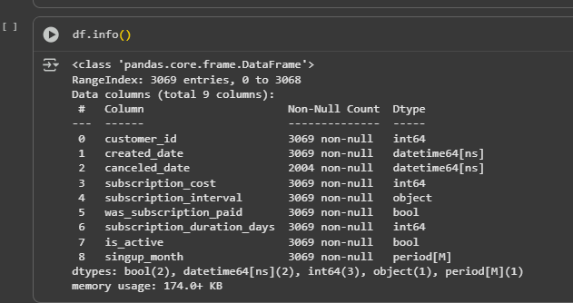
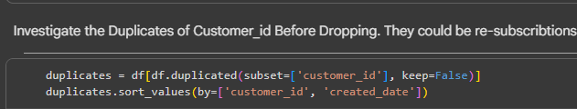
Data Cleaning
Feature Engineering
AND
Before feature Engineering
Cleaning
After Feature Engineering

Slide 6
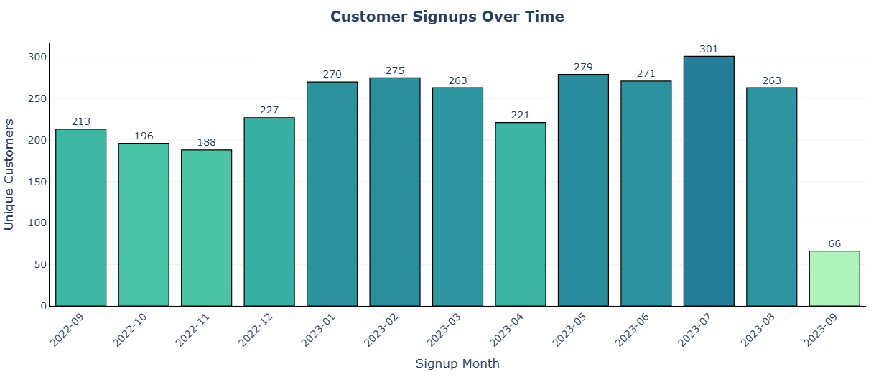
Key Visuals

Slide 7

Insights & Learnings
Only about 6% of customers return for a repeat subscription. This highlights a major gap in building long-term relationships with users. The service struggles to convert them into loyal, recurring customers.
Low Customer Loyalty
The overall churn rate is around 65%, which is quite concerning. This means that the majority of customers do not stick with the service after their first experience. For a subscription-based business, This rate can stall growth and increase acquisition costs.
High Churn Rate
Almost 11% of customers churn within 7 days of joining. This early exit suggests possible issues with customer onboarding, expectation mismatch, or product value not being realized quickly.
Early Dropouts Within the First Week
Flat Revenue
Contribution
The Average Revenue Per User (ARPU) is $39.80, which matches the flat subscription fee. it also shows that revenue growth heavily depends on reducing churn.

