Slide 1

VRINDA STORES SALES REPORT 2022 ANALYSIS
RONOJOY GOSWAMI

Slide 2

Project Objective: Create an Interactive Dashboard for Vrinda Store Sales 2022
Hello everyone,
I am excited to share my comprehensive analysis of Vrinda Stores’ Sales for the year 2022. The data was collected from Rishabh Mishra’s YouTube channel and Vrinda stores wanted to analyse the sales of 2022 to understand and make business decisions to increase sales in year 2023.
The problem statements I worked on are listed below:
Comparison of sales and orders in the store for 2022
Which month had the highest sales and orders
Who purchased more products: Men or Women
What are the different order status for 2022
List of 10 top states contributing to max sales
Relation between age and gender based on orders
Which channel contributed towards max sales
Prepare a search box to view details of any order with Order ID
Skillsets used: I have followed the needed steps for Data Cleaning, Data Processing, Data Analysis, and Visualization using MS Excel and prepared the presentation using PowerPoint.

Slide 3
The first 20 records as per the working table is shown below:

Slide 4
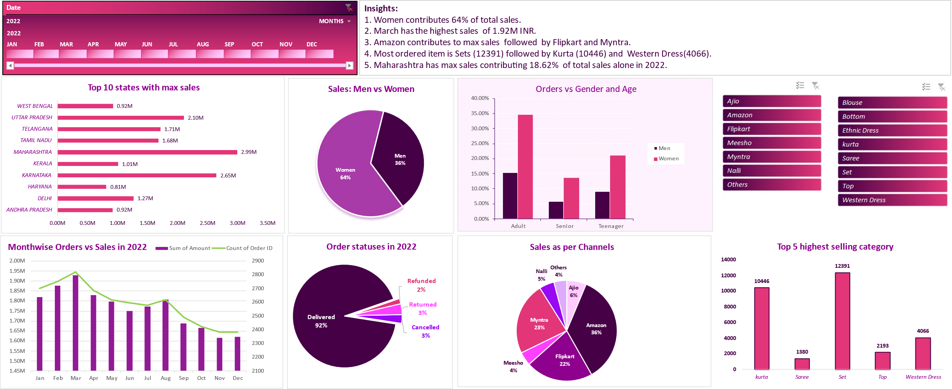
VRINDA STORES ANNUAL REPORT 2022

Slide 5
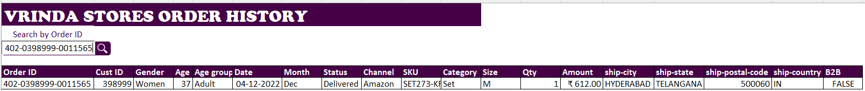
Search box to view details of order by Order ID:
Conclusion to improve Vrinda Stores Sales: Target women customers of the age group (30 to 49 years) living in Maharashtra, Karnataka, Uttar Pradesh, Telangana, and Tamil Nadu by providing some shopping coupons or offers and Ads available on Amazon, Flipkart, and Myntra.

