Slide 1


VXI NEW HIRE SURVEY
User Guide/Admin
Version 1.0 – JUNE 05, 2024
Version 1.1 – JUNE 29, 2024
Version 1.2 – JULY 30, 2024
Version 1.3 – AUG 28, 2024
Version 1.4 – DEC 05, 2024

Slide 2

LOGIN PAGE
"Access the HR touchpoint, and a notification will pop up prompting you to take the Hire Survey. Click the 'Take Survey' button, and you will be redirected to the login page for the New Hire Survey."

Slide 3

LOGIN PAGE
Click this icon to be redirected to the login page for the New Hire Survey

Slide 4
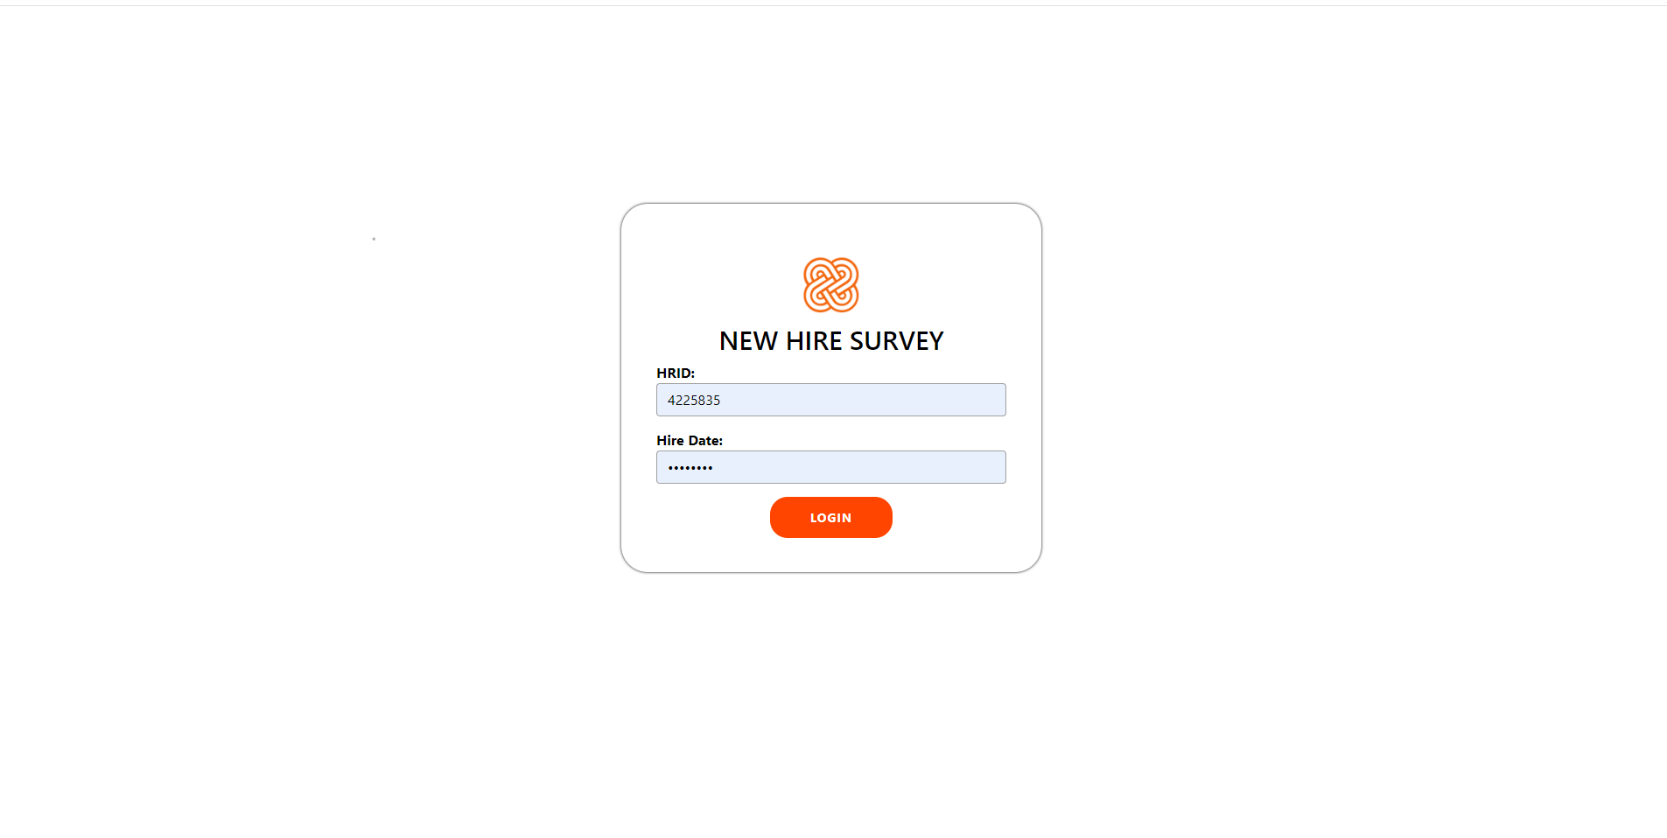
LOGIN PAGE
Input HRID
Input Hire Date
Click this button to Login

Slide 5
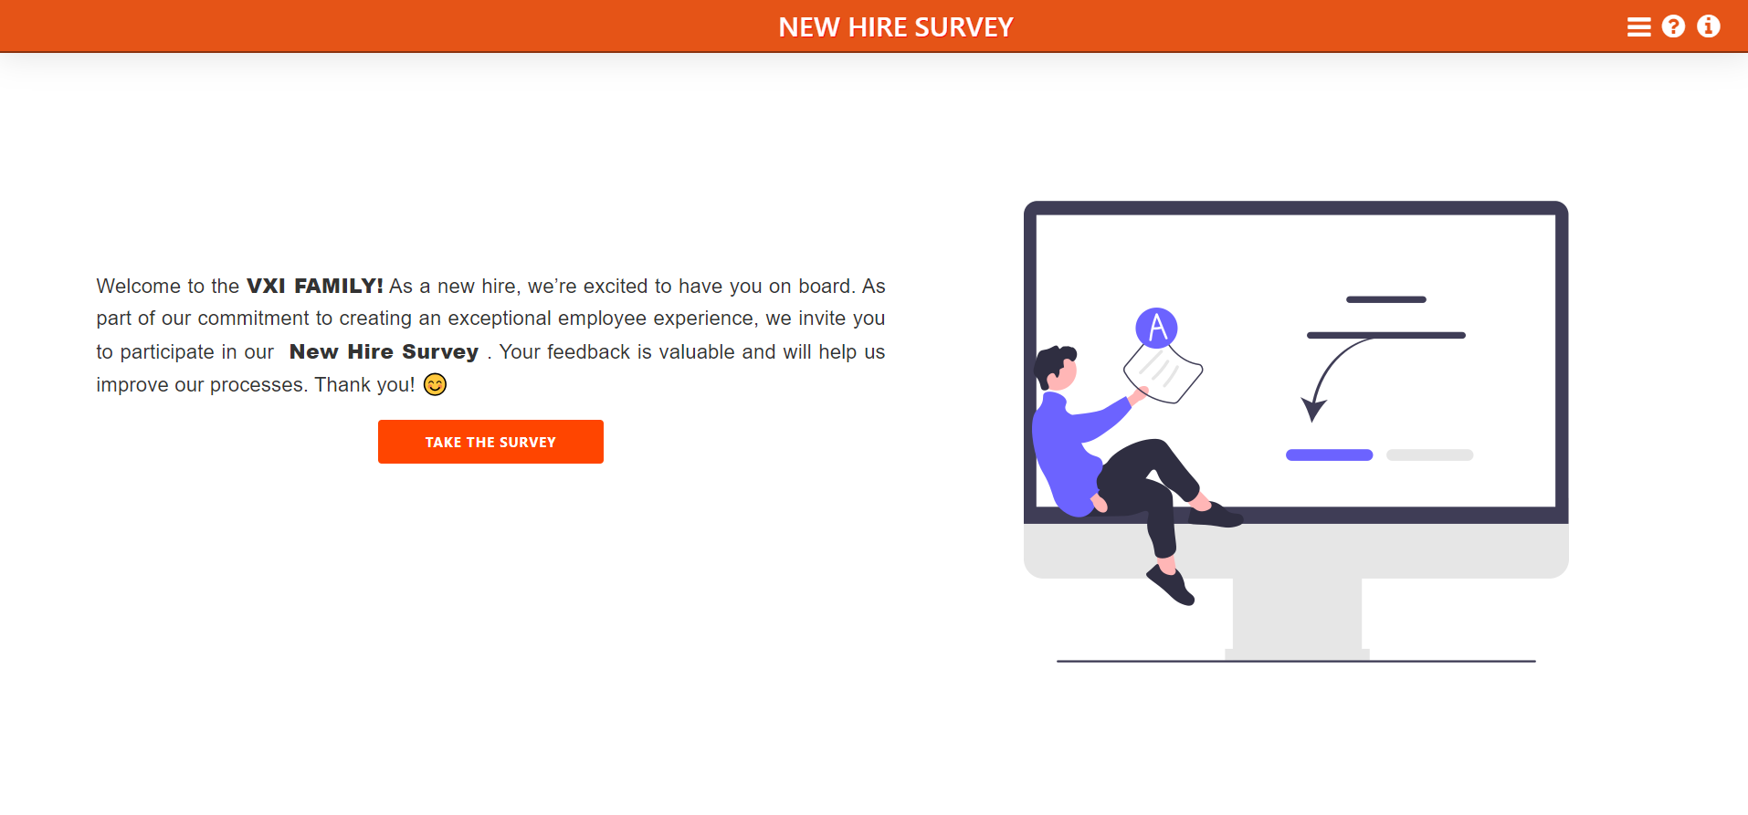
HOME PAGE
Click this button to take the survey

Slide 6
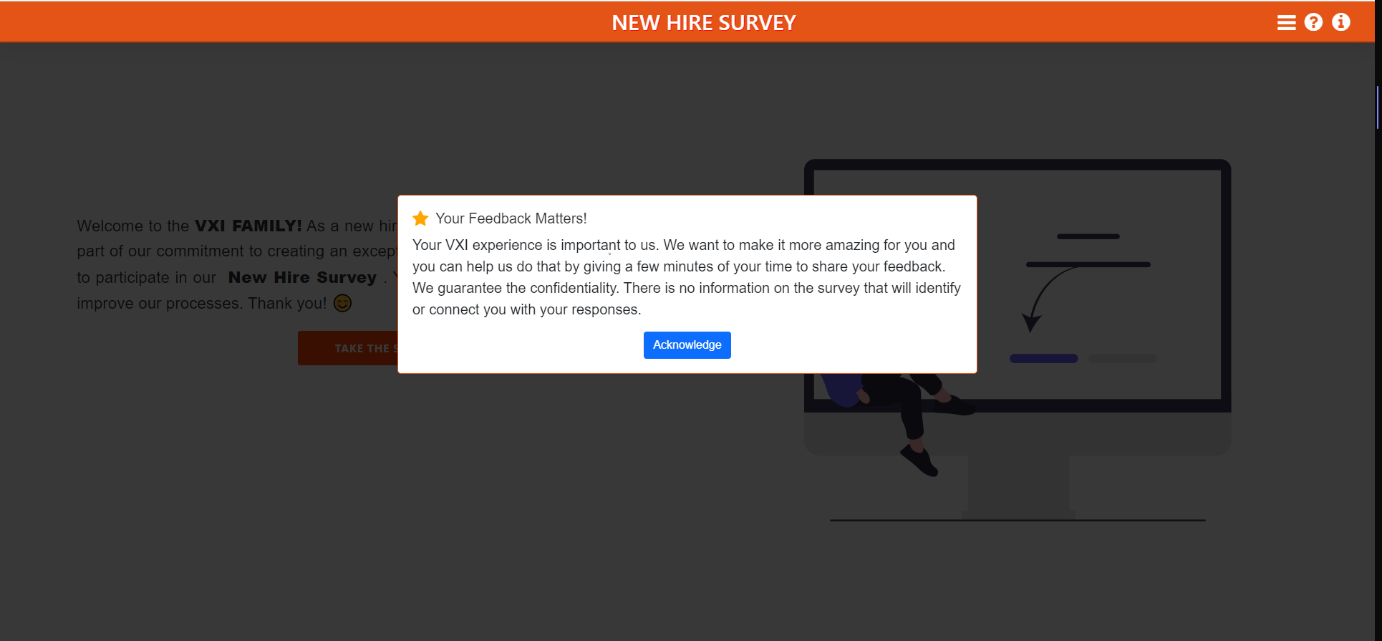
HOME PAGE
Click Acknowledge to begin the survey

Slide 7
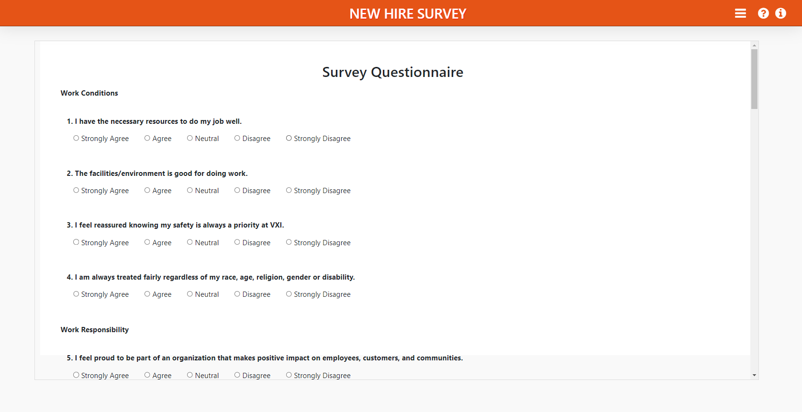
TAKE SURVEY PAGE
Select one option if you have an answer to this question
Note: All fields are required to be answered.

Slide 8
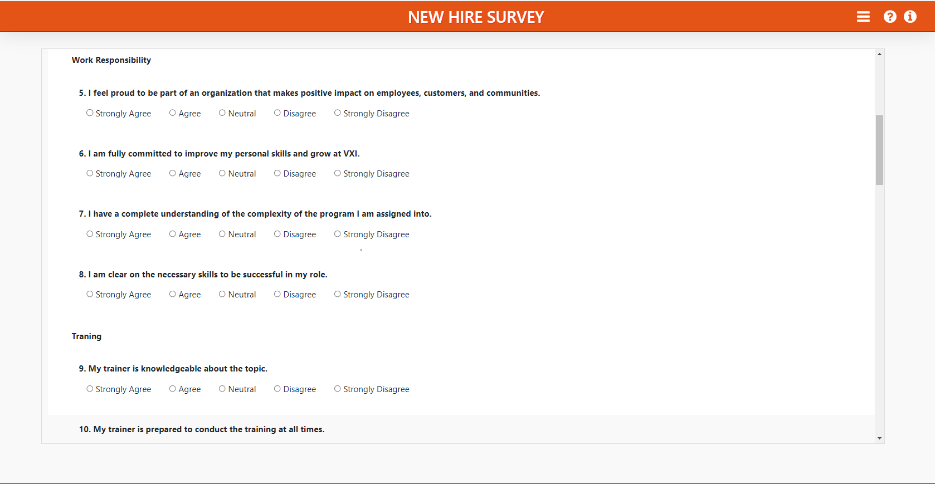
TAKE SURVEY PAGE
Select one option if you have an answer to this question
Note: All fields are required to be answered.

Slide 9
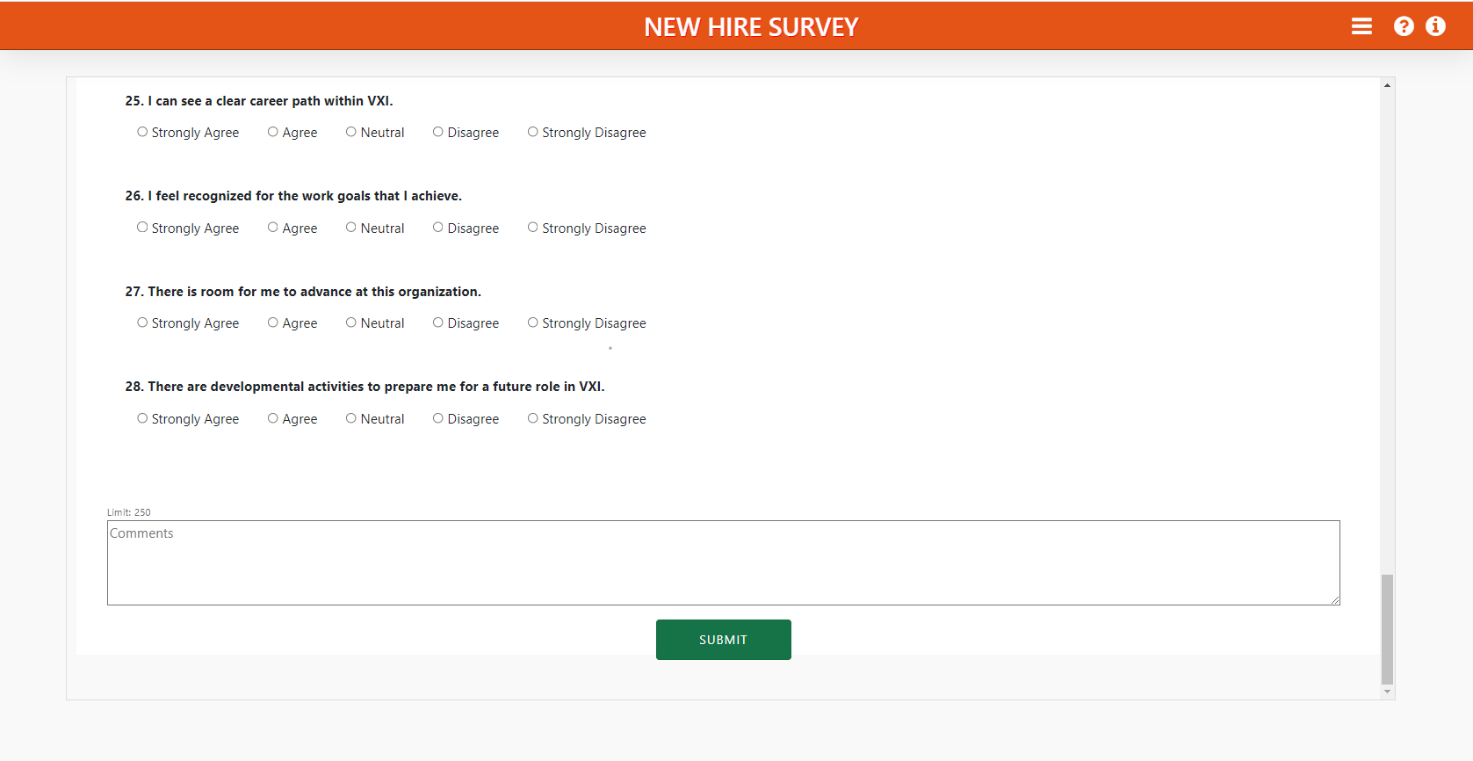
TAKE SURVEY PAGE
Select one option if you have an answer to this question
Click Submit to finish the survey
Note: All fields are required to be answered.

Slide 10
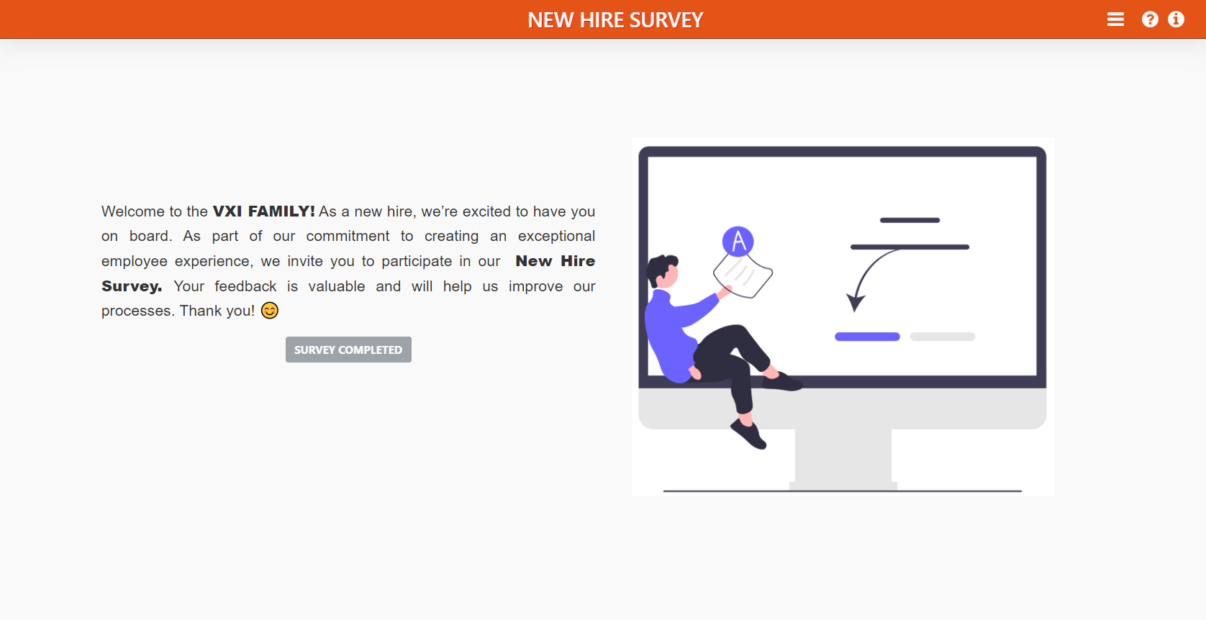
TAKE SURVEY PAGE
After completing the survey and submitting it, you will be redirected to this page. The button will gray out and display 'Survey Completed,' indicating that you have successfully finished the survey.
Note: All fields are required to be answered.

Slide 11
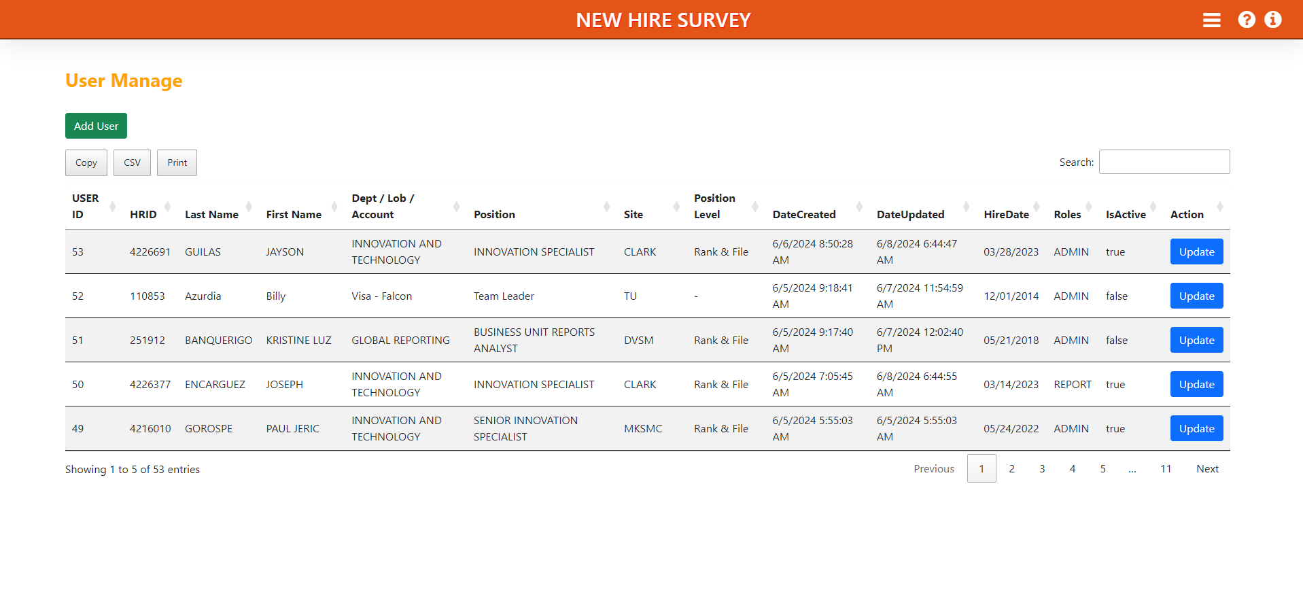
USER MANAGE PAGE
Click 'Add User' to create a new admin or report role.
Click ‘Update' to Update the role.

Slide 12
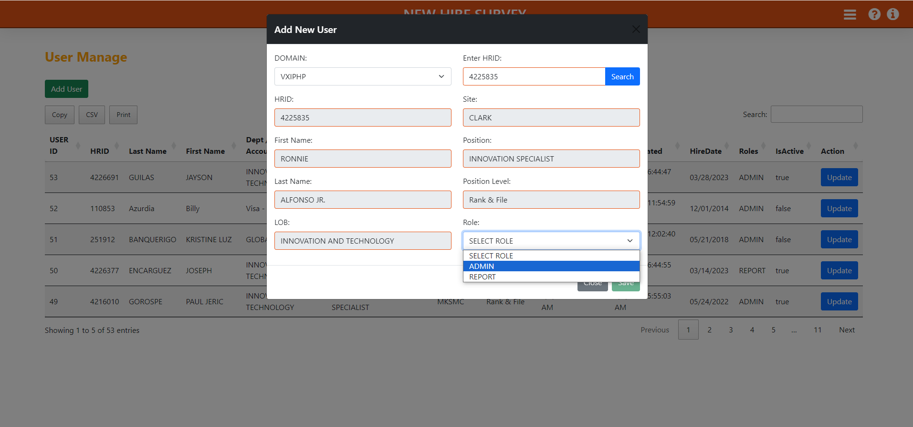
USER MANAGE PAGE
Select Domain
Enter the HRID and then click the 'Search' button to retrieve the information.
Click ‘Save' to Save the role.
Select Role Admin/Report

Slide 13
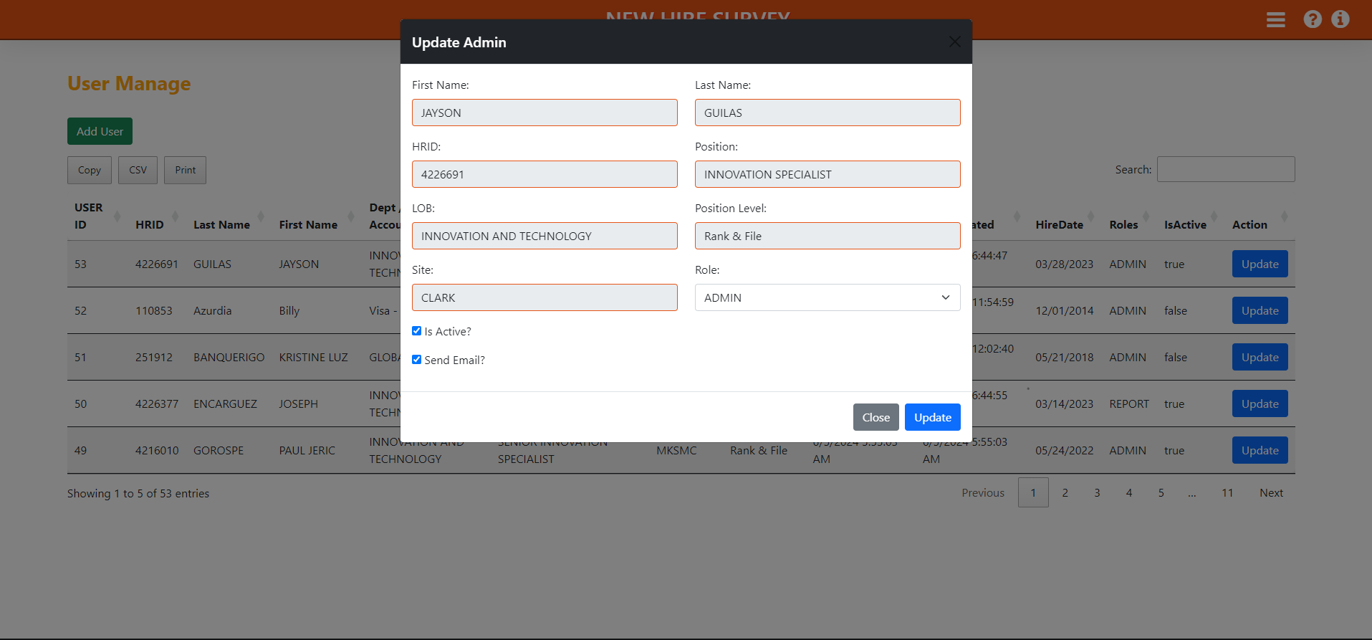
USER MANAGE PAGE
Select Role Admin/Report
Click ‘Update' to Save the role.

Slide 14
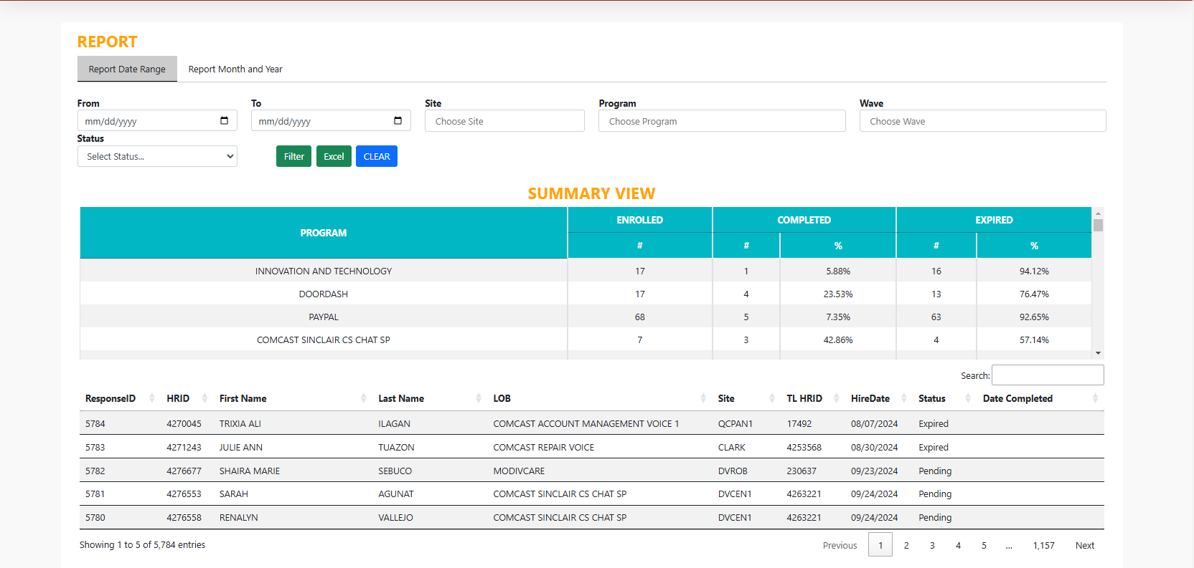
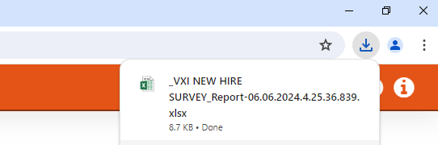
REPORT PAGE
Date Range
Select Site
Select Lob
Select Wave
Select Status
Generate Report
Downloaded File

Slide 15
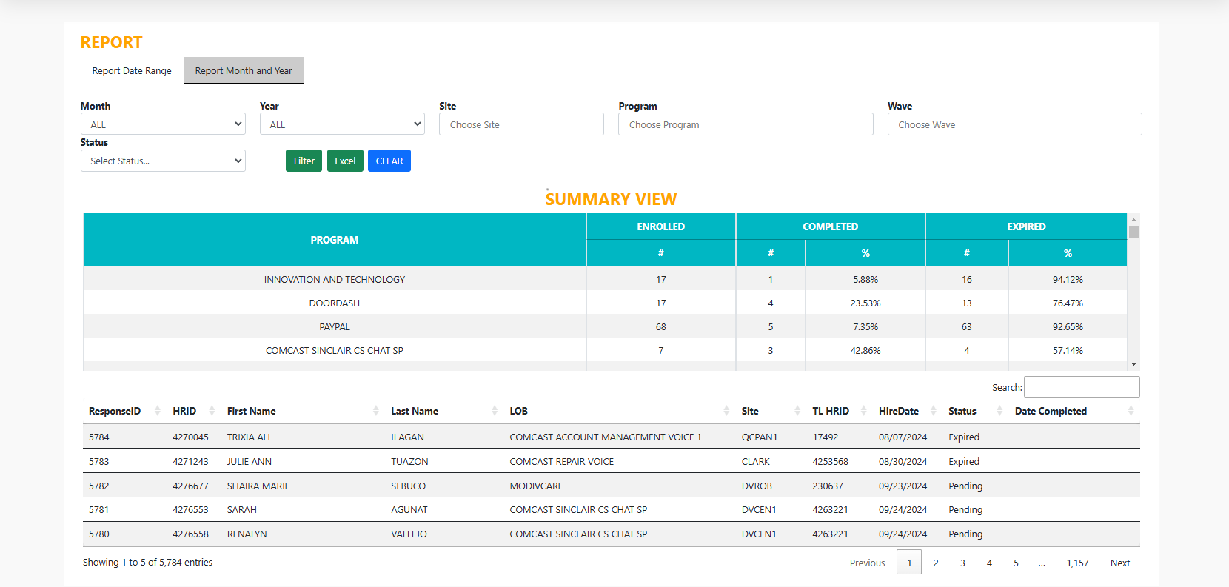
REPORT PAGE
Months
Year
Select Site
Select Lob
Select Wave
Select Status
Generate Report
Downloaded File

Slide 16
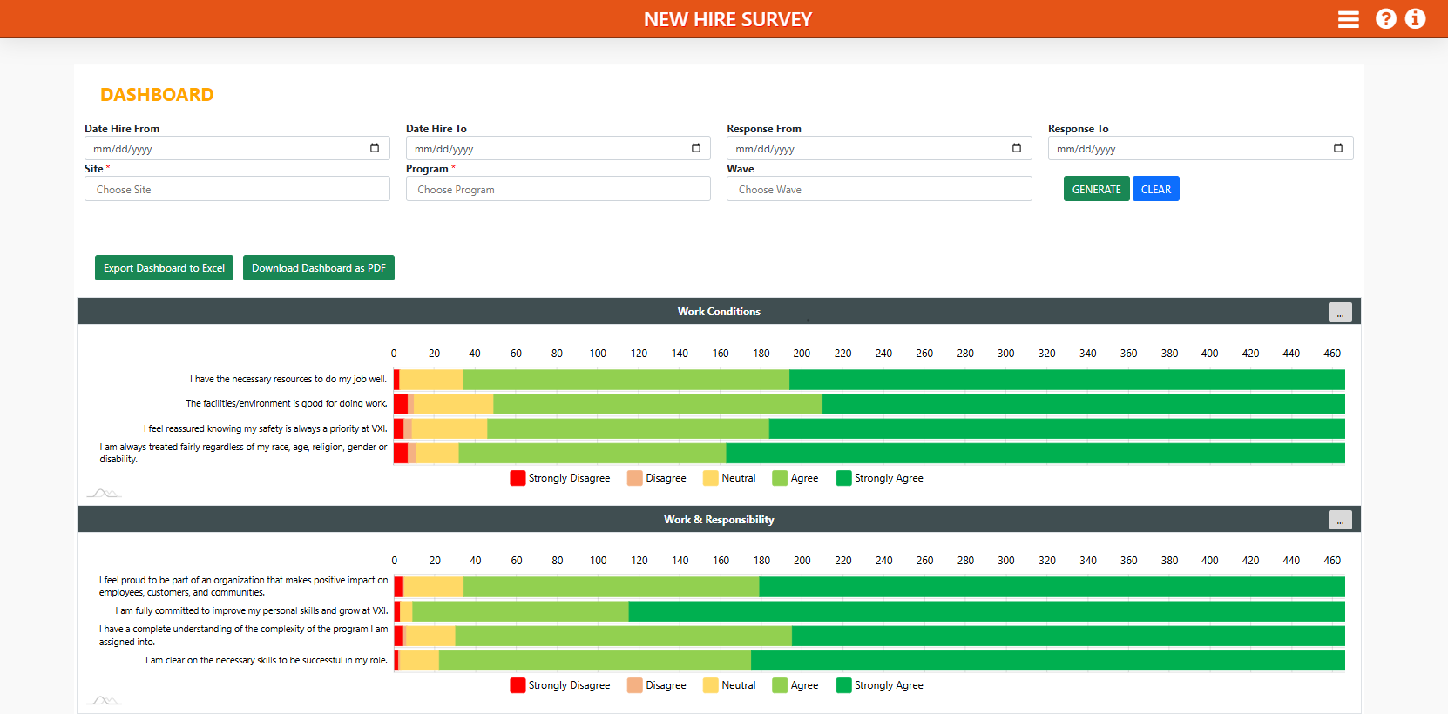
DASHBOARD PAGE
Hire Date Range
Date of Response
Select Site
Select Lob
Generate
Select Wave

Slide 17
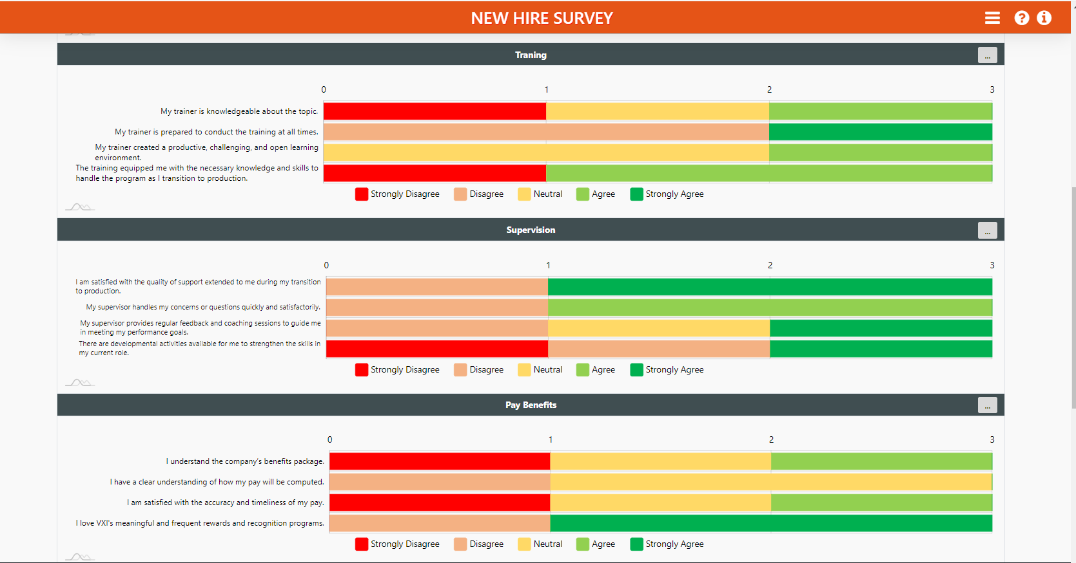
DASHBOARD PAGE

Slide 18
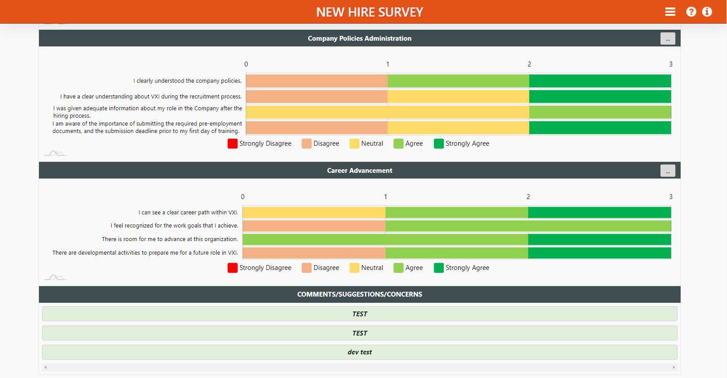
DASHBOARD PAGE

Slide 19
Thank you!

