Slide 1


VXI NEW HIRE SURVEY
User Guide/Report
Version 1.0 – JUNE 05, 2024
Version 1.1 – JUNE 29, 2024
Version 1.2 – JULY 30, 2024
Version 1.3 – AUG 28, 2024
Version 1.4 – DEC 05, 2024

Slide 2
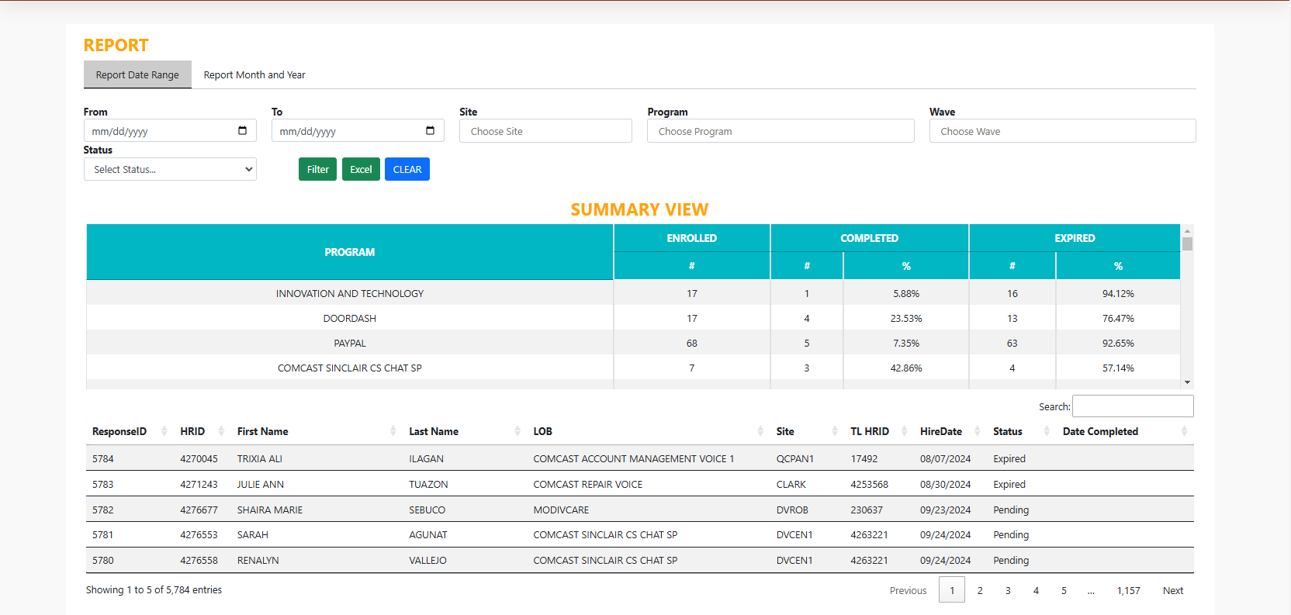
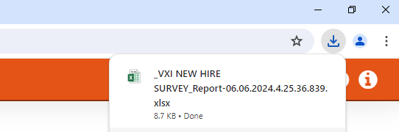
REPORT PAGE
Date Range
Select Site
Select Lob
Select Wave
Select Status
Generate Report
Downloaded File

Slide 3
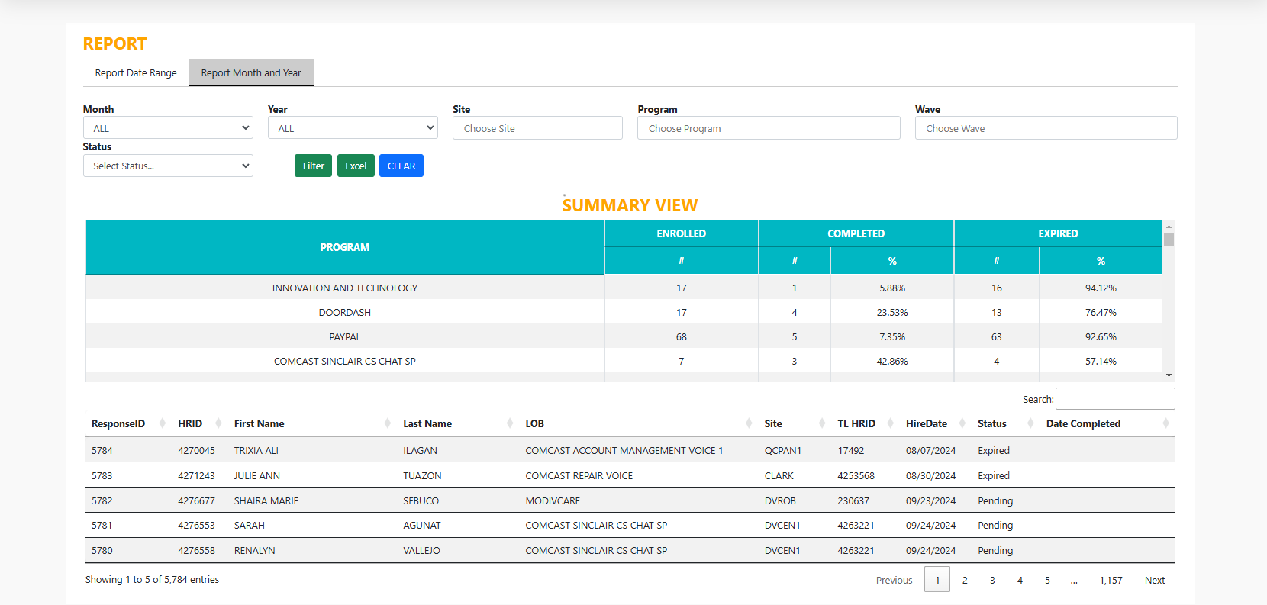
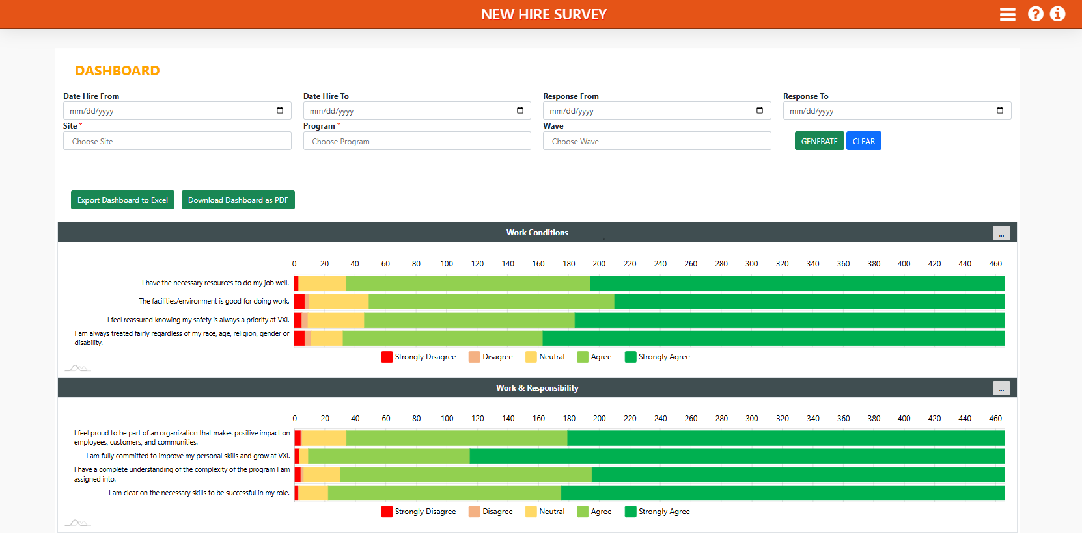
REPORT PAGE
Months
Year
Select Site
Select Lob
Select Wave
Select Status
Generate Report
Downloaded File

Slide 4
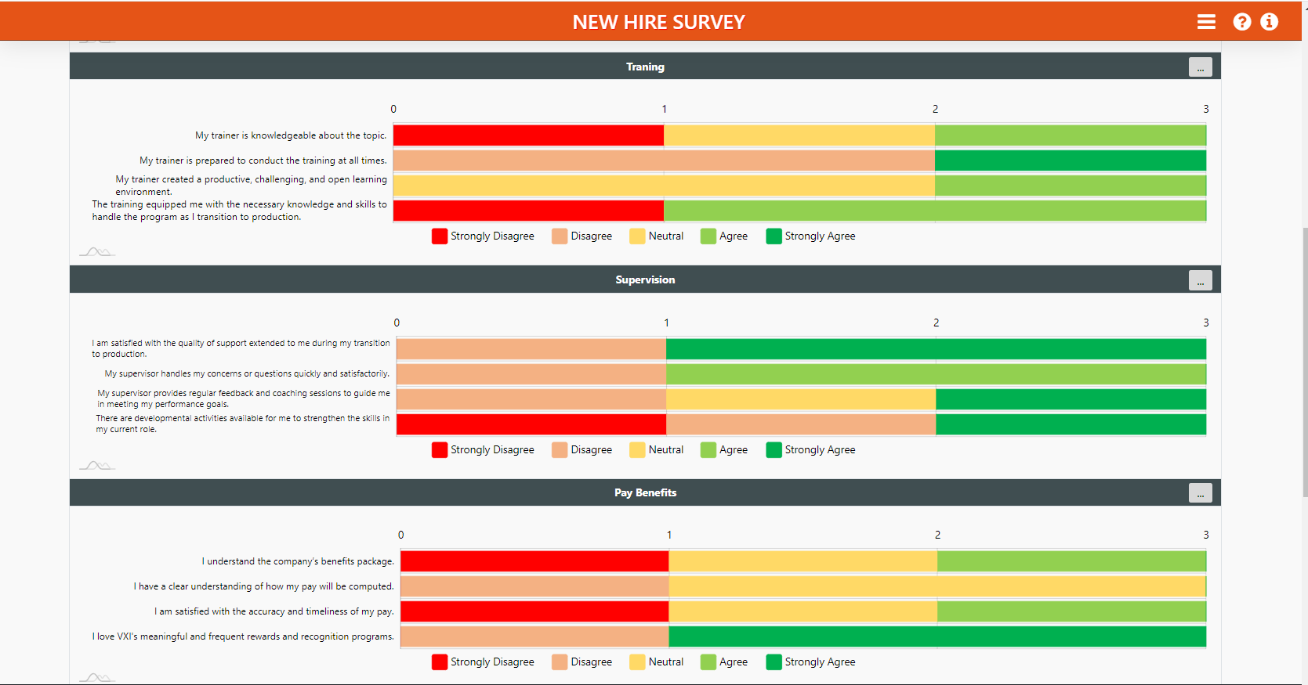
DASHBOARD PAGE

Slide 5
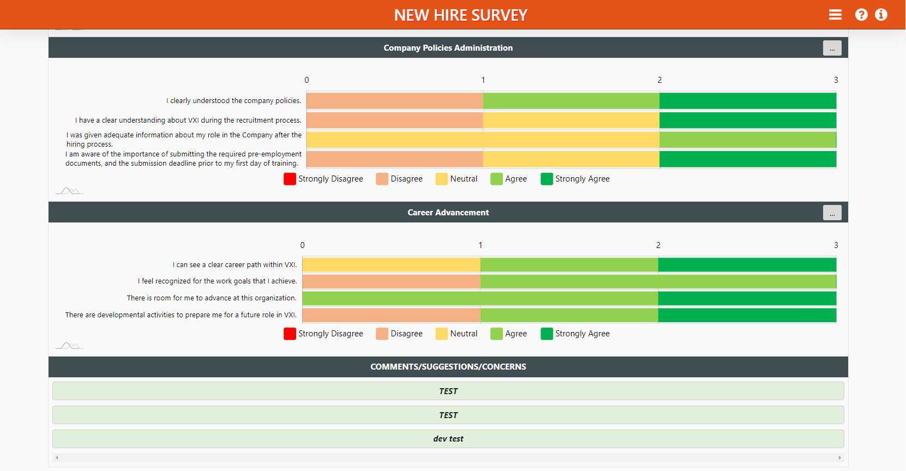
DASHBOARD PAGE

Slide 6
Thank you!

