Slide 1


VXI NEW HIRE SURVEY
User Guide
Version 1.0 – JUNE 05, 202
Version 1.1 – JUNE 29, 2024
Version 1.2 – JULY 30, 2024
Version 1.3 – AUG 28, 2024
Version 1.4 – DEC 05, 2024

Slide 2
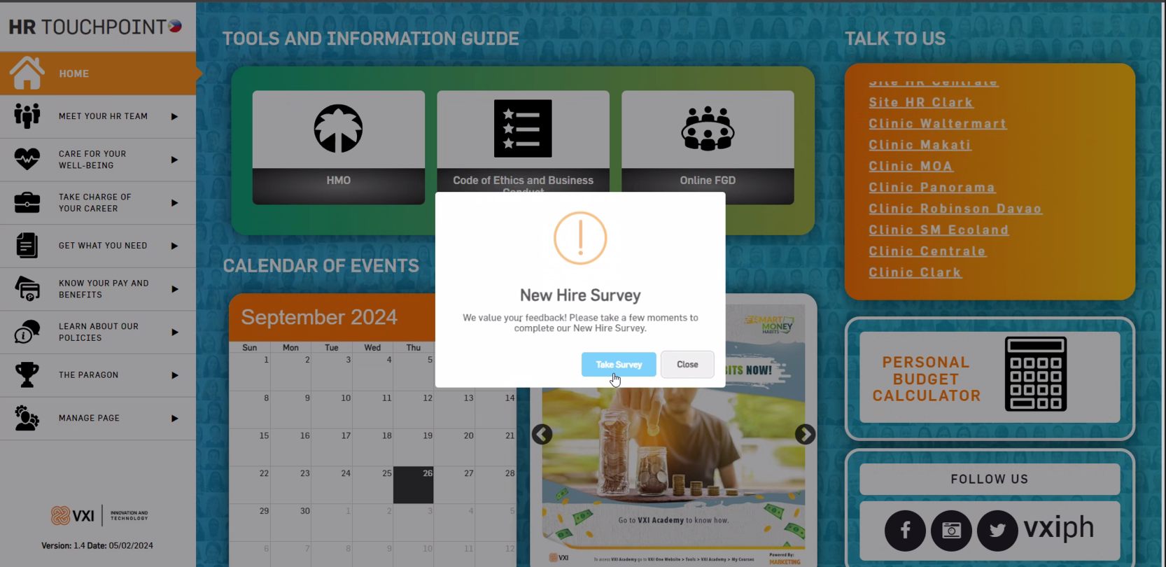
LOGIN PAGE
"Access the HR touchpoint, and a notification will pop up prompting you to take the Hire Survey. Click the 'Take Survey' button, and you will be redirected to the login page for the New Hire Survey."

Slide 3
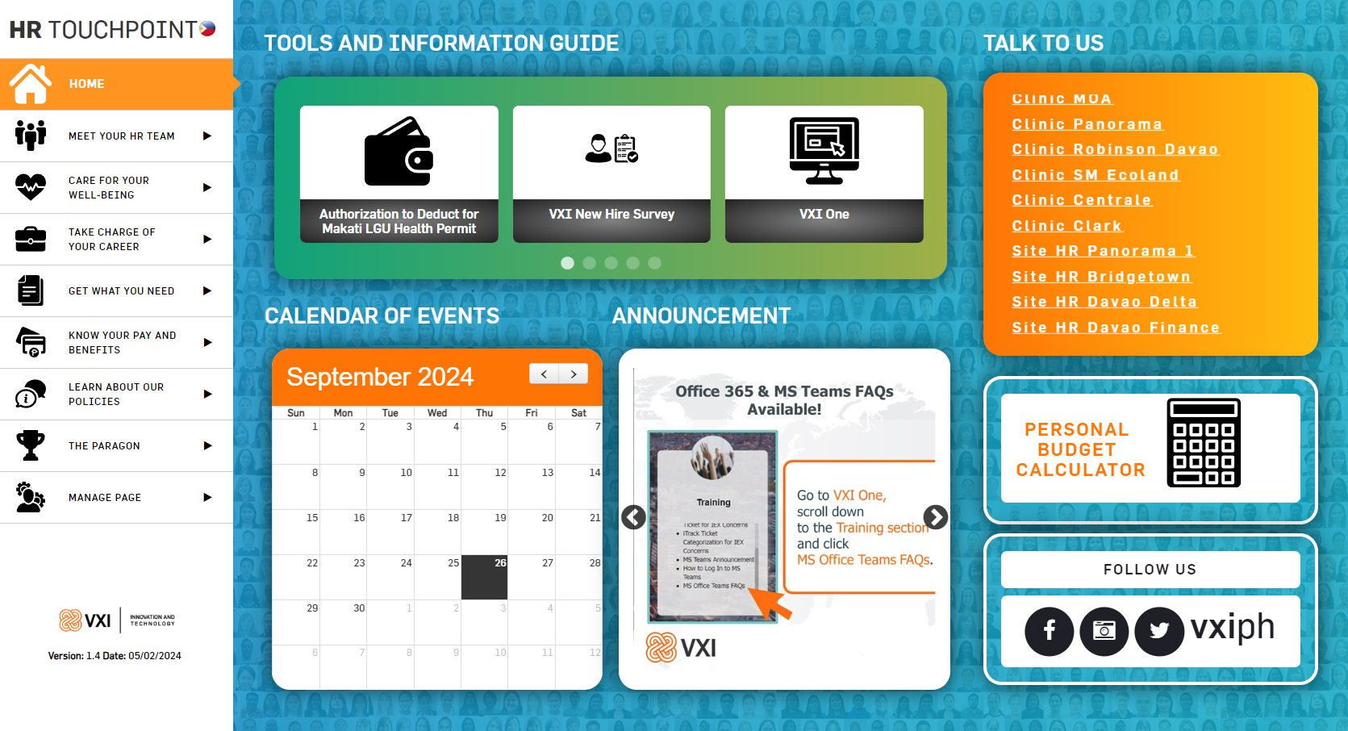
LOGIN PAGE
Click this icon to be redirected to the login page for the New Hire Survey

Slide 4
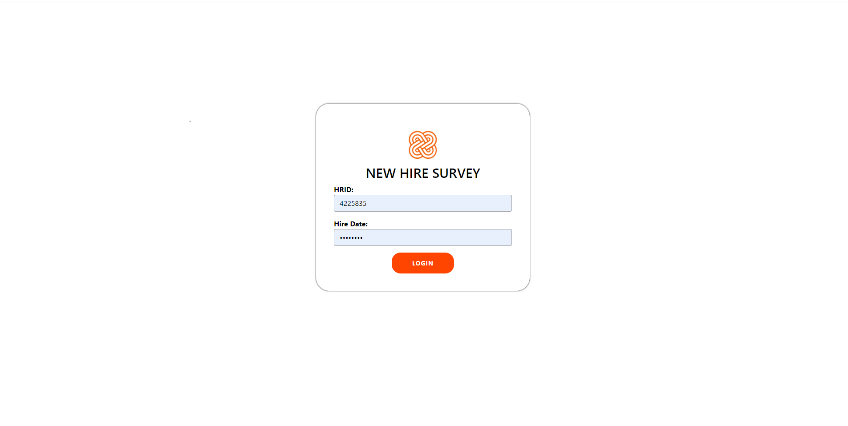
LOGIN PAGE
Input HRID
Input Hire Date
Click this button to Login

Slide 5
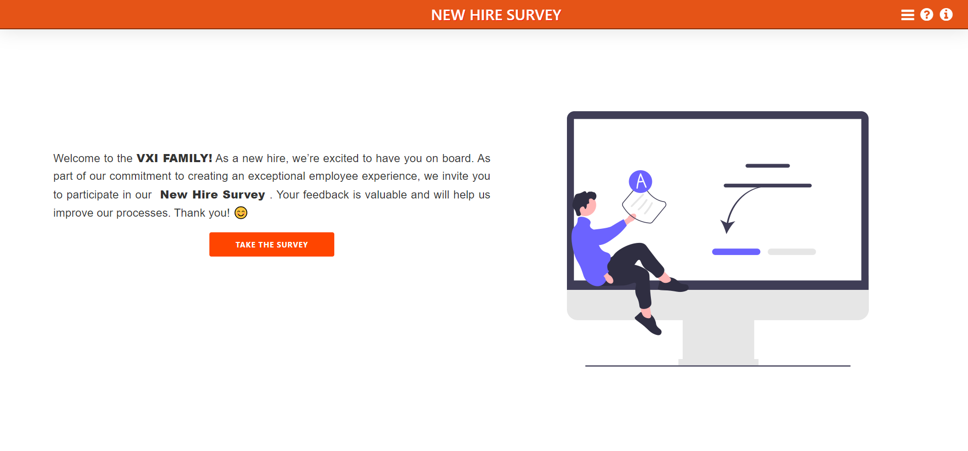
HOME PAGE
Click this button to take the survey

Slide 6
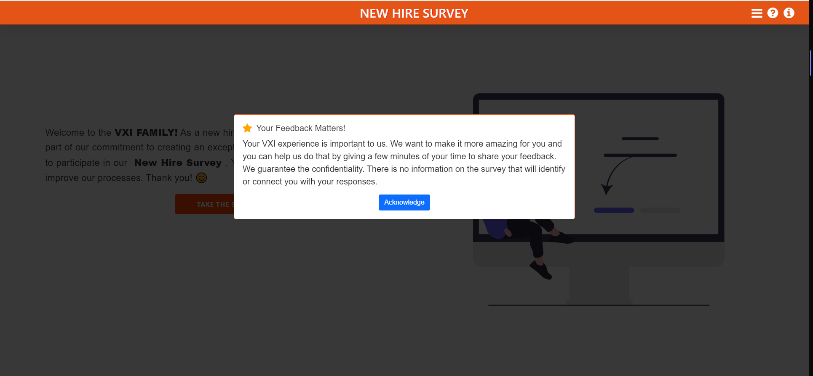
HOME PAGE
Click Acknowledge to begin the survey

Slide 7
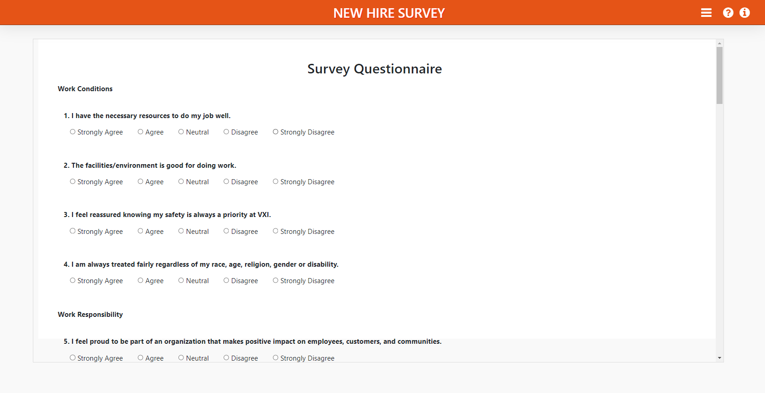
TAKE SURVEY PAGE
Select one option if you have an answer to this question
Note: All fields are required to be answered.

Slide 8
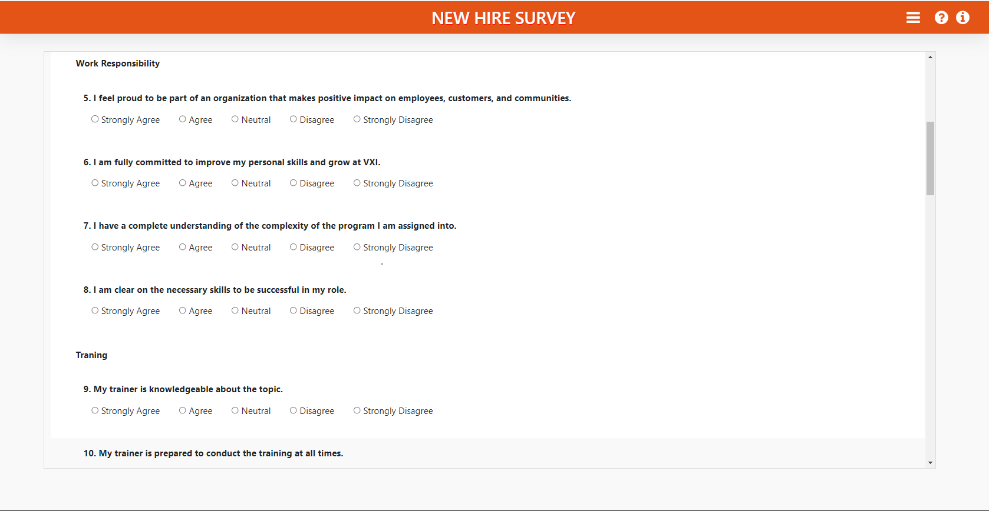
TAKE SURVEY PAGE
Select one option if you have an answer to this question
Note: All fields are required to be answered.

Slide 9
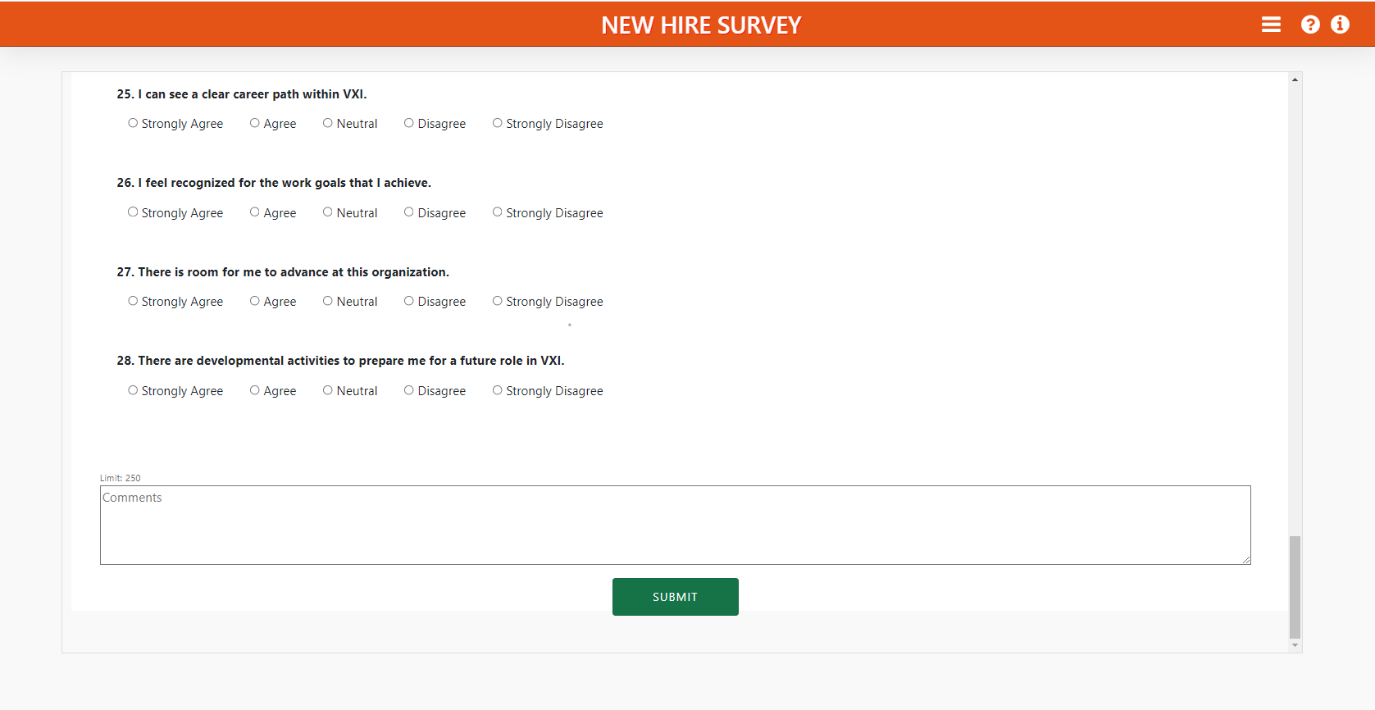
TAKE SURVEY PAGE
Select one option if you have an answer to this question
Click Submit to finish the survey
Note: All fields are required to be answered.

Slide 10
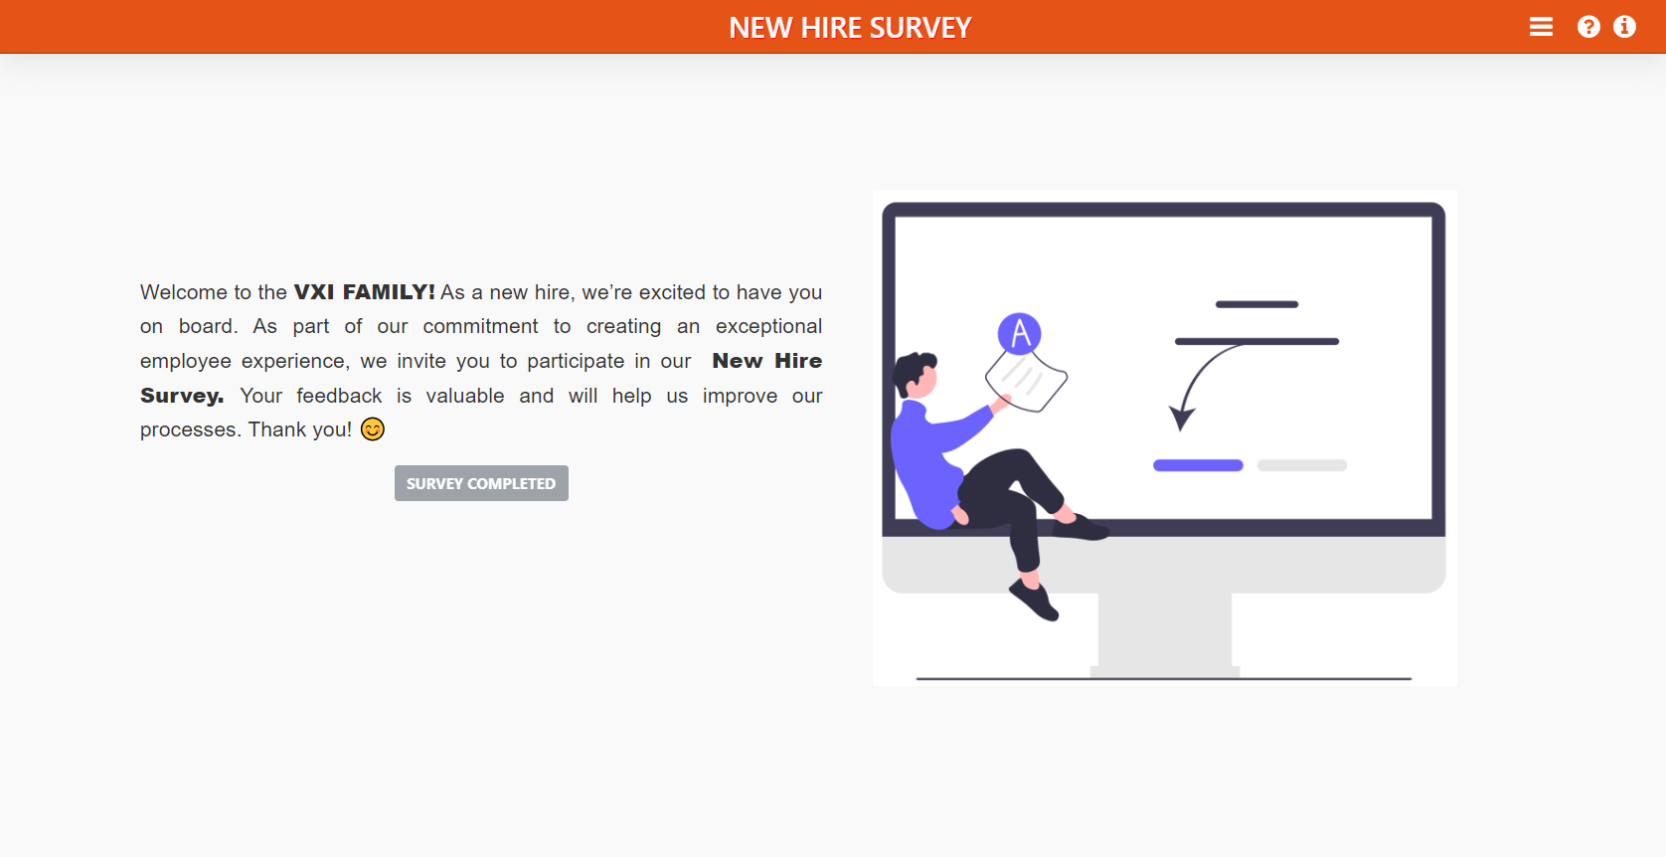
TAKE SURVEY PAGE
After completing the survey and submitting it, you will be redirected to this page. The button will gray out and display 'Survey Completed,' indicating that you have successfully finished the survey.
Note: All fields are required to be answered.

Slide 11
Thank you!

