Slide 1


Xilinx Tool Flow
Presenter:Hao-Te Lin
Email: p1165511@gmail.com
Date: 115/11/07

Slide 2
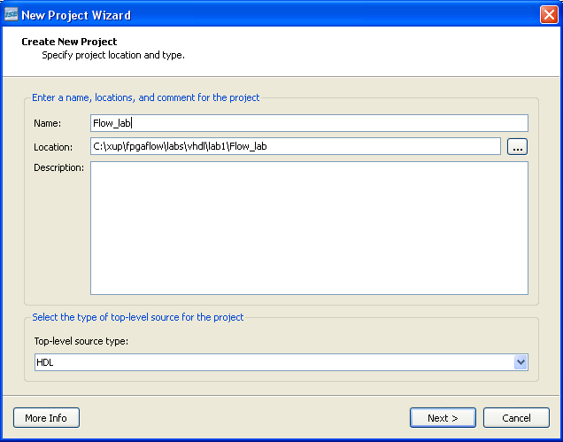
Create a New Project
In the Project Navigator, select File → New Project. The New Project Wizard opens.

Slide 3
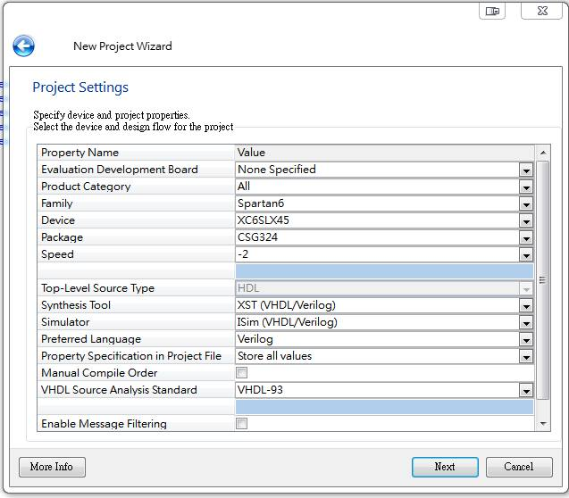
Create a New Project
Select your FPGA
Select your preferred language

Slide 4
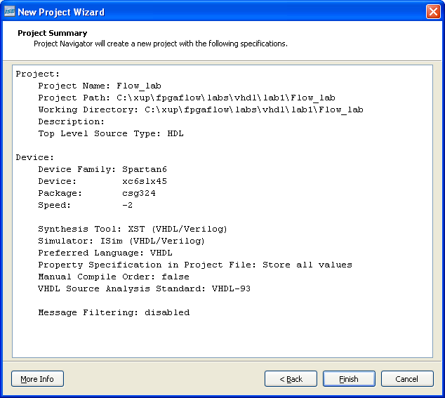
Create a New Project

Slide 5
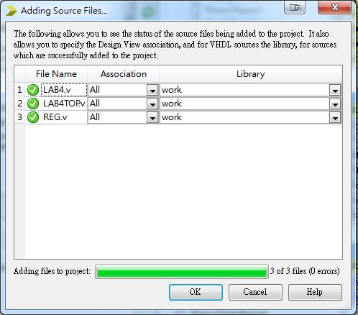
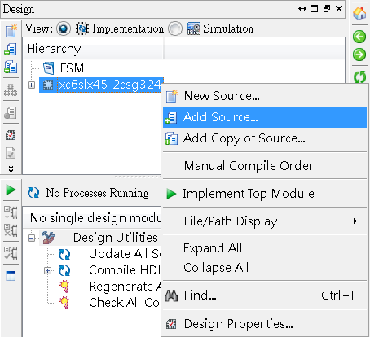
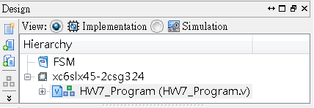
Add an Existing Design to the Project

Slide 6
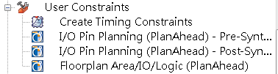
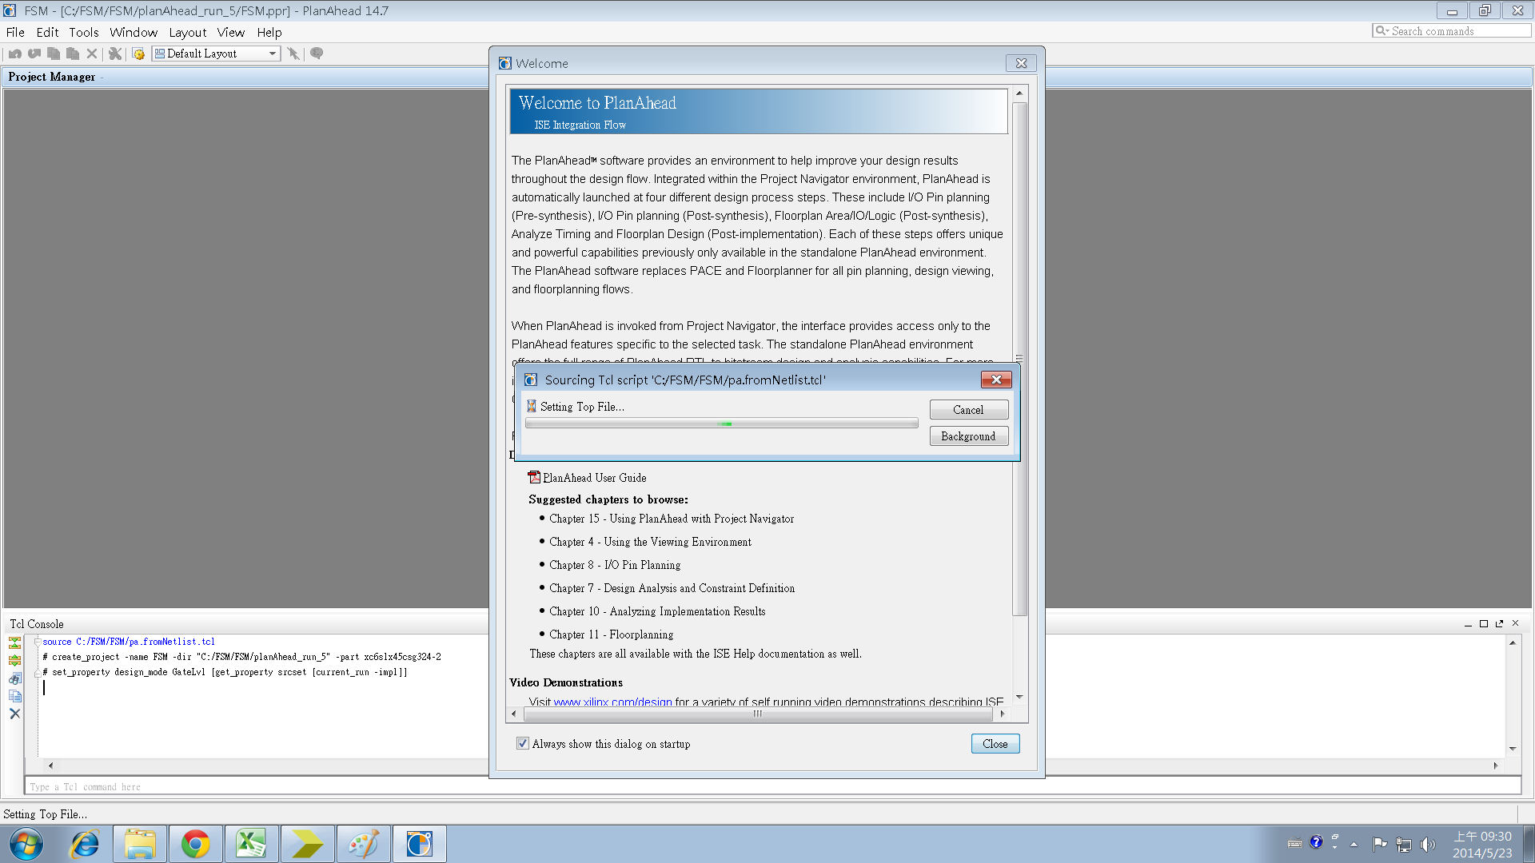
Pins Assignment (PlanAhead)
Double click

Slide 7
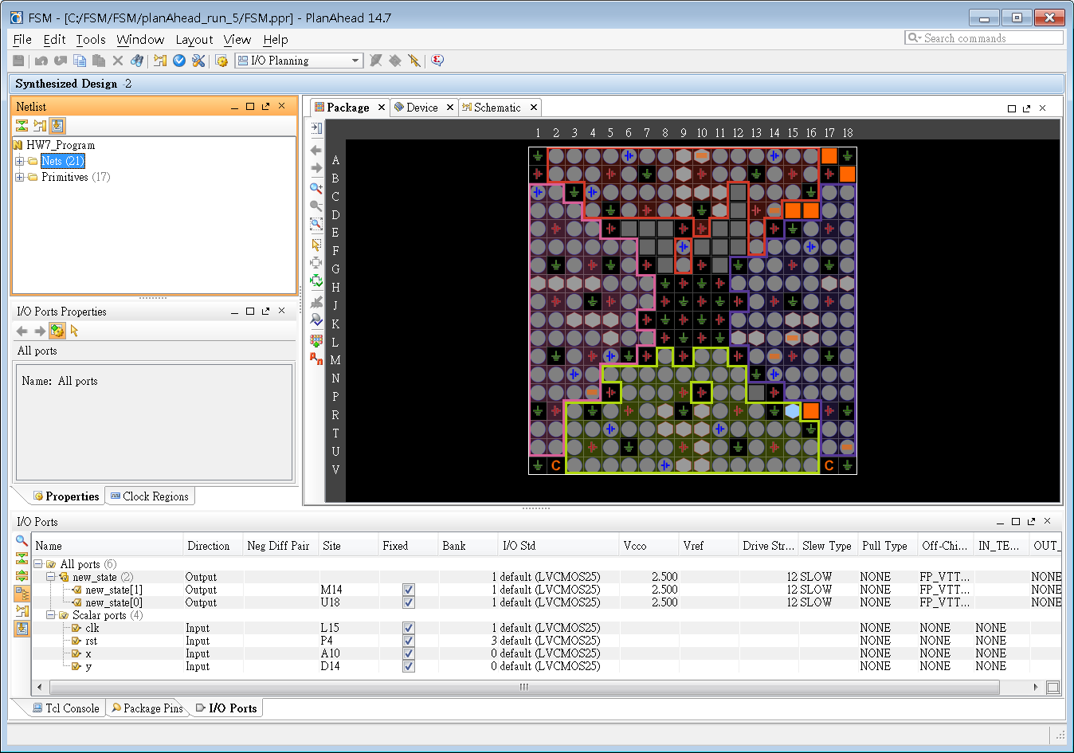
Pins Assignment (PlanAhead)
Assign Pin by Selecting
in I/O Ports Window
Dragging and Placing in
Package Window

Slide 8
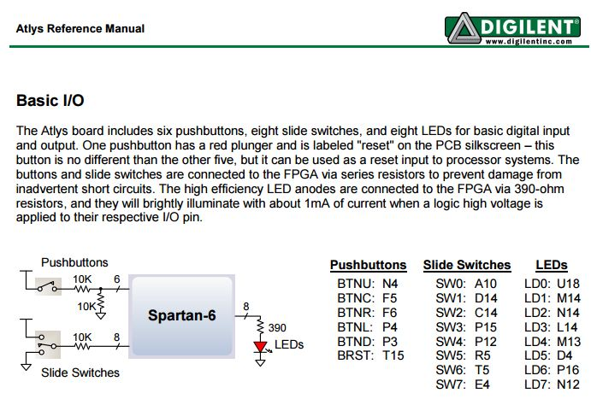
Pins Assignment (number)
1.Manual
115/11/07
P<number>

Slide 9
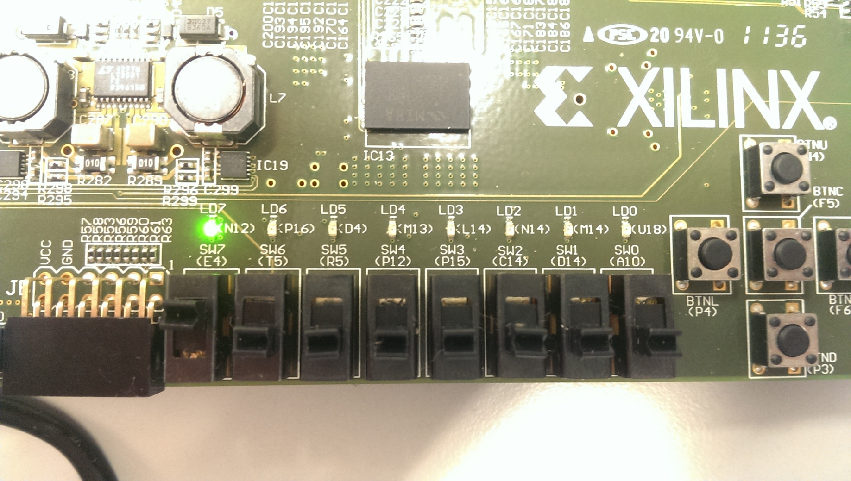
Pins Assignment (number)
2.Find pin at FPGA
115/11/07
P<number>

Slide 10
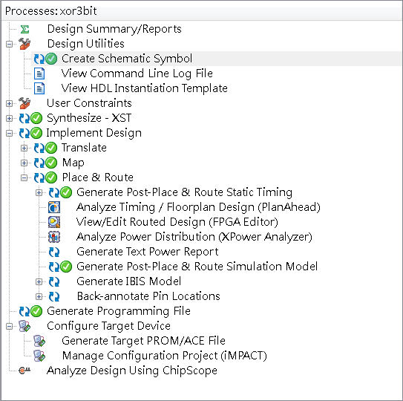
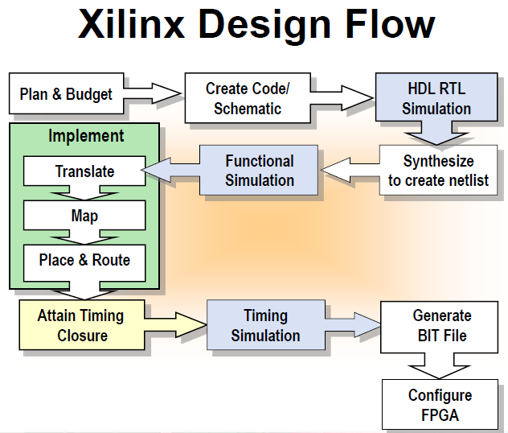
Xilinx Design Flow

Slide 11
Download
Double click

Slide 12
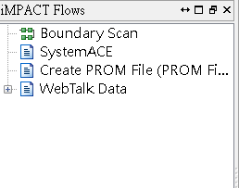
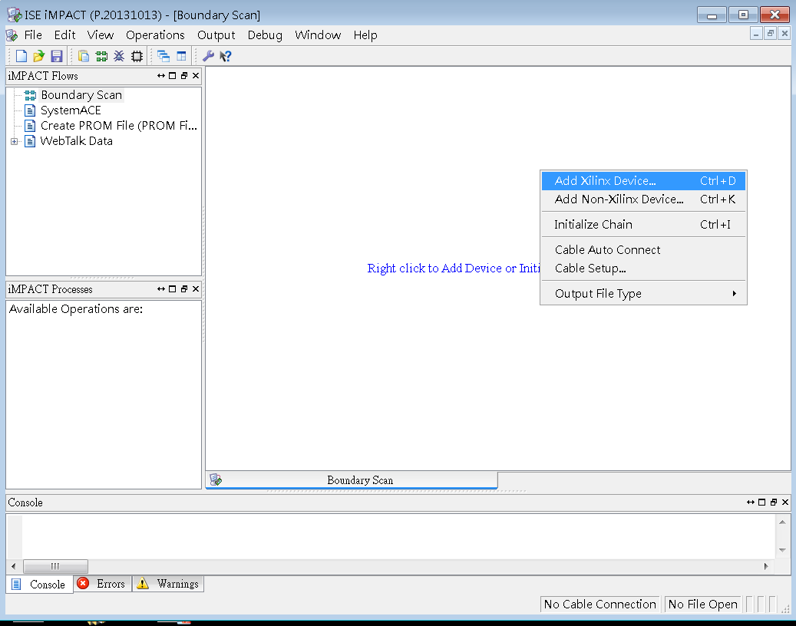
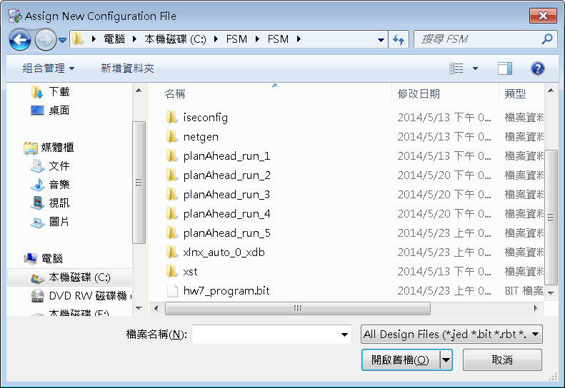
Download
Double click

Slide 13
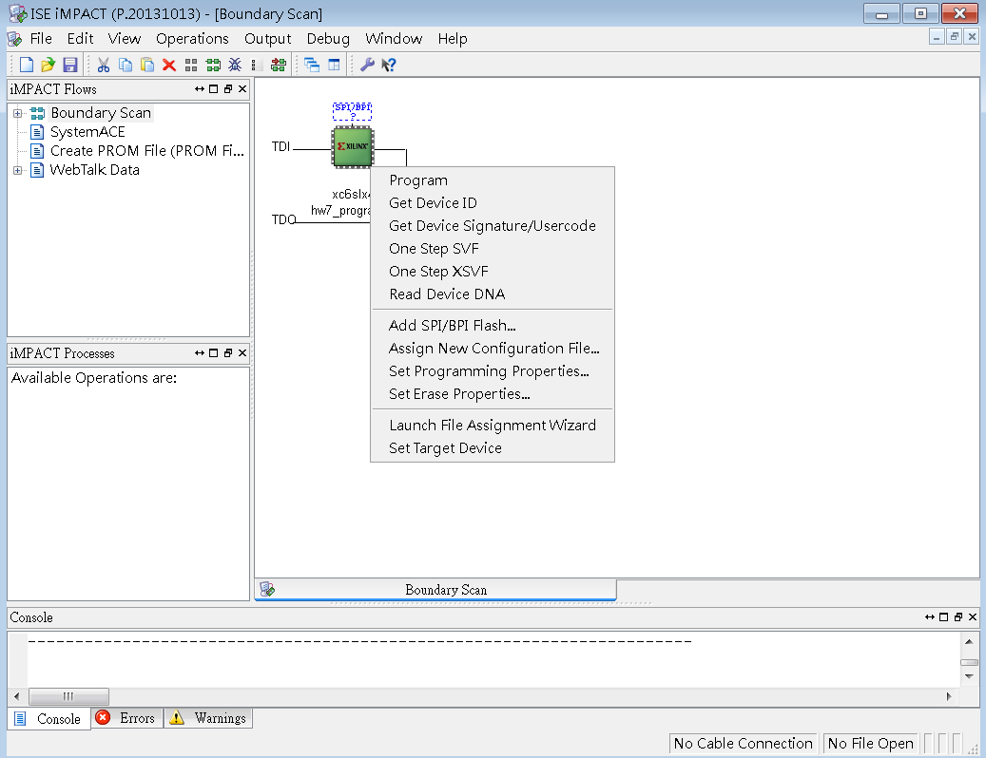
Download
click

Slide 14
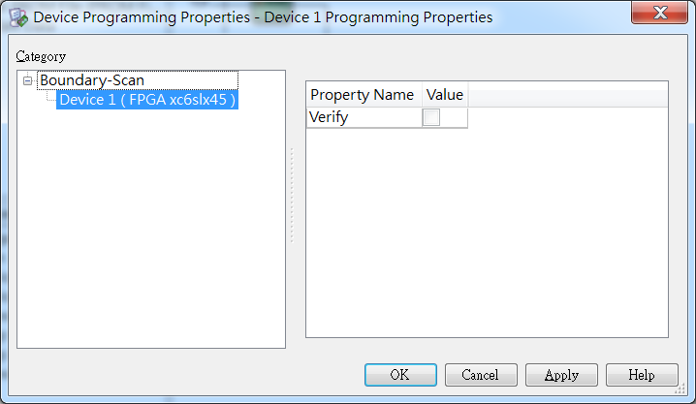
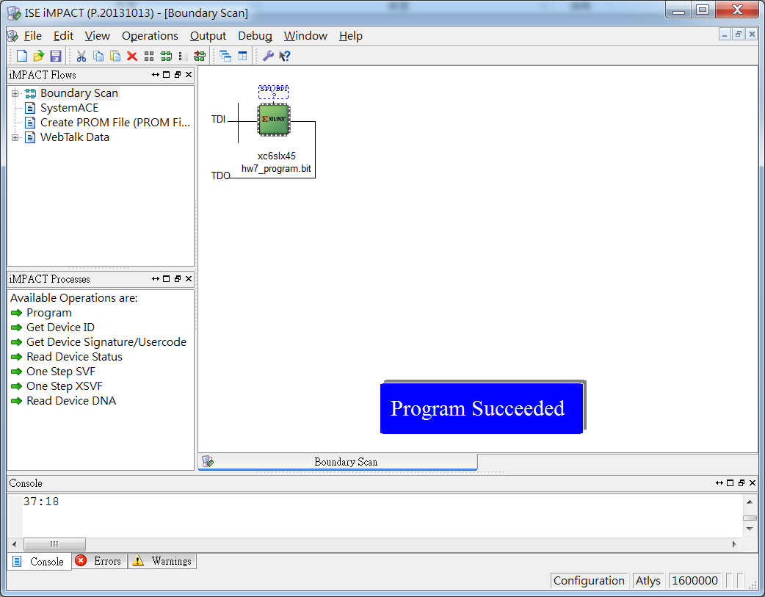
Download

Slide 15
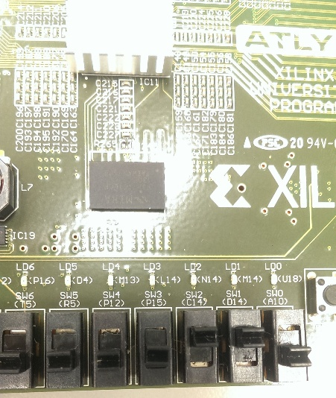
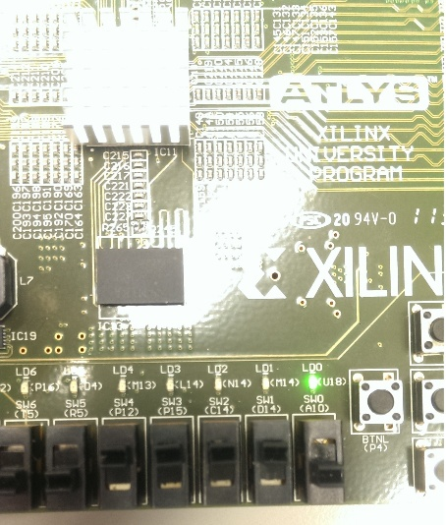
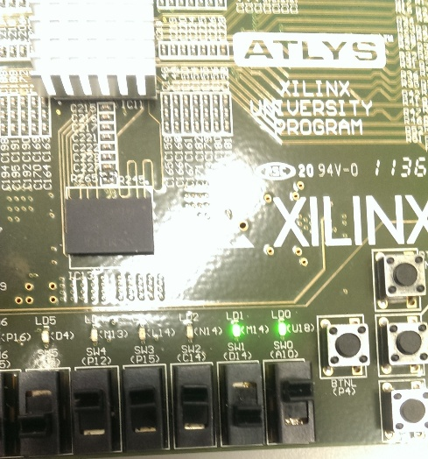
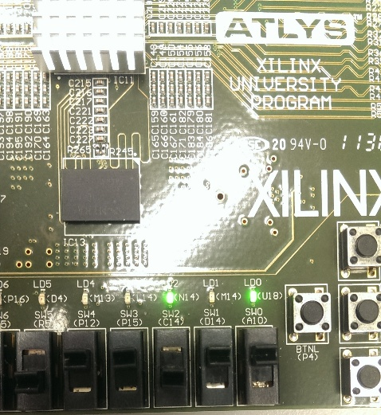
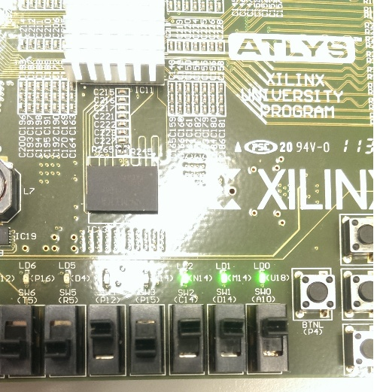
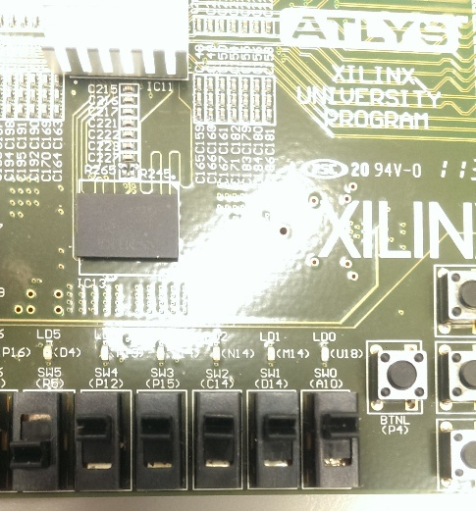
Test function
I3 | I2 | I1 | I0 | Y1 | Y0 | OE
1 | 1 | 1 | 0 | 0 | 0 | 1
1 | 1 | 0 | 1 | 0 | 1 | 1
1 | 0 | 1 | 1 | 1 | 0 | 1
0 | 1 | 1 | 1 | 1 | 1 | 1
others | others | others | others | 0 | 0 | 0

Slide 16
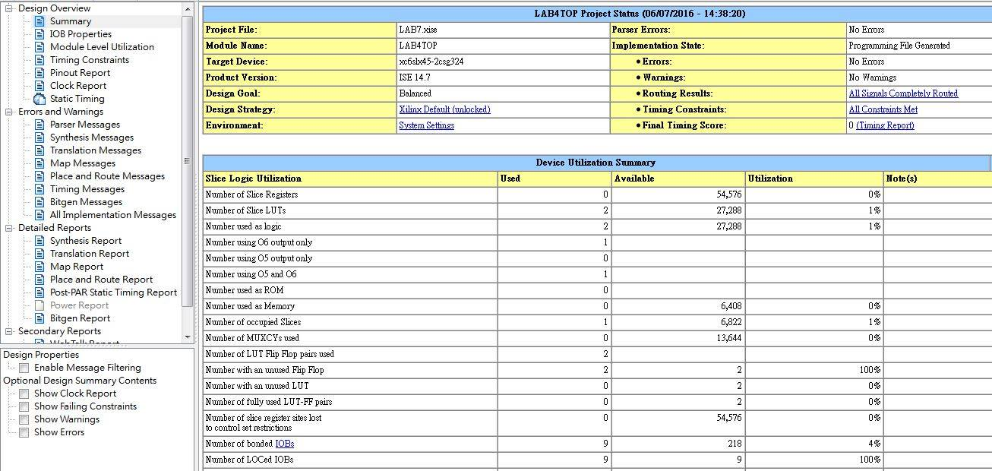
Report summary
used
resource

Slide 17
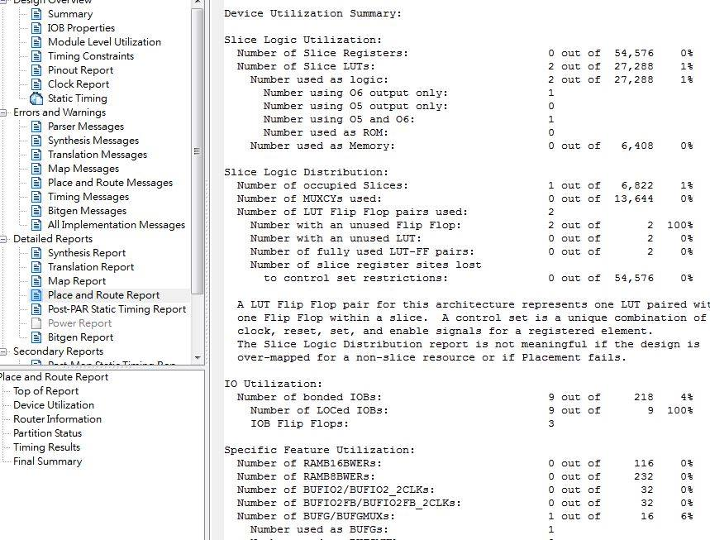
PAR report

Slide 18
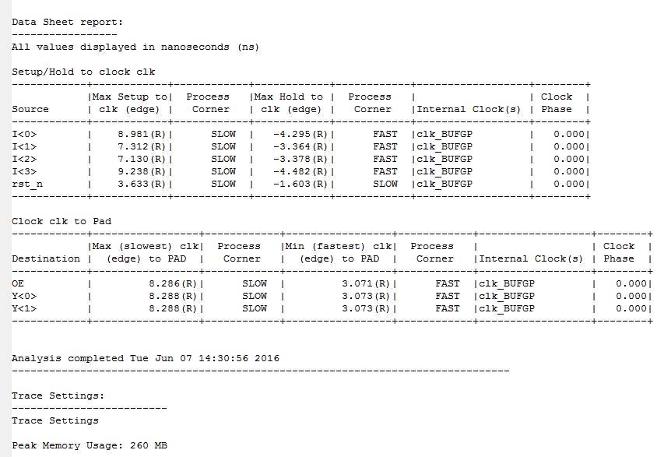
Timing report

