Slide 1
A Reconfigurable DNN Training Accelerator on FPGA
Presenter:
1070743 郭冠岑
1070529 張顥汶
Date: 2021/06/30

Slide 2
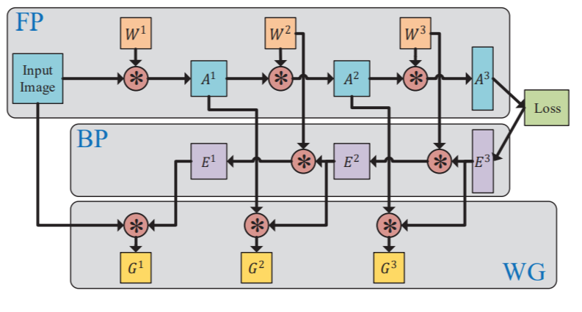

Slide 3
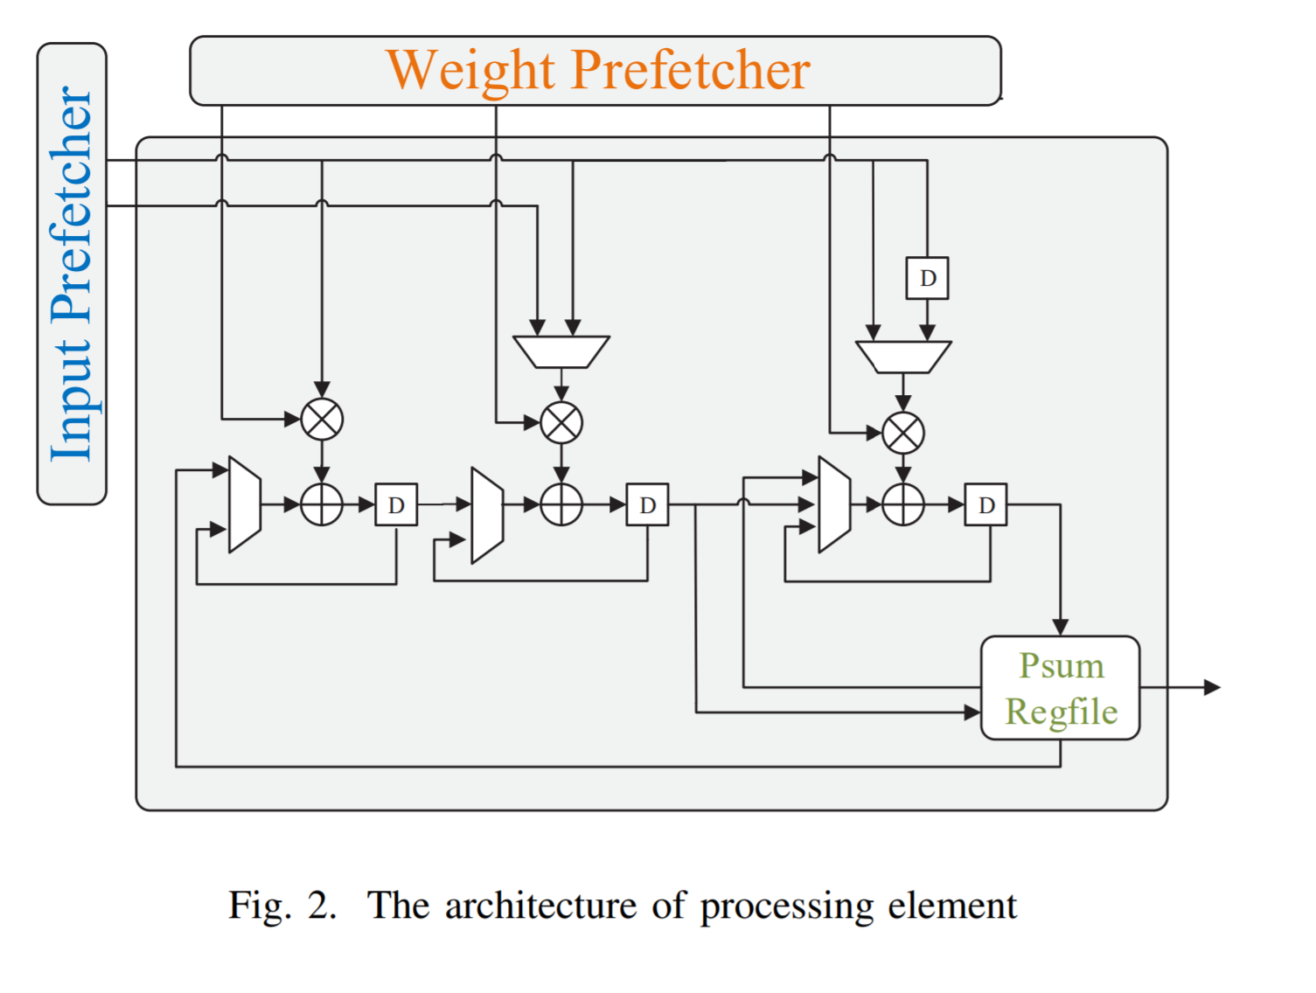

Slide 4
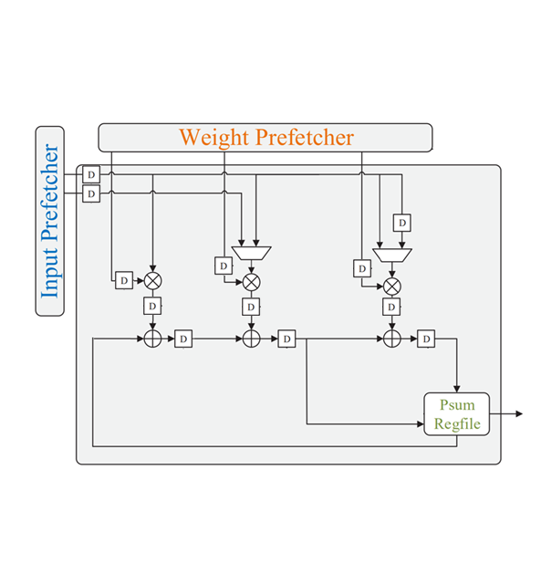
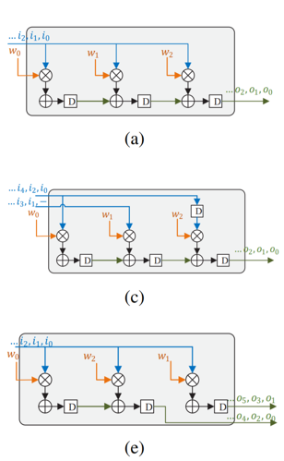

Slide 5
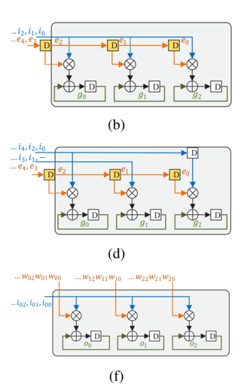
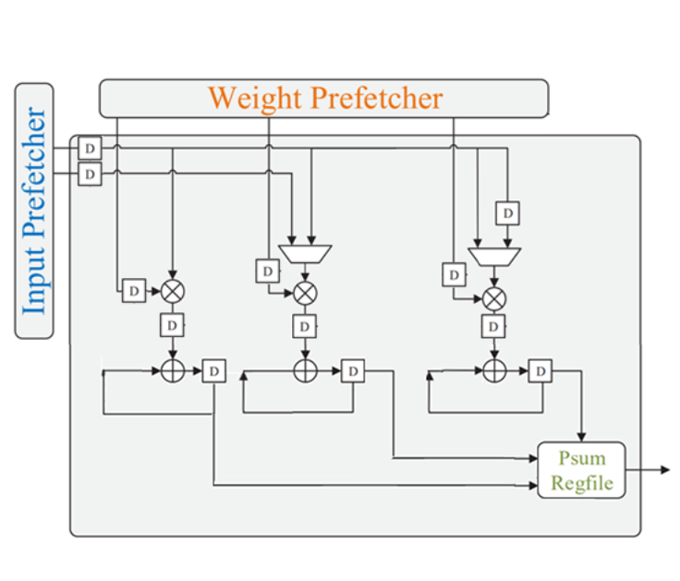

Slide 6
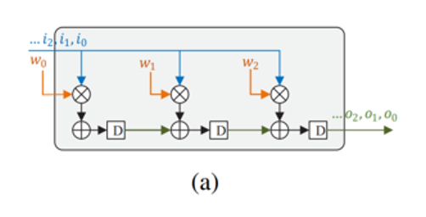
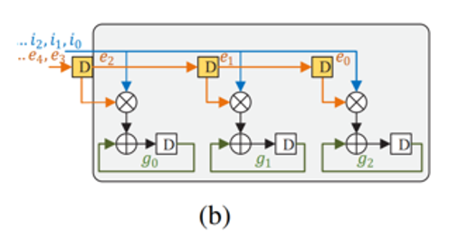
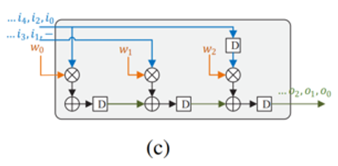
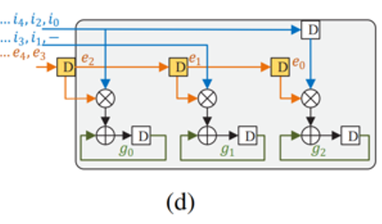
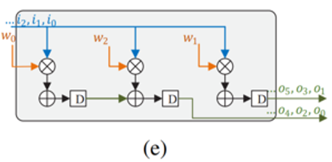
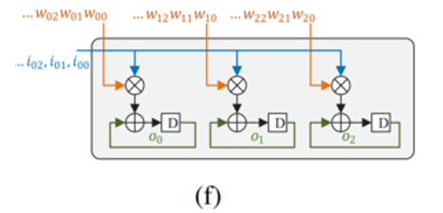
Stride=1
Stride=2
FullConnect

Slide 7
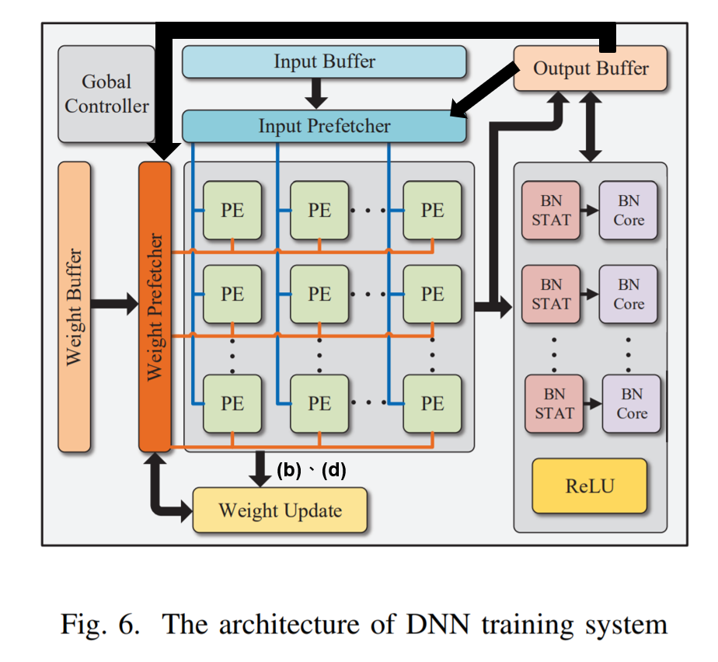

Slide 8
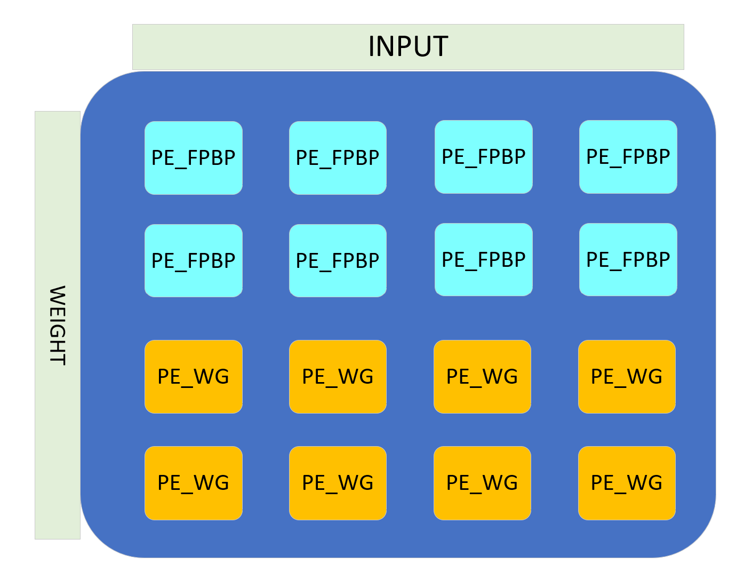

Slide 9
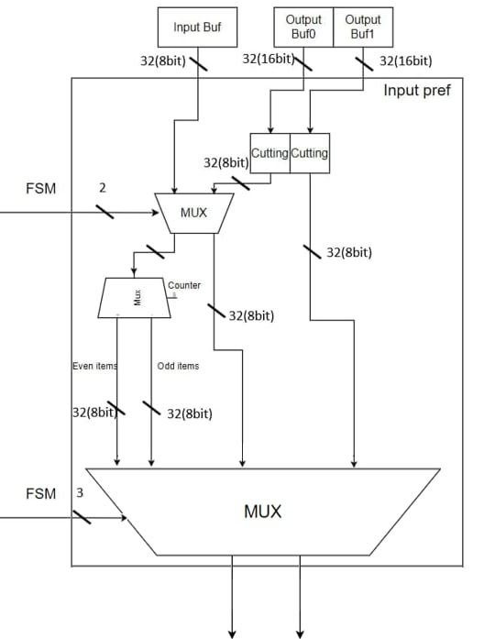
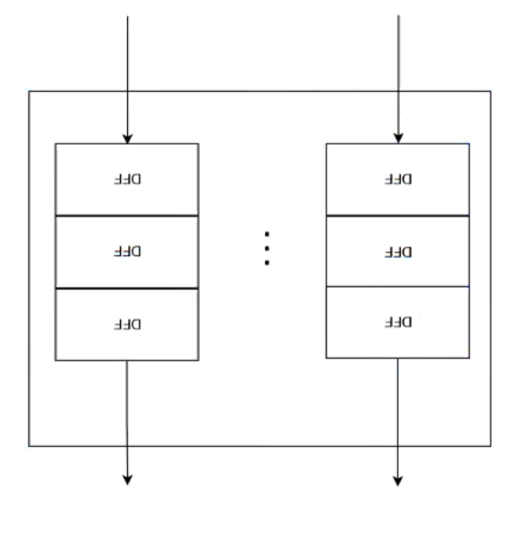
BUF and Pref
Mode | Stride | Layer | Select(out) | Path
a | 1 | FP | 000 | C→A
b | 1 | WG | 001 | C→A
c | 2 | FP | 010 | A→A,B→B
d | 2 | WG | 011 | C→A,D→B
e | 2 | BP | 100 | C→A
f | X | FC | 101 | C→A

Slide 10

Cutting
Mode Select

Slide 11
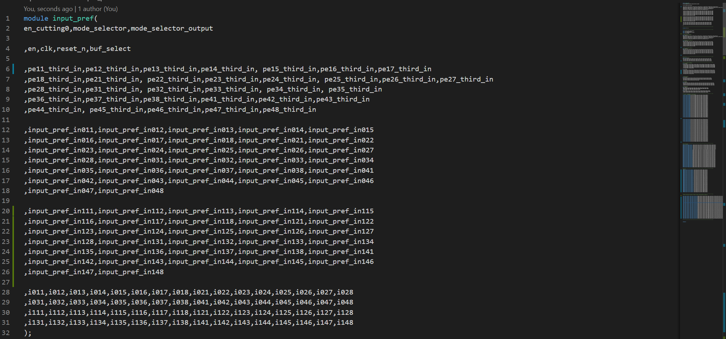


Slide 12


OUR FSM

Slide 13

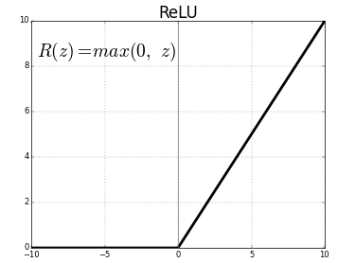
ReLU

