Slide 1

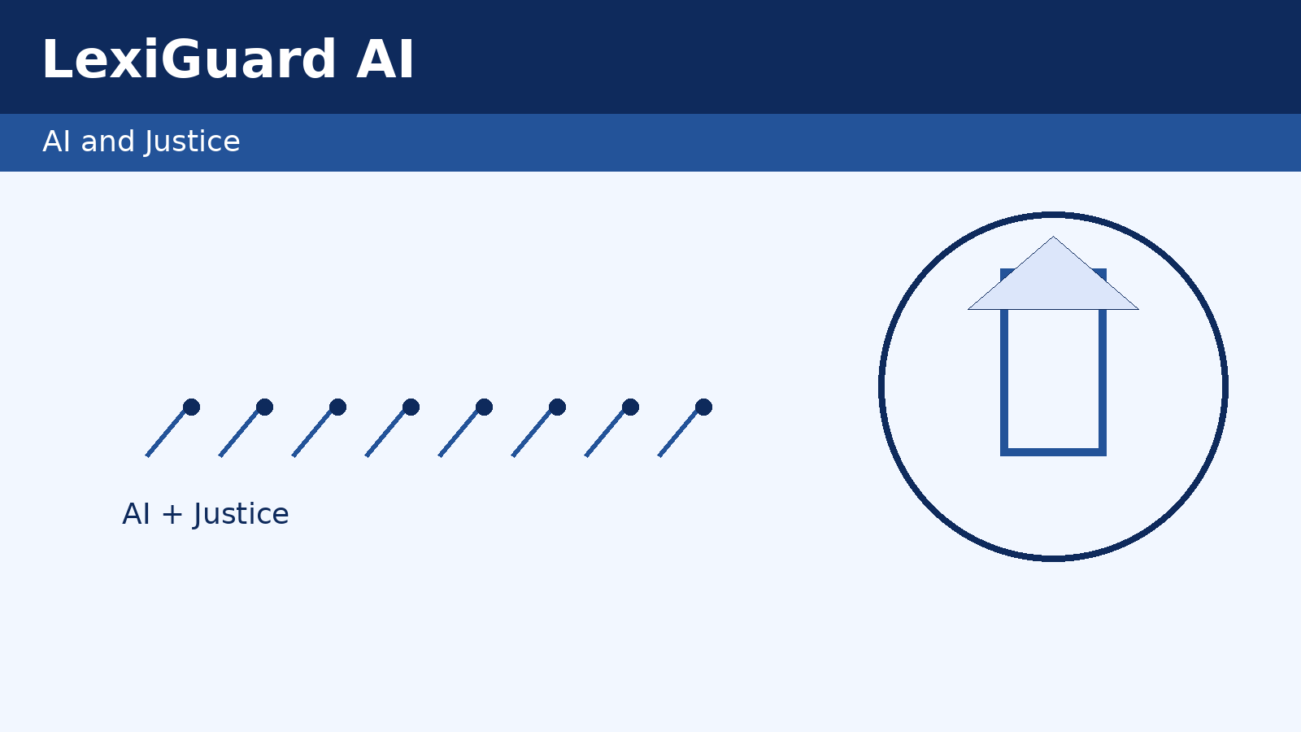
RonyGuard AI: Real-Time Legal Rights Assistant
Real-time legal rights guidance for everyday people.
Fictitious consumer legal-tech startup · CIS-421
R
Ronald Kipkemboi | Shaw University | Fictitious Company (F)
Notes:
RonyGuard is a class concept, not a launched company. I will use future language throughout: the proposed app would provide real-time legal-rights guidance. This establishes the required fictitious (F) designation clearly before discussing the business case.

Slide 2

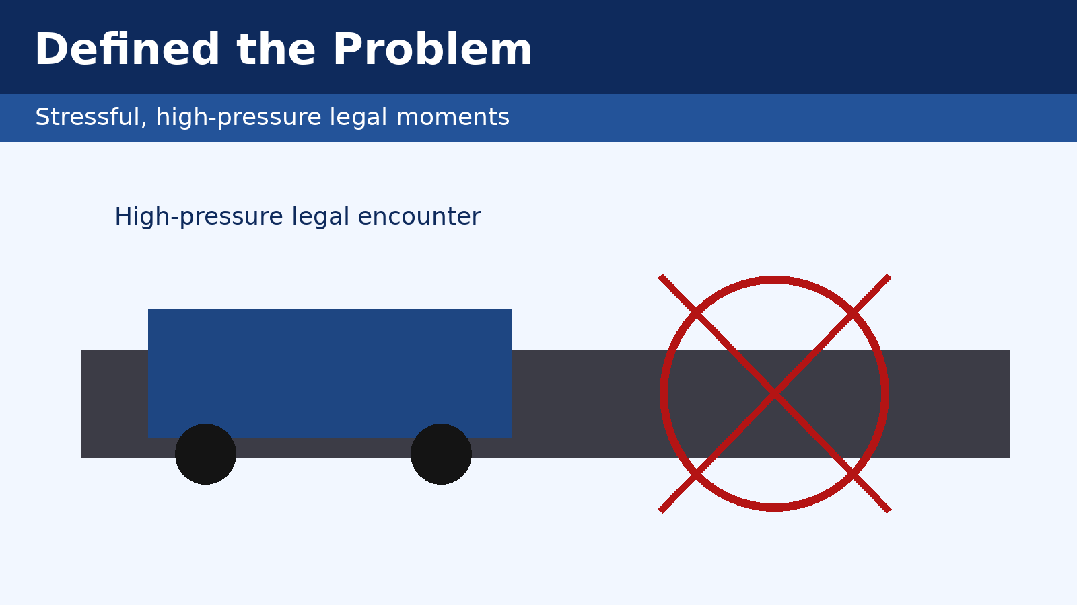
The Problem: The Justice Gap
Why consumers struggle in critical moments
• High-stress legal encounters cause “legal amnesia.”
• People can’t quickly recall rights during stops or disputes.
• Traditional legal help is too slow and expensive for real-time use.
• Large underserved market needs always-on plain-language support.
!
Notes:
I define the problem in business terms, not only technical terms. The unmet need is large, frequent, and costly, creating a strong market opportunity. RonyGuard would target moments where conventional legal services are unavailable or unaffordable.

Slide 3

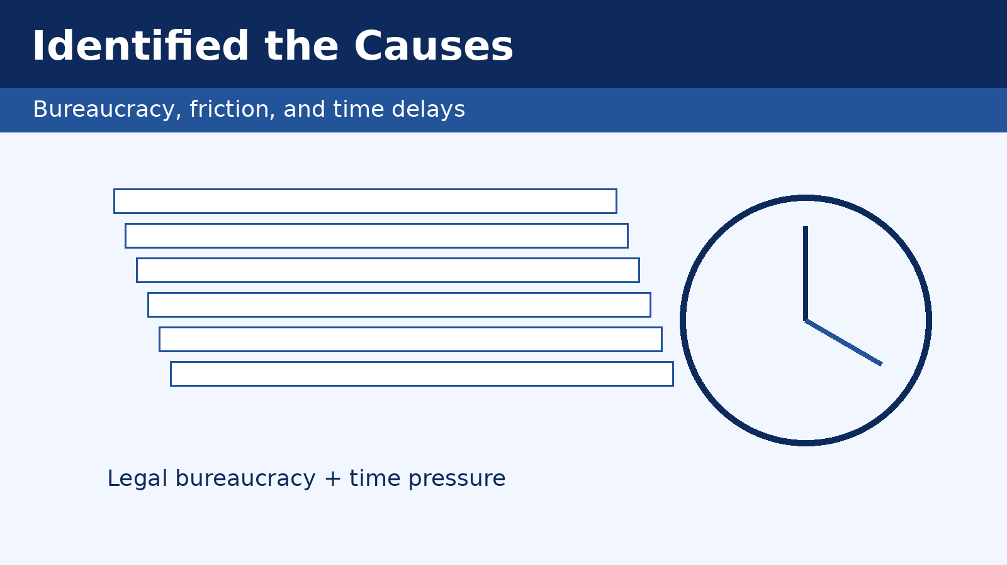
Why the Gap Persists
•
Process
Legal help starts after incidents, not during them.
•
Systems
Dense legal docs are hard to search on mobile.
•
Data
Rights questions are under-tracked, limiting insights.
•
Security
Surveillance concerns prevent people from asking.
•
Strategy
Legacy incentives underfund low-cost legal tools.
Notes:
These are root causes, not a restatement of the problem. The justice gap persists because process, system, data, security, and strategy issues reinforce each other. This analysis justifies why a technology-enabled model is needed.

Slide 4

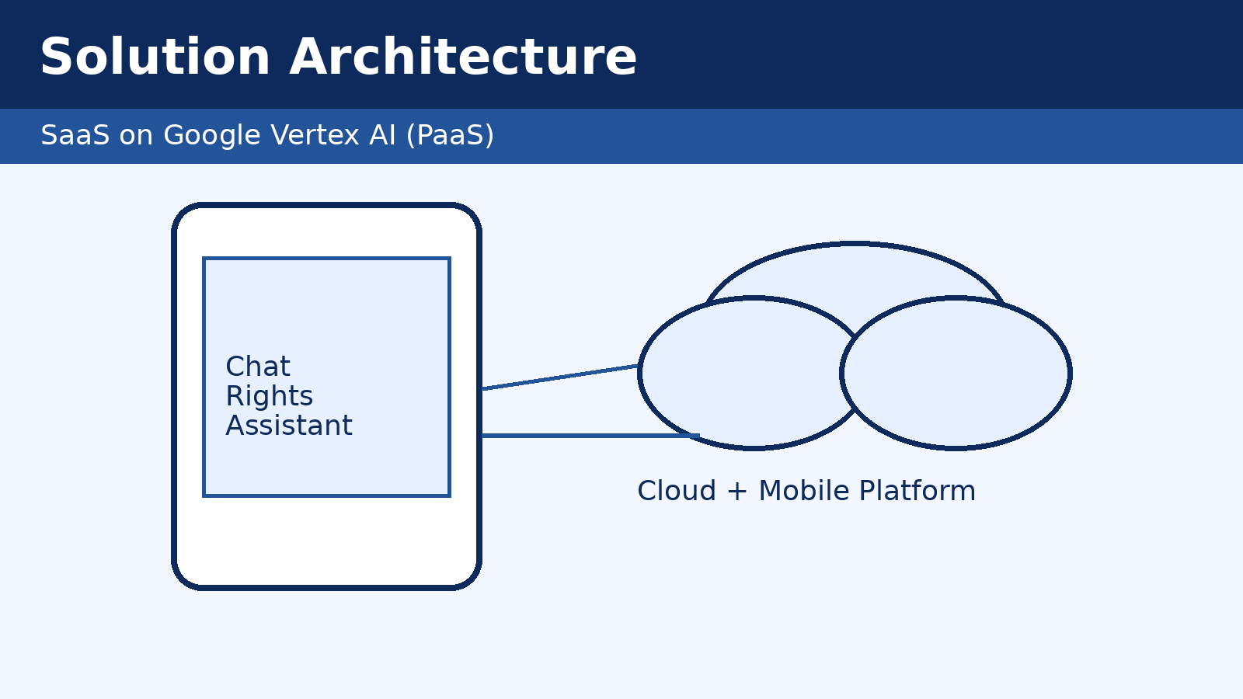
Solution: RonyGuard Platform
A subscription mobile + web service that gives immediate, plain-language legal guidance.
✓
24/7 Instant Support
Real-time next steps in high-stress moments.
✓
Scalable AI Platform
SaaS + PaaS architecture for fast iteration.
✓
Business Upside
Recurring revenue without linear staffing growth.
Notes:
This slide links the business model to platform choices. SaaS supports predictable recurring revenue, while PaaS supports rapid scaling and lower operational burden. The value proposition is improved access at lower cost with sustainable economics.

Slide 5
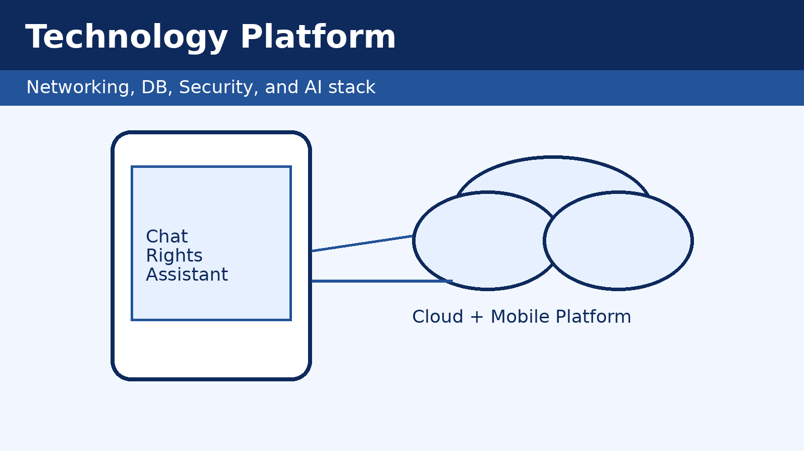
Revenue & Expense Visualization
1
API Networking
HTTPS APIs over mobile networks for low-latency responses.
2
Vector Retrieval
Semantic search across legal texts and FAQs.
3
Security Controls
AES-256, TLS, biometrics, RBAC, audit logs, backups.
4
Enterprise AI
RAG on Vertex AI-style stack to improve relevance.
5
Agile Delivery
MVP sprints, feedback loops, and localization readiness.
Notes:
Vector databases store embeddings so the system retrieves by meaning, not just keywords. Retrieval-augmented generation grounds model responses in trusted legal sources, which helps reduce hallucinations. Security is handled through encryption, access control, auditing, and resilience planning.

Slide 6

Project Roadmap & Evaluation Notes
$15
Monthly subscription per user
$150K MRR
10,000 subscribers × $15
~$40K
Estimated monthly cloud + ops cost
Compared with ~$600 for a typical 2-hour legal consultation, RonyGuard targets affordability and recurring revenue.
Roadmap to scale
MVP
Pilot
Regional Launch
Multi-jurisdiction
Notes:
I will walk left-to-right on the chart: traditional legal help is high-cost and episodic, while RonyGuard is low-cost and recurring. Then I connect MRR and ARR to subscription scalability, followed by estimated operating costs and margin potential. This directly satisfies the rubric requirement for revenue-and-expense visualization tied to the business case.

Slide 7
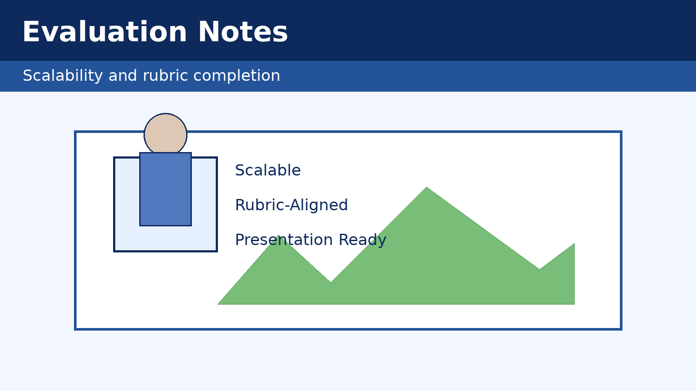
Close the Justice Gap, at Scale.
RonyGuard combines AI + modern MIS to deliver accessible legal-rights support when people need it most.
Visual Placeholder
• Add product screenshot or QR code
Request a Demo
Contact: ronald.kipkemboi@example.com · ronyguard.app (placeholder)
Notes:
Thank you for your time. RonyGuard is a realistic but fictitious model showing how MIS concepts can produce both social impact and business value. I am happy to answer questions on architecture, security controls, and financial assumptions.

