Slide 1

TensorFlow: Advanced Methods

Slide 2

Why TensorFlow
Popular in Industry

Slide 3


Why TensorFlow
2. Deployment Solution for Many Devices and Platforms

Slide 4
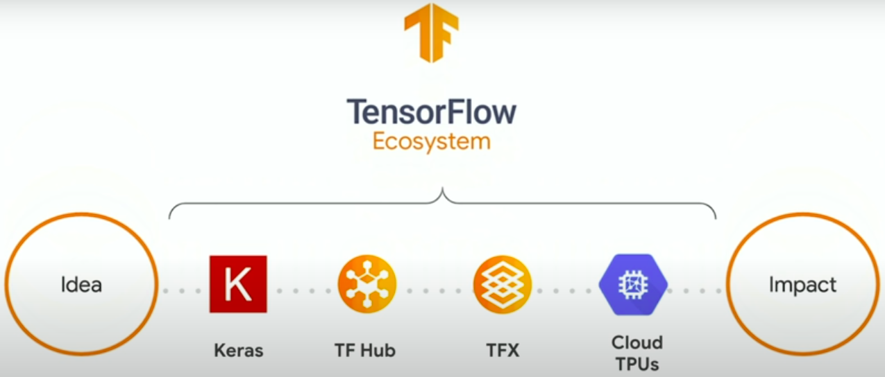
Why TensorFlow
3. Ecosystem

Slide 5
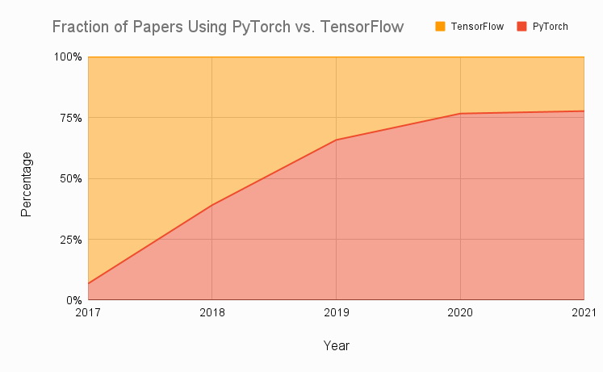
TensorFlow Vs Pytorch

Slide 6
Why Advanced Methods?
Most of the elementary courses only talk about toy projects not real ones.
Using a framework effectively can drastically reduce the development and training costs and time.
A reliable engineer most be able to choose the best solution among many candidates.

Slide 7
Prerequisites
Python Programming and OOP
Concepts and Theory of Machine Learning and Deep Learning
Basics of TensorFlow
A laptop or PC that can run Google Colab

Slide 8
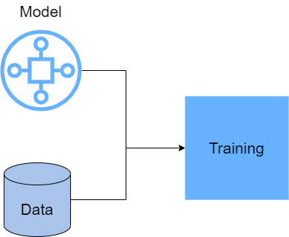

Slide 9
Course Outline
TensorFlow Advanced Topics
TensorFlow Architecture
difference between the eager and graph modes
2. Fast and customized Data Loaders
TF Records
TFDS
tf.data API
Data Augmentation

Slide 10
Course Outline
3. Custom Layers and Models
Sequential API
Functional API
Subclass API
Lambda Layers
Preprocessing layers with Keras
SavedModels
4. Custom Loss Functions (contrastive loss function)

Slide 11
Course Outline
5. Callbacks
6. Custom training
Automatic Differentiation
GradientTape
Customizing model.fit

Slide 12

Interviews

Slide 13
Assignments
Quizzes
Programming Assignments
Final Project

Slide 14
What is Coming up in This Series …
ML Scientist Track
Learning a Programming Language
Basics of Machine Learning
Basics of DL, CNN, RNN
Learning one DL FrameWork Basics
ML Engineer Track

Slide 15

Study
Practice
Search
Enjoy!

