Slide 1
Eager Execution Vs Graph Execution

Slide 2
TensorFlow Codes can be run in two modes:
Eager Execution
Graph Execution

Slide 3
Suppose that you have this code snippet:
x = [[2.0]]
m = tf.matmul(x, x)
print(m)
What do you expect?
Let’s run this …

Slide 4
The Output is as expected:
tf.Tensor([[4.]], shape=(1, 1), dtype=float32)
However it is like a obvious thing, This behaviour of TensorFlow become the default behaviour since TensorFlow 2.x.
TensorFlow call this mode “Eager Execution”

Slide 5
Eager Execution execute the code as it is executed in ordinary Python codes.
Eager Execution evaluates operations immediately. TensorFlow operations are executed by Python, operation by operation, and returning results back to Python.

Slide 6
It means when you run m = tf.matmul(x, x) The value of m will be evaluated before the code move to the next line.
It is in contrast with Graph Mode!!!

Slide 7
Graph Execution
In graph mode the operations do not evaluate immediately. TensorFlow first creates a Symbolic Graph of Operations and Tensors which is independent of Python and can be ported outside of Python.

Slide 8
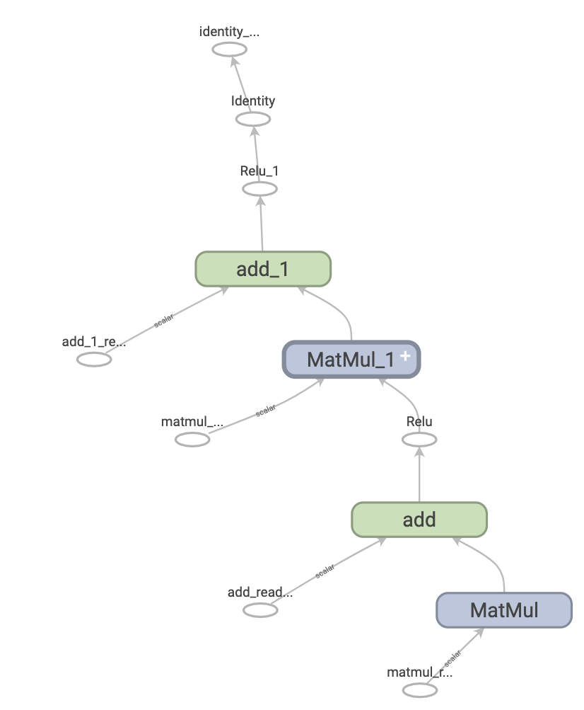

Slide 9
So when TensorFlow see this line:
m = tf.matmul(x, x)
It creates a symbolic node in the Graph and does not evaluate the value of m.
In the next phase after the Graph has been created. You can feed data flow to the Graph and get the value of each variable.

Slide 10

Analogy

Slide 11
The Graph Execution was the default behaviour before TensorFlow 2.x. But now the Eager Execution is default.
However you can easily force the python function to run in Graph mode by decorating them with tf.function
@tf.function
def square(x):
m = tf.matmul(x, x)
return m

Slide 12
Benefits of Graphs
Very Fast;
Very Flexible;
Runs in parallel
Portable

Slide 13
Downsides of Graphs
Difficult-to-learn
Difficult-to-test
Non-intuitive

Slide 14
Benefits of Eager
Intuitive and Pythotic Interface
Easy Debug
Easy-to-prototype
beginner-friendly

Slide 15
Downsides of Eager
Slower
Dependency to Python Code

Slide 16
Looking for the best of two modes?
Code with Eager, Executive with Graph!!!
Notes:
Dynamic computation

Slide 17
There are some differences in practice.
Let’s investigate some in practice!

