Slide 1
tf.data Performance Improvements

Slide 2
So far took a look at some of the features available in tf.data like:
Parse and extract common data format
Transform and Augment data
This session is about Efficiency

Slide 3
The way we load data have a huge impact on the model training efficiency.
As data get larger Optimization and Finding Bottlenecks are more important

Slide 5
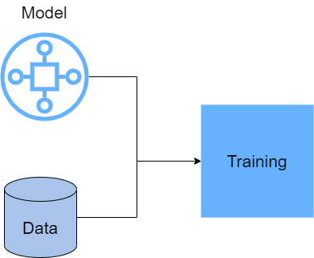
Machine Learning Training
GPU/ TPU
CPU

Slide 6
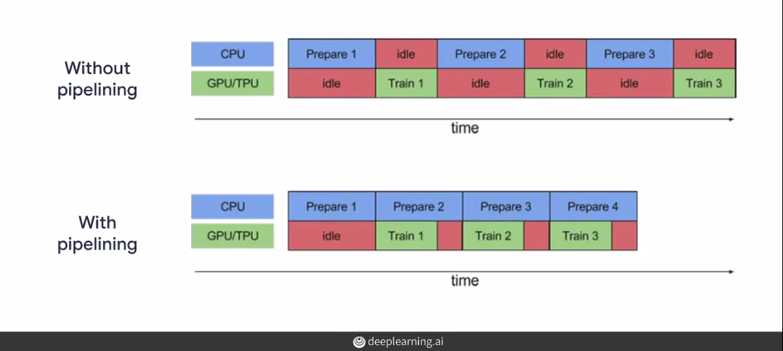

Slide 7
How to Improve Data Pipelines with tf.data
Caching
Parallelizing transformations
Prefetching
Parallelizing I/O

Slide 8
Caching
If all of data fits to the memory (In Memory Caching):
tf.data.Dataset.cache()
If data is large (Disk Caching):
tf.data.Dataset.cache(filename=…)
Most of the time we use caching after transformations and before model training

Slide 9
Parallelize transformations
Transformations are Expensive Tasks for CPU
Most of the time we apply map method element-wize. (For example for image augmentation we augment one image at a time.)
So CPU will be under utilized.
The map function takes a parameter called num_parallel_calls, which defines the number of cores in your CPU that it can use in parallel.

Slide 10
Parallelize transformations
augmented_dataset = dataset.map(func, num_parallel_calls=8)
How we can how do we figure out how many cores we can use?

Slide 11
AUTOTUNE
Setting optimization parameters like num_parallel_calls by hand might not necessarily help you reach a CPU's peak usage.
TensorFlow AUTOTUNE automatically tune such values dynamically at runtime.

Slide 12
AUTOTUNE
AUTOTUNE = tf.data.AUTOTUNE
augmented_dataset = dataset.map(func,
num_parallel_calls=AUTOTUNE)

Slide 13
Prefetch
One way to reducing CPU idle time is to use the prefetch operation of the data set API.
train_dataset = dataset.map(func).prefetch(AUTOTUNE)
It fetch some number of batches in a buffer ahead of time and when the GPU is busy with training with a batch, the CPU will preprocess the next batch simultaneously.

Slide 14
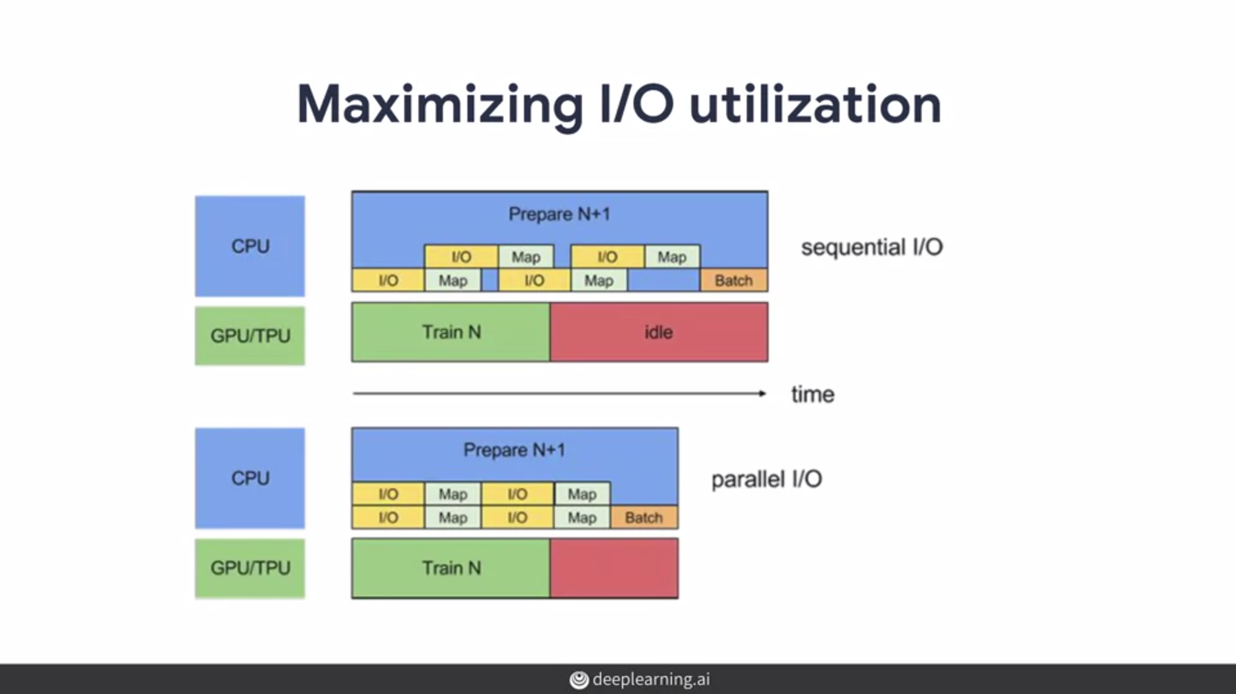
Parallelizing I/O

Slide 15
Interleave
list_ds = tf.data.Dataset.list_files(str(data_dir/'*/*'), shuffle=False)
num_parallel_reads = 4
dataset = list_ds.interleave(map_func,
cycle_length=num_parallel_reads,
num_parallel_calls=AUTOTUNE)

Slide 16
Other Ideas
Snapshot
Horizontal Scaling (distributed preprocessing)

Slide 17
Further Readings
https://www.tensorflow.org/guide/data_performance

