Slide 1
Models In TensorFlow

Slide 2
In This Section
We investigate different approaches for developing DL models.
Extending TensorFlow Layers and Models to develop customized architectures.
Dig into models and layers to change their attributes.

Slide 3
After This Section you Should be Able to …
Select an appropriate API for model development
Developing different model architecture from scratch
Use developed models and customize its characteristics and attributes.

Slide 4
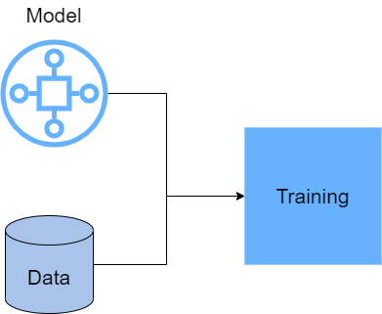

Slide 5
Different Model Development Approaches
Sequential
Approaches
Functional
Subclassing

Slide 6
Sequential API
A Sequential model is appropriate for a plain stack of layers (Linear Architecture) where each layer has exactly one input tensor and one output tensor.

Slide 7
Model = tf.keras.Sequential(
[
layers.Dense(2, activation=”relu”, name=”layer_1”),
layers.Dense(3, activation="relu", name="layer2"),
layers.Dense(4, name="layer3"),
]
)

Slide 8
Sequential API gets a list of layers that will be stacked linearly.
It means the output of each layer fed into the next layer.
It is equivalent to this:

Slide 9
layer1 = layers.Dense(2, activation="relu", name="layer1")
layer2 = layers.Dense(3, activation="relu", name="layer2")
layer3 = layers.Dense(4, name="layer3")
# Call layers on a test input
x = tf.ones((3, 3))
y = layer3(layer2(layer1(x)))

Slide 10
You can call different methods like add and pop to manipulate the layers of a sequential model.
See this tutorial for more:
https://keras.io/guides/sequential_model/

Slide 11
Shortcomings of Sequential API
A Sequential model is not appropriate when:
Your model has multiple inputs or multiple outputs
You need to do layer sharing
You want non-linear topology (e.g. a residual connection, a multi-branch model)
You want to add recursion in your model (e.g. for and while loops)

