Slide 1
Functional API

Slide 2
The Keras functional API is a way to create models that are more flexible than the tf.keras.Sequential API.
The functional API can handle models with non-linear topology, shared layers, and even multiple inputs or outputs.

Slide 3
Functional API
Input Layers Model
1
2
3

Slide 4
Functional API
Input Layers Model
1
2
3
Define a Keras Input Layer

Slide 5
Functional API
Input Layers Model
1
2
3
Define a set of connected layers. (model architecture)

Slide 6
Functional API
Input Layers Model
1
2
3
Creating a Model by specifying the Inputs and Outputs

Slide 7
input = tf.keras.Input(shape=(784,))
x = tf.keras.layers.Dense(64, activation="relu")(input)
x = tf.keras.layers.Dense(64, activation="relu")(x)
prediction = tf.keras.layers.Dense(10, activation=”softmax”)(x)
model = tf.keras.Model(inputs=input, outputs=prediction, name="mlp_model")

Slide 8
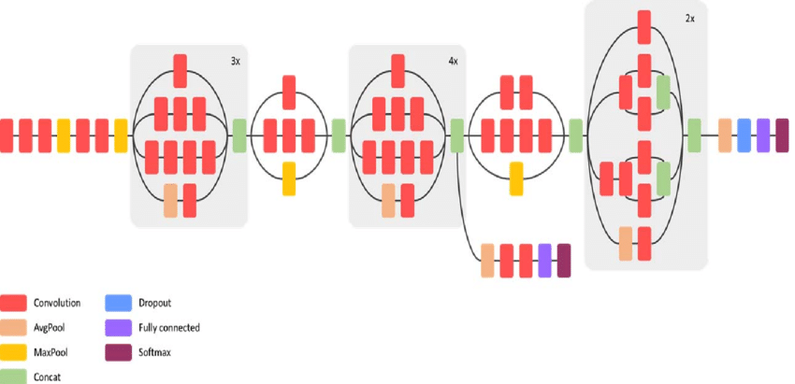
Branching
Many famous architectures have layer branching. Like Inception:

Slide 9
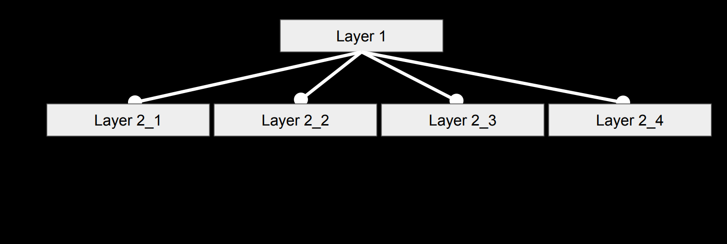

Slide 10
layer1 = Dense(32)(x)
layer2_1 = Dense(32)(layer1)
layer2_2 = Dense(32)(layer1)
layer2_3 = Dense(32)(layer1)
layer2_4 = Dense(32)(layer1)
merge = Concatenate([layer2_1, layer2_2, layer2_3, layer2_4])

Slide 11
Multi-Input Multi-Output
The functional API makes it easy to manipulate multiple inputs and outputs. This cannot be handled with the Sequential API.

Slide 12
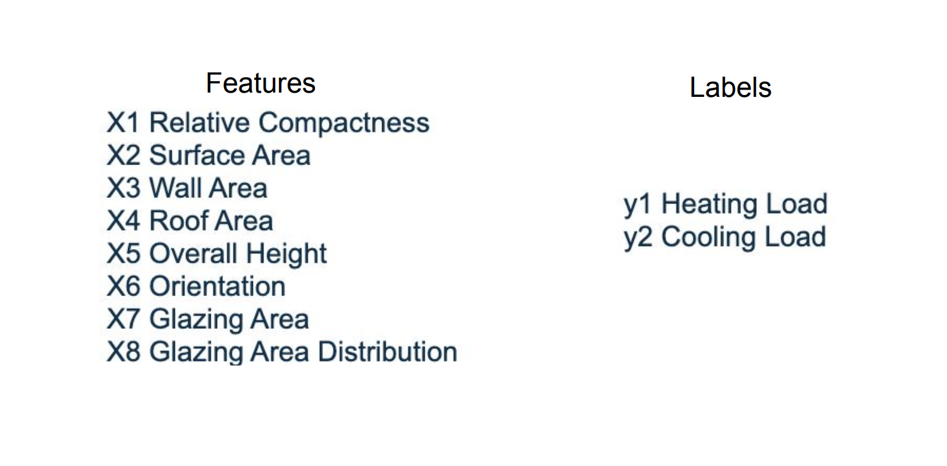
Energy Efficiency Dataset
https://archive.ics.uci.edu/ml/datasets/Energy+efficiency

Slide 13
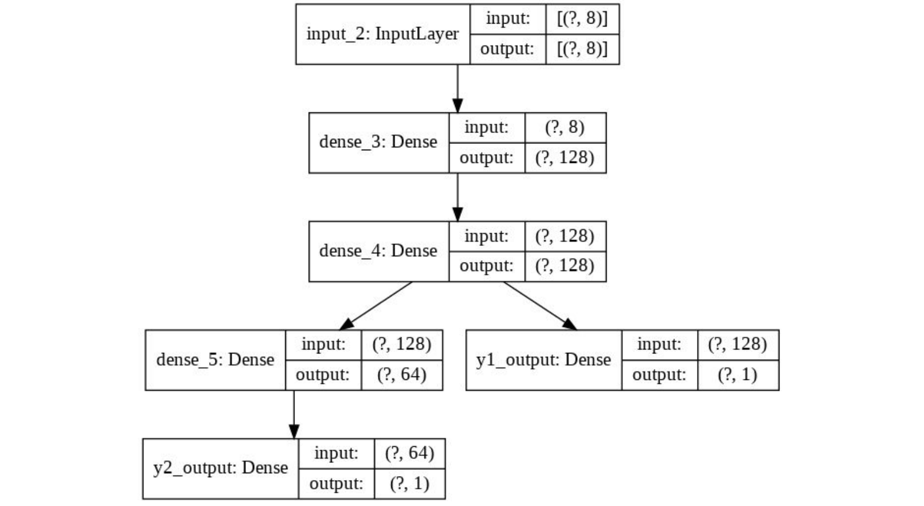

Slide 14
input_layer = Input(shape=(len(train .columns),))
first_dense = Dense(units='128',activation='relu')(input_layer)
second_dense = Dense(units='128',activation='relu')(first_dense)
y1_output = Dense(units='1', name='y1_output')(second_dense)
third_dense = Dense(units='64',activation='relu')(second_dense)
y2_output = Dense(units='1', name='y2_output')(third_dense)
# Define the model with the input layer and a list of output layers
model = Model(inputs=input_layer, outputs=[y1_output, y2_output])

Slide 15
Now let's get our hands dirty and write some codes …

