Slide 1
Custom Layers

Slide 2
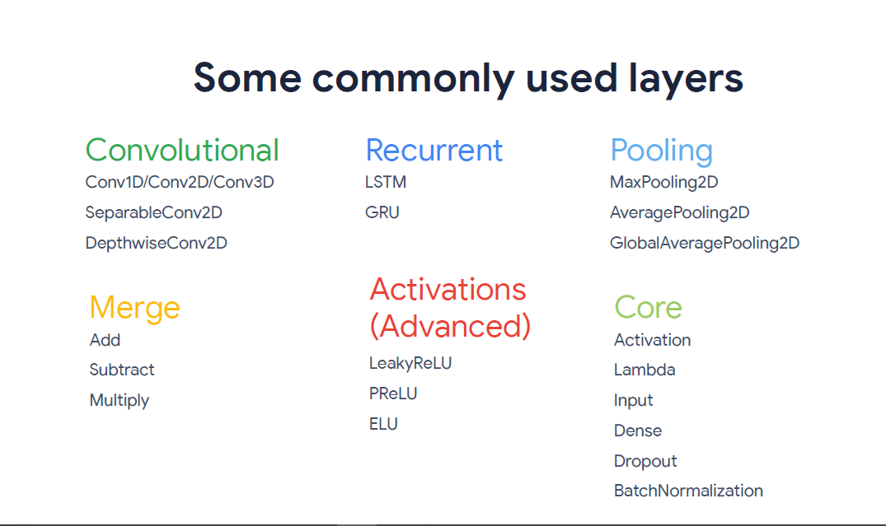
There are lots of built-in layers in TensorFlow.

Slide 3
However sometimes you need to write your own custom layer.
Keras Lambda Layers
TF Custom Layers
Layer Subclassing

Slide 4
Lambda Layers
Quickly create a Keras Layer from a Python Function or Expression
Lambda layers are best suited for simple operations or quick experimentation

Slide 5
model = tf.keras.models.Sequential([
tf.keras.layers.Flatten(input_shape=(28, 28)),
tf.keras.layers.Dense(128),
tf.keras.layers.Lambda(lambda x: tf.abs(x)),
tf.keras.layers.Dense(10, activation='softmax')
])

Slide 6
def my_relu(x):
return K.maximum(0.0, x)
model = tf.keras.models.Sequential([
tf.keras.layers.Flatten(input_shape=(28, 28)),
tf.keras.layers.Dense(128),
tf.keras.layers.Lambda(my_relu),
tf.keras.layers.Dense(10, activation='softmax')
])

Slide 7
Lambda layers has portability issues. They should only be loaded in the same environment where they were saved.
A more flexible and portable Approach is Layer Subclassing

Slide 8
Layer Subclassing
Each Layer consist of Three Main Part
Layer State
(weights)
Input to Output Computation
(Forward Path)
Gradient of weights
(Back Propagation)

Slide 9
Layer Subclassing
Each Layer consist of Three Main Part
Layer State
(weights)
Input to Output Computation
(Forward Path)
Gradient of weights
(Back Propagation)
TensorFlow handles This Part

Slide 10
“One of the central abstraction in Keras is the Layer class. A layer encapsulates both a state (the layer's "weights") and a transformation from inputs to outputs (a "call", the layer's forward pass).”

Slide 11
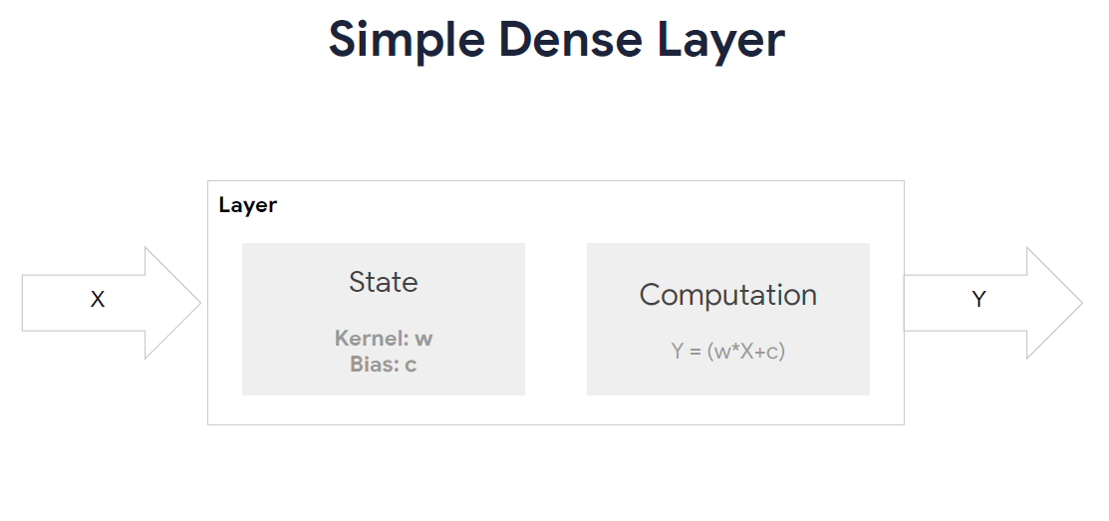

Slide 12
class SimpleDense(keras.layers.Layer):
def __init__(self, units=32, input_dim=32):
super(SimpleDense, self).__init__()
w_init = tf.random_normal_initializer()
self.w = tf.Variable(
initial_value=w_init(shape=(input_dim, units), dtype="float32"),
trainable=True,
)
b_init = tf.zeros_initializer()
self.b = tf.Variable(
initial_value=b_init(shape=(units,), dtype="float32"), trainable=True
)
def call(self, inputs):
return tf.matmul(inputs, self.w) + self.b

Slide 13
class SimpleDense(keras.layers.Layer):
def __init__(self, units=32, input_dim=32):
super(SimpleDense, self).__init__()
w_init = tf.random_normal_initializer()
self.w = tf.Variable(
initial_value=w_init(shape=(input_dim, units), dtype="float32"),
trainable=True,
)
b_init = tf.zeros_initializer()
self.b = tf.Variable(
initial_value=b_init(shape=(units,), dtype="float32"), trainable=True
)
def call(self, inputs):
return tf.matmul(inputs, self.w) + self.b

Slide 14
class SimpleDense(keras.layers.Layer):
def __init__(self, units=32, input_dim=32):
super(SimpleDense, self).__init__()
w_init = tf.random_normal_initializer()
self.w = tf.Variable(
initial_value=w_init(shape=(input_dim, units), dtype="float32"),
trainable=True,
)
b_init = tf.zeros_initializer()
self.b = tf.Variable(
initial_value=b_init(shape=(units,), dtype="float32"), trainable=True
)
def call(self, inputs):
return tf.matmul(inputs, self.w) + self.b

Slide 15
class SimpleDense(keras.layers.Layer):
def __init__(self, units=32, input_dim=32):
super(SimpleDense, self).__init__()
w_init = tf.random_normal_initializer()
self.w = tf.Variable(
initial_value=w_init(shape=(input_dim, units), dtype="float32"),
trainable=True,
)
b_init = tf.zeros_initializer()
self.b = tf.Variable(
initial_value=b_init(shape=(units,), dtype="float32"), trainable=True
)
def call(self, inputs):
return tf.matmul(inputs, self.w) + self.b

Slide 16
class SimpleDense(keras.layers.Layer):
def __init__(self, units=32, input_dim=32):
super(SimpleDense, self).__init__()
w_init = tf.random_normal_initializer()
self.w = tf.Variable(
initial_value=w_init(shape=(input_dim, units), dtype="float32"),
trainable=True,
)
b_init = tf.zeros_initializer()
self.b = tf.Variable(
initial_value=b_init(shape=(units,), dtype="float32"), trainable=True
)
def call(self, inputs):
return tf.matmul(inputs, self.w) + self.b

Slide 17
class SimpleDense(keras.layers.Layer):
def __init__(self, units=32, input_dim=32):
super(SimpleDense, self).__init__()
w_init = tf.random_normal_initializer()
self.w = tf.Variable(
initial_value=w_init(shape=(input_dim, units), dtype="float32"),
trainable=True,
)
b_init = tf.zeros_initializer()
self.b = tf.Variable(
initial_value=b_init(shape=(units,), dtype="float32"), trainable=True
)
def call(self, inputs):
return tf.matmul(inputs, self.w) + self.b

Slide 18
class SimpleDense(keras.layers.Layer):
def __init__(self, units=32, input_dim=32):
super(SimpleDense, self).__init__()
w_init = tf.random_normal_initializer()
self.w = tf.Variable(
initial_value=w_init(shape=(input_dim, units), dtype="float32"),
trainable=True,
)
b_init = tf.zeros_initializer()
self.b = tf.Variable(
initial_value=b_init(shape=(units,), dtype="float32"), trainable=True
)
def call(self, inputs):
return tf.matmul(inputs, self.w) + self.b

Slide 19
x = tf.ones((2, 2))
linear_layer = SimpleDense(4, 2)
y = linear_layer(x)
print(y)
tf.Tensor(
[[ 0.01103698 0.03099662 -0.1009444 0.10721317]
[ 0.01103698 0.03099662 -0.1009444 0.10721317]], shape=(2, 4), dtype=float32)

Slide 20
It was the simplest way to create a Layer.
More in Lab …

