Slide 1
Siamese Networks

Slide 2
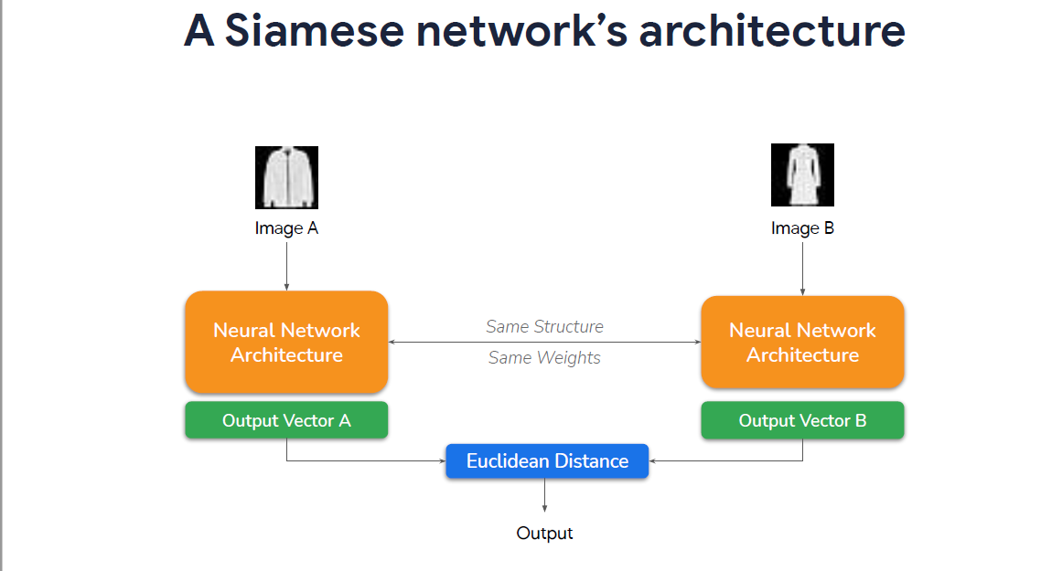

Slide 7
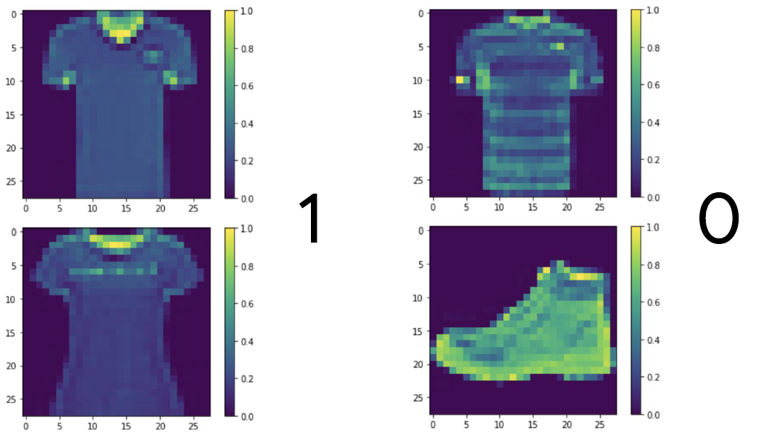

Slide 8
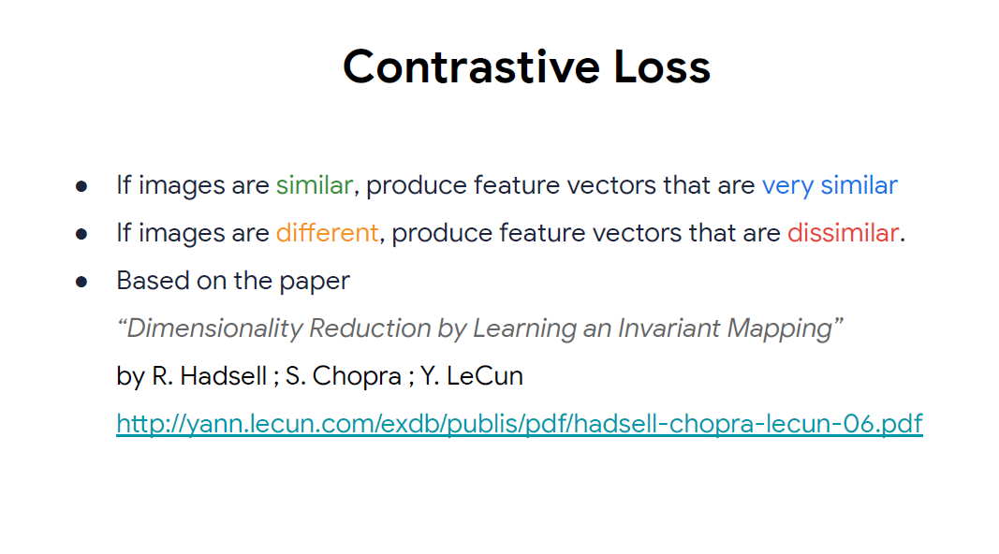

Slide 9
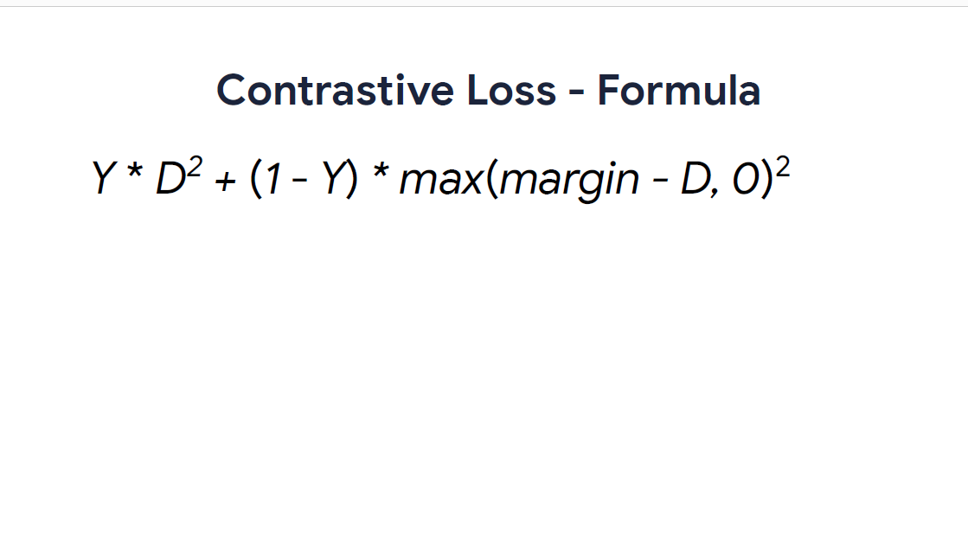

Slide 13
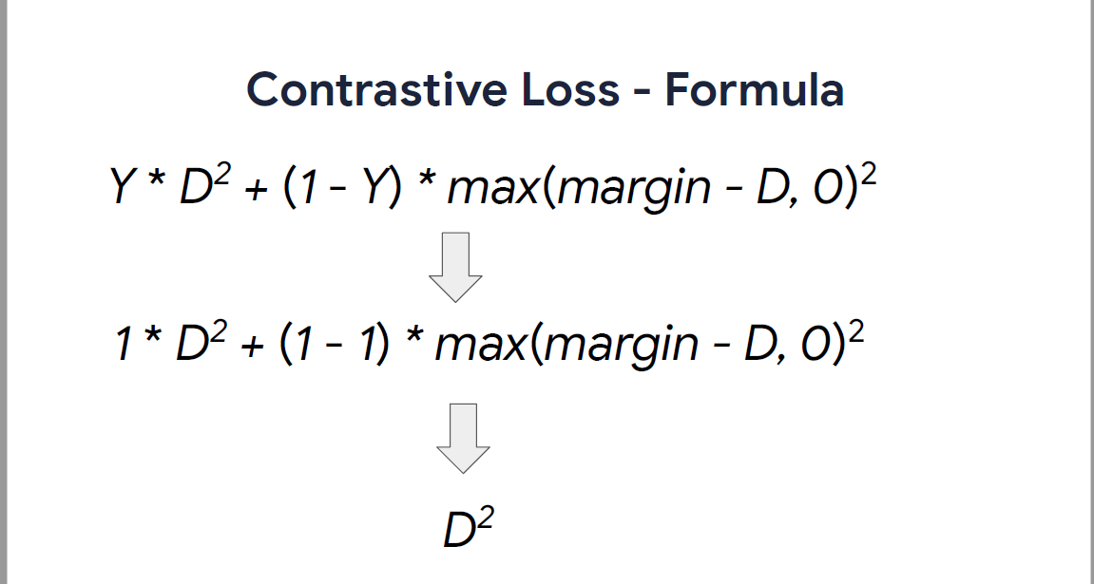

Slide 14
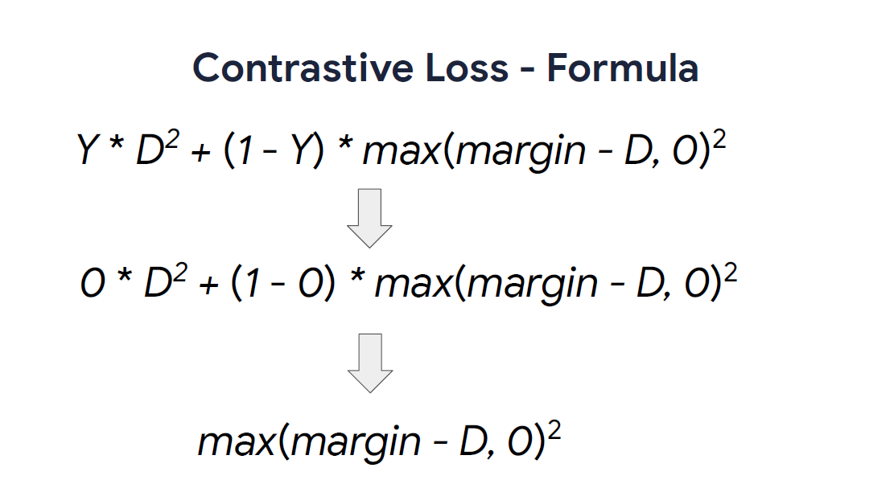

Slide 15
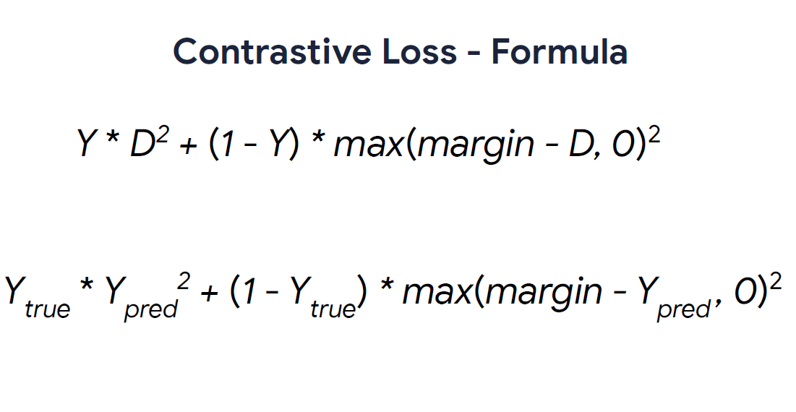

Slide 16
References
https://www.coursera.org/learn/custom-models-layers-loss-functions-with-tensorflow
http://yann.lecun.com/exdb/publis/pdf/chopra-05.pdf
http://slazebni.cs.illinois.edu/spring17/lec09_similarity.pdf

