Slide 1
Custom Training

Slide 2
In This Section
We will checkout how TensorFlow compute gradient and perform Automatic Differentiation.
We will go through the customized training loops in TensorFlow.

Slide 3
After this section you should be able to …
Compute gradient of any expression with respect to any of the variables.
Writing custom training loops for your application
Extend .fit method of Keras models

Slide 4
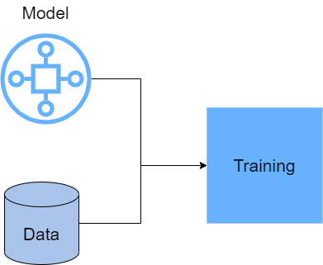

Slide 5
One of the crucial parts of any deep neural network training is computing gradients of weights (backpropagation).
TensorFlow uses a method called Automatic Differentiation (Auto Diff) to compute gradient of any expression.

Slide 6
To differentiate automatically, TensorFlow needs to remember what operations happen in what order during the forward pass. Then, during the backward pass, TensorFlow traverses this list of operations in reverse order to compute gradients.

Slide 7
TensorFlow has a context manager named tf.GradientTape to remember the operations so later it can compute the gradients.
with tf.GradientTape() as tape:
…
…

Slide 8
Training Loops
Keras provides built-in methods to train and evaluate neural networks: model.compile(), model.fit(), model.evaluate()
Most of the times these methods are sufficient for our applications.

Slide 9
However in special cases we need to create our own training loops, like in GAN models.

Slide 10
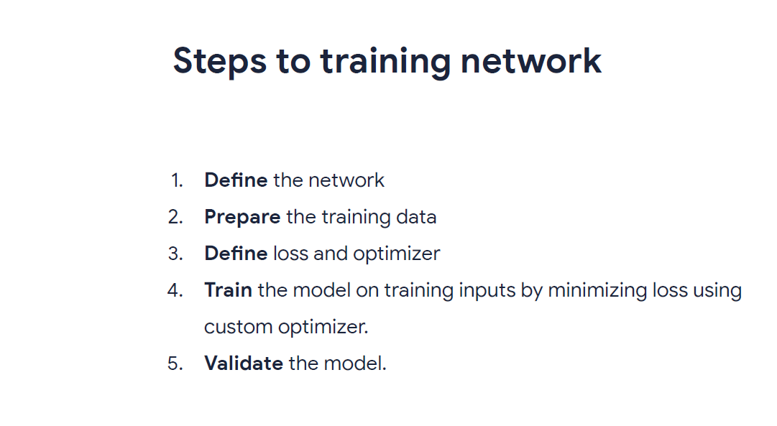

Slide 11
