Slide 1
Data analysis of HSBC financial market data
Group 18

Slide 2
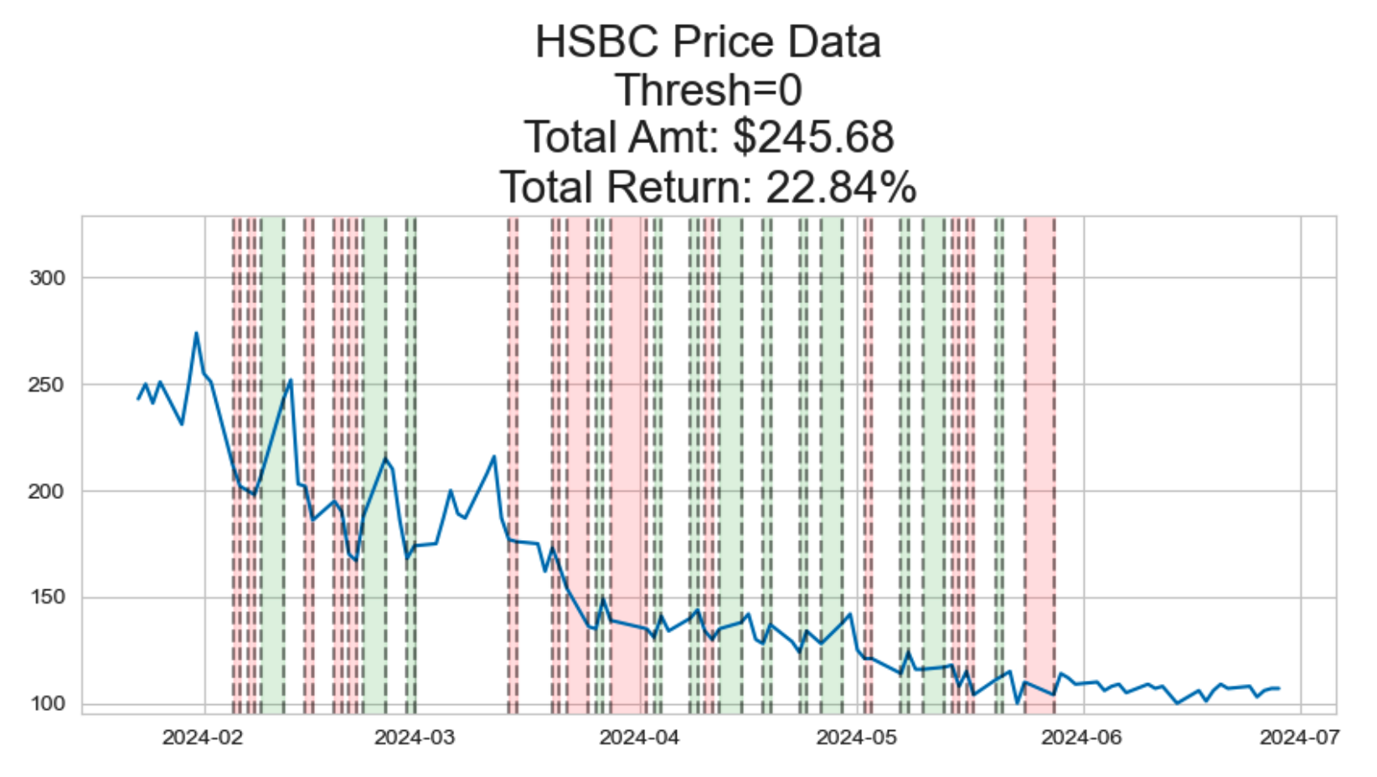
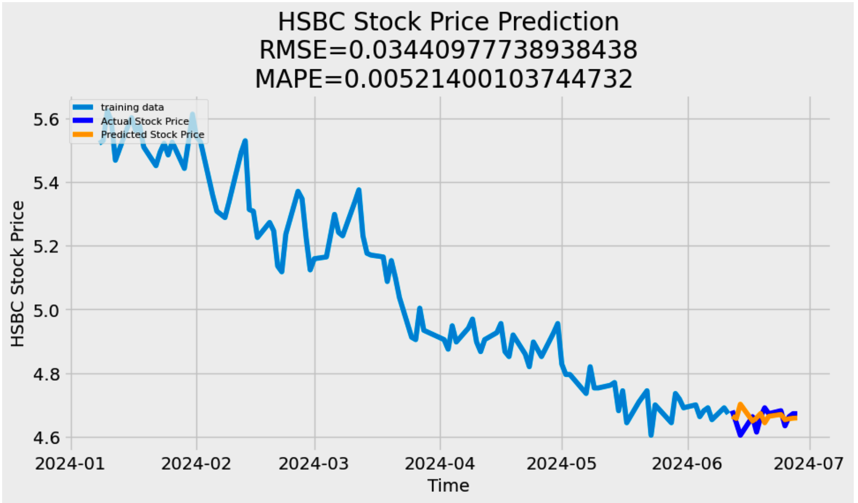
Simulating Buying And Selling Stock Using ARMA(2,0,2)
Process so far
Tapes Data
OHLC Data
Predictions Using ARIMA(1,1,11)

Slide 3
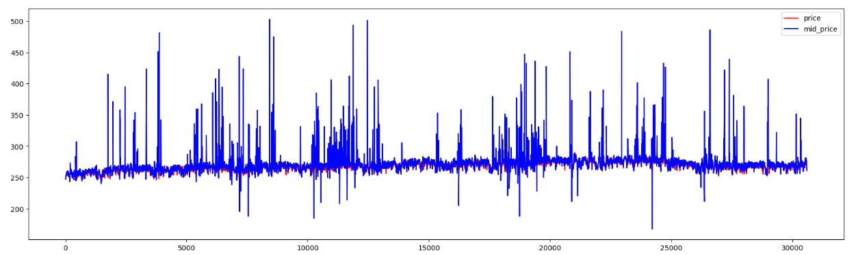
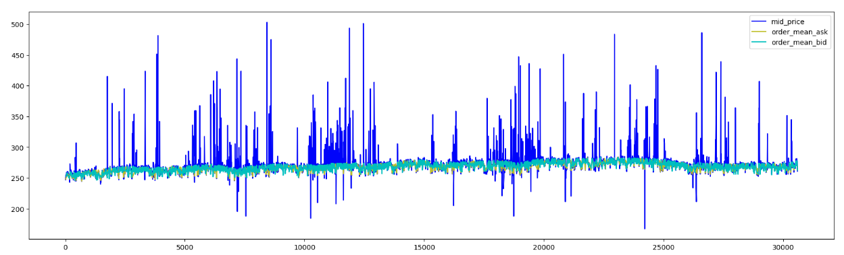
Process so far
Data Processing: Match the data in the Tapes with the data in the LOBs and determine whether the transaction behaviour at each point in time in the Tapes is bid or ask.
Data Visulization:
The graph shows the relationship between the traded price and the mid-price as well as the relationship between the traded price and the average price

Slide 4
What we plan on doing next
Since we have used the OHLC data for the ARIMA model, we plan to implement this on the actual LOB to give us better results.
However, ARIMA is a basic model and we are working on predicting the stock prices using LSTM model to achieve our goal.
We plan to do the real-time predictions during the day, and based on the stock prices we predict at the next timestamp, this will hopefully let us decide how to make profits (buy or sell the stocks).
Our idea is to use the mid-price as a parameter to predict the prices

Slide 5
Challenges
Our biggest challenge so far has been the data itself
We are also struggling to find the most optimum model for the prediction
Find other features to fit pass into models to get desired results

