Slide 1

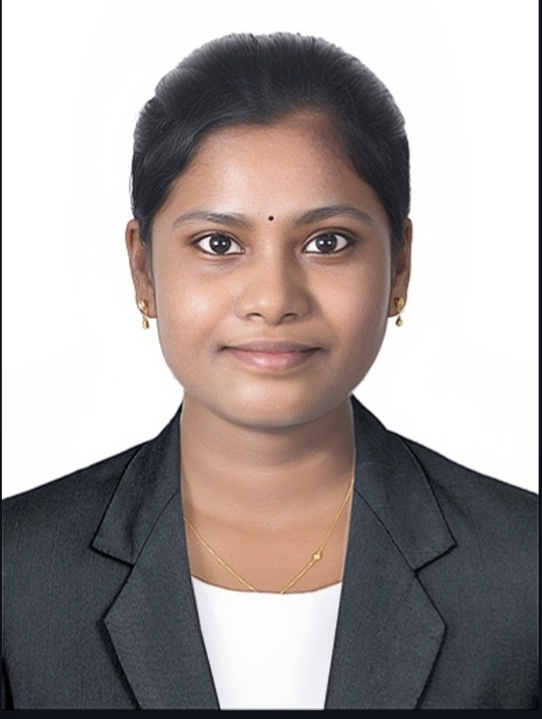
Rooba Sree
Total Experience: Experience @ Accenture: 1Years,5 Months
Rooba Sree
Package App Development Associate
Level: 12
Email: rooba.s.manivannan@accenture.com
Expertise
Hands-on experience developing Angular (Spartacus) frontend applications within SAP Commerce Cloud (Hybris)
Strong expertise in e-commerce frontend development, including cart, checkout, and profile flows
Proficient in Angular, TypeScript, JavaScript, HTML5, CSS3, SCSS, and Spartacus Dynamic Forms
Experienced in REST API integration and handling backend-driven data flows
Solid understanding of component-based architecture, separation of concerns, and scalable frontend design principles
Skilled in debugging production issues and managing regressions across multiple environments
Gained working knowledge of the MEAN stack
Here’s a polished and professional version of your summary:
I am an Associate Software Engineer with 1+ year of experience in frontend development, specializing in Angular (Spartacus) and the MEAN stack. Proficient in TypeScript, JavaScript, HTML5, CSS3, and SCSS, with hands-on experience building responsive UI components and integrating REST APIs.
Experienced in SAP Commerce Cloud (Hybris) projects for Samsung, contributing to e-commerce platform development and enhancements across profile, cart, and checkout flows. Skilled in developing configuration-driven UI using Impex and supporting large-scale migration from JSP to Spartacus, including regression handling.
Strong understanding of component-based architecture, RxJS, and scalable frontend design principles. Seeking opportunities to contribute to high-quality, scalable e-commerce applications while continuously enhancing technical expertise.
Background
Relevant Projects
Samsung ATCI
Worked on migrating JSP-based UI to Spartacus for dynamic forms and overall site UI.
Implemented short code fields in profile and checkout flows in compliance with Saudi government regulations
Handled UI styling and improved web accessibility by addressing audit items, including ARIA labels and MDC external properties
Enabled features using backend APIs and BackOffice configurations
Worked on email UI and localized email UI using Impex, and resolved related regression issues.
Resolved environment-related issues in SAP Commerce Cloud tools, including BackOffice (BO) and HAC (Hybris Administration Console)
Created login and registration pages using Impex and migrated them from JSP to Spartacus
Implemented rewards user popup functionality, including component development, configuration services, and API integration using interceptors.
Training & Certification
TechGenic MEAN Stack training at Accenture
Continuously upskilling in Angular and scalable frontend architecture.
Techleap - Application Engineering School – MEAN
Agentic AI Course

