Slide 1
INTELLIGENT SURVEILLANCE & VMS TECHNOLOGY RESEARCH
AI Video Analytics
Capabilities, Examples & Demonstrations
AI-powered video intelligence for modern surveillance and security
28 Core Capabilities • Verified Real-World Demonstrations • Standardized Reference Architecture

Slide 2
ANALYTICS OVERVIEW & TAXONOMY
The 28 Core AI Video Analytics Capabilities by Category
1. Detection & Recognition
01. Face Detection
02. Face Recognition*
03. Person Detection
04. Vehicle Detection
05. Human/Vehicle Classification
2. Movement & Zone Analytics
06. Line Crossing
07. Intrusion Detection
08. Restricted Area Detection
09. Loitering Detection
14. Direction Detection
15. Wrong-Way Movement Detection
24. Perimeter Protection
3. Crowd & Counting Analytics
10. Crowd Detection
11. Crowd Density Analysis
12. People Counting
13. Occupancy Counting
4. Object Analytics
16. Abandoned Object Detection
17. Missing Object Detection
18. Object Removal Detection
19. Scene Change Detection
5. Camera Health & Diagnostics
20. Camera Tampering Detection
21. Video Loss Detection
22. Defocus Detection
23. Camera Obstruction Detection
6. Safety Analytics
25. Fall Detection*
26. Fire/Smoke Detection*
7. Tracking & Behaviour
27. Vehicle/person tracking
28. Behaviour/event-based analytics*

Slide 3
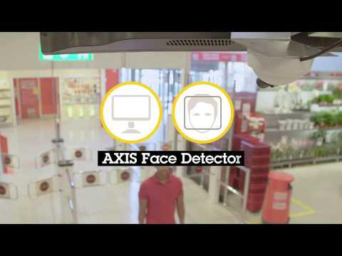
DETECTION & RECOGNITION • CAPABILITY 01 OF 28
01. Face Detection
“Detects and pinpoints the presence and location of human faces in a camera's field of view.”
WHAT IT DETECTS & TECHNICAL OPERATION
Scans real-time video frames using deep-learning models to locate human faces, drawing visual bounding boxes and capturing facial crops regardless of facial angle or lighting.
KEY ANALYTIC DISTINCTION
Face Detection only determines THAT a human face exists and where it is located; it does NOT identify WHO the person is (which is Face Recognition).
PRIMARY ENTERPRISE USE CASES
Retail customer engagement, framing subjects, visitor snapshot logs, and entry portal monitoring.
▶ DEMO VIDEO
SOURCE: AXIS COMMUNICATIONS
AXIS Face Detector - Loss Prevention Demonstration
▶ WATCH DEMONSTRATION VIDEO

Slide 4

DETECTION & RECOGNITION • CAPABILITY 02 OF 28
02. Face Recognition, where legally authorized
“Matches detected human faces against an authorized database of known individuals for access control or security alerts.”
WHAT IT DETECTS & TECHNICAL OPERATION
Extracts mathematical biometric feature vectors from facial captures and compares them against pre-enrolled authorized databases to establish identity matches.
KEY ANALYTIC DISTINCTION
Unlike Face Detection (which only locates faces), Face Recognition identifies the specific individual by matching against an enrolled database.
PRIMARY ENTERPRISE USE CASES
Touchless employee turnstile access, VIP client recognition, and authorized facility security.
LEGAL & COMPLIANCE NOTICE
Deployment is subject to strict legal, privacy, and regulatory compliance (e.g., GDPR, BIPA, statutory privacy laws). Requires explicit legal authority, consent where mandated, and robust data protection.
▶ DEMO VIDEO
SOURCE: HIKVISION UK & IRELAND
How to Set Up Facial Recognition on HikCentral Professional
▶ WATCH DEMONSTRATION VIDEO

Slide 5
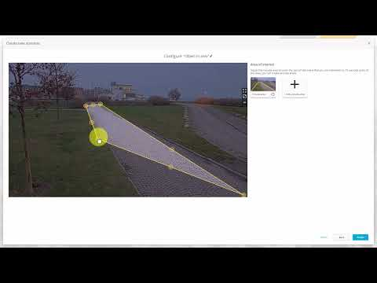
DETECTION & RECOGNITION • CAPABILITY 03 OF 28
03. Person Detection
“Identifies and isolates human figures in the video frame, distinguishing people from background objects.”
WHAT IT DETECTS & TECHNICAL OPERATION
Analyzes pixel patterns with neural networks trained on human silhouettes to accurately detect standing, walking, and running individuals across challenging scenes.
KEY ANALYTIC DISTINCTION
Focuses on identifying the full human body, whereas Vehicle Detection targets motor vehicles and Face Detection isolates facial close-ups.
PRIMARY ENTERPRISE USE CASES
Perimeter intrusion alerting, construction site safety monitoring, and after-hours intruder alerts.
▶ DEMO VIDEO
SOURCE: AXIS TECHNICAL SUPPORT VIDEOS
Object in Area Scenario: Human Target Detection (AXIS Object Analytics)
▶ WATCH DEMONSTRATION VIDEO

Slide 6
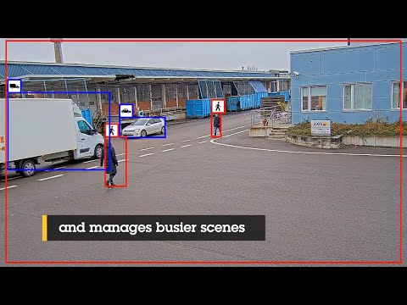
DETECTION & RECOGNITION • CAPABILITY 04 OF 28
04. Vehicle Detection
“Identifies motorized vehicles such as cars, trucks, motorcycles, and buses within the camera's view.”
WHAT IT DETECTS & TECHNICAL OPERATION
Recognizes vehicular geometric structures, wheels, and outlines in motion or parked, providing reliable detection across diverse lighting and angles.
KEY ANALYTIC DISTINCTION
Specialized for motor vehicle detection, differentiating motorized transport from pedestrians, animals, or general background motion.
PRIMARY ENTERPRISE USE CASES
Parking lot occupancy, automated barrier gates, loading bay oversight, and traffic flow monitoring.
▶ DEMO VIDEO
SOURCE: AXIS COMMUNICATIONS
AXIS Object Analytics - Edge AI Vehicle & Object Detection
▶ WATCH DEMONSTRATION VIDEO

Slide 7

DETECTION & RECOGNITION • CAPABILITY 05 OF 28
05. Human/Vehicle Classification
“Differentiates whether a detected moving object is a person or a vehicle, filtering out false alarms caused by animals, weather, and foliage.”
WHAT IT DETECTS & TECHNICAL OPERATION
Classifies moving targets specifically into 'human' or 'vehicle' categories, eliminating false alerts triggered by swaying branches, rain, shadows, or wildlife.
KEY ANALYTIC DISTINCTION
Applies real-time semantic labeling to separate humans and vehicles simultaneously, drastically improving signal-to-noise ratio over raw motion detection.
PRIMARY ENTERPRISE USE CASES
Outdoor perimeter fences, critical infrastructure borders, and automated surveillance dispatch.
▶ DEMO VIDEO
SOURCE: BOARDTAC SOLUTIONS (DAHUA AI SYSTEMS)
Dahua WizSense AI CCTV Explained: How AI Cameras Classify People & Vehicles
▶ WATCH DEMONSTRATION VIDEO

Slide 8
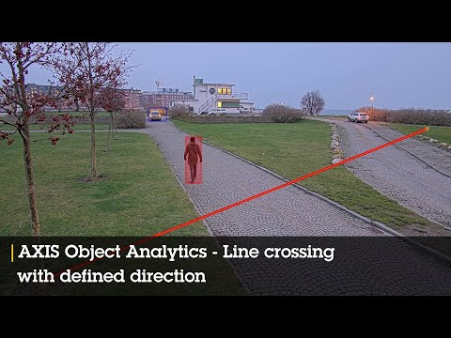
MOVEMENT & ZONE ANALYTICS • CAPABILITY 06 OF 28
06. Line Crossing
“Generates an instant alert when a person or vehicle crosses a predefined virtual tripwire line in a specified direction.”
WHAT IT DETECTS & TECHNICAL OPERATION
Monitors user-configured 2D virtual tripwire vectors across entryways, fence lines, or corridors, triggering alarms when a classified target traverses the line.
KEY ANALYTIC DISTINCTION
Monitors boundary passage along a 1D vector line; unlike Intrusion Detection, it does not evaluate dwell time inside an enclosed area.
PRIMARY ENTERPRISE USE CASES
Property boundary fences, railway platform safety lines, and warehouse loading bay borders.
▶ DEMO VIDEO
SOURCE: AXIS COMMUNICATIONS USA
AXIS Object Analytics - Virtual Line Crossing Detection
▶ WATCH DEMONSTRATION VIDEO

Slide 9
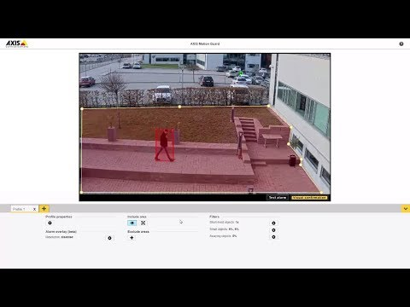
MOVEMENT & ZONE ANALYTICS • CAPABILITY 07 OF 28
07. Intrusion Detection
“Triggers an alarm when an unauthorized subject enters and remains inside a designated virtual zone for a set threshold.”
WHAT IT DETECTS & TECHNICAL OPERATION
Enforces security boundaries across multi-point polygonal zones, alerting operators when a person or vehicle enters the zone and stays beyond a configurable dwell time.
KEY ANALYTIC DISTINCTION
Intrusion Detection evaluates entry and dwell time inside a 2D polygonal area, unlike Line Crossing which triggers instantly upon crossing a line.
PRIMARY ENTERPRISE USE CASES
Securing outdoor storage yards, electrical substation enclosures, and corporate premises after hours.
▶ DEMO VIDEO
SOURCE: AXIS TECHNICAL SUPPORT VIDEOS
Configuration & Demonstration: AXIS Motion Guard Intrusion Detection
▶ WATCH DEMONSTRATION VIDEO

Slide 10
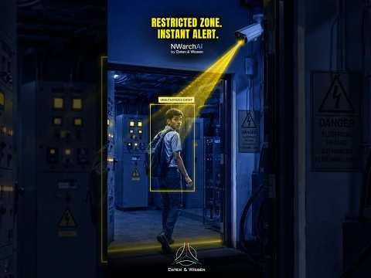
MOVEMENT & ZONE ANALYTICS • CAPABILITY 08 OF 28
08. Restricted Area Detection
“Immediately alerts the instant any person or vehicle enters a strictly forbidden, high-security zone.”
WHAT IT DETECTS & TECHNICAL OPERATION
Maintains zero-tolerance no-entry zones around hazardous, high-voltage, or classified assets, initiating immediate lockdown alerts without delay.
KEY ANALYTIC DISTINCTION
Restricted Area Detection fires immediately upon the slightest boundary breach (zero dwell time tolerance), unlike Intrusion Detection which often uses configurable dwell buffers.
PRIMARY ENTERPRISE USE CASES
Airport tarmac runways, pharmaceutical cleanrooms, high-voltage electrical enclosures, and bank vaults.
▶ DEMO VIDEO
SOURCE: DATEN & WISSEN AI SURVEILLANCE
AI Real-Time Alerts for Restricted No-Entry Zone Violations
▶ WATCH DEMONSTRATION VIDEO

Slide 11
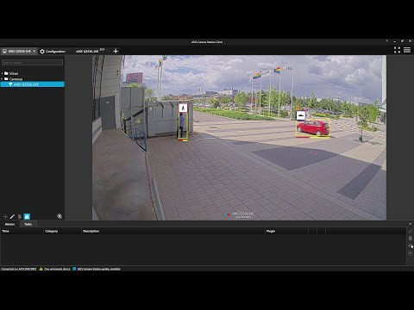
MOVEMENT & ZONE ANALYTICS • CAPABILITY 09 OF 28
09. Loitering Detection
“Detects when an individual or vehicle lingers or remains stationary in a defined area longer than the permitted time limit.”
WHAT IT DETECTS & TECHNICAL OPERATION
Tracks spatial dwell timers for targets within sensitive areas, triggering an alert only when someone remains in the zone beyond a specified time (e.g., >60 seconds).
KEY ANALYTIC DISTINCTION
Trigger is based strictly on dwell duration rather than mere entry; subjects passing straight through without lingering will not trigger an alarm.
PRIMARY ENTERPRISE USE CASES
ATM vestibules, jewelry storefronts, school perimeter perimeters, and unattended transit platforms.
▶ DEMO VIDEO
SOURCE: AXIS TECHNICAL SUPPORT VIDEOS
Detecting Dwell Time & Loitering Using AXIS Object Analytics
▶ WATCH DEMONSTRATION VIDEO

Slide 12
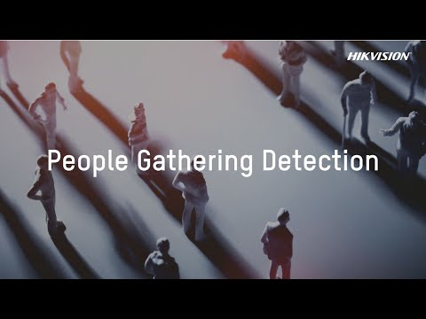
CROWD & COUNTING ANALYTICS • CAPABILITY 10 OF 28
10. Crowd Detection
“Identifies when a group of people gathers in a specific area exceeding normal group size or threshold.”
WHAT IT DETECTS & TECHNICAL OPERATION
Analyzes spatial groupings of individuals in real time, alerting control rooms when an abnormal accumulation or sudden gathering of people forms in a monitored zone.
KEY ANALYTIC DISTINCTION
Crowd Detection flags discrete gathering events or sudden group formations, whereas Crowd Density Analysis continuously measures spatial percentage saturation across a floor.
PRIMARY ENTERPRISE USE CASES
Public plazas, concert venue bottlenecks, hospital emergency lobbies, and protest monitoring.
▶ DEMO VIDEO
SOURCE: HIKVISION EUROPE
People Gathering & Abnormal Crowd Detection Demo
▶ WATCH DEMONSTRATION VIDEO

Slide 13
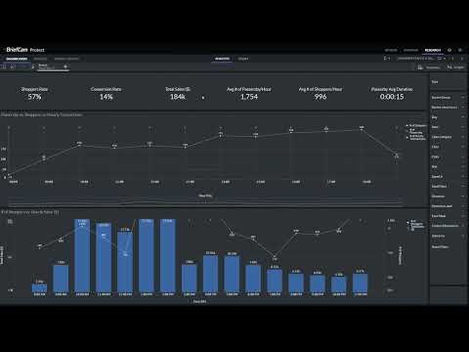
CROWD & COUNTING ANALYTICS • CAPABILITY 11 OF 28
11. Crowd Density Analysis
“Measures and visualizes the percentage and density of spatial occupancy across an area to prevent dangerous overcrowding.”
WHAT IT DETECTS & TECHNICAL OPERATION
Calculates real-time density heatmaps and occupancy percentages (e.g., persons per square meter) across concourses, warning operators before crowd crushing occurs.
KEY ANALYTIC DISTINCTION
Measures continuous spatial saturation and heat gradients across an entire physical area, unlike Crowd Detection which flags discrete group clusters.
PRIMARY ENTERPRISE USE CASES
Metro subway platforms, airport concourses, stadium stairwells, and festival entry gates.
▶ DEMO VIDEO
SOURCE: BRIEFCAM VIDEO ANALYTICS
Visualizing & Managing Occupancy and Crowd Density with Video Analytics
▶ WATCH DEMONSTRATION VIDEO

Slide 14

CROWD & COUNTING ANALYTICS • CAPABILITY 12 OF 28
12. People Counting
“Continuously counts the number of people entering, exiting, or passing through a defined entrance or passage.”
WHAT IT DETECTS & TECHNICAL OPERATION
Uses overhead or angled AI cameras to track bidirectional foot traffic across threshold lines, compiling accurate In, Out, and Total pedestrian tallies.
KEY ANALYTIC DISTINCTION
People Counting measures continuous traffic flow and cumulative footfall over time, whereas Occupancy Counting maintains the live net head count inside a space.
PRIMARY ENTERPRISE USE CASES
Retail store visitor conversion rates, public transit passenger volume auditing, and building facility planning.
▶ DEMO VIDEO
SOURCE: AXIS COMMUNICATIONS
AXIS People Counter - Operational Insight Beyond Footfall
▶ WATCH DEMONSTRATION VIDEO

Slide 15

CROWD & COUNTING ANALYTICS • CAPABILITY 13 OF 28
13. Occupancy Counting
“Maintains a live, real-time count of total individuals currently inside a building or enclosed space to enforce capacity limits.”
WHAT IT DETECTS & TECHNICAL OPERATION
Dynamically aggregates entries and exits across all doors (Live Count = Total In − Total Out), driving digital signage and triggering alerts when nearing fire safety limits.
KEY ANALYTIC DISTINCTION
Tracks net concurrent occupants present inside an enclosed facility in real time, unlike People Counting which simply records cumulative transit events.
PRIMARY ENTERPRISE USE CASES
Fire safety code enforcement, supermarket capacity control, corporate cafeteria management, and venue safety.
▶ DEMO VIDEO
SOURCE: AXIS COMMUNICATIONS NORTH ASIA
Real-Time Occupancy Control Solution with AXIS Occupancy Estimator
▶ WATCH DEMONSTRATION VIDEO

Slide 16
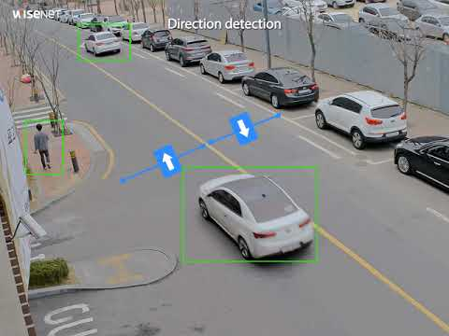
MOVEMENT & ZONE ANALYTICS • CAPABILITY 14 OF 28
14. Direction Detection
“Determines and monitors the travel vector of moving pedestrians or vehicles along designated paths.”
WHAT IT DETECTS & TECHNICAL OPERATION
Calculates speed and heading vectors for moving targets, verifying that motion adheres to permitted traffic patterns or designated pedestrian corridors.
KEY ANALYTIC DISTINCTION
Monitors general motion heading and directional distribution; differs from Wrong-Way Detection which functions specifically as an active violation alarm for illegal reverse travel.
PRIMARY ENTERPRISE USE CASES
Airport terminal transit corridors, warehouse forklift lanes, and highway traffic flow management.
▶ DEMO VIDEO
SOURCE: HANWHA VISION EUROPE
Wisenet X Direction Detection Video Analytics Demonstration
▶ WATCH DEMONSTRATION VIDEO

Slide 17
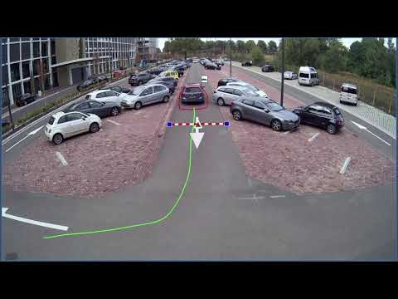
MOVEMENT & ZONE ANALYTICS • CAPABILITY 15 OF 28
15. Wrong-Way Movement Detection
“Generates an urgent warning when a vehicle or person travels in reverse or against the mandatory flow of traffic.”
WHAT IT DETECTS & TECHNICAL OPERATION
Enforces strict one-way travel rules on ramps, access lanes, and airport security exits, triggering immediate acoustic or strobe alarms upon reverse traversal.
KEY ANALYTIC DISTINCTION
An enforcement alarm designed specifically to prevent hazardous reverse travel in one-way corridors, unlike general Direction Detection which observes multi-directional flows.
PRIMARY ENTERPRISE USE CASES
Highway exit ramps (wrong-way driver alert), airport one-way security exit gates, and underground parking spirals.
▶ DEMO VIDEO
SOURCE: KEENFINITY GROUP (BOSCH SECURITY)
Bosch Security - Video Analytics - Wrong-Way Movement Detection
▶ WATCH DEMONSTRATION VIDEO

Slide 18
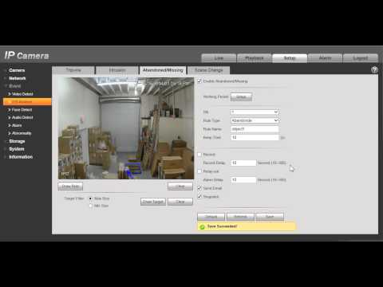
OBJECT ANALYTICS • CAPABILITY 16 OF 28
16. Abandoned Object Detection
“Flags unattended stationary items, such as bags or boxes, left behind in public areas beyond a set time limit.”
WHAT IT DETECTS & TECHNICAL OPERATION
Detects when an object separates from a human owner and remains stationary in a monitored public space longer than a configured threshold (e.g., 60-120 seconds).
KEY ANALYTIC DISTINCTION
Detects NEW, unapproved stationary objects introduced into a scene; in contrast, Missing Object Detection monitors preexisting registered items that disappear.
PRIMARY ENTERPRISE USE CASES
Airport departure halls, train stations, mass transit terminals, and critical government infrastructure.
▶ DEMO VIDEO
SOURCE: SECURITY CAMERA KING
What is IVS? Abandoned Object Feature Demonstration
▶ WATCH DEMONSTRATION VIDEO

Slide 19
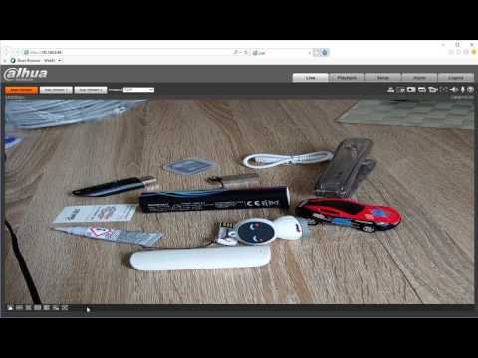
OBJECT ANALYTICS • CAPABILITY 17 OF 28
17. Missing Object Detection
“Alerts security operators immediately when a designated stationary asset or valuable object disappears from its location.”
WHAT IT DETECTS & TECHNICAL OPERATION
Maintains a visual reference profile of a stationary valuable item and raises an alarm when that asset is no longer detected within its defined boundary.
KEY ANALYTIC DISTINCTION
Monitors the absence or disappearance of an existing monitored asset; differs from Object Removal Detection which actively detects someone physically lifting the item.
PRIMARY ENTERPRISE USE CASES
Museum exhibits, retail high-value electronics display counters, warehouse inventory checkpoints, and emergency equipment stations.
▶ DEMO VIDEO
SOURCE: DAHUA TECHNOLOGY
Dahua IVS Missing Object Detection Live Demo
▶ WATCH DEMONSTRATION VIDEO

Slide 20
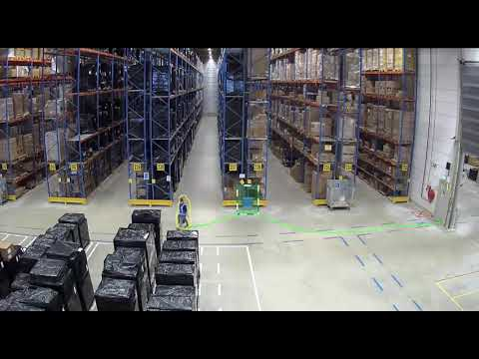
OBJECT ANALYTICS • CAPABILITY 18 OF 28
18. Object Removal Detection
“Detects the deliberate physical act of an individual lifting, taking, or removing a protected item from its resting place.”
WHAT IT DETECTS & TECHNICAL OPERATION
Combines human interaction tracking and object state analysis to trigger an alarm the instant a person picks up, dislodges, or removes a protected item from a shelf or pedestal.
KEY ANALYTIC DISTINCTION
Focuses on the active physical action of theft or lifting in progress, whereas Missing Object Detection alerts on the static state of the item being gone.
PRIMARY ENTERPRISE USE CASES
Art gallery protection, luxury retail theft prevention, high-value tool cribs, and pharmacy narcotics cabinets.
▶ DEMO VIDEO
SOURCE: KEENFINITY GROUP (BOSCH SECURITY)
Bosch Security - Video Analytics - Removed Object Detection Demo
▶ WATCH DEMONSTRATION VIDEO

Slide 21
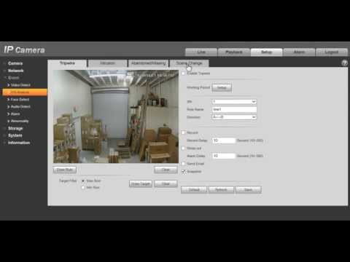
OBJECT ANALYTICS • CAPABILITY 19 OF 28
19. Scene Change Detection
“Detects sudden significant changes in the camera's visual background caused by physical rotation, repositioning, or environmental shifts.”
WHAT IT DETECTS & TECHNICAL OPERATION
Compares structural scene histograms and key visual landmarks, alerting operators if the camera has been physically twisted, knocked, or redirected away from its target scene.
KEY ANALYTIC DISTINCTION
Flags changes where the viewing angle or perspective shifts, unlike Camera Obstruction (where view is blocked) or Defocus (where view is blurry).
PRIMARY ENTERPRISE USE CASES
Surveillance system health audits, detecting unauthorized camera realignment, and PTZ preset drift detection.
▶ DEMO VIDEO
SOURCE: SECURITY CAMERA KING
What is IVS? Scene Change Detection Feature Demonstration
▶ WATCH DEMONSTRATION VIDEO

Slide 22
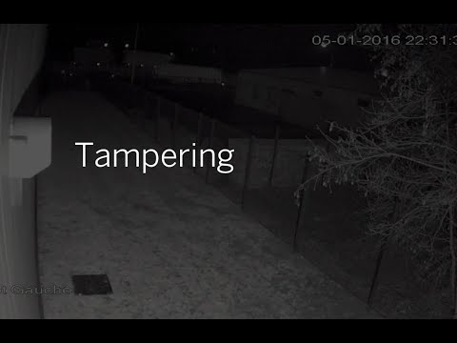
CAMERA HEALTH • CAPABILITY 20 OF 28
20. Camera Tampering Detection
“Alarms when an attacker attempts to vandalize or incapacitate a camera via spray painting, laser blinding, sudden redirection, or physical impact.”
WHAT IT DETECTS & TECHNICAL OPERATION
Detects malicious physical interventions including harsh camera strikes, spray paint coating, intentional blinding with high-power lights, and sudden harsh rotation.
KEY ANALYTIC DISTINCTION
An overarching alarm designed to detect malicious human sabotage attempts on the physical camera hardware.
PRIMARY ENTERPRISE USE CASES
Correctional facilities, public transit stations, bank exterior walls, and high-crime urban areas.
▶ DEMO VIDEO
SOURCE: DAVANTIS PERIMETER SECURITY
Alarm Activation When Detecting Camera Tampering (Perimeter Security)
▶ WATCH DEMONSTRATION VIDEO

Slide 23
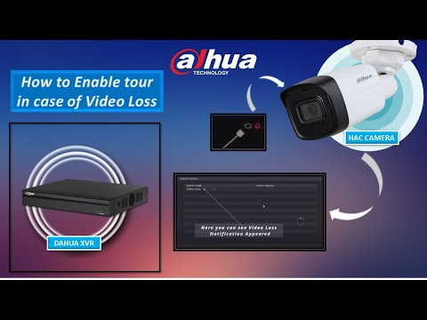
CAMERA HEALTH • CAPABILITY 21 OF 28
21. Video Loss Detection
“Alerts security operators instantly when a camera signal drops, disconnects, or experiences complete transmission failure.”
WHAT IT DETECTS & TECHNICAL OPERATION
Monitors stream continuity and video decoder signals at the VMS or NVR level, sounding an immediate alert if the video feed drops due to cable disconnection, power loss, or network failure.
KEY ANALYTIC DISTINCTION
Alerts on the total absence or death of the incoming video stream, whereas Tampering, Defocus, and Obstruction occur while the video signal is still streaming.
PRIMARY ENTERPRISE USE CASES
Security Operations Centers (SOC), enterprise VMS health monitoring, and regulatory uptime auditing.
▶ DEMO VIDEO
SOURCE: DAHUA TECHNOLOGY INDIA
Automated PTZ Tour & Alarm Linkage Triggered on Video Loss
▶ WATCH DEMONSTRATION VIDEO

Slide 24
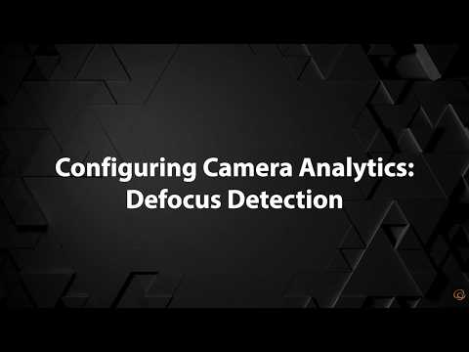
CAMERA HEALTH • CAPABILITY 22 OF 28
22. Defocus Detection
“Identifies when a camera's optical focus degrades or blurs, warning operators that image quality has been compromised.”
WHAT IT DETECTS & TECHNICAL OPERATION
Monitors high-frequency image edge sharpness across the visual field and fires a maintenance alert when edge sharpness falls below critical recognition thresholds.
KEY ANALYTIC DISTINCTION
Detects optical blurring and softness; the scene is still visible and illuminated, but out of focus, unlike Obstruction which blocks the visual field.
PRIMARY ENTERPRISE USE CASES
Automated maintenance ticketing, ANPR/LPR camera quality assurance, and long-range perimeter optical verification.
▶ DEMO VIDEO
SOURCE: HANWHA VISION AMERICA
How to Set Up Defocus Detection on Hanwha Vision AI Cameras
▶ WATCH DEMONSTRATION VIDEO

Slide 25
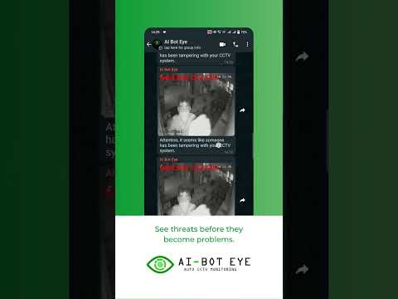
CAMERA HEALTH • CAPABILITY 23 OF 28
23. Camera Obstruction Detection
“Detects when a camera's lens is covered, blocked, or obscured by foreign objects, bags, tape, or overgrown foliage.”
WHAT IT DETECTS & TECHNICAL OPERATION
Analyzes sudden loss of visual variation and persistent low-contrast uniform frames to detect foreign physical objects placed directly over or in front of the lens.
KEY ANALYTIC DISTINCTION
Detects physical blocking or masking directly over the front of the lens, whereas Tampering covers physical strikes/vandalism and Defocus covers optical blur.
PRIMARY ENTERPRISE USE CASES
Parking garages, building stairwells, ATM security cameras, and outdoor cameras prone to vegetation overgrowth.
▶ DEMO VIDEO
SOURCE: AI-BOT EYE SYSTEMS
CCTV Camera Tampering & Lens Obstruction Alert Demo
▶ WATCH DEMONSTRATION VIDEO

Slide 26
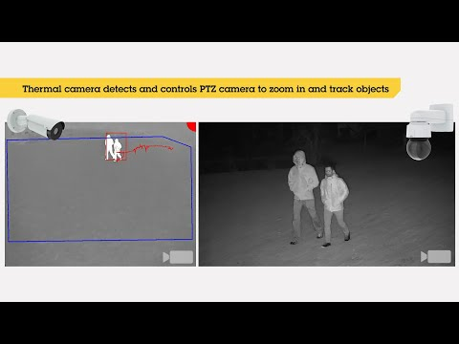
MOVEMENT & ZONE ANALYTICS • CAPABILITY 24 OF 28
24. Perimeter Protection
“Establishes automated multi-layered virtual boundary security around property borders while filtering out environmental noise.”
WHAT IT DETECTS & TECHNICAL OPERATION
Integrates deep-learning human/vehicle classification with multi-rule tripwires and boundary zones along outer property borders, delivering 24/7 boundary security with near-zero false alarms.
KEY ANALYTIC DISTINCTION
A comprehensive enterprise perimeter solution combining classified targets, directional rules, and boundary fences rather than a single basic line crossing rule.
PRIMARY ENTERPRISE USE CASES
Solar energy farms, electrical substations, industrial manufacturing plants, military installations, and critical infrastructure.
▶ DEMO VIDEO
SOURCE: AXIS COMMUNICATIONS
AXIS Perimeter Defender PTZ Autotracking Demonstration
▶ WATCH DEMONSTRATION VIDEO

Slide 27
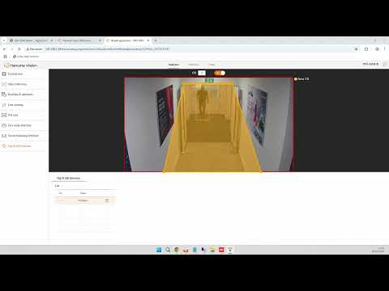
SAFETY ANALYTICS • CAPABILITY 25 OF 28
25. Fall Detection, where applicable
“Recognizes sudden changes in human posture indicative of a person collapsing or falling down, enabling immediate emergency assistance.”
WHAT IT DETECTS & TECHNICAL OPERATION
Tracks human skeletal pose keypoints and downward velocity vectors in real time, differentiating accidental falls from deliberate sitting or lying down, and raising emergency alarms.
KEY ANALYTIC DISTINCTION
Monitors rapid vertical body collapse and subsequent lack of motion on the floor, unlike loitering or intrusion which monitor horizontal zone presence.
PRIMARY ENTERPRISE USE CASES
Elderly assisted living facilities, hospital patient rooms, industrial lone-worker zones, and warehouse high-bay racking aisles.
LEGAL & COMPLIANCE NOTICE
Deployed in healthcare, assisted living, and lone-worker environments; subject to healthcare privacy guidelines and operational applicability.
▶ DEMO VIDEO
SOURCE: HANWHA VISION EUROPE
Slip & Fall Detection AI Camera Demonstration
▶ WATCH DEMONSTRATION VIDEO

Slide 28
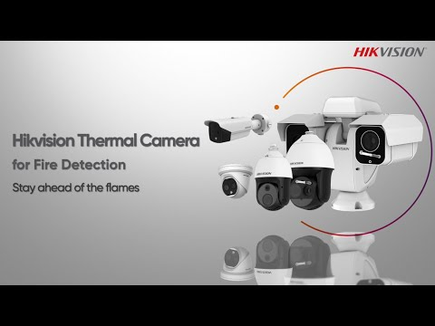
SAFETY ANALYTICS • CAPABILITY 26 OF 28
26. Fire/Smoke Detection, where supported
“Visually detects open flames and developing smoke plumes significantly faster than traditional spot detectors, especially in high-ceiling spaces.”
WHAT IT DETECTS & TECHNICAL OPERATION
Processes optical and thermal video streams using deep learning models that analyze flame flicker frequencies, spectral color distributions, and expanding smoke plume dynamics.
KEY ANALYTIC DISTINCTION
Detects fire and smoke optically at the source within seconds, unlike traditional smoke/heat sensors that require smoke to physically travel up to a ceiling sensor.
PRIMARY ENTERPRISE USE CASES
Aircraft hangars, high-ceiling logistics warehouses, timber mills, waste recycling plants, and petrochemical refineries.
LEGAL & COMPLIANCE NOTICE
Serves as an early optical warning system where supported; intended to supplement rather than replace mandatory certified life-safety fire alarm systems.
▶ DEMO VIDEO
SOURCE: HIKVISION CORPORATE CHANNEL
Hikvision Thermal Optical Camera for Rapid Early Fire Detection
▶ WATCH DEMONSTRATION VIDEO

Slide 29
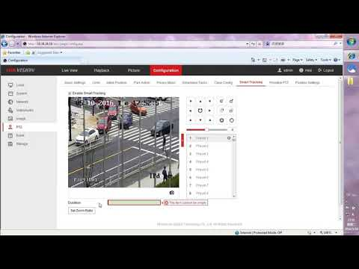
TRACKING & BEHAVIOUR • CAPABILITY 27 OF 28
27. Vehicle/person tracking
“Continuously follows and plots the real-time path of an individual or vehicle across camera fields of view or via motorized PTZ tracking.”
WHAT IT DETECTS & TECHNICAL OPERATION
Assigns and maintains persistent object IDs across sequential frames, automatically steering motorized PTZ cameras to keep targets centered and mapping suspect trajectories across cameras.
KEY ANALYTIC DISTINCTION
Unlike Person/Vehicle Detection (which identifies objects at an isolated instant), Tracking maintains persistent identity, trajectory, and spatial coordinates over time.
PRIMARY ENTERPRISE USE CASES
Automated PTZ tracking of perimeter intruders, forensic suspect journey reconstruction, and airport apron ground vehicle tracking.
▶ DEMO VIDEO
SOURCE: HIKVISION MEA
How to Configure Smart Tracking on PTZ (Human & Vehicle Auto-Tracking)
▶ WATCH DEMONSTRATION VIDEO

Slide 30
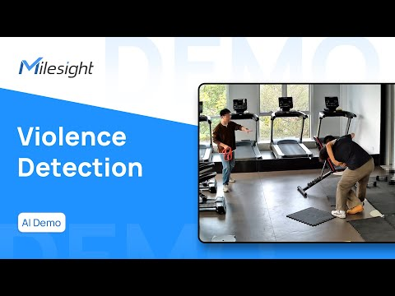
TRACKING & BEHAVIOUR • CAPABILITY 28 OF 28
28. Behaviour/event-based analytics where legally and technically appropriate
“Detects complex human actions and anomalous security incidents, such as fighting, running, distress gestures, or erratic movements.”
WHAT IT DETECTS & TECHNICAL OPERATION
Applies spatio-temporal deep-learning networks to recognize predefined anomalous human behaviors, such as physical fighting, aggressive shoving, running in secured areas, or distress waving.
KEY ANALYTIC DISTINCTION
Analyzes dynamic human interactions and complex bodily behaviors over time, moving beyond simple presence or object classification into intent and event understanding.
PRIMARY ENTERPRISE USE CASES
Correctional facilities, public transit platforms, school corridors, entertainment venues, and bank branches.
LEGAL & COMPLIANCE NOTICE
Deployed where legally and technically appropriate; requires rigorous operational safeguards, algorithmic governance, and privacy compliance.
▶ DEMO VIDEO
SOURCE: MILESIGHT SECURITY
Milesight AI Violence & Abnormal Behavior Detection Demo
▶ WATCH DEMONSTRATION VIDEO

Slide 31
CAPABILITY MATRIX • PART 1 OF 2
Core Detection, Movement & Counting Analytics (Capabilities 01 – 14)
# | Capability Name | Category | Core Function (One-Line Summary)
01 | Face Detection | Detection & Recognition | Detects and pinpoints the presence and location of human faces in a camera's field of view.
02 | Face Recognition, where legally authorized | Detection & Recognition | Matches detected human faces against an authorized database of known individuals for access control or security alerts.
03 | Person Detection | Detection & Recognition | Identifies and isolates human figures in the video frame, distinguishing people from background objects.
04 | Vehicle Detection | Detection & Recognition | Identifies motorized vehicles such as cars, trucks, motorcycles, and buses within the camera's view.
05 | Human/Vehicle Classification | Detection & Recognition | Differentiates whether a detected moving object is a person or a vehicle, filtering out false alarms caused by animals, weather, and foliage.
06 | Line Crossing | Movement & Zone Analytics | Generates an instant alert when a person or vehicle crosses a predefined virtual tripwire line in a specified direction.
07 | Intrusion Detection | Movement & Zone Analytics | Triggers an alarm when an unauthorized subject enters and remains inside a designated virtual zone for a set threshold.
08 | Restricted Area Detection | Movement & Zone Analytics | Immediately alerts the instant any person or vehicle enters a strictly forbidden, high-security zone.
09 | Loitering Detection | Movement & Zone Analytics | Detects when an individual or vehicle lingers or remains stationary in a defined area longer than the permitted time limit.
10 | Crowd Detection | Crowd & Counting Analytics | Identifies when a group of people gathers in a specific area exceeding normal group size or threshold.
11 | Crowd Density Analysis | Crowd & Counting Analytics | Measures and visualizes the percentage and density of spatial occupancy across an area to prevent dangerous overcrowding.
12 | People Counting | Crowd & Counting Analytics | Continuously counts the number of people entering, exiting, or passing through a defined entrance or passage.
13 | Occupancy Counting | Crowd & Counting Analytics | Maintains a live, real-time count of total individuals currently inside a building or enclosed space to enforce capacity limits.
14 | Direction Detection | Movement & Zone Analytics | Determines and monitors the travel vector of moving pedestrians or vehicles along designated paths.

Slide 32
CAPABILITY MATRIX • PART 2 OF 2
Object, Camera Health, Safety & Tracking Analytics (Capabilities 15 – 28)
# | Capability Name | Category | Core Function (One-Line Summary)
15 | Wrong-Way Movement Detection | Movement & Zone Analytics | Generates an urgent warning when a vehicle or person travels in reverse or against the mandatory flow of traffic.
16 | Abandoned Object Detection | Object Analytics | Flags unattended stationary items, such as bags or boxes, left behind in public areas beyond a set time limit.
17 | Missing Object Detection | Object Analytics | Alerts security operators immediately when a designated stationary asset or valuable object disappears from its location.
18 | Object Removal Detection | Object Analytics | Detects the deliberate physical act of an individual lifting, taking, or removing a protected item from its resting place.
19 | Scene Change Detection | Object Analytics | Detects sudden significant changes in the camera's visual background caused by physical rotation, repositioning, or environmental shifts.
20 | Camera Tampering Detection | Camera Health | Alarms when an attacker attempts to vandalize or incapacitate a camera via spray painting, laser blinding, sudden redirection, or physical impact.
21 | Video Loss Detection | Camera Health | Alerts security operators instantly when a camera signal drops, disconnects, or experiences complete transmission failure.
22 | Defocus Detection | Camera Health | Identifies when a camera's optical focus degrades or blurs, warning operators that image quality has been compromised.
23 | Camera Obstruction Detection | Camera Health | Detects when a camera's lens is covered, blocked, or obscured by foreign objects, bags, tape, or overgrown foliage.
24 | Perimeter Protection | Movement & Zone Analytics | Establishes automated multi-layered virtual boundary security around property borders while filtering out environmental noise.
25 | Fall Detection, where applicable | Safety Analytics | Recognizes sudden changes in human posture indicative of a person collapsing or falling down, enabling immediate emergency assistance.
26 | Fire/Smoke Detection, where supported | Safety Analytics | Visually detects open flames and developing smoke plumes significantly faster than traditional spot detectors, especially in high-ceiling spaces.
27 | Vehicle/person tracking | Tracking & Behaviour | Continuously follows and plots the real-time path of an individual or vehicle across camera fields of view or via motorized PTZ tracking.
28 | Behaviour/event-based analytics where legally and technically appropriate | Tracking & Behaviour | Detects complex human actions and anomalous security incidents, such as fighting, running, distress gestures, or erratic movements.

Slide 33
RESEARCH METHODOLOGY & GOVERNANCE
Verified Sources & Presentation Disclaimer
PRIMARY TECHNOLOGY MANUFACTURERS & REFERENCE SOURCES
• Axis Communications — AXIS Object Analytics, AXIS Face Detector, AXIS Perimeter Defender, AXIS People Counter
• Hikvision Digital Technology — Hikvision AcuSense Series, HikCentral Professional, ColorVu, Thermal Fire Detection
• Dahua Technology — Dahua WizSense, WizMind Series, IVS Intelligent Video Surveillance, TiOC Active Deterrence
• Hanwha Vision / Wisenet — Hanwha AI Cameras, Direction Detection, Slip & Fall Detection, Defocus Detection
• Bosch Security Systems — Bosch Intelligent Video Analytics (IVA), Removed Object Detection, Wrong-Way Movement Analytics
• BriefCam & Milestone Systems — Crowd Density & Occupancy Synopses, XProtect Video Management Integration
OFFICIAL PRESENTATION DISCLAIMER & REGULATORY COMPLIANCE
AI analytics capabilities, accuracy and availability vary by camera, software platform, scene conditions and deployment configuration. Certain analytics, particularly face recognition and behaviour analysis, may also be subject to legal, privacy and regulatory requirements. Key Deployment Considerations: 1. Environmental Factors: Detection accuracy depends on illumination, optical sensor quality, target distance, mounting height, and weather conditions. 2. Biometric Compliance: Face recognition and individual identification require compliance with GDPR, BIPA, CCPA, and statutory privacy laws. 3. Life Safety Systems: Video-based fire, smoke, and fall detection act as early operational warnings and must supplement rather than replace certified, statutory life-safety systems. 4. Active Hyperlinks: All demonstration video links embedded in this presentation point to publicly available, verified manufacturer and technical demonstration videos.

