Slide 1
MetroQuest
Strava for Metro
Pune, one station at a time
Working prototype / October 2026
Notes:
MetroQuest working prototype for Pune commuters. Visual palette inspired by the user-supplied images.png reference; no OpenAI affiliation, sponsorship or AI functionality is claimed. Product source: https://github.com/Roojool/pune-metro-strava .

Slide 2
The commuter problem
The route repeats.
Progress is hard to see.
Our hypothesis to test in Pune
Visible progress and friendly competition can make
a repeated journey more rewarding.
Notes:
Problem framing is a hypothesis to validate with Pune commuters, not a result from completed interviews or market research. No market-size or ridership statistics are claimed.

Slide 3
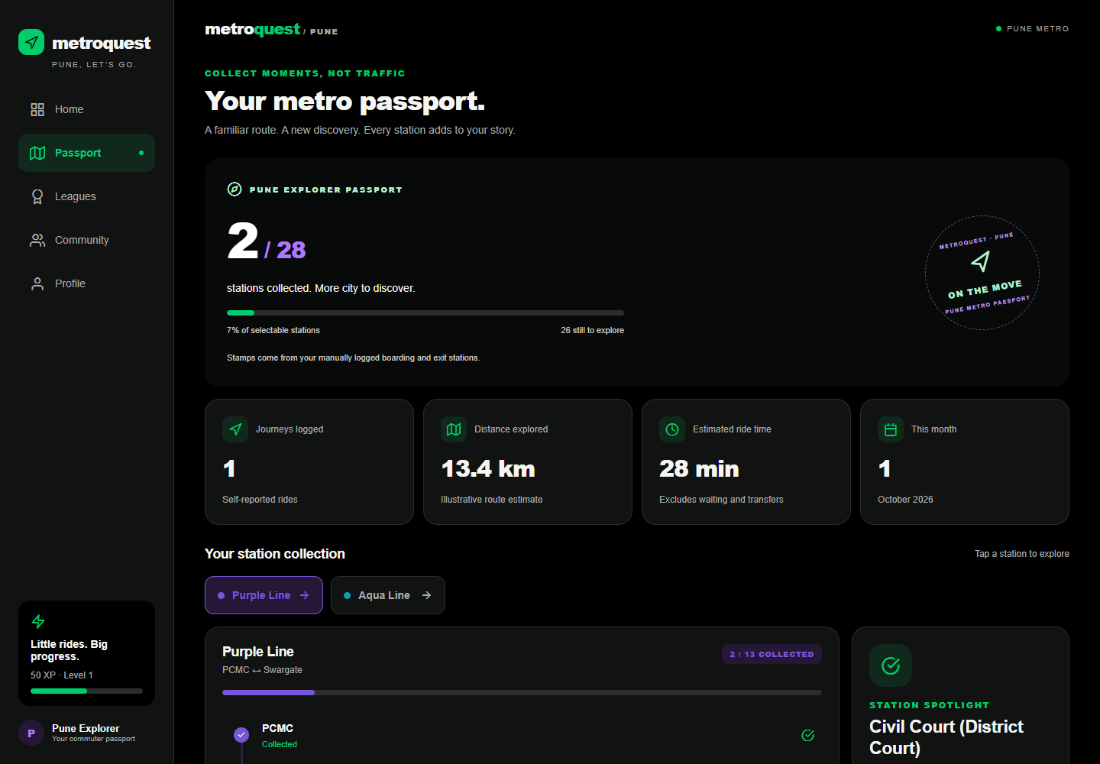
The MetroQuest loop
01
Log a ride
PCMC → Civil Court
02
Collect stops
Board and exit station stamps
03
Earn XP
50 XP for the first demo ride
04
Find your line
Local posts and reactions
Your metro passport
Manual logs / Local persistence / Sample leagues and profiles
Notes:
Screenshot source: actual updated MetroQuest app, provided by the engineering lead after the UI theme change and one manually logged PCMC → Civil Court journey, 2026-10-24. File: pitch/assets/updated-metroquest-passport.png. No screenshot was synthesized.Implemented demo behavior: manual ride logging, endpoint-only station stamps, shared XP calculations and local community posts/reactions. First new-endpoint ride gives 10 ride XP + 20 for each endpoint = 50. Sources: src/domain/metro.ts, src/state/AppState.tsx in https://github.com/Roojool/pune-metro-strava .

Slide 4
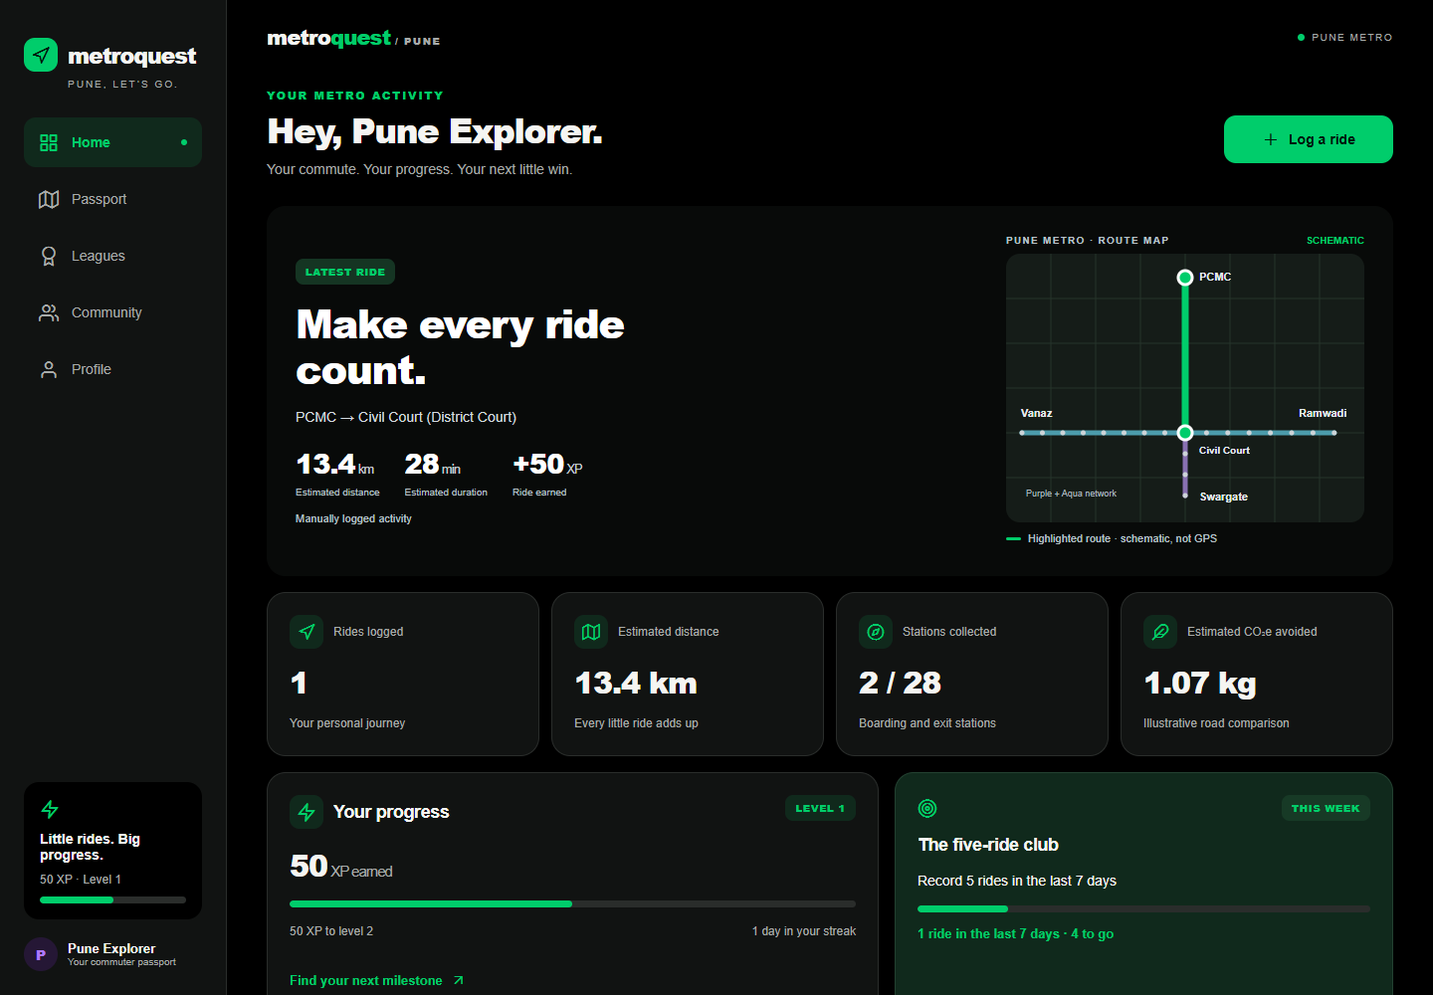
A working product, today
One Expo app
Web + Android demo
24 tests passing
iOS bundle exports;
iOS runtime not tested.
Try the live app →
Prototype: manual rides, local data, simulated social ranks.
Notes:
Screenshot source: actual updated MetroQuest Home, provided by the engineering lead after the UI theme change and one manually logged PCMC → Civil Court journey, 2026-10-24. File: pitch/assets/updated-metroquest-home.png. No screenshot was synthesized.Implementation proof supplied by the engineering lead at pitch creation: 24 tests passing; working hosted web; Android Expo Go demo previously verified; iOS bundle export is not iOS runtime testing. No APK is delivered. Live demo: https://roojool.github.io/pune-metro-strava/ . Prototype uses manual self-reported rides and local state. League identities and community sample profiles are simulations.

Slide 5
Start with a Pune pilot
PROPOSED LAUNCH
Possible revenue
Campus and office
commuters on Purple
and Aqua routes
Employer commute
challenges
Optional premium
passport
Test repeat logging and
community participation.
Ideas to validate through a Pune pilot.
Notes:
Pilot audiences, measurement focus and monetization are proposals, not existing traction, customers or revenue. No actual pilot partners are claimed. This slide is a launch hypothesis for a Pune campus/office pilot.

Slide 6
Try one ride.
Help shape the pilot.
Open the live demo →
roojool.github.io/pune-metro-strava
Seeking Pune campus and office pilot partners
Notes:
Call to action: try the live working demo and discuss a Pune campus or office pilot. URL: https://roojool.github.io/pune-metro-strava/ . No investment, partner or usage claims are implied.

